Slide 1
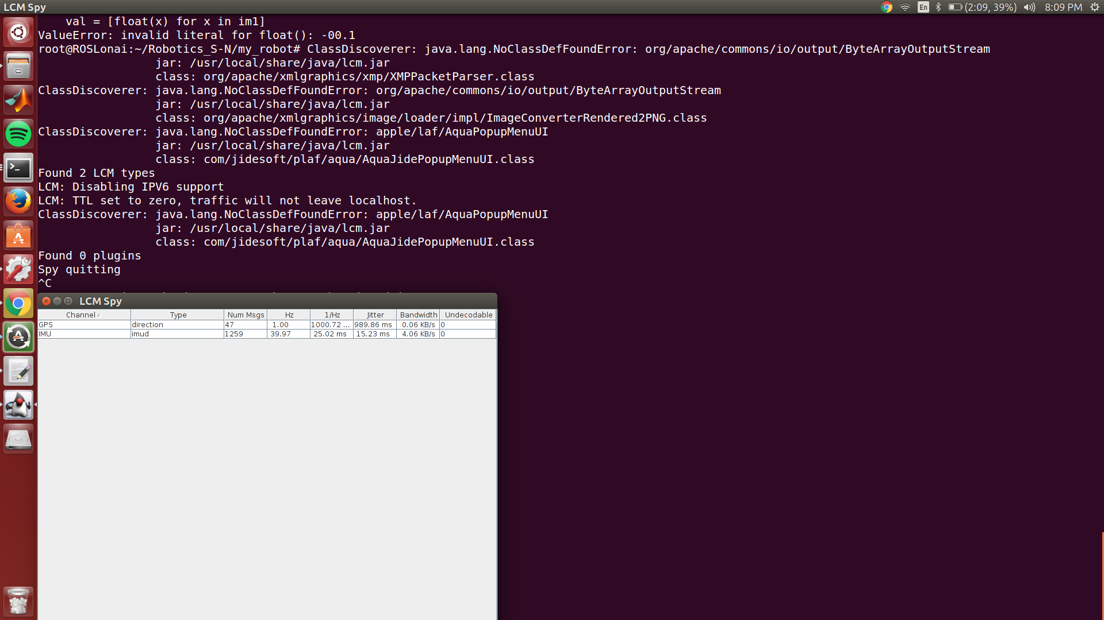
Simultaneous Running of Both GPS and IMU
As the GPS is operating @ 1 Hz there is a lesser number of messages generated
The IMU is generating @ 40Hz

Slide 2
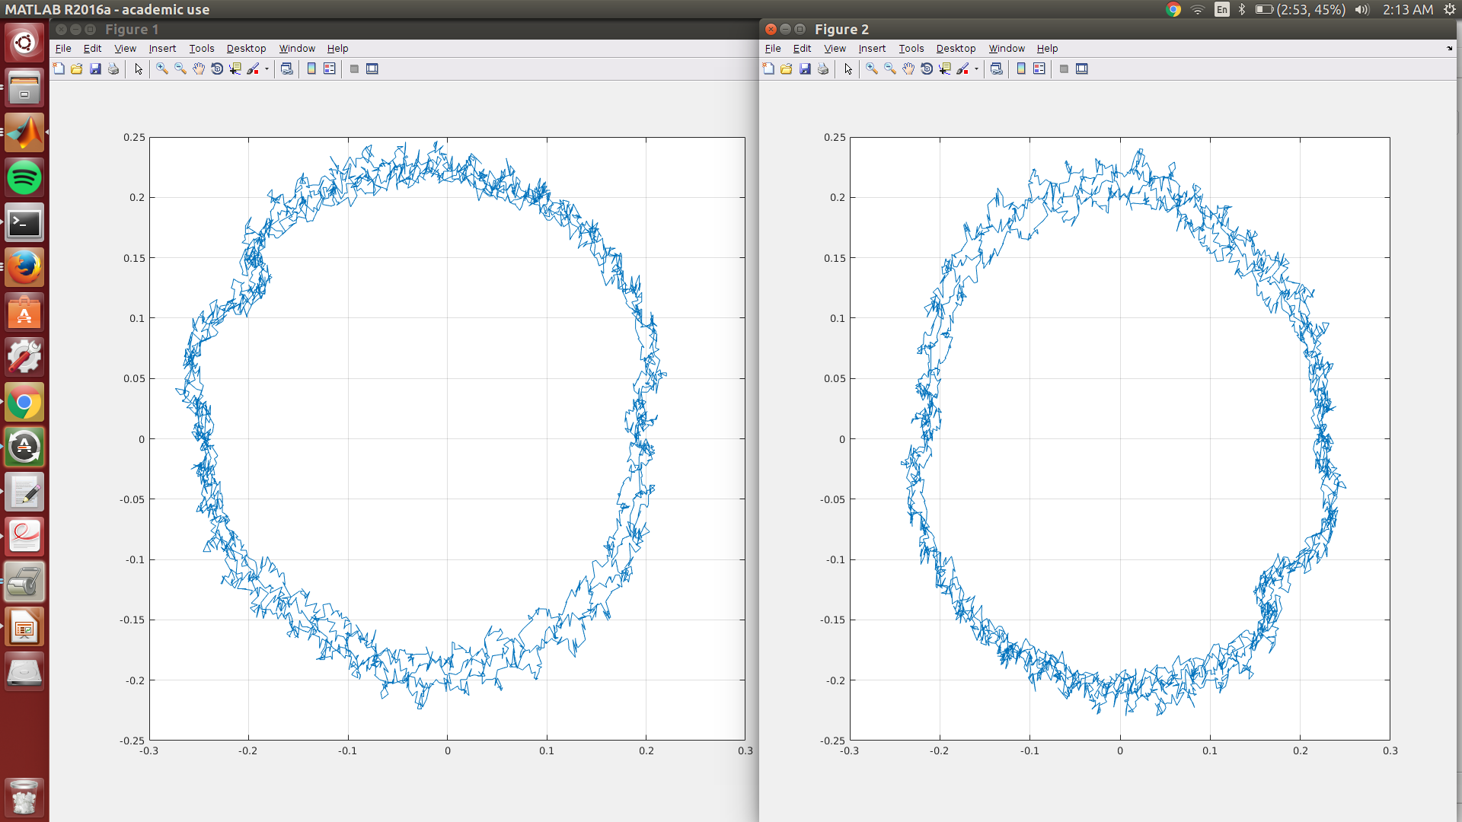
Correcting Hard Iron and Soft Iron effects
Readings had to be taken in from middle of the data set. For the set of data points selected I observed that Magnetometer readings had a slight ellipse in the direction of @ x= -0.27 y=0.24 and the hard iron effect is seen for the ellipse not centered in the grid as displayed in Fig 1. In fig 2 the corrections have been modified the elliptical shape has been transformed to that of a circle centered @ x=0 and y=0 the elliptical abnormalities have reduced from +mag Y and –mag X values respectively

