Slide 1
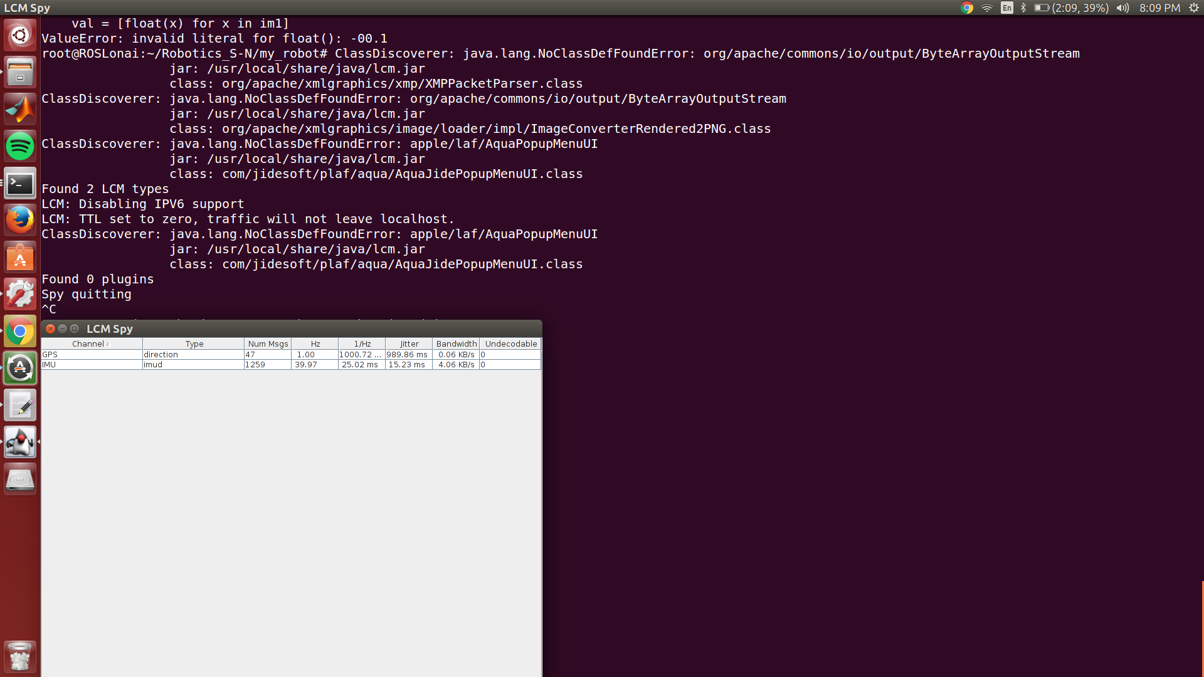
Simultaneous Running of Both GPS and IMU
As the GPS is operating @ 1 Hz there is a lesser number of messages generated
The IMU is generating @ 40Hz. The same is displayed for networking between the computers.

Slide 2
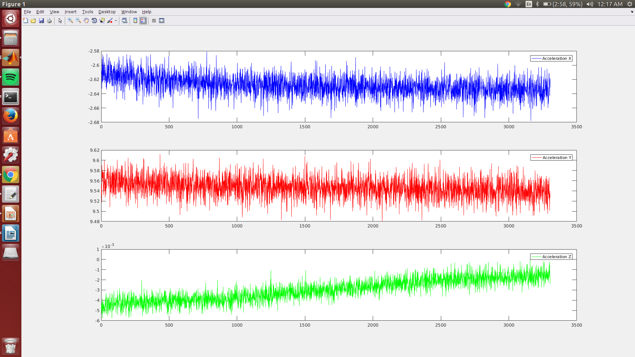
Stationary Data for Accelerometer from IMU
Heavy noise within the three axises of the accelerometer

Slide 3
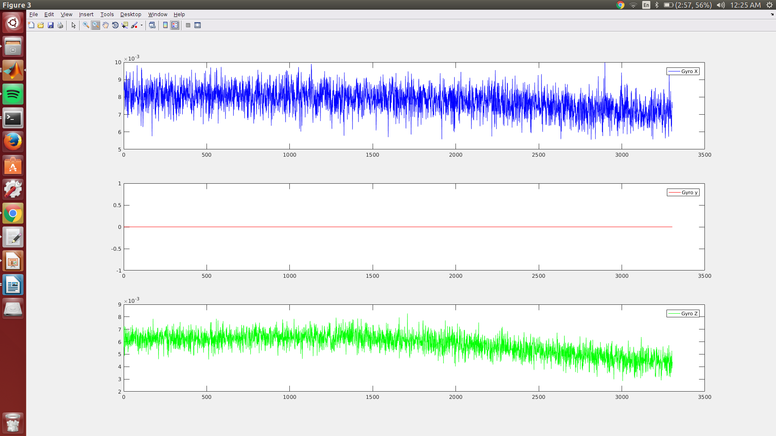
Stationary Data for Gyrometer from IMU
Imu was placed on a table I suspect this would be the real reason that IMU Gyro Y data is neglible. Multiple spikes indicative of noise present in signal

Slide 4
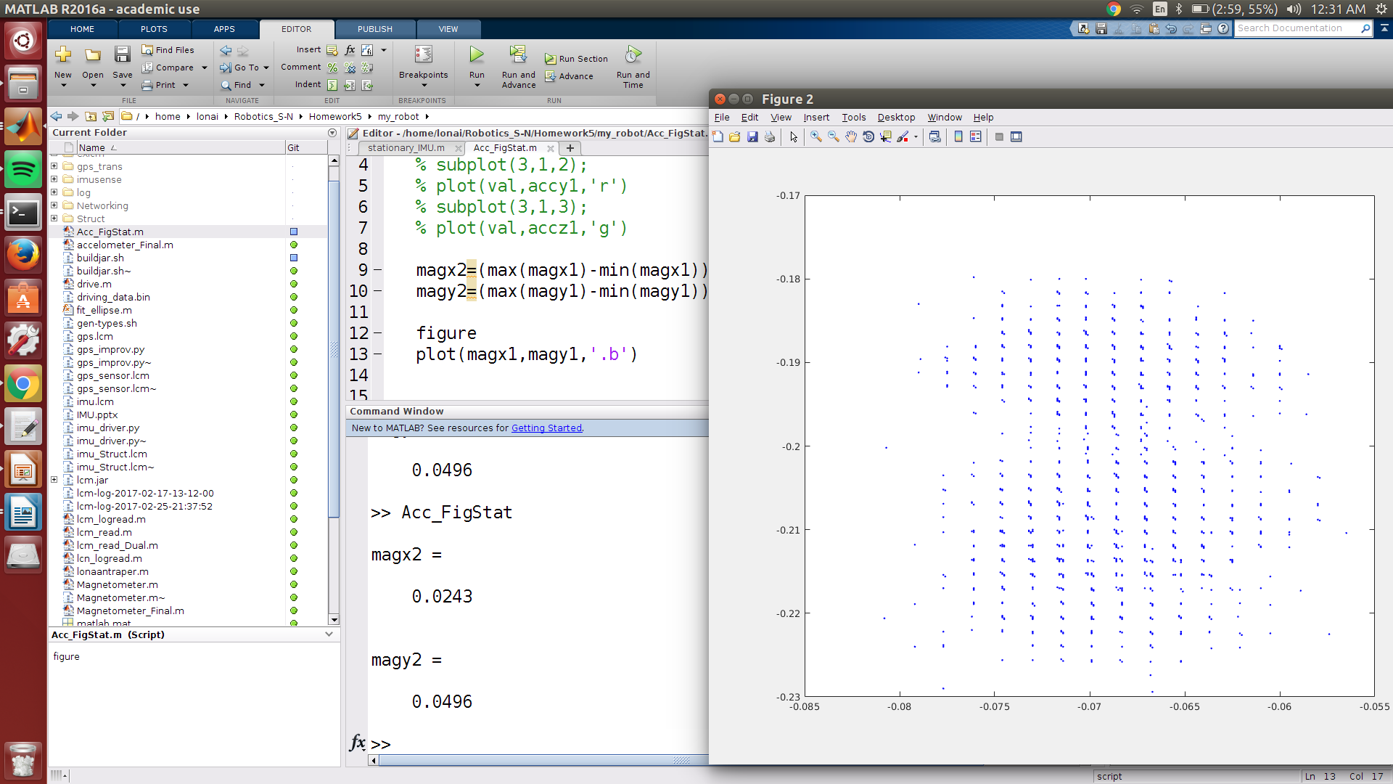
Stationary Data for Gyrometer from IMU
Magentometer has been plotted against x & y where difference in X is found to be 0.0243 and difference in Y is 0.0496.

Slide 5
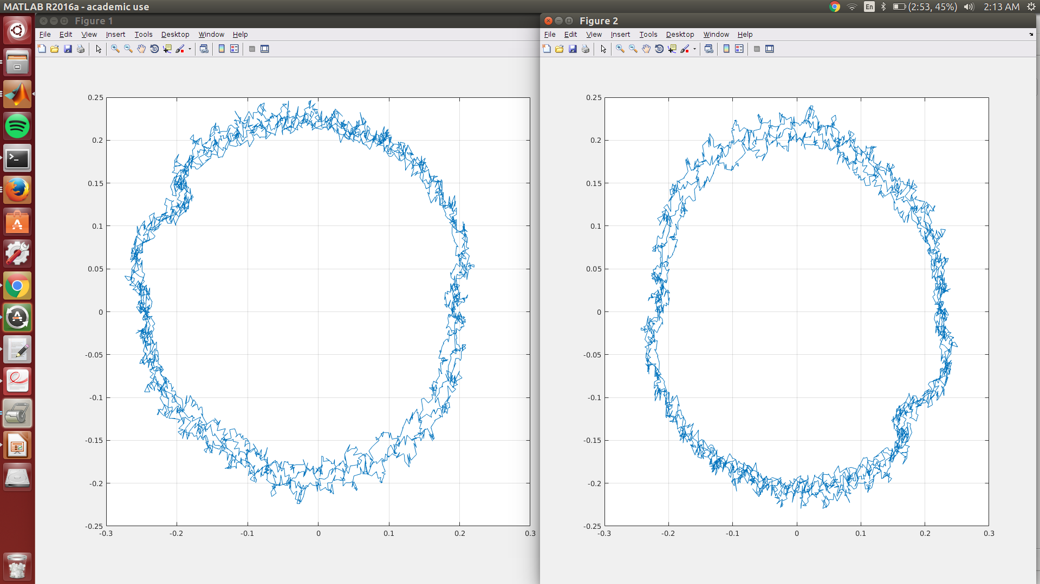
Correcting Hard Iron and Soft Iron effects
Readings had to be taken in from middle of the data set. For the set of data points selected I observed that Magnetometer readings had a slight ellipse in the direction of @ x= -0.27 y=0.24 and the hard iron effect is seen for the ellipse not centered in the grid as displayed in Fig 1. In fig 2 the corrections have been modified the elliptical shape has been transformed to that of a circle centered @ x=0 and y=0 the elliptical abnormalities have reduced from +mag Y and –mag X values respectively

Slide 6
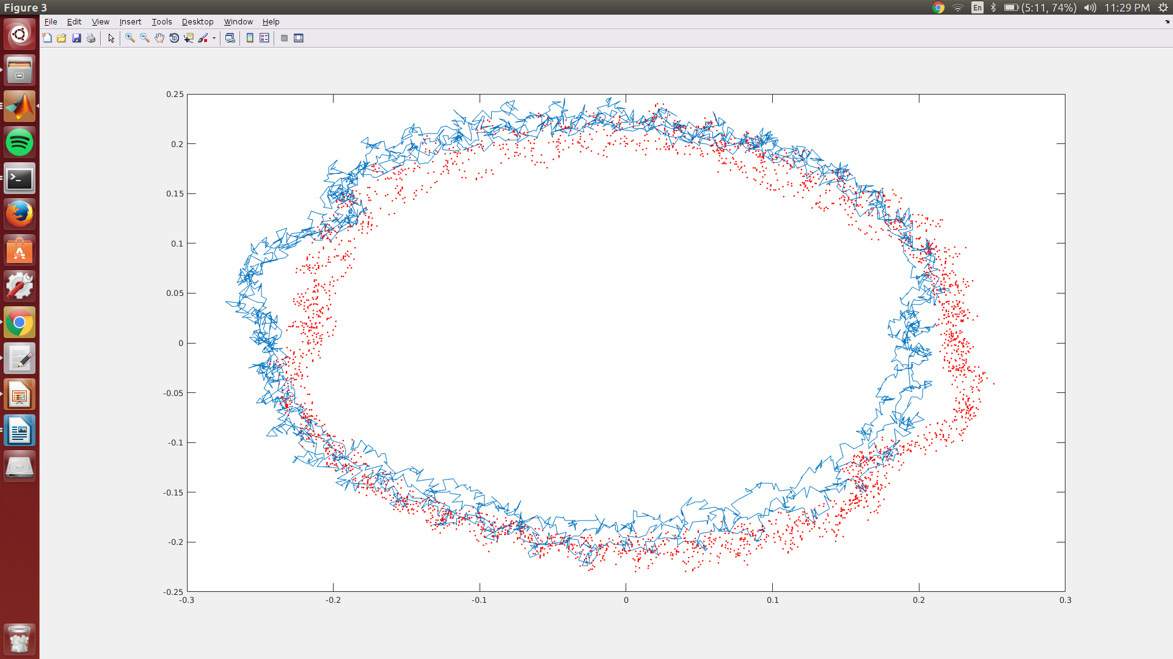
Superimposed image showcasing corrected Hard and Soft Iron effects

Slide 7
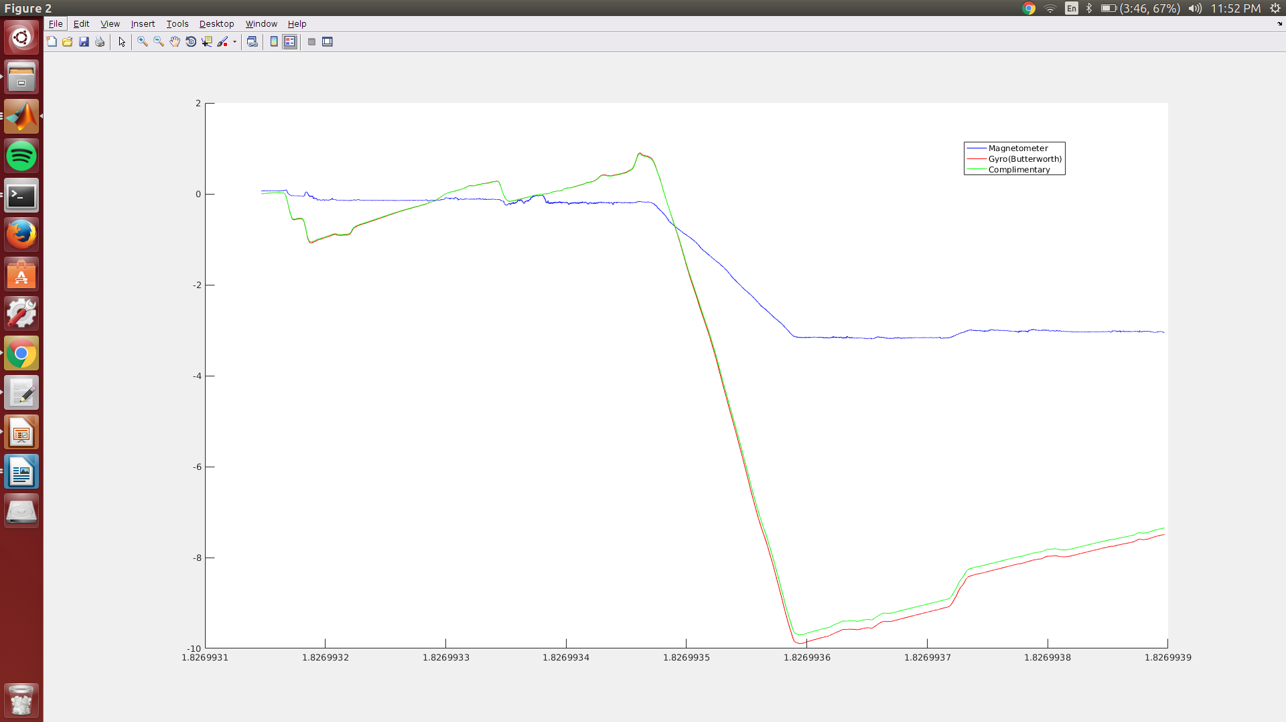
Complimentary Filter comparison for Yaw angle

Slide 8
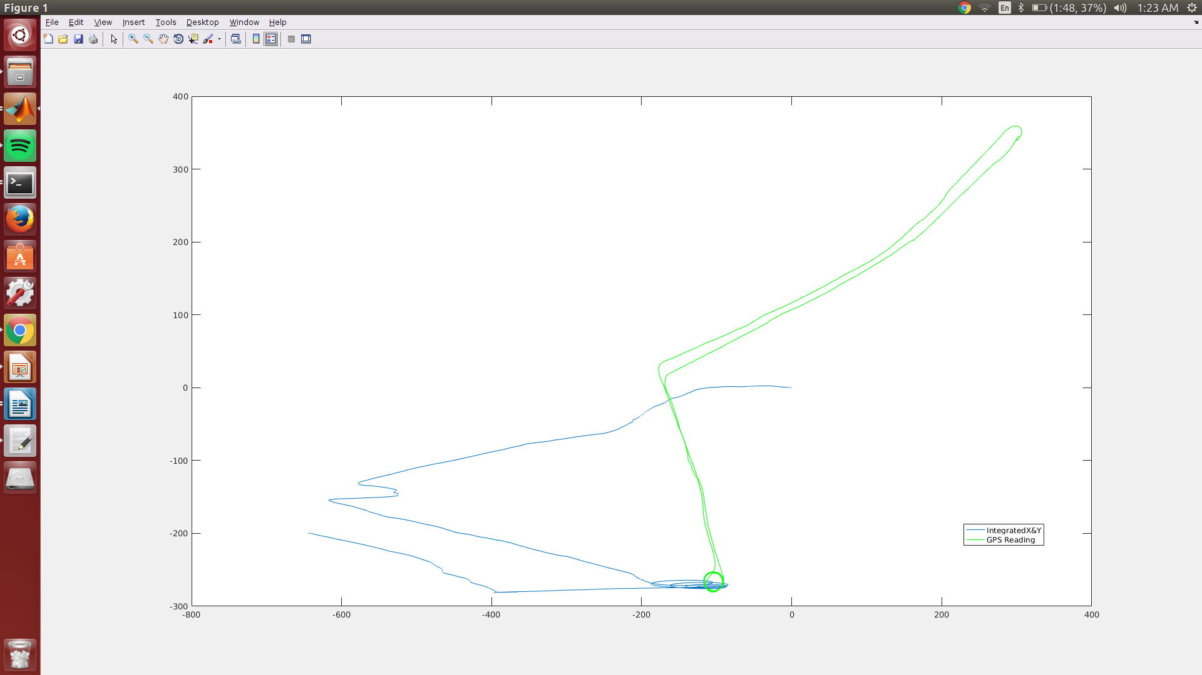
Overlap data
Here we can trace out the path taken by our car by the GPS and compare that of the path created by calculating the accelerometer data along x axis and double integrating the data along the axis .

