Slide 1
Fence Cost Calculator
Write a program to calculate the cost of fencing for a rectangular area. You can assume that all units are in meters. You need to ask the user for the length and width of the area to be fenced. You also need to ask for the cost of fencing per m. Your program should then calculate the cost of fencing. It should be possible to do more than one calculation at a time.
Please supply a link to your code on github (paste the URL below)https://github.com/Lonaldinho/Year10DGT-code-1

Slide 2
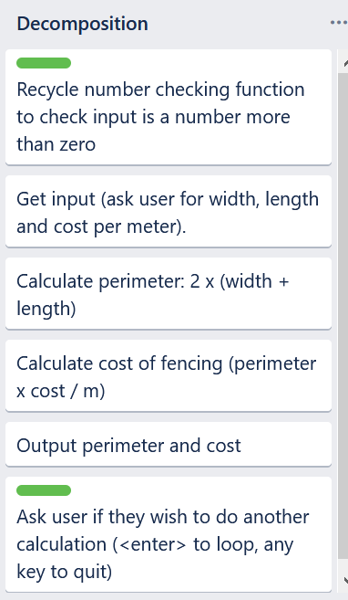
Program Steps
This is a very simple program. The cards marked in green have been recycled from the area / perimeter calculator.

Slide 3
Test Plan - Program works as expected
Test Case | Expected Values
Width: 5 Length: 3 Cost / m: $10 Again? <enter> Width: 4 Length: 7 Cost / m: $2 Again? <n> | Perimeter: 16 m Cost: $160.00 <loops> Perimeter: 22 m Cost: $44.00 Thank you for using the calculator <program ends>

Slide 4
Program works as expected (evidence)
Test Case | Expected Values
Width: 6 Length: 3 Cost / m: $36 Again? <enter> Width: 6 Length: 4 Cost / m: $42 Again? <n> | Cost: $288.00 <loops> Cost: $1152.0 Thank you for using the calculator <program ends>

Slide 5
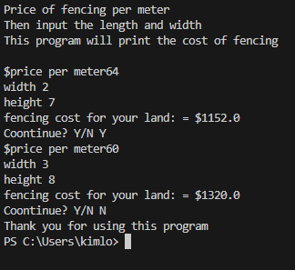
program works as expected (evidence)

Slide 6
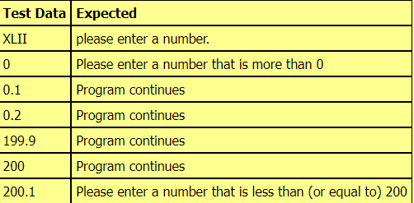
Test Plan - Program works for unexpected / boundary values
Use the program planning helper (http://bitly.com/program-planner) to generate THREE test plans. One for width, one for height and one for cost_per_m. Please delete this instruction when you are done. Take screenshots of the plan and paste them below. You can use more than one slide if necessary.

Slide 7
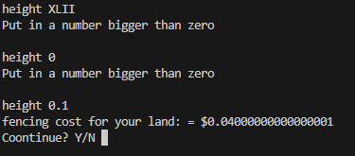
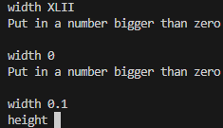
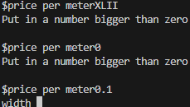
Program works as unexpected and boundary values (evidence)

