Slide 1
Max
Group 8 – The Mix

Slide 2
Problems Tackled
Problem 1
High demand for support and a limited amount of staff
Long queues for even mundane information requests
Solution
A Chatbot to be available throughout the Mix desktop and mobile web experience, using natural, human interactions to provide access to the wide breath of resources at The Mix
Problem 2
Despite the high quantity of data sources, lack of personal and development capacity to allow proper utilisation
Problem 3
Single page visits followed by site exit
Lack of personalised experiences and interactivity many struggling people need

Slide 3
Demonstration
User Story
User enters site, possible through Google, and access information through articles or the homepage
Whilst reading the article, the scrolling user will be accompanied by a small chat box at the side of the screen on desktop, or inconspicuously in the bottom right on mobile (like current triage)
If user’s problem unresolved, can open Max
As you can see, requests can be made in natural language and information and resources provided

Slide 4

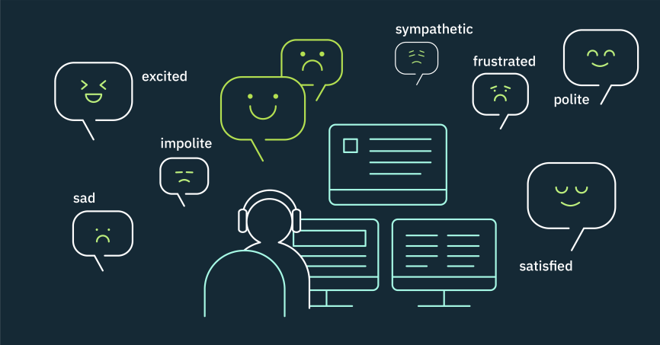

Technical Features (current & Future)
Keyword-Category Mapping
Identifying keywords in conversations to designate which categories of resources may be useful
Tone Analysis/Natural Language Processing
Detects tone of the user to determine severity of concern (e.g. suicidal)
NHS Open Data
Using user’s location to offer more informative support (e.g. local support centres)

Slide 5
What difference will Max Make?
Website currently provides two extremes – passive self-service or one-to-one counselling
Chatbot is a middle way, providing the ‘personal’ touch of an interactive experience with the resource-effectiveness and information-sharing capabilities of a digital solution
Max bridges the gap between self-help and counselling services, with no human interaction needed
User has option to save chat and email it to themselves, to provide easier access in the future
MAXIMUM RESOURCE UTILISATION & ALLOCATION
INCREASE IN USER INTERACTION
INCREASE IN USER FEEDBACK

Slide 6
Questions?

