Slide 1
Attrition at Frito-Lay
Jordan Wolfgang Klein

Slide 2
Goals
Objectives
This analysis aims to:
Explore the data to identify key drivers of employee turnover.
Develop a predictive models to identify employees at risk of leaving.
Recommend targeted interventions that reduce attrition and generate a measurable return on investment.

Slide 3
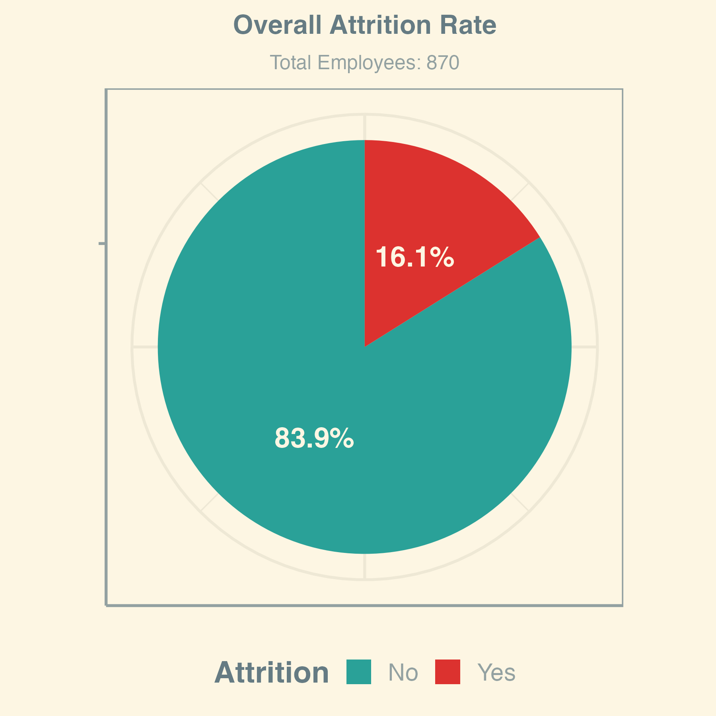
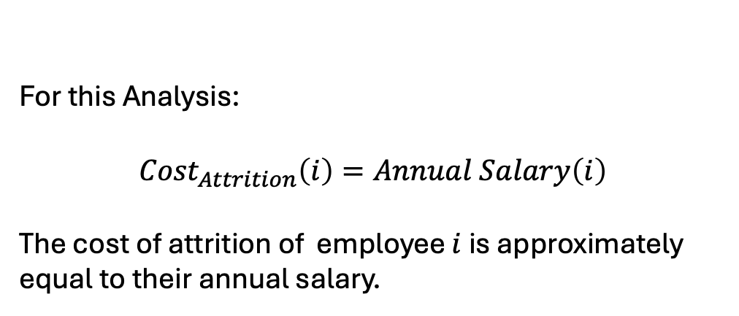
What is the cost of attrition?
For this Analysis:
$${Cost}_{Attrition}\left(i\right)=Annual Salary\left(i\right)$$
The cost of attrition of employee $i$ is approximately equal to their annual salary.

Slide 4
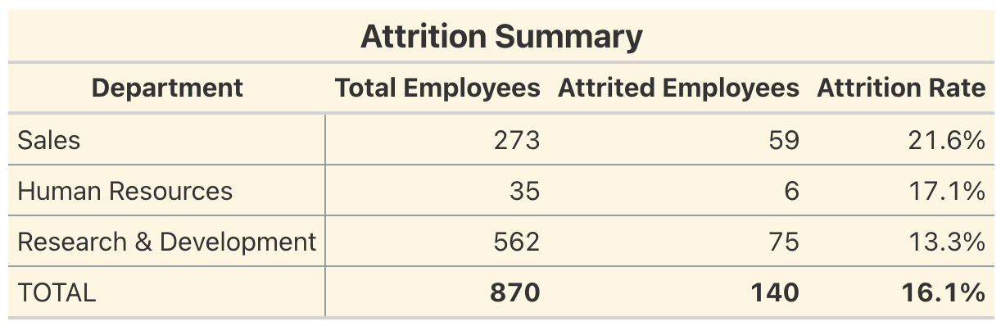
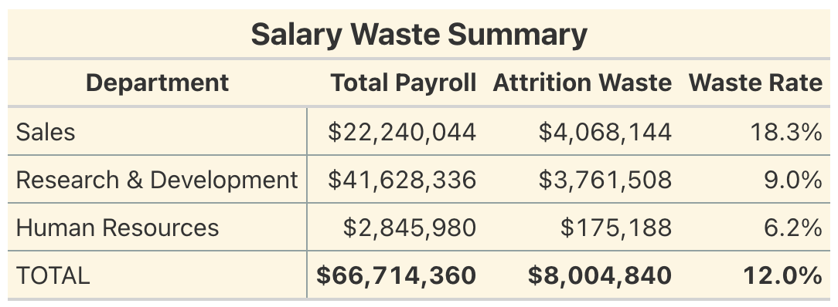
What is the cost of attrition?
*Attrition Waste equals the Annual Salary (Monthly Income * 12) of attrited employees

Slide 5
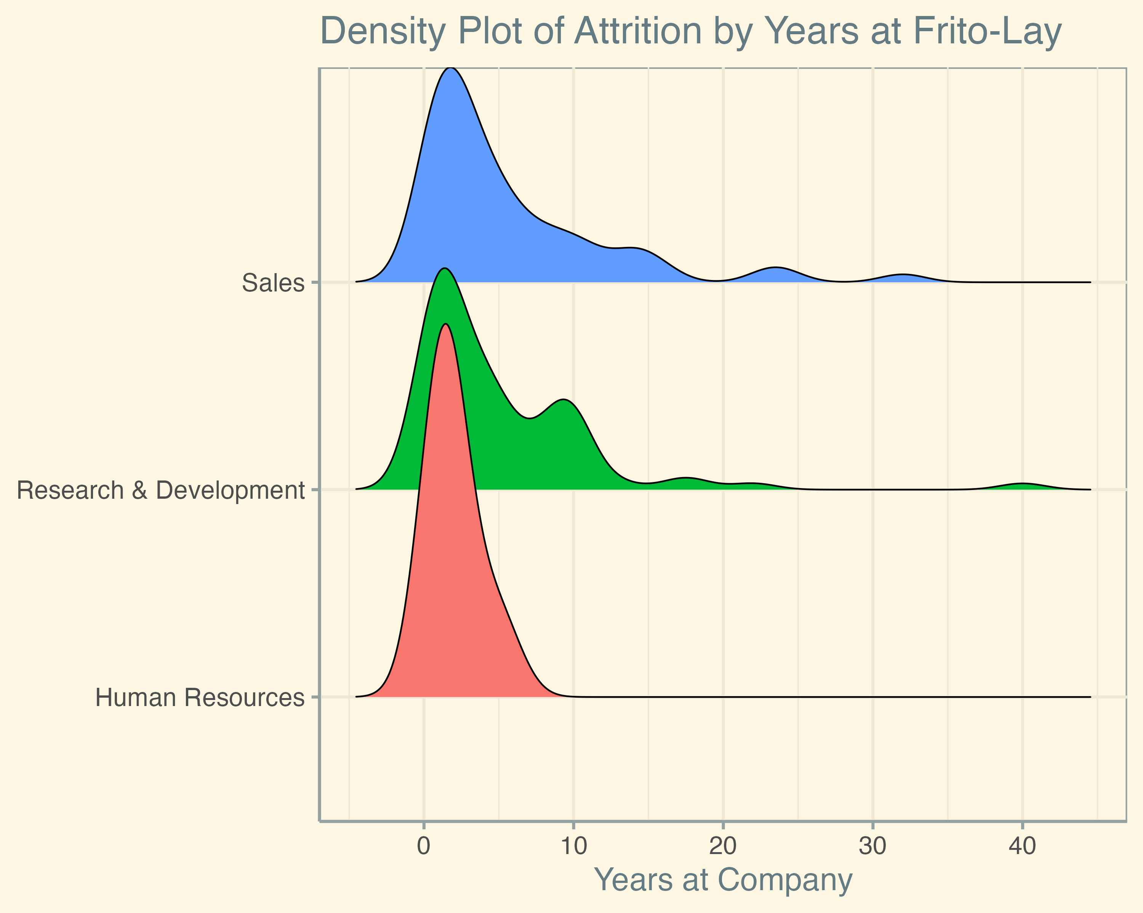
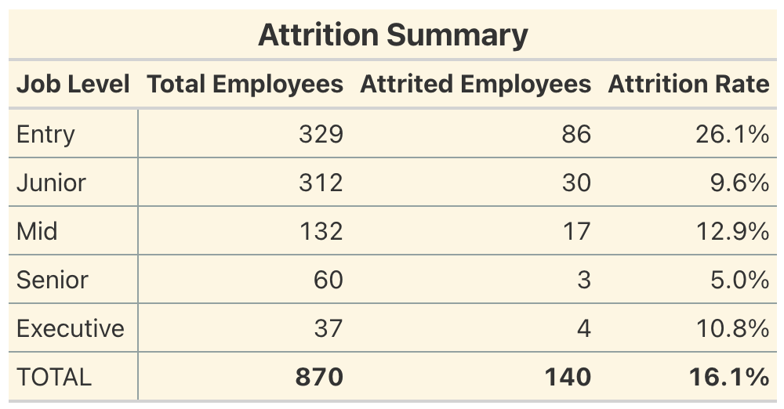
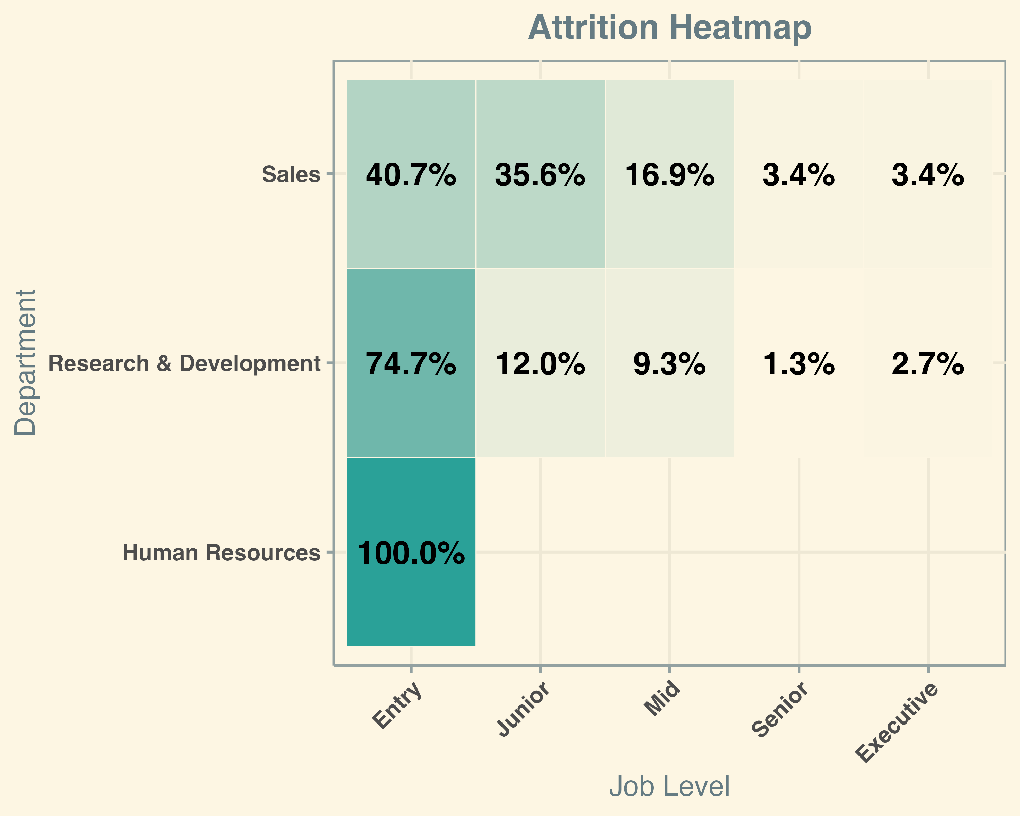
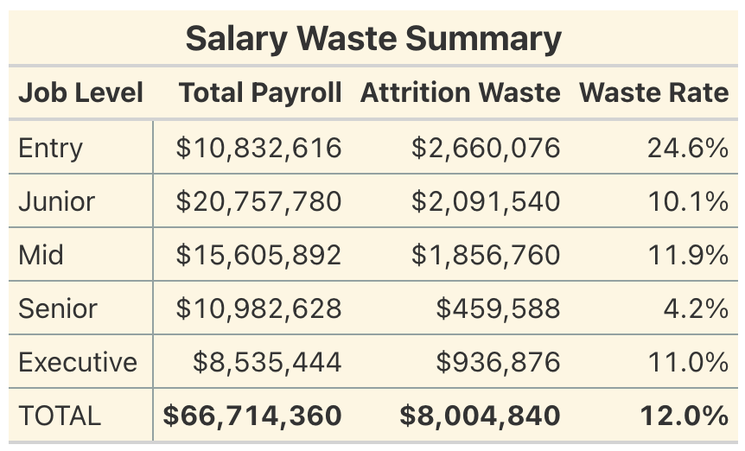
What is the cost of attrition?
Percent Values reflect the ratio of employees that left within each department

Slide 6
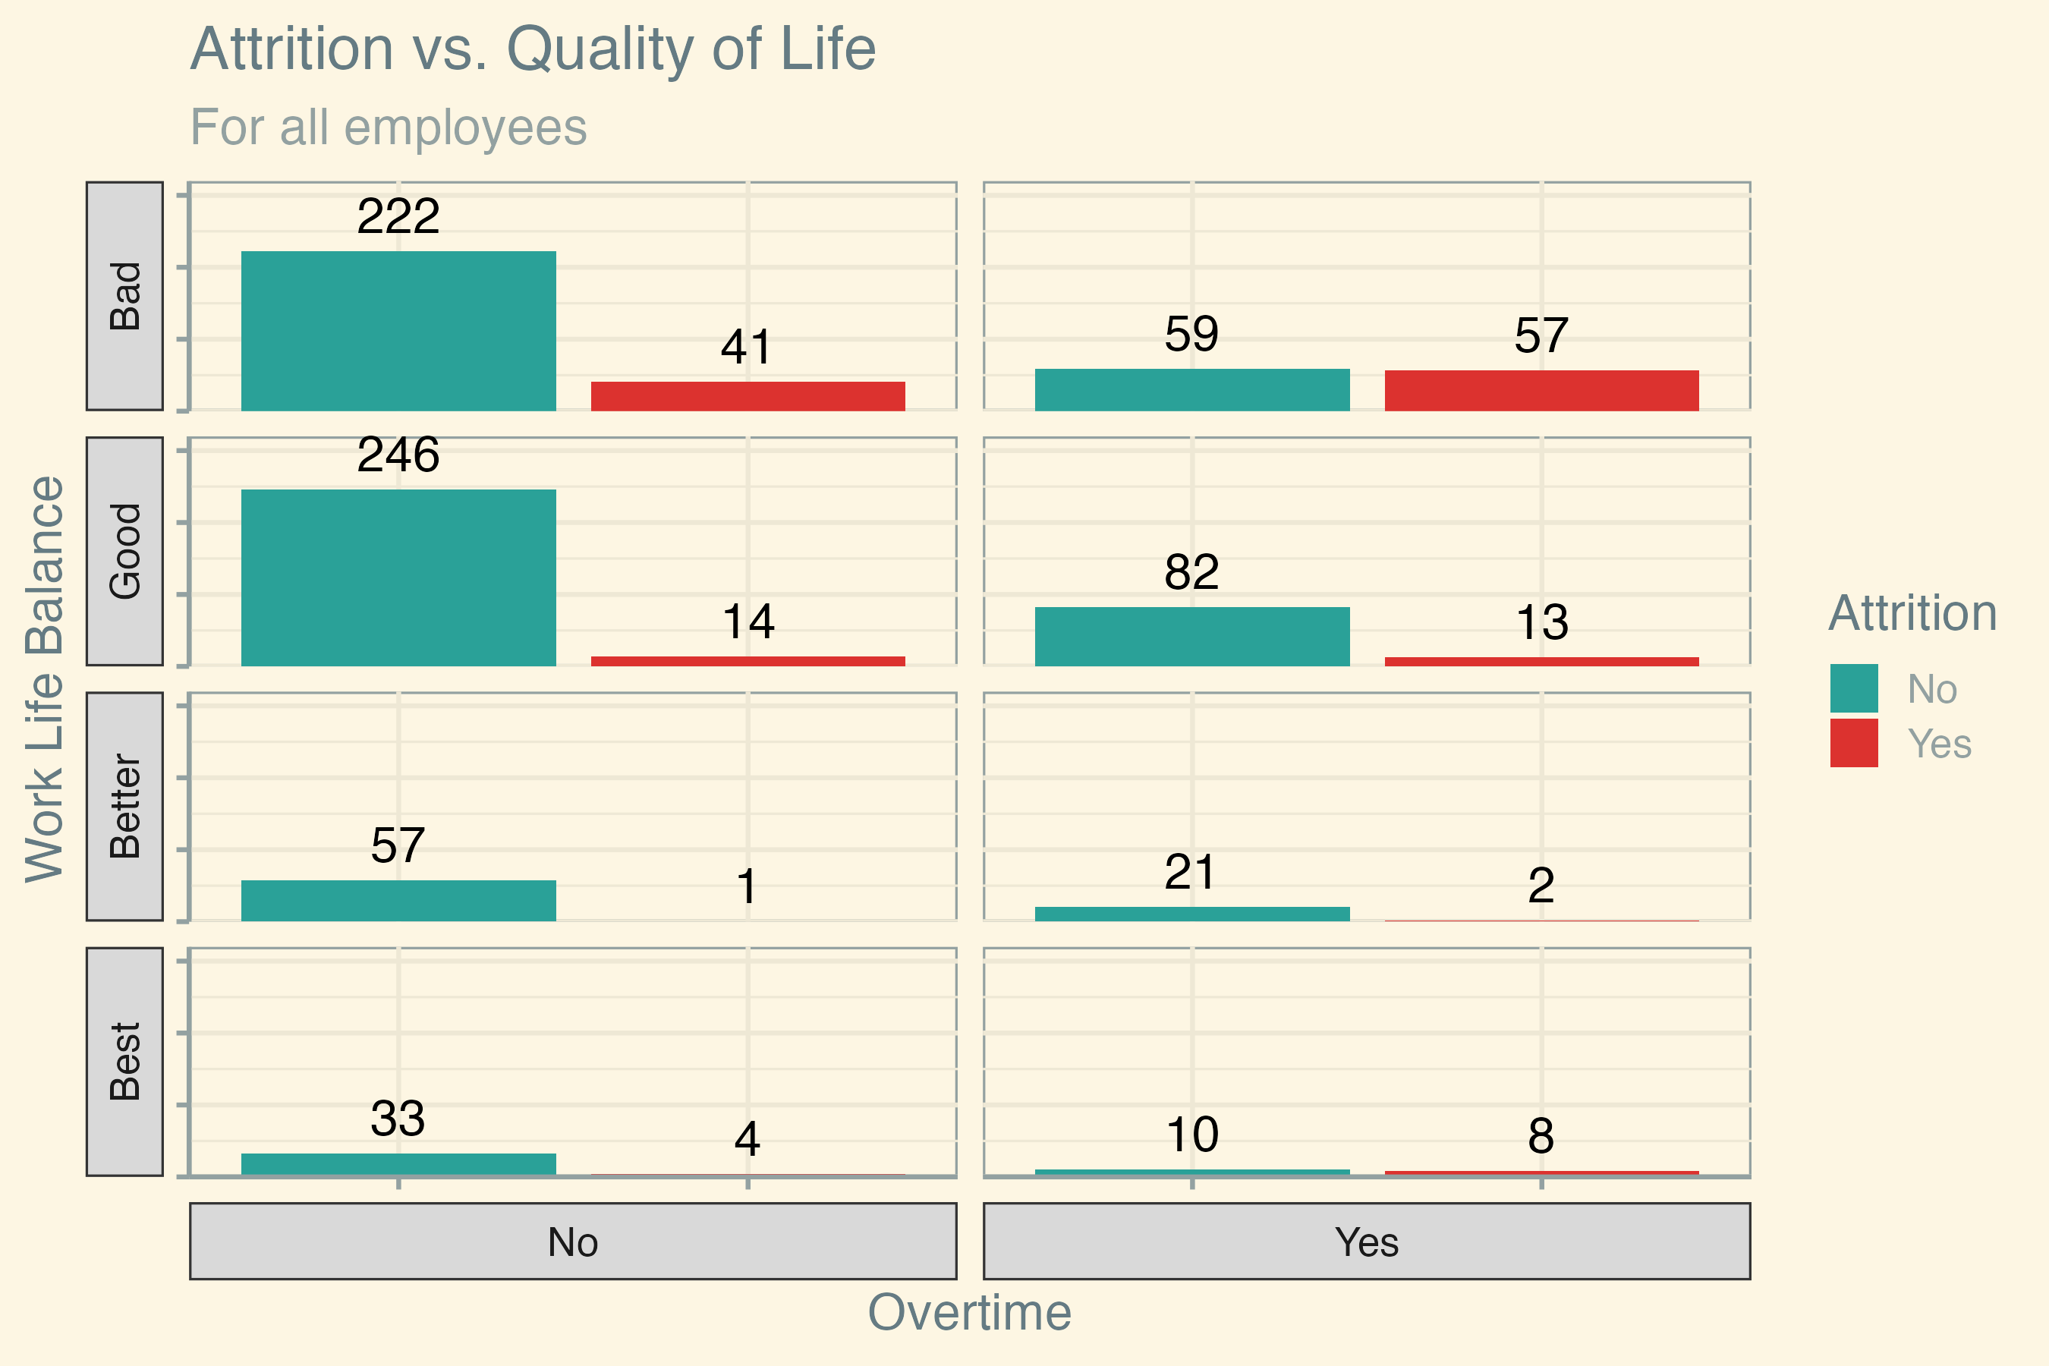
Why do employees leave?

Slide 7
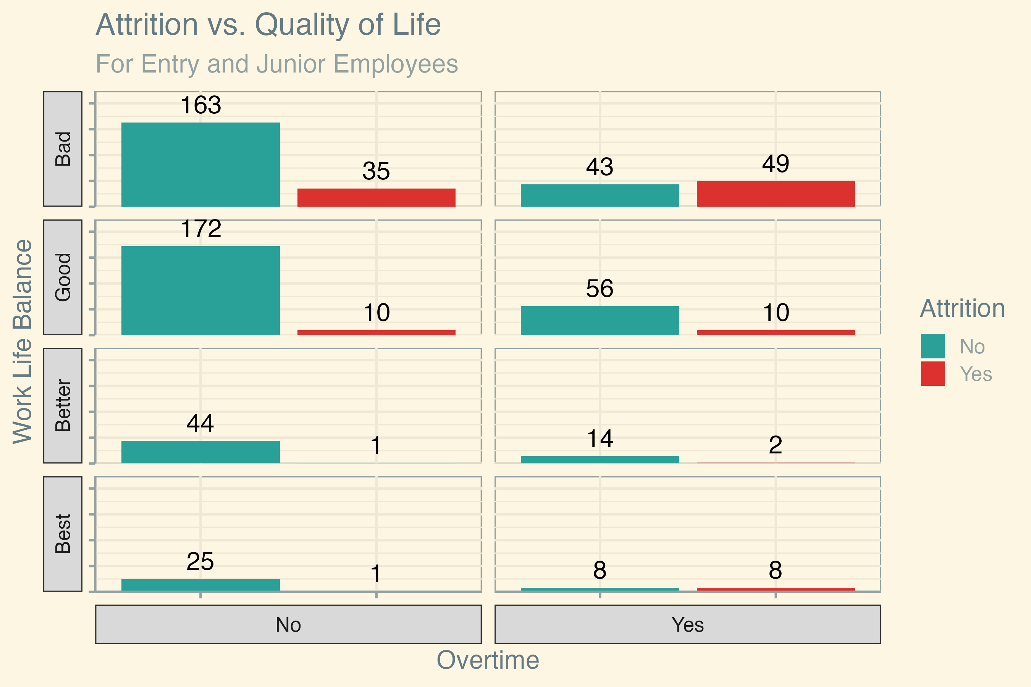
Why do employees leave?
Entry and Junior level employees that leave tend to work overtime and have poor work life balance.

Slide 8
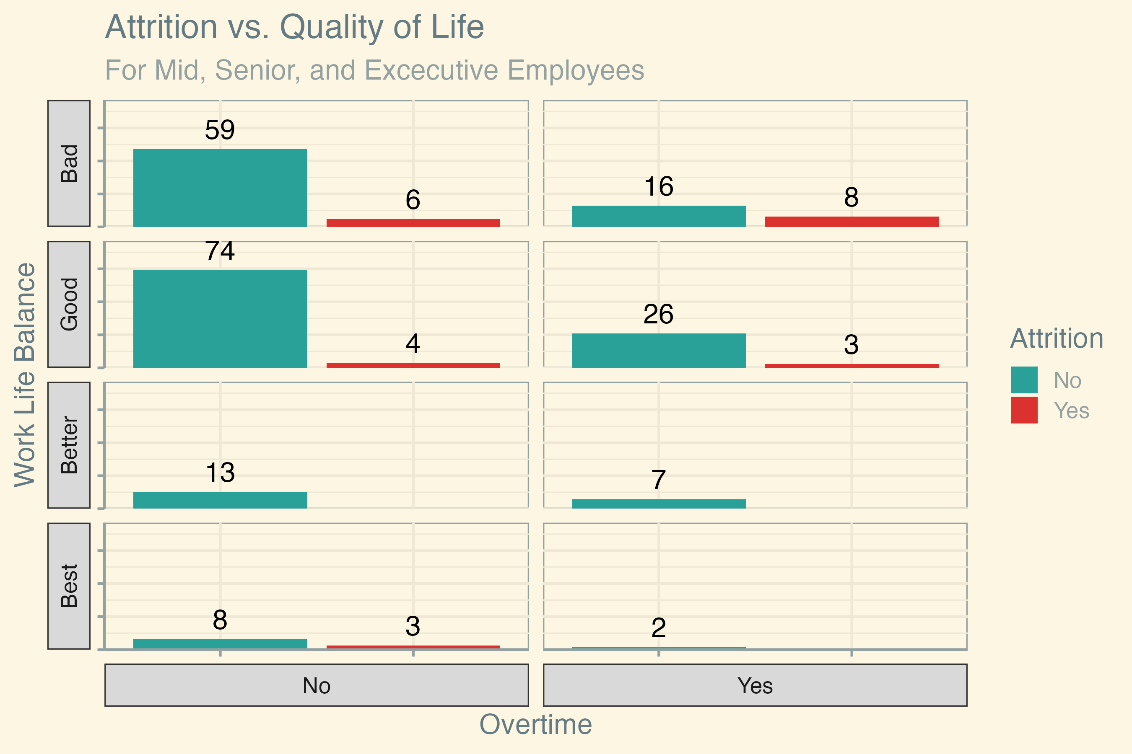
Why do employees leave?
Quality of Life indicators seem to be less important for Mid, Senior, and Excecutive employees.

Slide 9
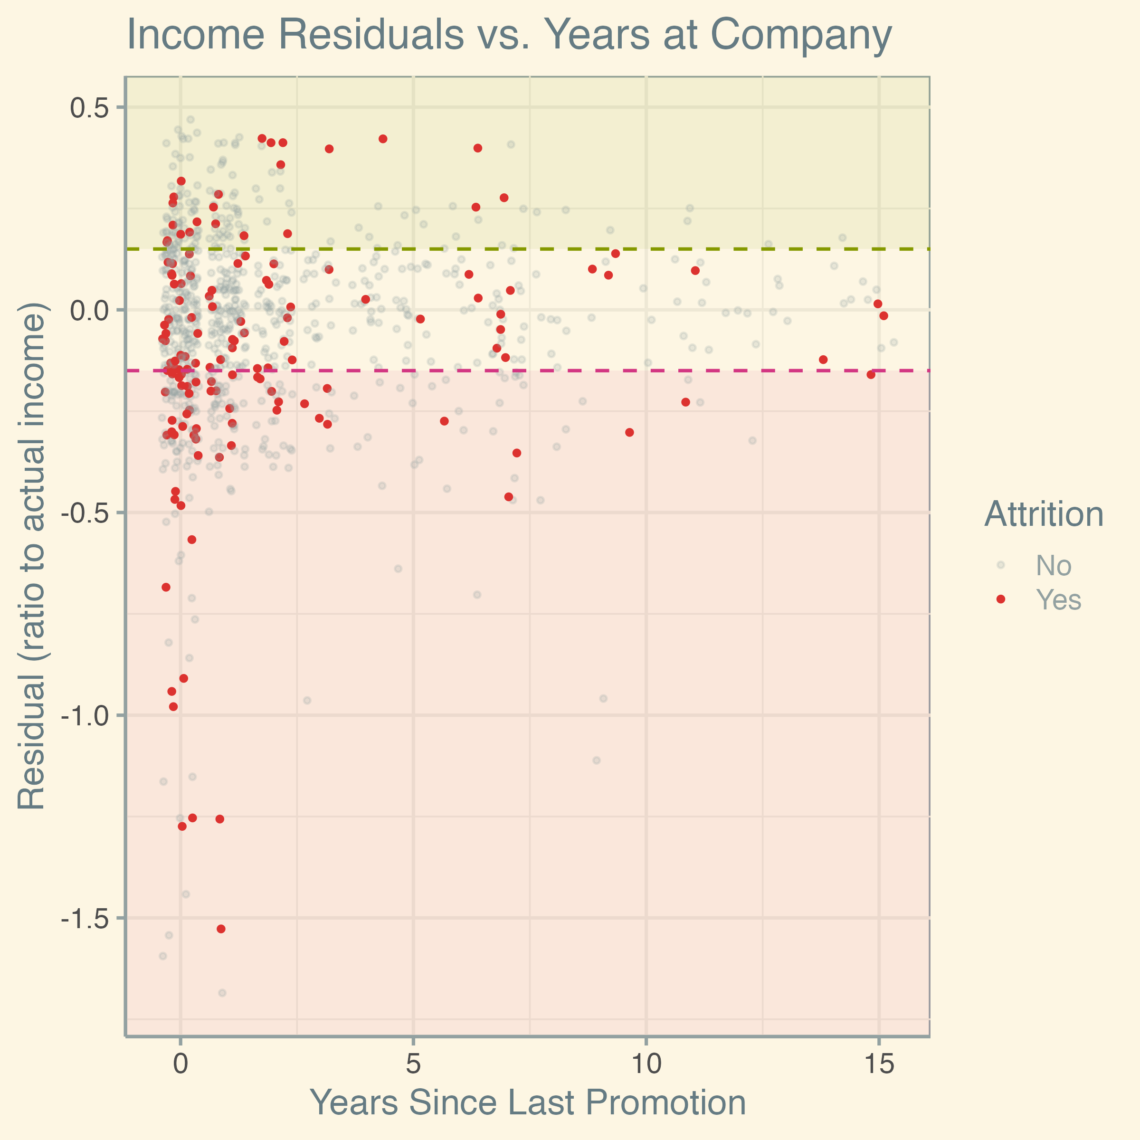
Why do employees leave?
Above Expected
Around Expected
When accounting for residuals, the evidence suggests that income is a significant driver of attrition.
Below Expected
*Redsiduals were computed from a linear model.
Expected income is a function of ”Department”, “Job Level”, and “Years Since Last Promotion”.

Slide 10
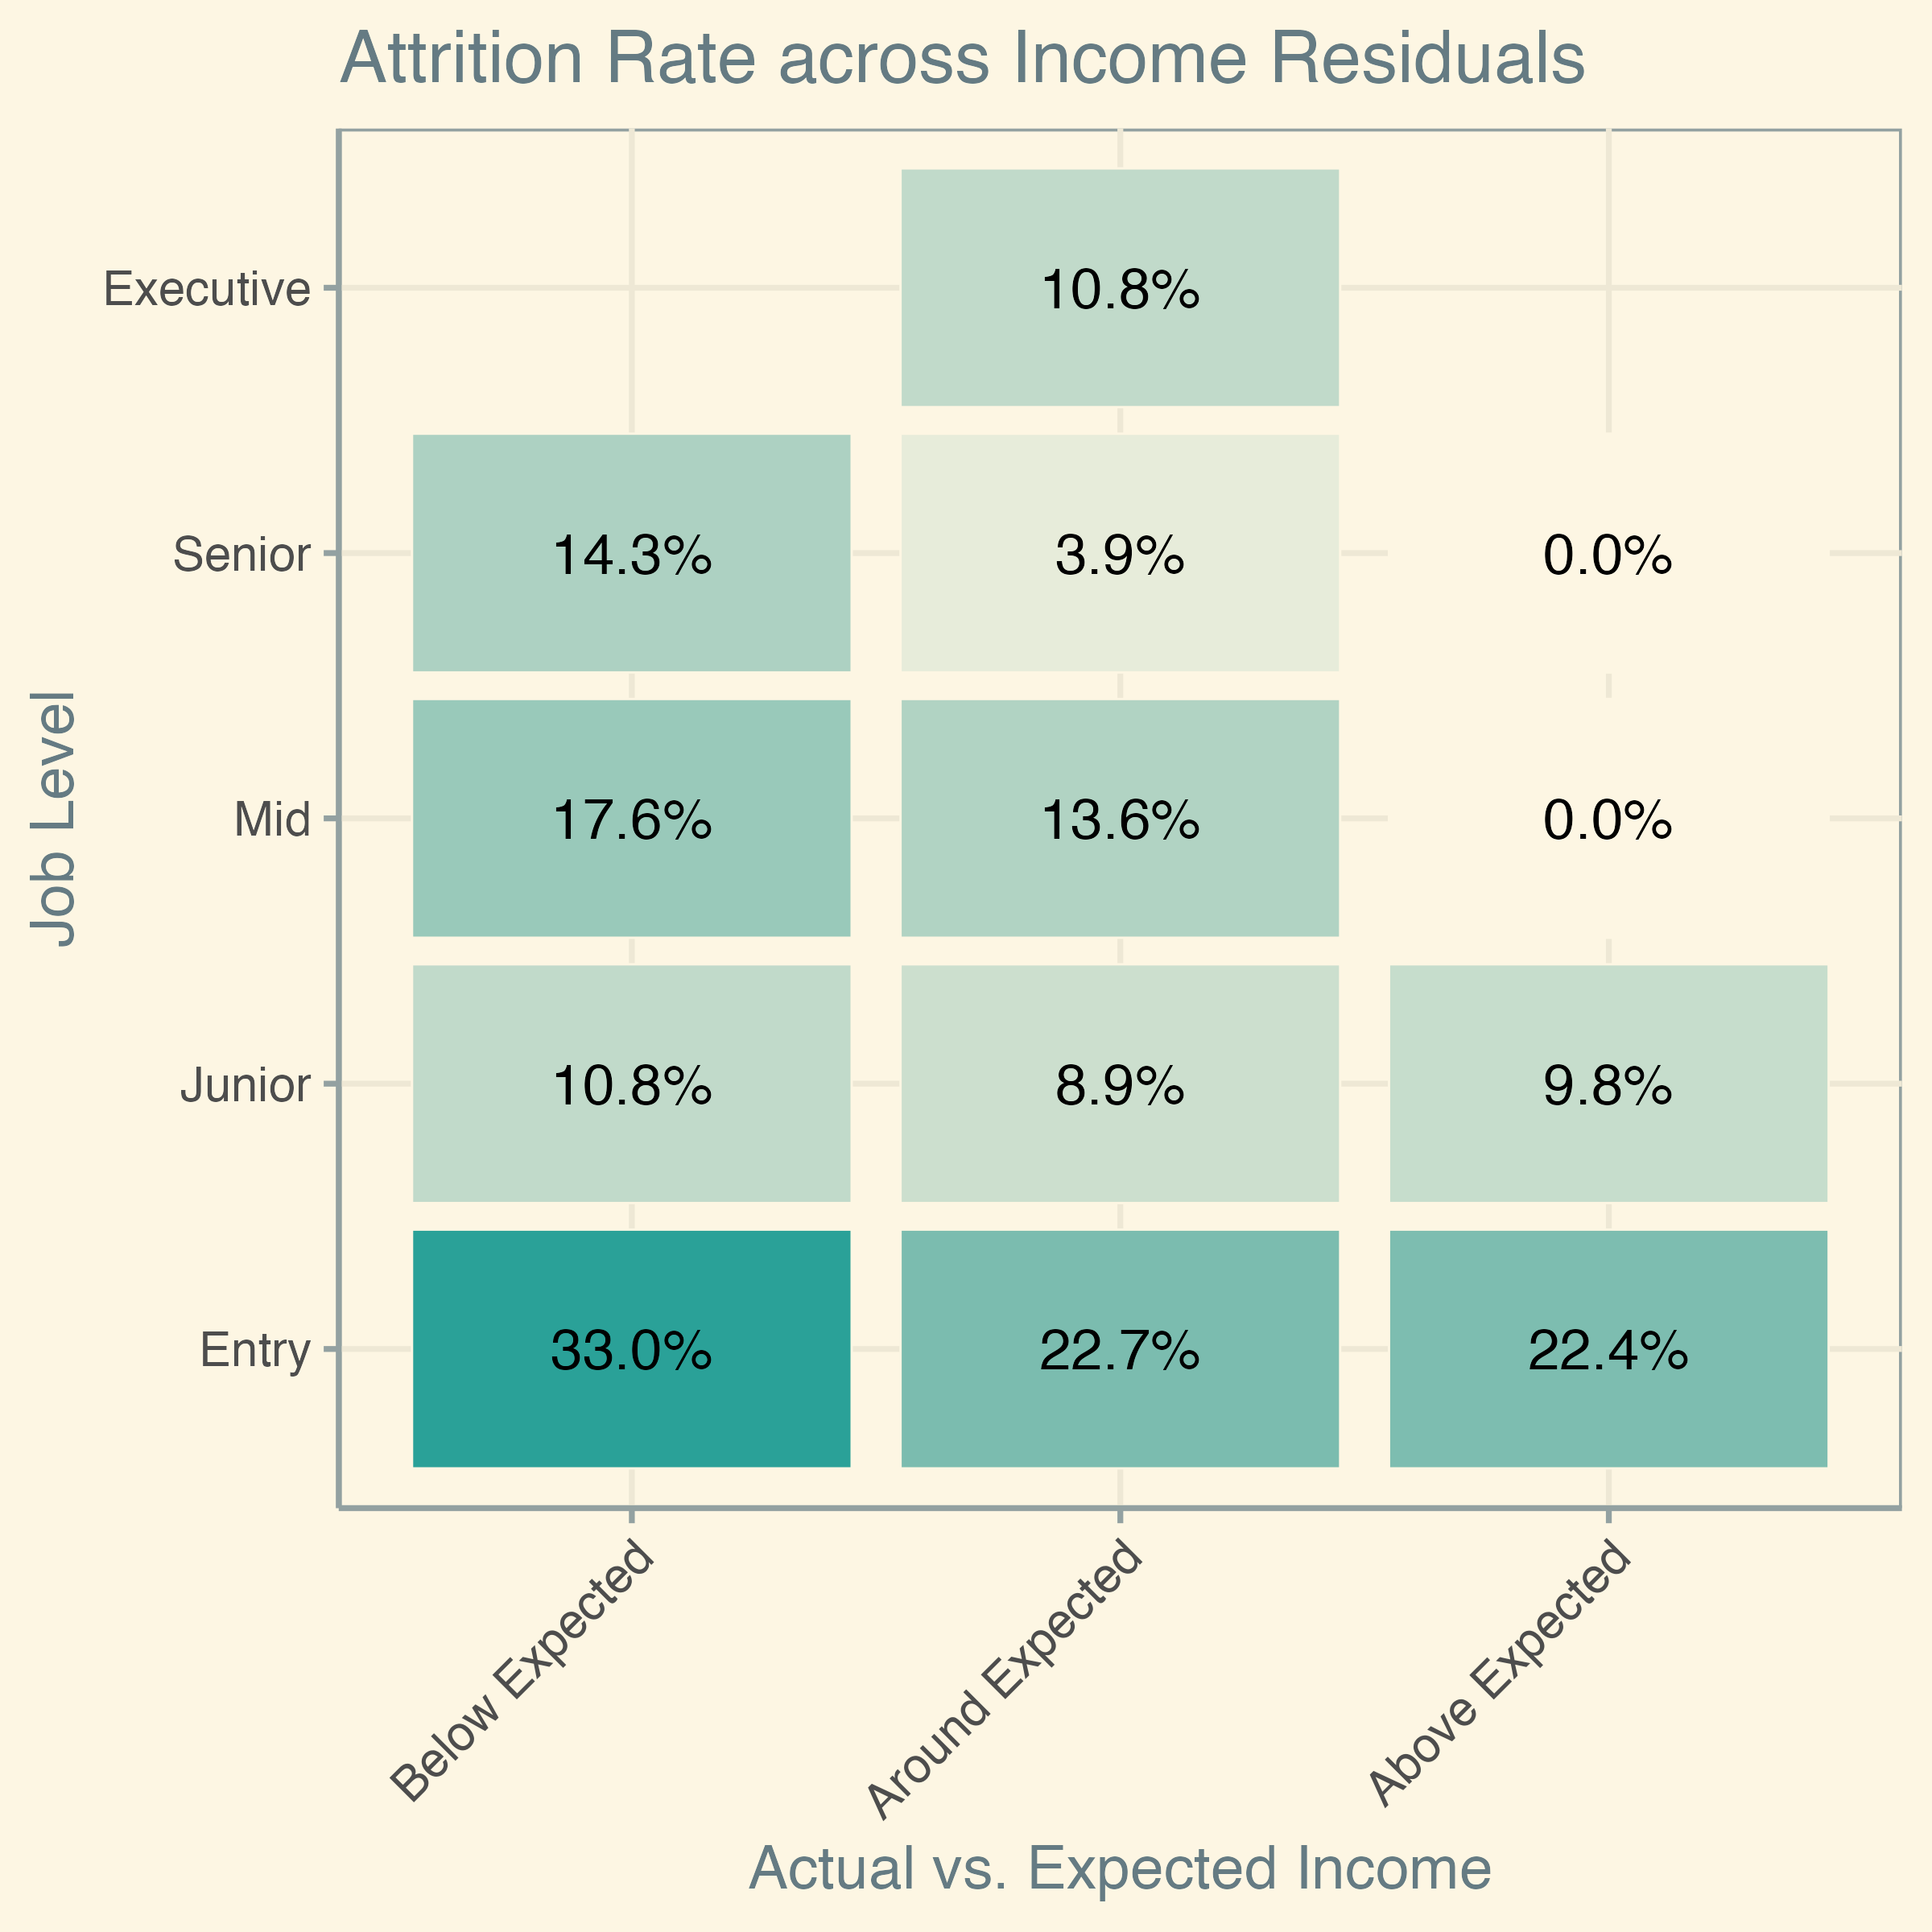
Why do employees leave?
When accounting for residuals, the evidence suggests that income is a significant driver of attrition.
Below Expected Income
The Attrition rate is higher across all job levels
Above Expected Income
Attrition rate is lower for Mid and Senior
Attrition rate is comparable to “Around Expected” for Entry and Junior
*Redsiduals were computed from a linear model.
Expected income is a function of ”Department”, “Job Level”, and “Years Since Last Promotion”.

Slide 11
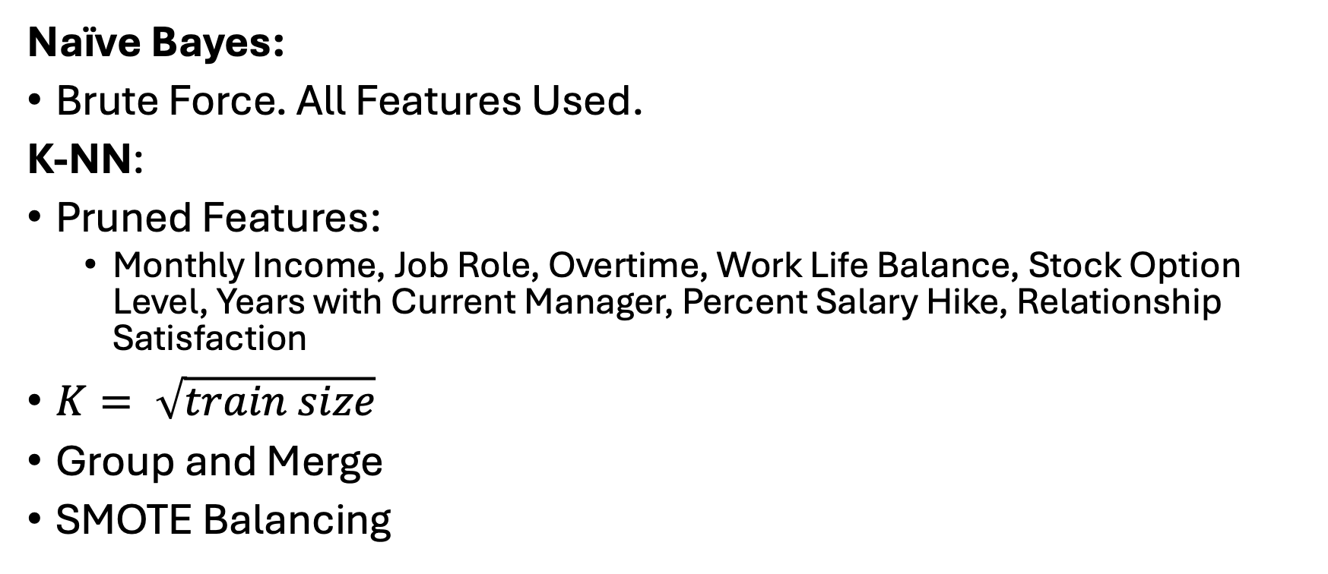
Comparing Models
Naïve Bayes:
Brute Force. All Features Used.
K-NN:
Pruned Features:
Monthly Income, Job Role, Overtime, Work Life Balance, Stock Option Level, Years with Current Manager, Percent Salary Hike, Relationship Satisfaction
$K= \sqrt{train size}$
Group and Merge
SMOTE Balancing

Slide 12
Comparing Models
Metrics:
Sensitivity: How accurate is the model at detecting who is leaving?
Speceficity: How accurate is the model at detecting who is staying?

Slide 13
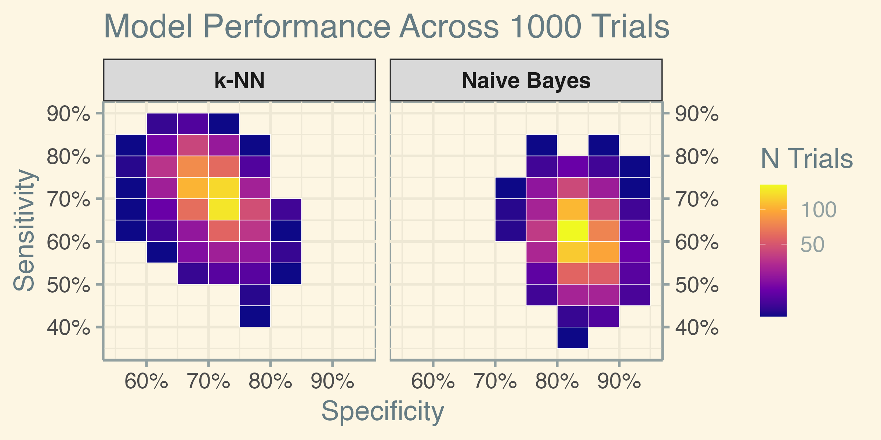
Evaluation

Slide 14
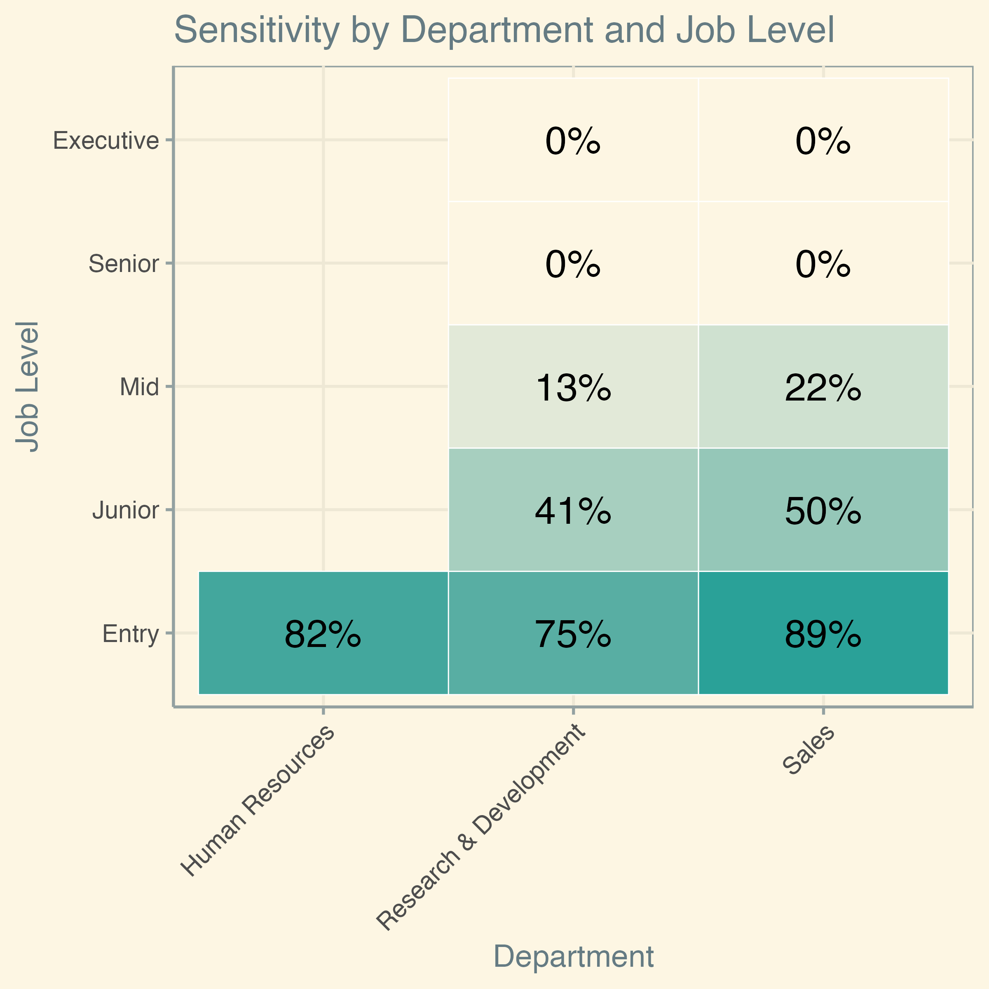
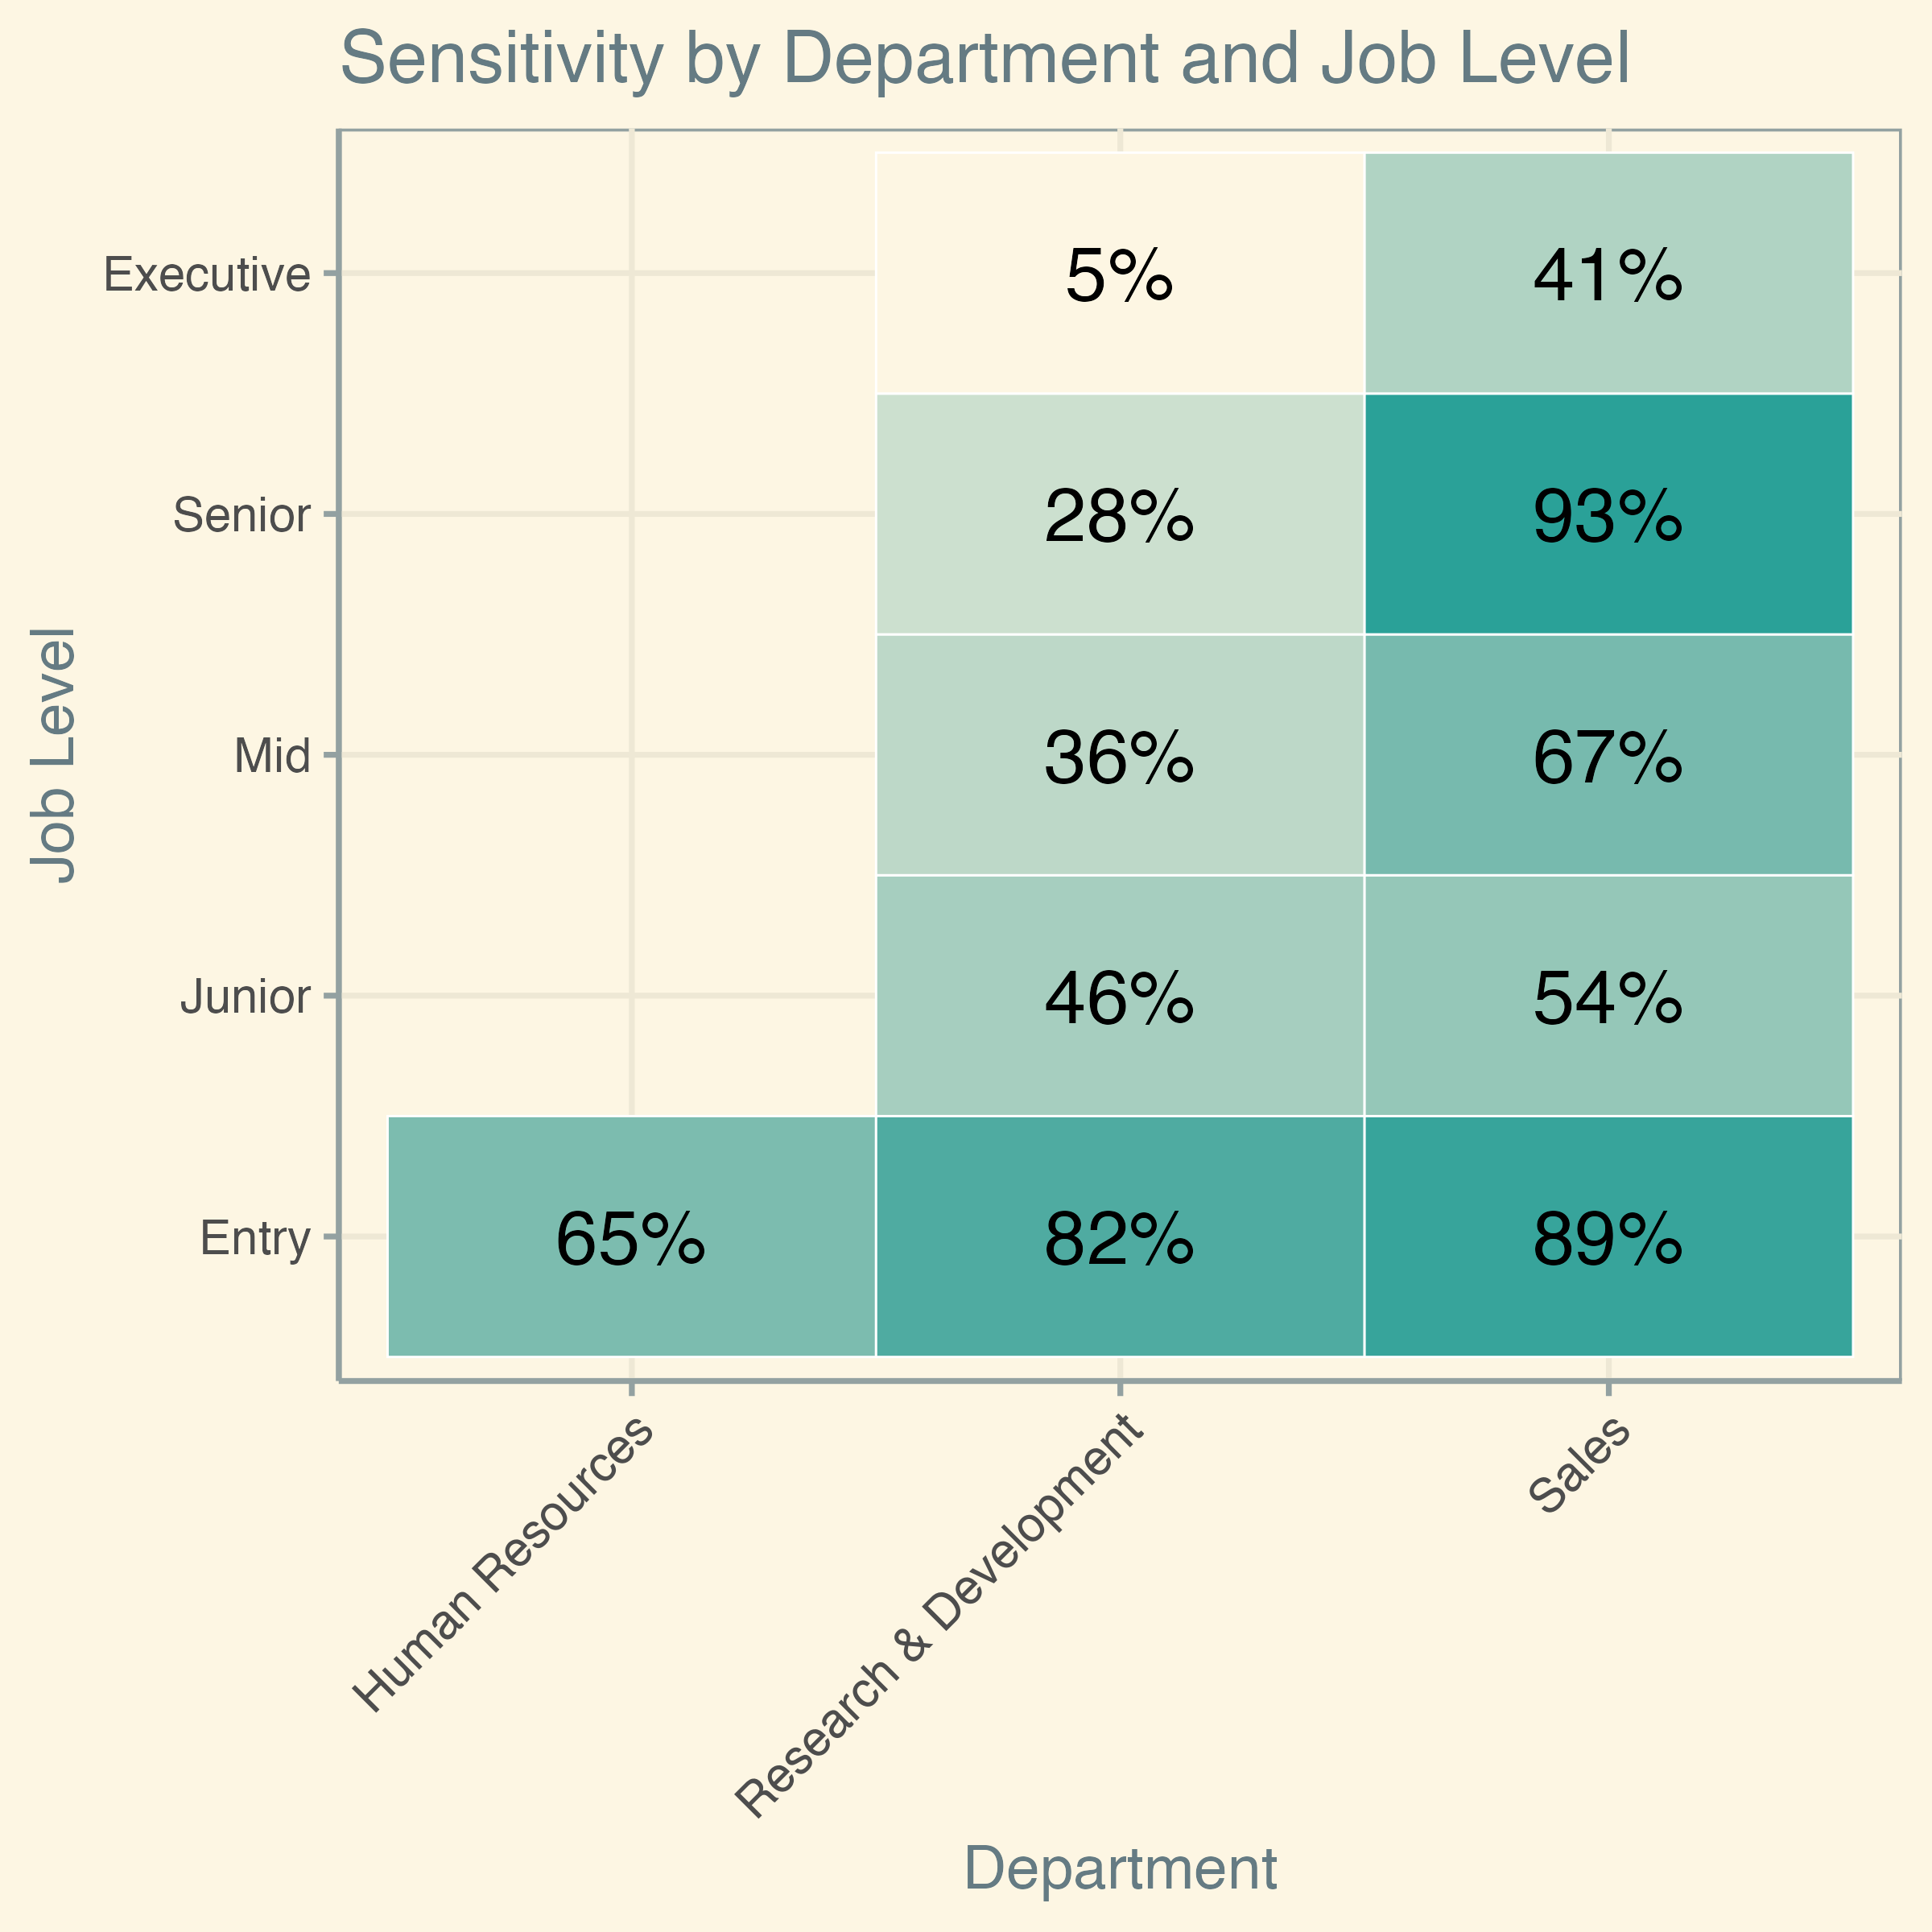
Evaluation
Naïve Bayes
K-NN

Slide 15
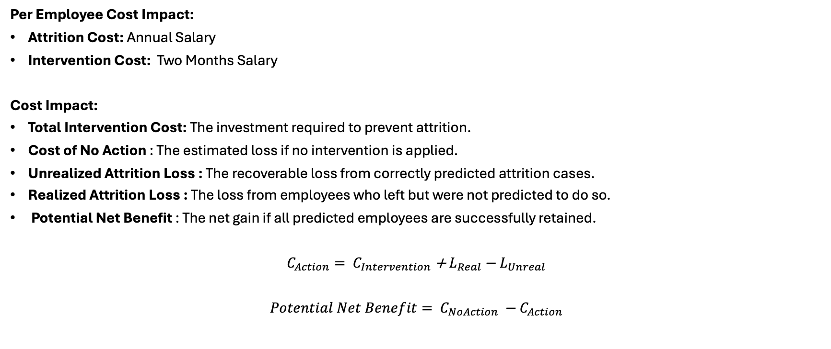
Evaluation
Per Employee Cost Impact:
Attrition Cost: Annual Salary
Intervention Cost: Two Months Salary
Cost Impact:
Total Intervention Cost: The investment required to prevent attrition.
Cost of No Action : The estimated loss if no intervention is applied.
Unrealized Attrition Loss : The recoverable loss from correctly predicted attrition cases.
Realized Attrition Loss : The loss from employees who left but were not predicted to do so.
Potential Net Benefit : The net gain if all predicted employees are successfully retained.
$C_{Action}= C_{Intervention}$ + $L_{Real}−$ $L_{Unreal}$
$Potential Net Benefit= C_{NoAction} −$ $C_{Action}$

Slide 16
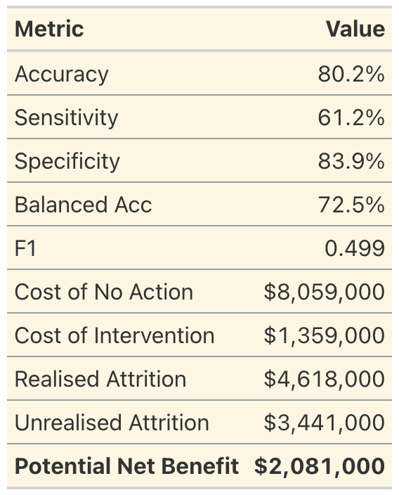
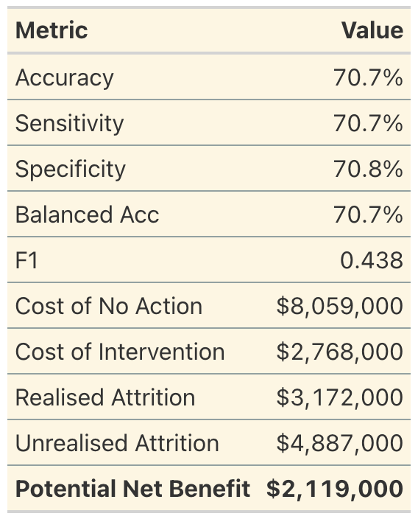
Evaluation
Naïve Bayes
K-NN

Slide 17
Closing Remarks
Naïve Bayes was a better fit for the dominant problem: high turnover in entry level jobs related to overtime and poor work-life balance
K-NN had higher sensitivity across the board, but also lower specificity
Both models should be used going forward as baseline for future development
Intervention should focus on the most prominent problems: overtime and work life balance

Slide 18
Closing Remarks
Naïve Bayes was a better fit for the dominant problem: high turnover in entry level jobs related to overtime and poor work-life balance
K-NN had higher sensitivity across the board, but also lower specificity
Both models should be used going forward as baseline for future development
Intervention should focus on the most prominent problems: overtime and work life balance

