Slide 1
Education Intervention Project
Wolfgang Klein & Avery John
DS 6372 – Applied Statistics (Final Project)

Slide 2
The Problem
~ 10%
of students receive the majority of the intervention resources from budget
Can we identify at-risk students early enough to help?

Slide 3
Defining our Metrics / Goals
Metric | Purpose
Sensitivity | Correctly flags at-risk students
Specificity | Correctly clears passing students
Positive Predictive Value (PPV) | Flags that turn out correct
Negative Predictive Value (NPV) | Clears that turn out correct
Prevalence | Percentage of students who fail (8.8%)
AUC-ROC | Overall ability to separate risk levels

Slide 4
The Approach
Clean / Exploring Data
Build Interpretable Model
Test Complexity / Check Assumptions
Compare Several Models
Select Final Model
Outline Business Case (Conclusion)

Slide 5
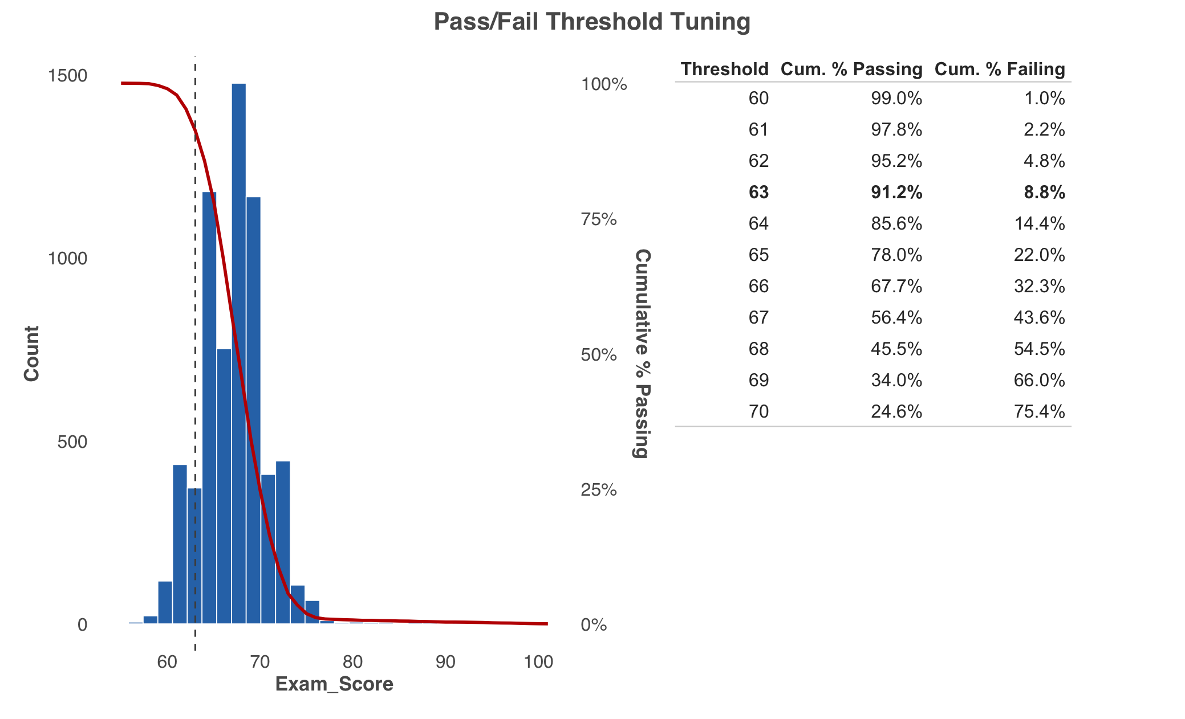
EDA – Handling the Data
6,607 students | 19 Predictors
91.2% Pass | 8.8% Fail
< 2% Missing (Handled with mode imputation)

Slide 6
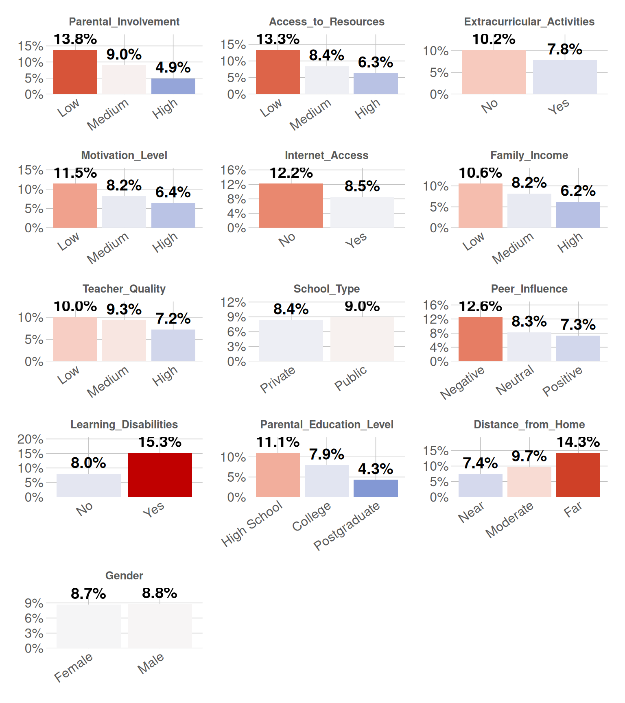
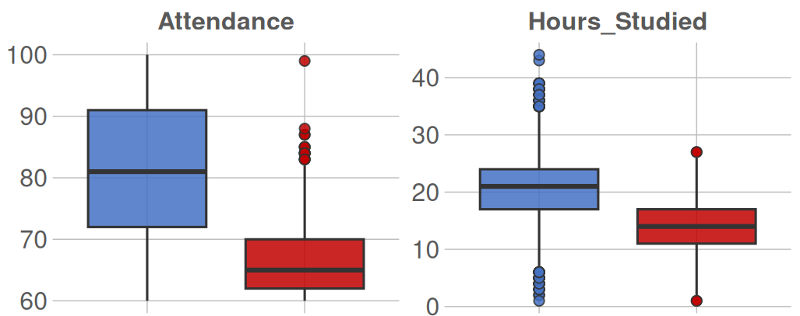
EDA – Associations with Failing
Numeric Predictors by Outcome
Fail Rate Among Categorical Factors
Pass
Fail
Pass
Fail

Slide 7
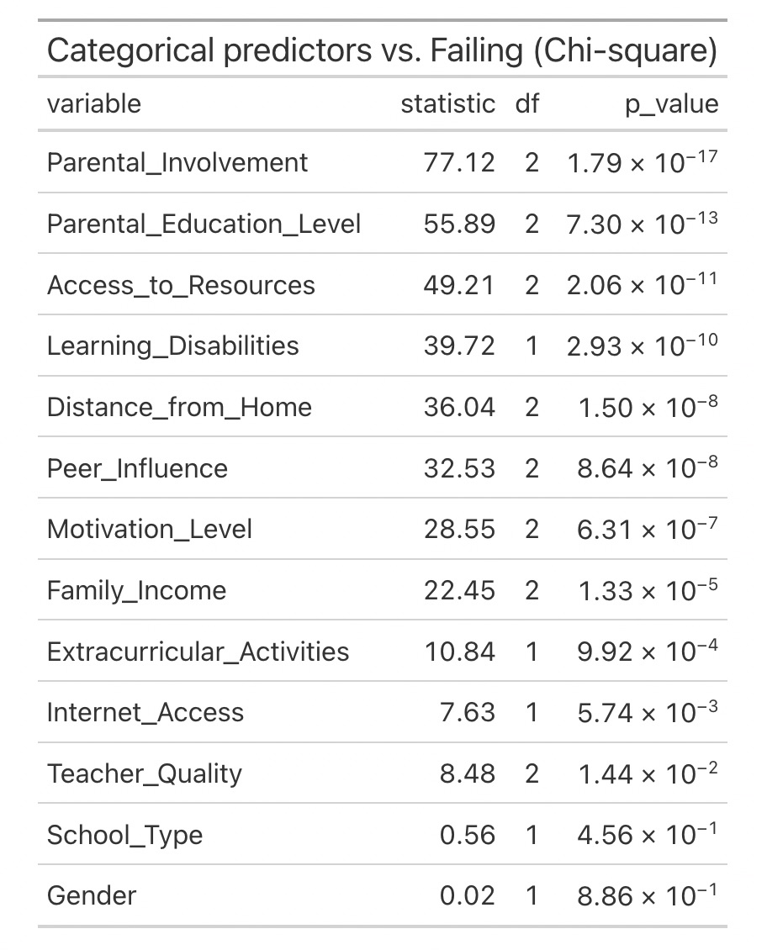
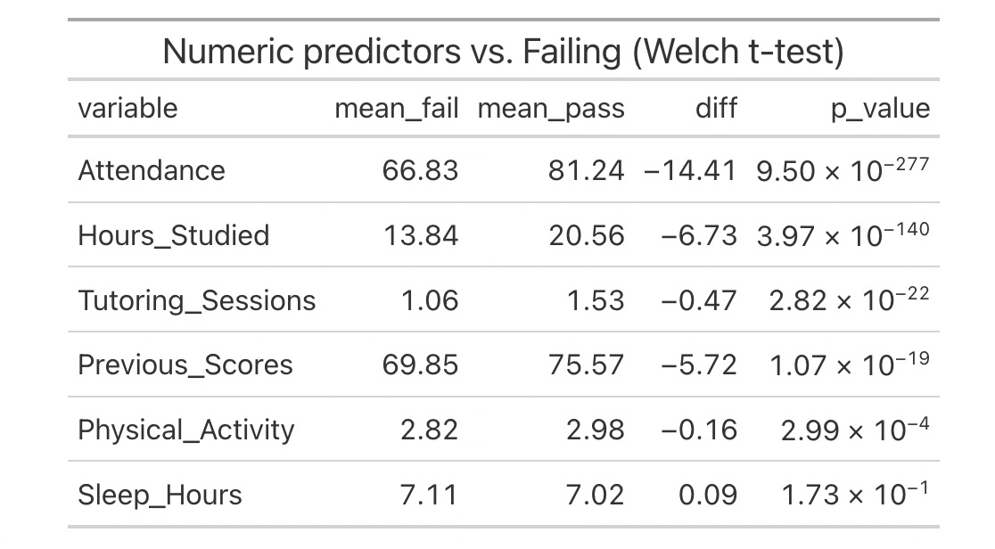
EDA – Feature Selection
What variables were dropped?
Sleep Hours, Gender & School Type (statistically insignificant)
AIC: 424 to 411

Slide 8
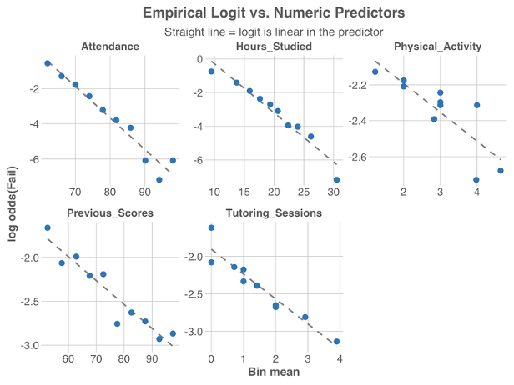
Linearity of Logits

Slide 9
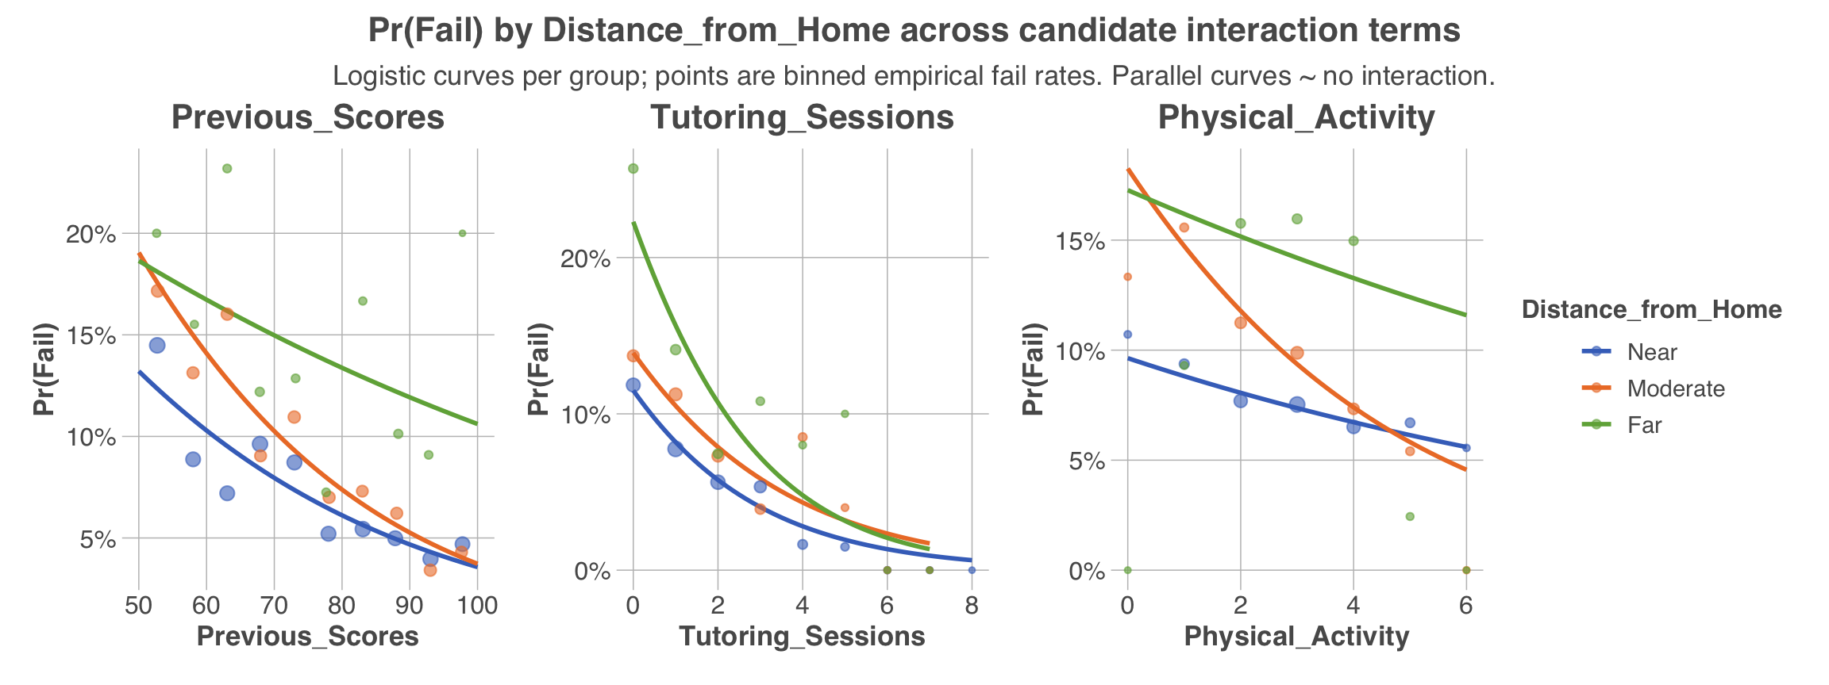
Probing for Interactions

Slide 10
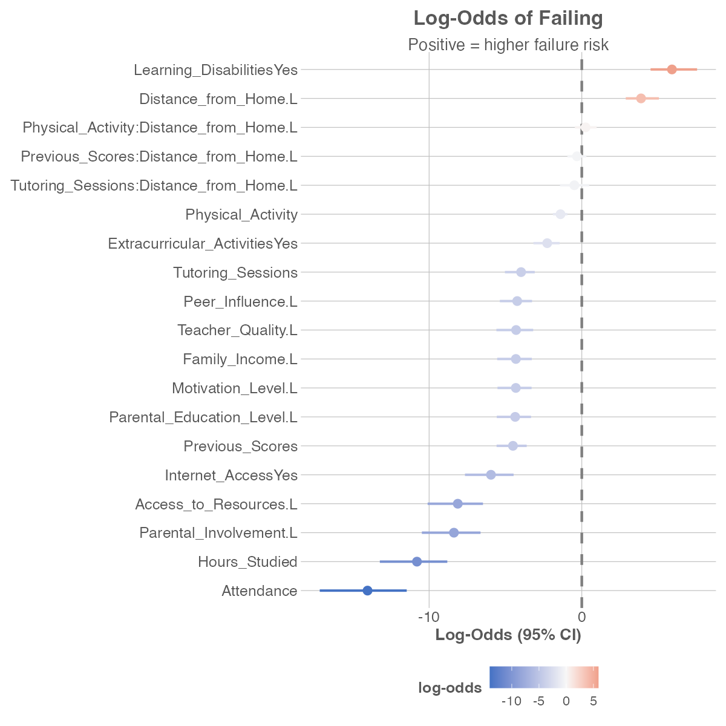
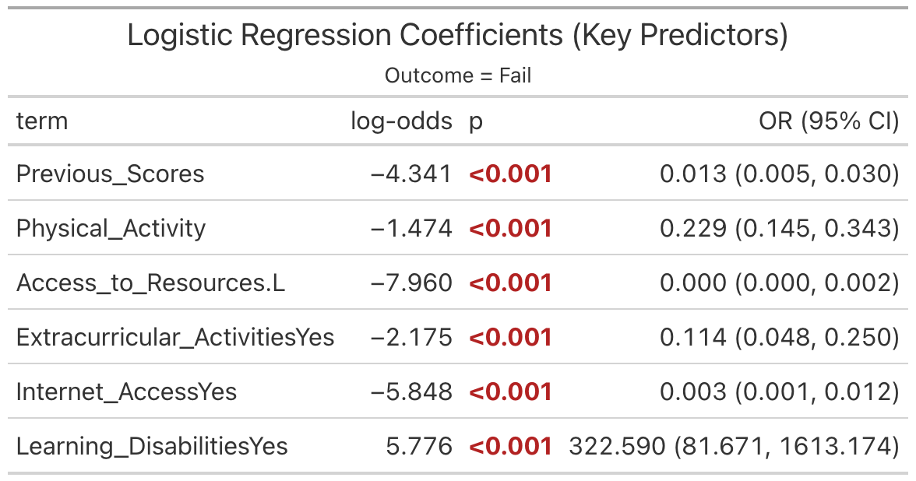
Interpretation of Coefficients
(other variables omitted)

Slide 11
Interpretation of Coefficients
(other variables omitted)
Each point increase reduces the odds of failure by 99%​

Slide 12
Interpretation of Coefficients
(other variables omitted)
Each hour of physical activity reduces the odds by 77%
Extracurriculars reduces odds by 89%.

Slide 13
Interpretation of Coefficients
(other variables omitted)
Each tier of resource access reduces the odds of failure tremendously.
Same with Internet Access.

Slide 14
Interpretation of Coefficients
(other variables omitted)
Learning disabilities increase the odds of failure 322x.

Slide 15
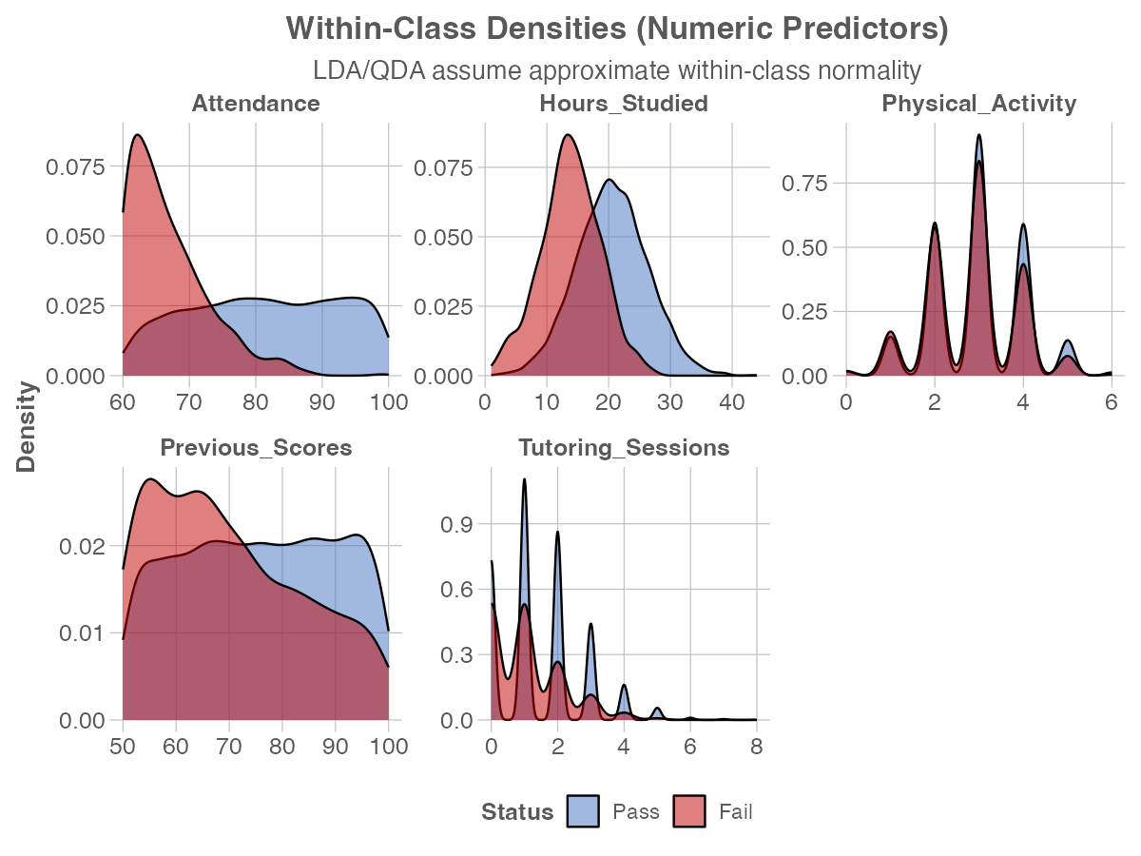
Multivariate Normality

Slide 16
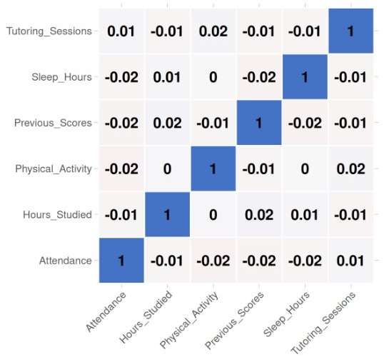
Correlation Structure
All

Slide 17
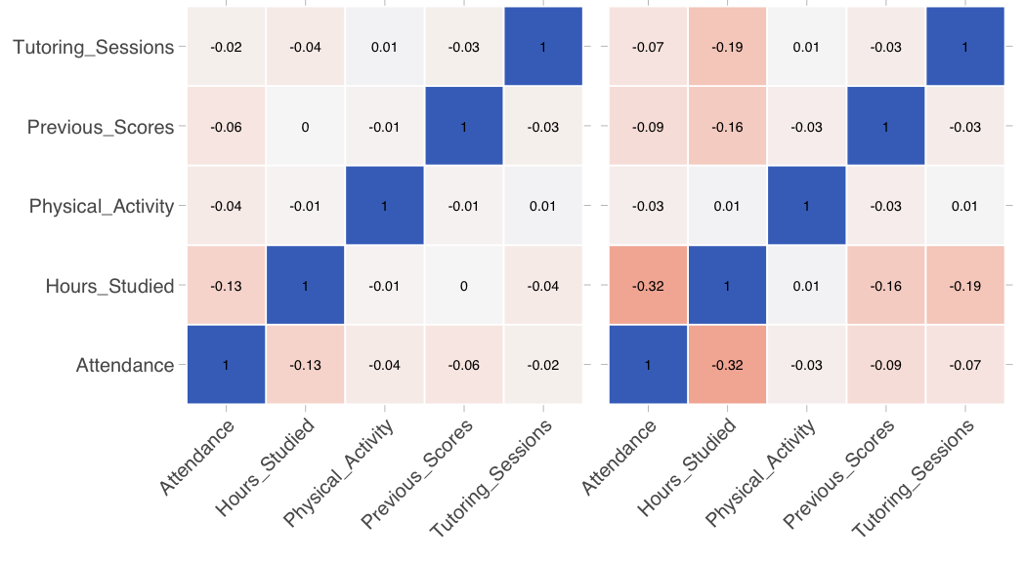
Correlation Structure
Pass
Fail

Slide 18
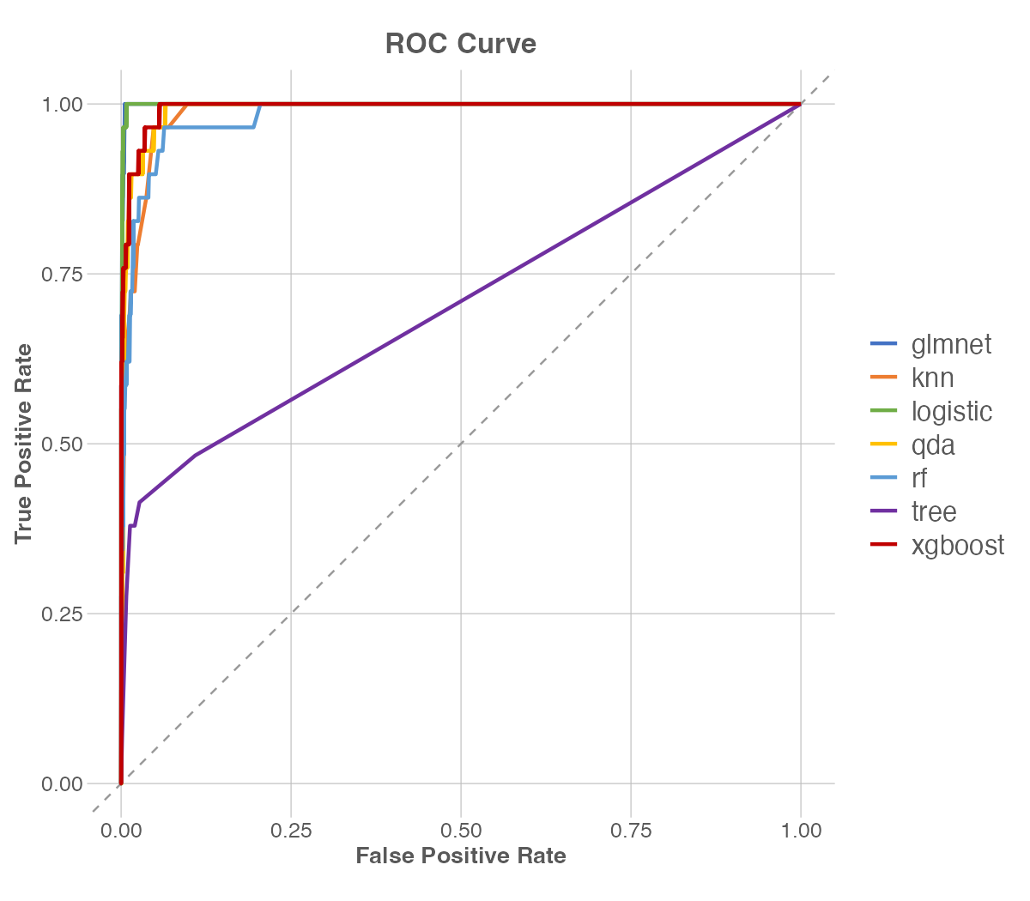
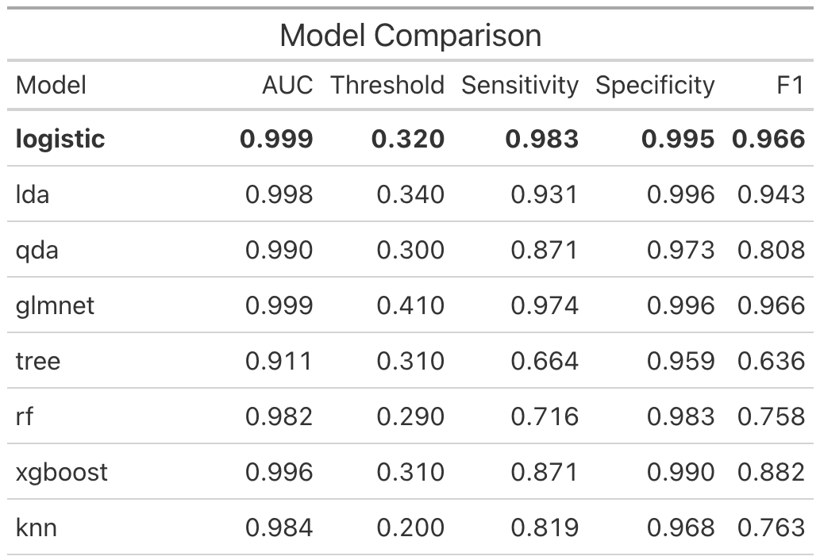
Model Comparison

Slide 19
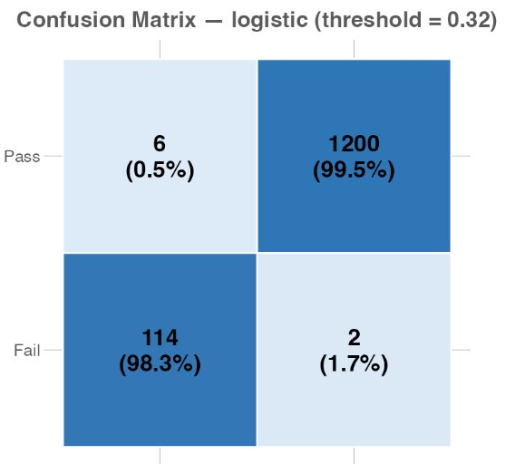
Model Comparison
Pass
Actual
Fail
Pass
Fail
Predicted

Slide 20
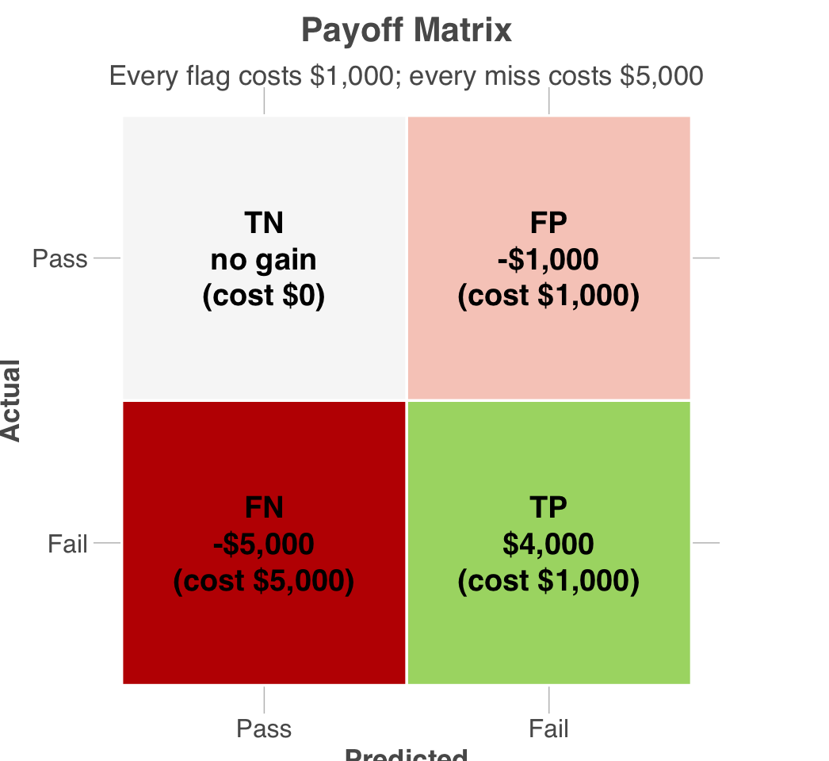
Cost Optimization
A passing student is predicted to pass.
Nothing spent.
Nothing lost.

Slide 21
Cost Optimization
A failing student is undetected.
Nothing spent.
$5,000 loss

Slide 22
Cost Optimization
A passing student is predicted to fail.
$1,000 spent
(waste)

Slide 23
Cost Optimization
A failing student is detected.
$1,000 spent
$5,000 expense avoided
$4,000 Net Benefit

Slide 24
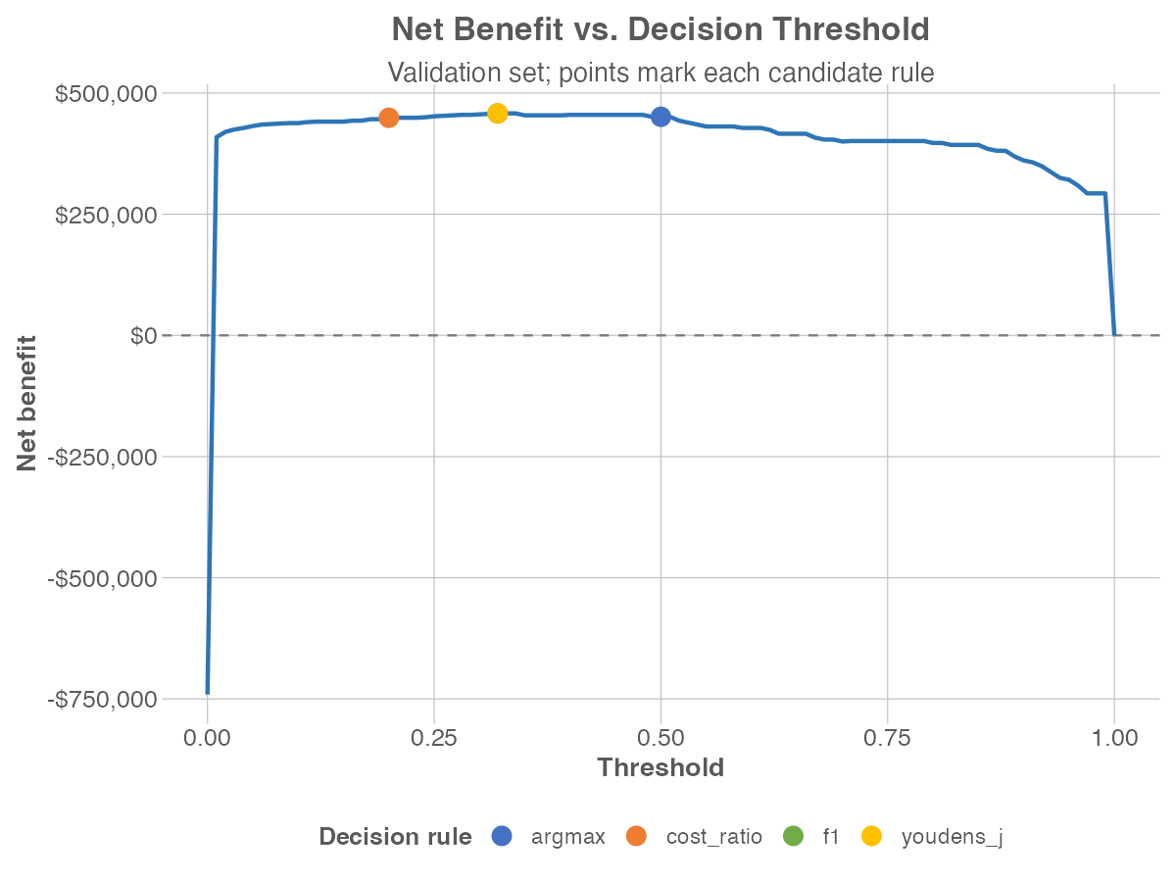
Cost Optimization
Net Benefit driven threshold selection.
F1 & Youden’s J
Converge

Slide 25
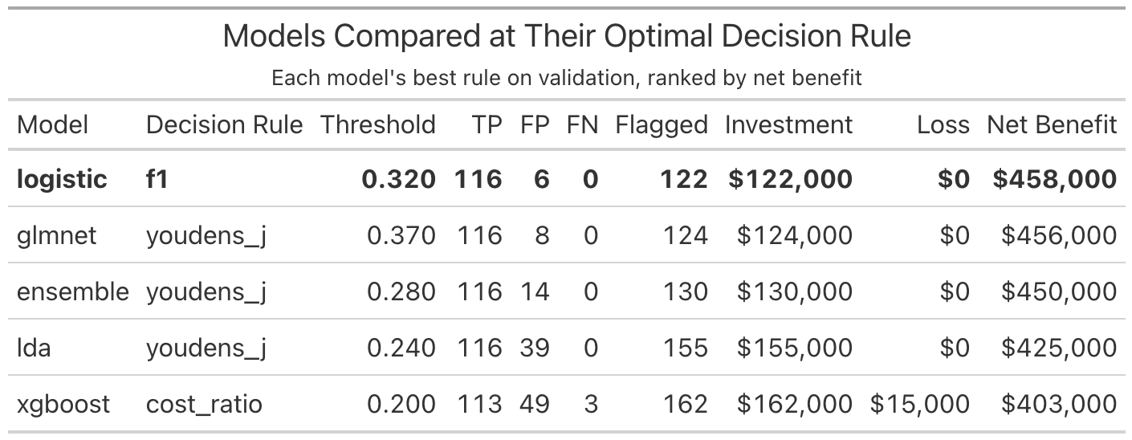
Cost Optimization

Slide 26
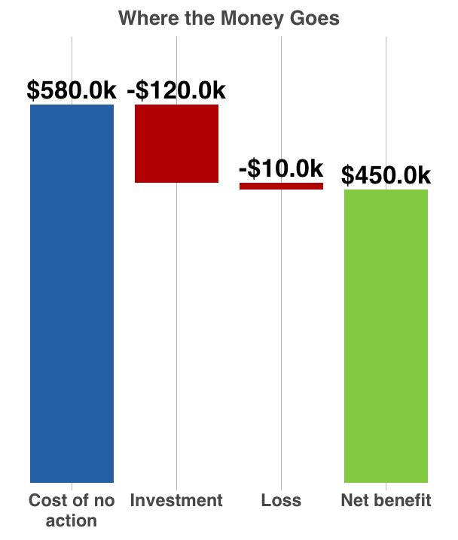
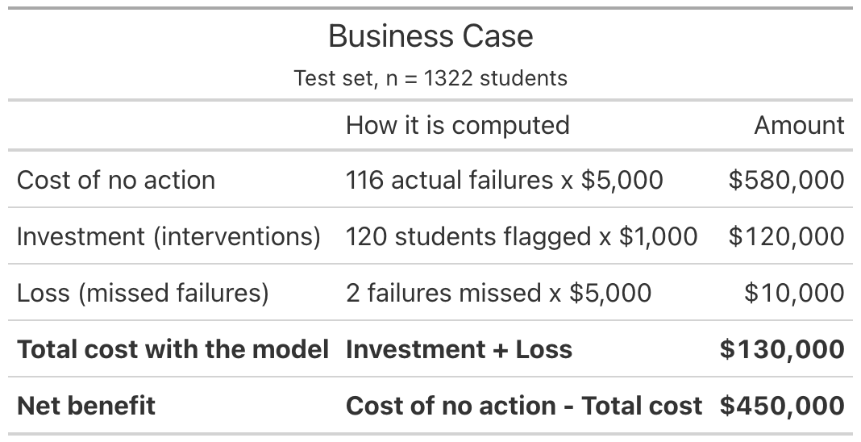
Business Case

Slide 27
Business Case

Slide 28
Business Case

Slide 29
Business Case
1,322 students
$340.39/student

Slide 30
Final model is a tool meant to focus attentions on these areas.
Let's direct support to the students who need it the most.
Attendance
Study Hours
Access to Resources
Learning Disabilities
Parental Involvement

