Slide 1

The Lone Ninja !

Slide 2
Design:
Interpreter - Python
Natural Language Processor - Natural Language Tool Kit (NLTK)
Machine Learning Algorithm - Naïve Bayes Classifier
Approach - Supervised Classification

Slide 3
Python and Natural Language Tool Kit
Python is what is nowadays called a “scripting language”, an interpretive language with its own
memory management and good facilities for calling and cooperating with other programs.
Python has the open source Natural Language Toolkit (NLTK).
This library is a rich set of natural language processing tools and datasets.
The combination of NLTK and Python make the perfect combination for teaching NLP techniques

Slide 4
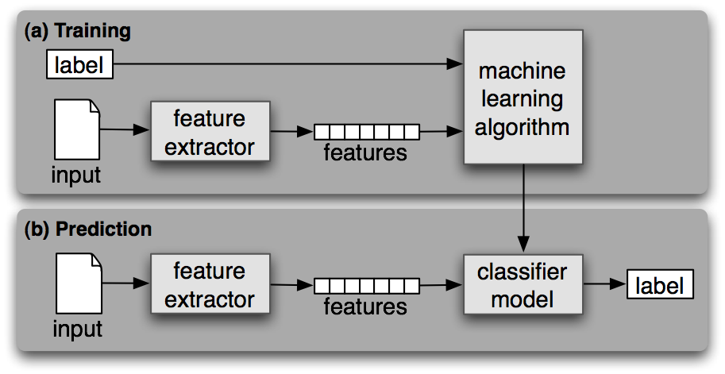
Supervised Classification Technique
Classification is the task of choosing the correct class label for a given input.
In basic classification tasks, each input is considered in isolation from all other inputs, and the set of labels is defined in advance.

Slide 5
Thank you

