Slide 1

Machine Learning course 2023. Final Project 11.
Contrastive Learning for Event Sequences with Self-Supervision on multiple domains
Replication study
Denis Grankin
Ekaterina Andreichuk
Ivan Apanasevich
Irena Gureeva
Mikhail Konenkov

Slide 2
Motivation
Learning best algorithms for lifestream data embeddings
Extracting embeddings from event sequences is a useful approach that can be used for learning users preferences, advising customers products based on their clickstream data and many other real-world applications. However, classical methods for analyzing event sequences that are attributed to a person and capture their regular and routine behavior do not capture relationships between single object and its immediate neighborhood very well. Also, it usually requires a labeled data to operate this.
Therefore, new methods for data augmentation and event sequences extraction is needed.

Slide 3
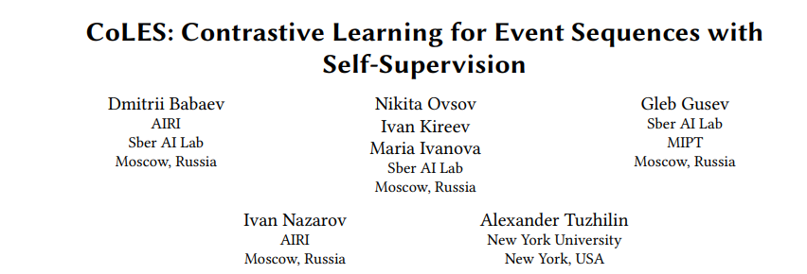
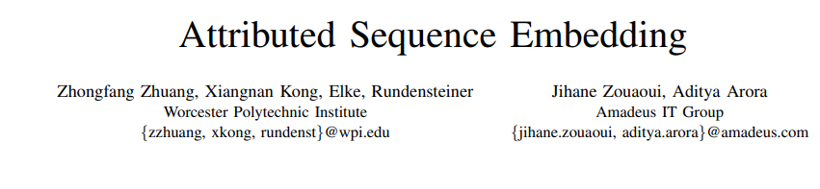


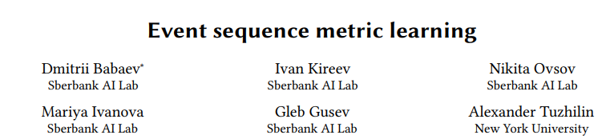
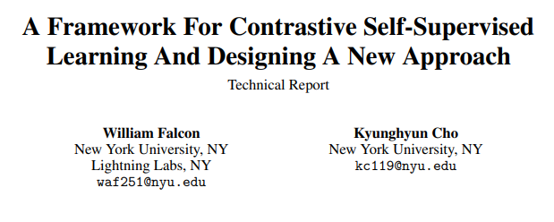


Related work
The paper on which our replication study is based on.
Study about extracting data embeddings from attributed sequences.
Metric learning method for producing embeddings of complex event sequences. The main advantage is that almost no pre-processing is needed for complex even streams to get their compact embedding.
Study with analysis of contrastive learning approaches and conceptual framework for Contrastive Learning.

Slide 4
Project main goal
Replicate the methods, proposed in the paper, on different types of event sequence data and compare its results.
Get familiar with the pytorch-lifestream library
Run the proposed methods for learning embeddings on two types of data(transactions and clickstream)
Implement downstream machine learning task on both types of data and compare its results

Slide 5
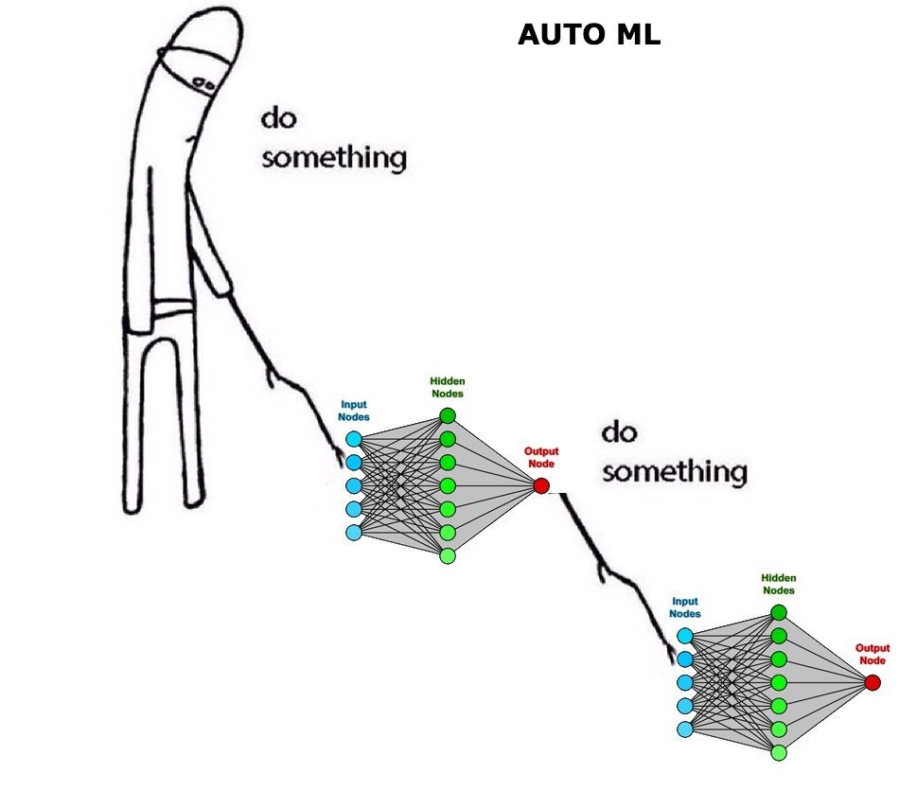
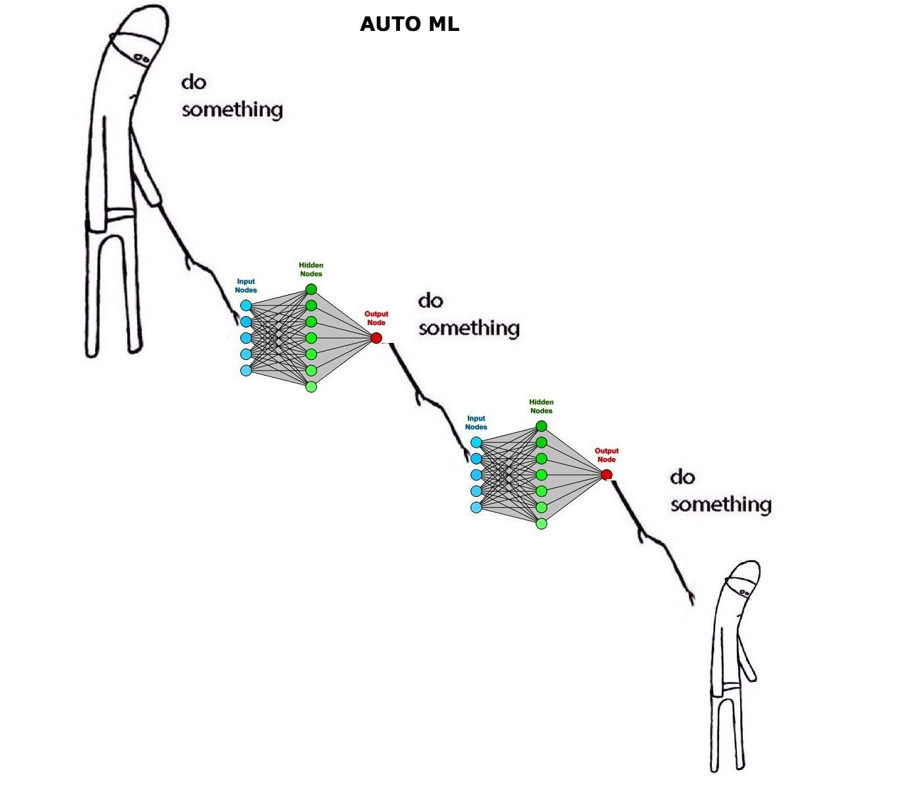
Related work
How we thought it works
How we it actually works
Some theory text about sequential data, self-supervised algorithms and so on

Slide 6

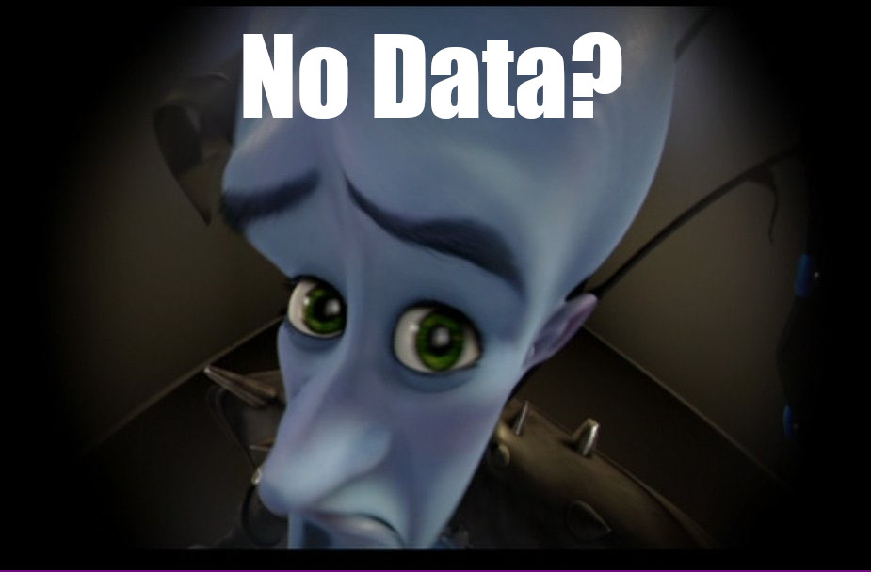
Scope and limitations
Given both the competitive landscape and the safety implications of contrastive learning models like CoLES, this presentation contains no further details about the architecture (including model size), hardware, training compute, dataset construction, training method, or similar.

Slide 7
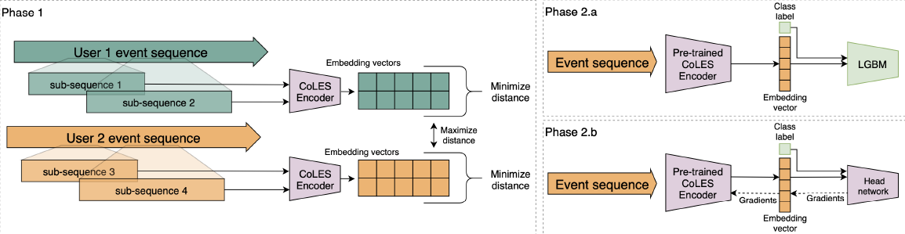
CoLES framework
Figure 1: General framework. Phase 1: Self-supervised training. Phase 2.a Self-supervised embeddings as features for supervised model. Phase 2.b: Pre-trained encoder fine-tuning.
Our implementation consists only of Phase 1 and Phase 2.a steps. Also we’ve implemented aggregate baseline encoder and random feature encoder on both datasets in order to investigate more data embeddings’ extraction methods and to compare the resulting scores of these three methods.

Slide 8
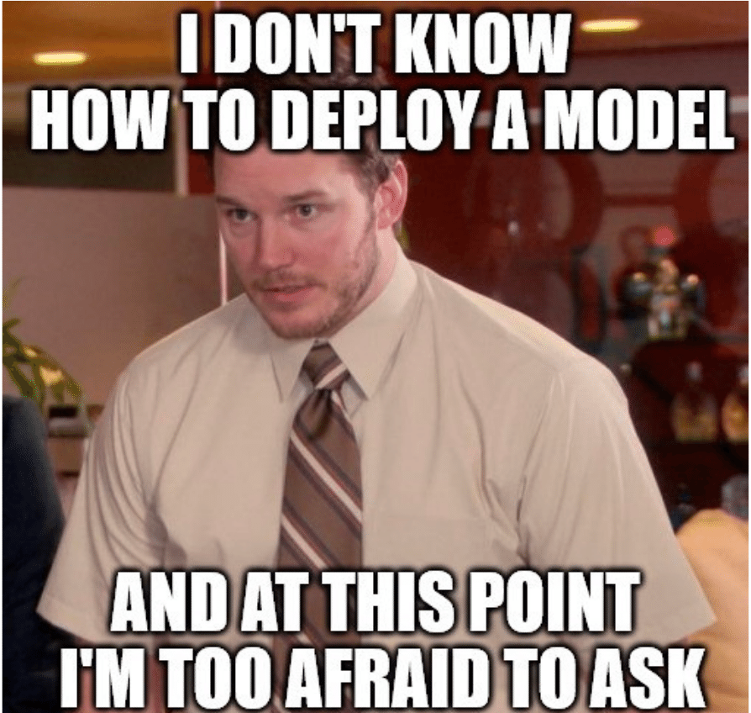
Baseline methods
Random feature encoder has architecture which is similar to CoLES, but it is not pre-trained. Therefore, all weights are random.
In aggregate baseline encoder categorical features are decomposed into One-Hot Encoder. Numerical features are decomposed according to the resulting columns. A separate encoder is used to generate features. The encoder interface is the same as that of RNN CoLES.
Aggregate baseline encoder doesn’t take into account the sequential nature of data, unlike CoLES.

Slide 9
General pipeline
Tuning
Metrics
Configuring the model, choosing hyper-parameters, tuning the model and obtaining embeddings
Achieve metrics for further comparison
We combine information about each user by implementing ptls library
Tune CatBoost using embeddings from previous step to predict whether a client has a higher education
Preprocessing
Down-stream task

Slide 10
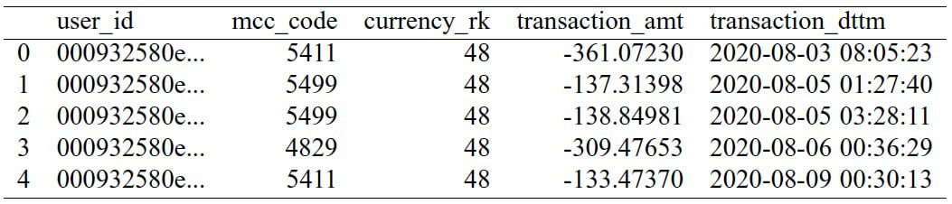
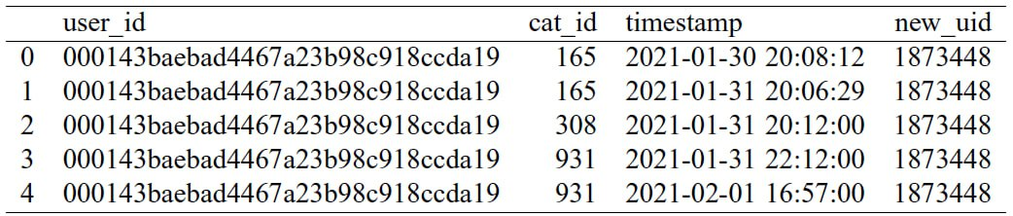
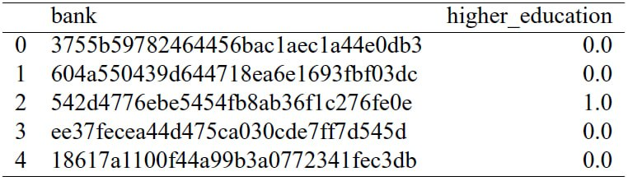
DataFusion 2022 datasets
We have datasets with industrial data of transactions and clickstreams.
Due to this data we need to predict whether a client has a higher education.
transactions
19821910 rows
clickstream
126752515 rows
target
8509 rows

Slide 11

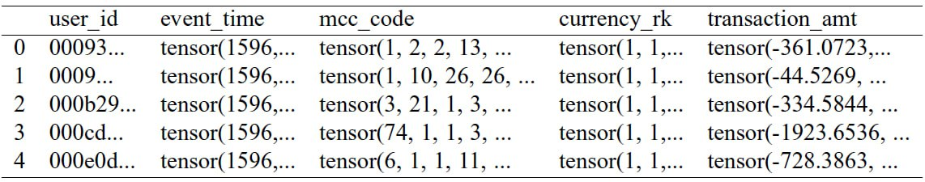
Transactions preprocessing
transactions.csv -> pd.read_csv(‘transactions.csv’) ->

Slide 12

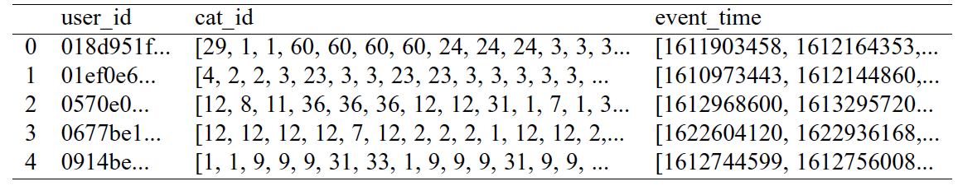
Clickstreams preprocessing
clickstreams.csv -> pd.read_csv(‘clickstreams.csv’) ->
-> PySpark ->

Slide 13
Hyper-parameters
Table 1: Hyper-parameters for models training
Models | CoLES | Agg baseline | Random encoder
Embedding size | 256
Loss function | Contrastive loss
Learning rate | 0.001
Resampling | Sample Slices
Number of splits | 5
Size of subsequence | 25-200
Encoder | GRU
We’ve tried different parameters on both transactions and clickstream datasets, but the parameters listed in that are the best for models training.

Slide 14
Results
Table 2: Scores on transactions and clickstream datasets with different metrics
 | CoLES |  | Agg baseline | Random encoder
Metrics | Transaction dataset | Clickstream dataset | Transaction dataset | Transaction dataset
F1 score | 0.8615 | 0.8334 | 0.8522 | 0.8519
ROC AUC score | 0.7583 | 0.5936 | 0.5014 | 0.5047
Precision | 0.9605 | 1 | 1 | 1
Accuracy | 0.7708 | 0.7145 | 0.7427 | 0.7421

Slide 15
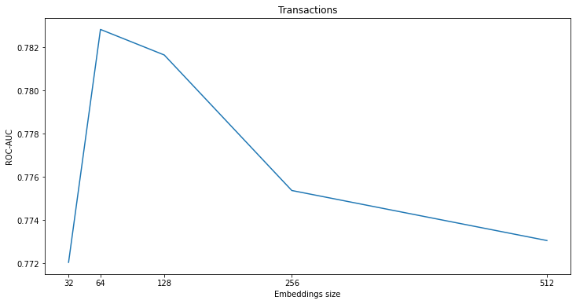
Results
Transaction dataset gives better result than Clickstream dataset
CoLES performs better than other used models (agg baseline and random encoder)
Embedding dimensionality vs Quality for transactions

Slide 16
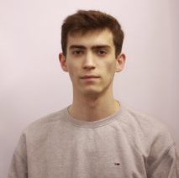

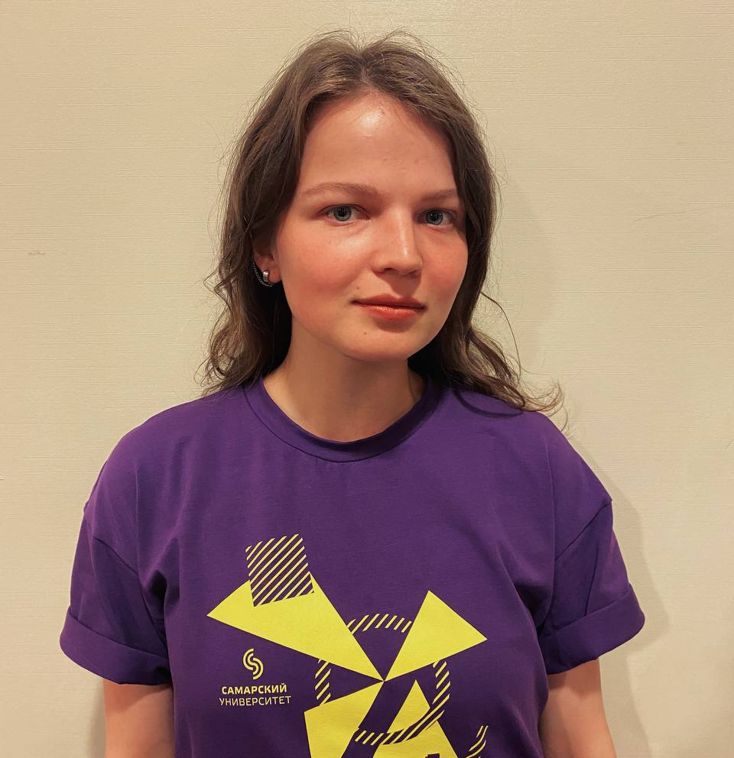
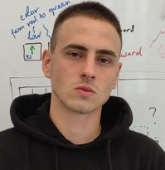
Contribution
Denis Grankin
Code
Mikhail Konenkov
Report
Presentaion
Irena Gureeva
Report
Presentaion
Ivan Apanasevich
Code
Ekaterina Andreichuk
Code

Slide 17
Conclusion
Pytorch-lifestream library was implemented for event sequences data extraction and CoLES method was used for embeddings
Data Fusion 2022 datasets were investigated and prepared for testing
Downstream tasks were implemented for data embeddings extracted with CoLES, Agg Baseline and Random Encoder.
Results were obtained for different methods and datasets, their performance was compared

