Slide 1

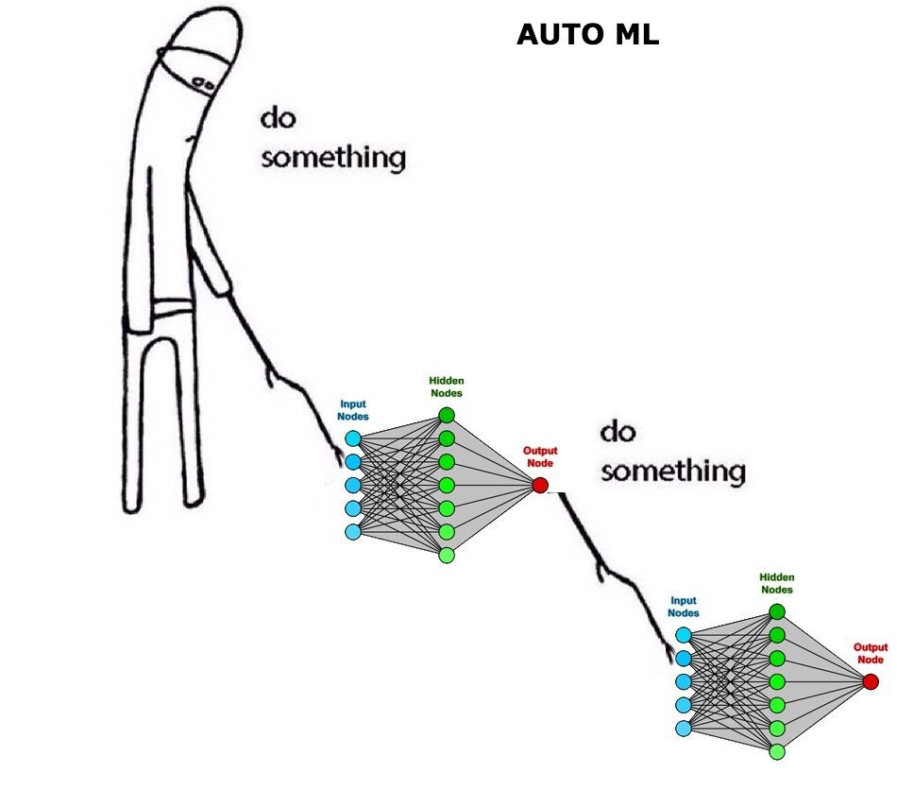
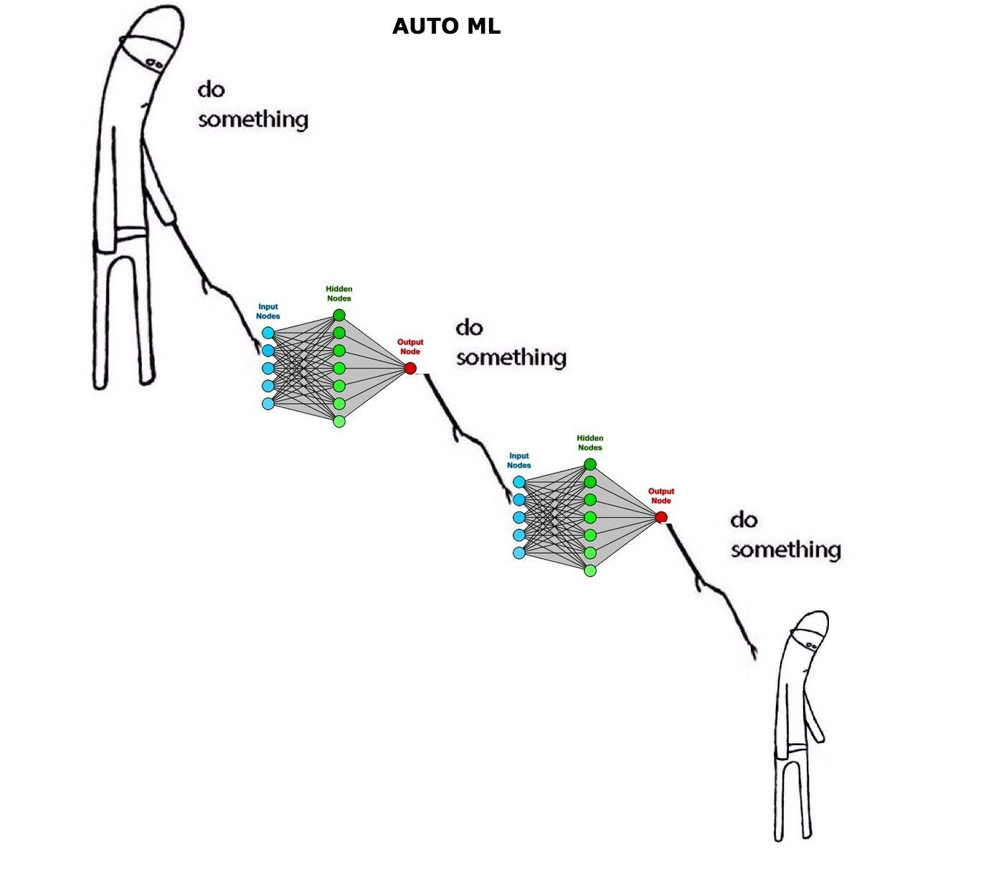
Related work
How we thought it works
How we it actually works
Self-Supervised Learning (SSL) is one such methodology that can learn complex patterns from unlabeled data. Contrastive self-supervised learning (CSL) has been recently found successful for semi-supervised
learning (SSL).
In CSL, the goal is to generate representations of instances such that similar instances are near each other and far from dissimilar ones. In supervised learning, associative labels determine the similarities among instances.
Different from conventional multidimensional data, the sequential data are not represented as feature vectors of continuous values, but as sequences of categorical items with variable-lengths.
Examples of sequential data include
click streams of web users, purchase histories of online customers, and DNA sequences of genes.
Sequential data usually requires a careful design of itsembedding before being fed to data mining algorithms. One of the feature learning problems on sequential data is called sequence embedding, where the goal is to transform a sequence into a fixed-length embedding.

