Slide 1

Vv256 Mid1 RC
Liu Qinhao

Slide 2

Linear independence

Slide 3

Example 1
{1 ,e^{t}, e^{2t}}
Linearly independent

Slide 4
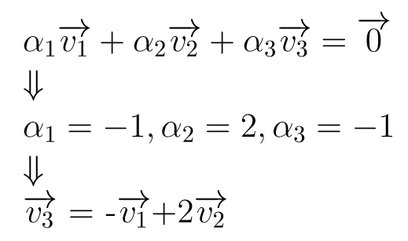

Example 2
Linearly dependent

Slide 5

Inverse matrix
Invertible: det(A)≠0

Slide 6
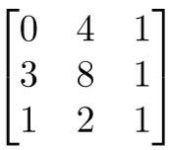

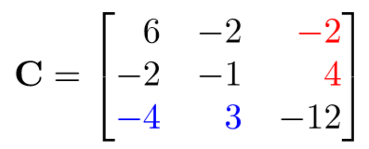

Example 3
Find the inverse of
Find the cofactor matrix C:
Compute the determinant:
Inverse of the matrix:

Slide 7

Eigenvalues and eigenvectors

Slide 8
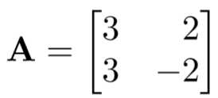

Example 4
Find the eigenvalues and the corresponding eigenvectors of the matrix

Slide 9
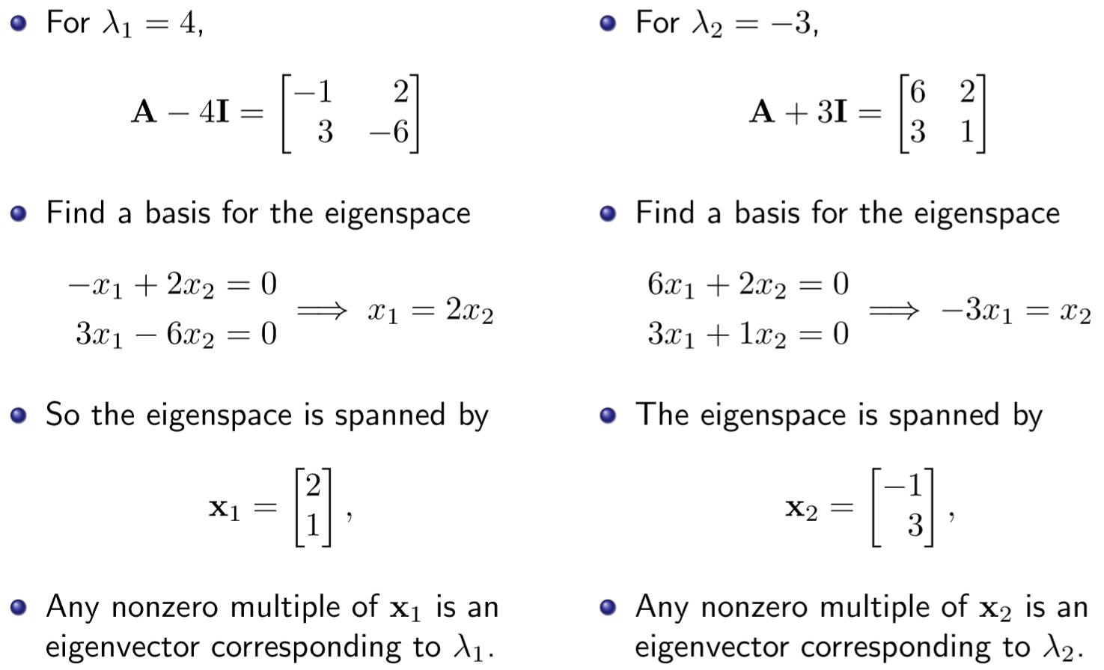

Slide 10

Solve system of linear equations
Cramer’s rule
Gaussian elimination (recommended)

Slide 11
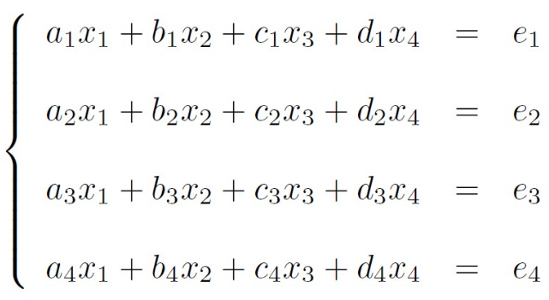
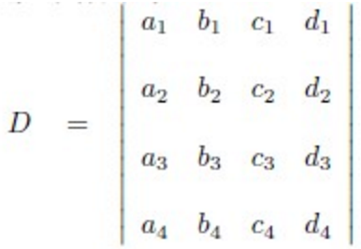
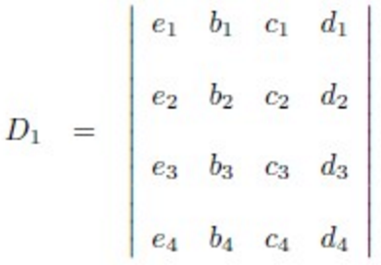
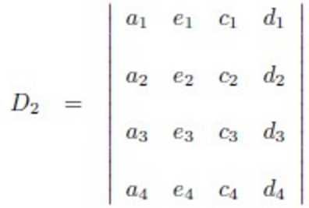
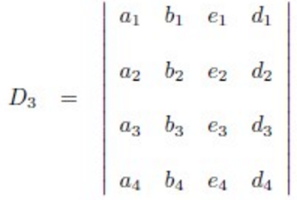
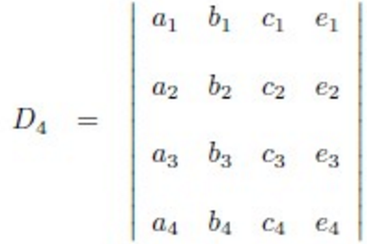
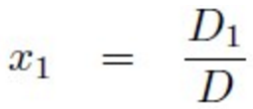
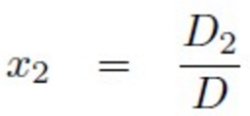
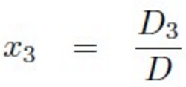
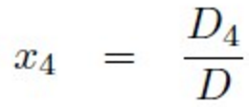
Cramer’s rule

Slide 12

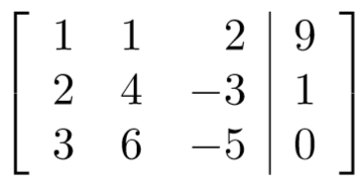
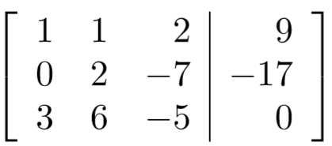
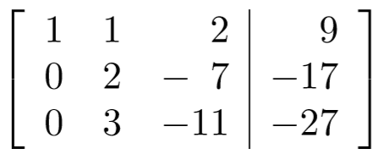
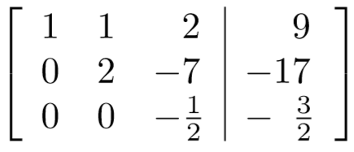
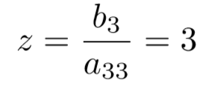


Gaussian elimination
Solve

Slide 13
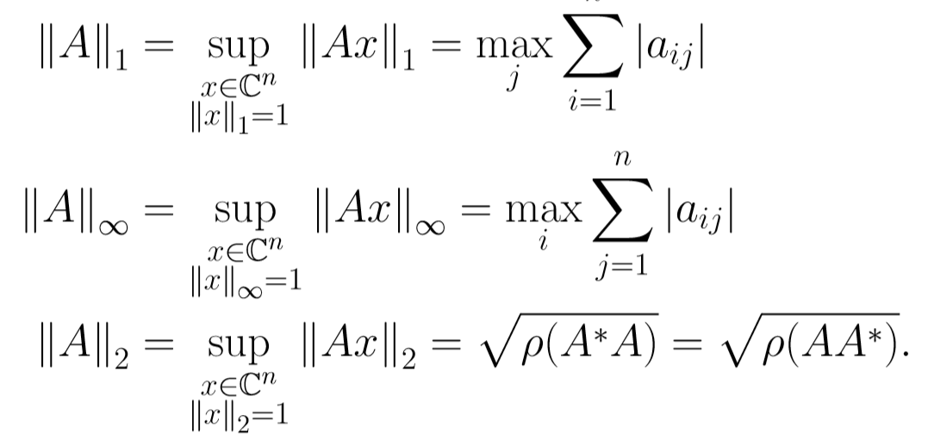
Homework
Matrix norm
For every square matrix A

Slide 14
Any questions?

Slide 15
Good Luck！

