Slide 1
Deliverable 2
https://github.com/LonelyRick/second-deliverable
Alejandro Ruiz
Marta Hidalgo
Patricia Cifrián
Rubén Llorente

Slide 2
Advanced data analysis on research publications

Slide 3

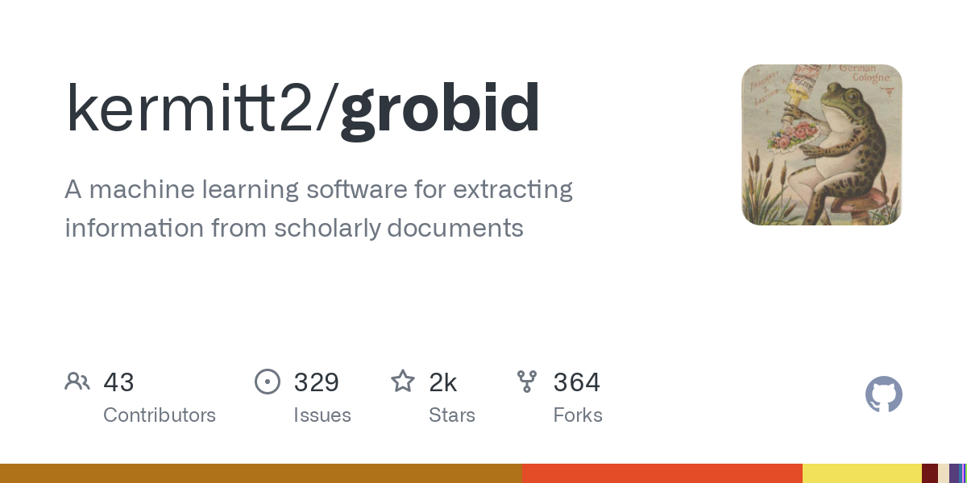
Data Sources
30 papers on different topics on artificial intelligence.
With Grobid we extract titles, acknowledgements and abstracts.
With the abstracts and the titles Spark eliminates the stop words.

Slide 4
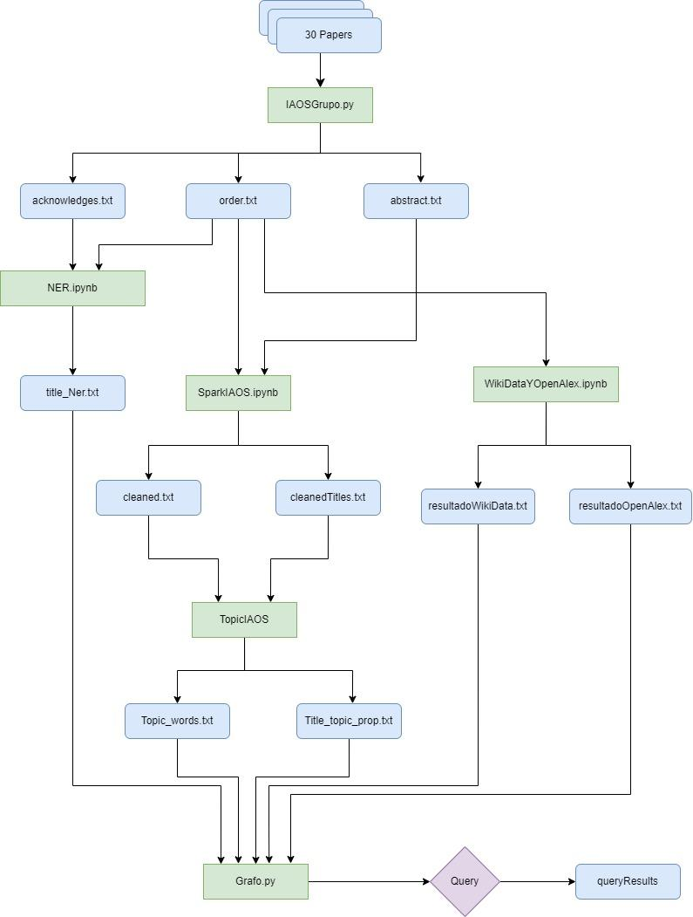
Steps
Data
Code
Query

Slide 5
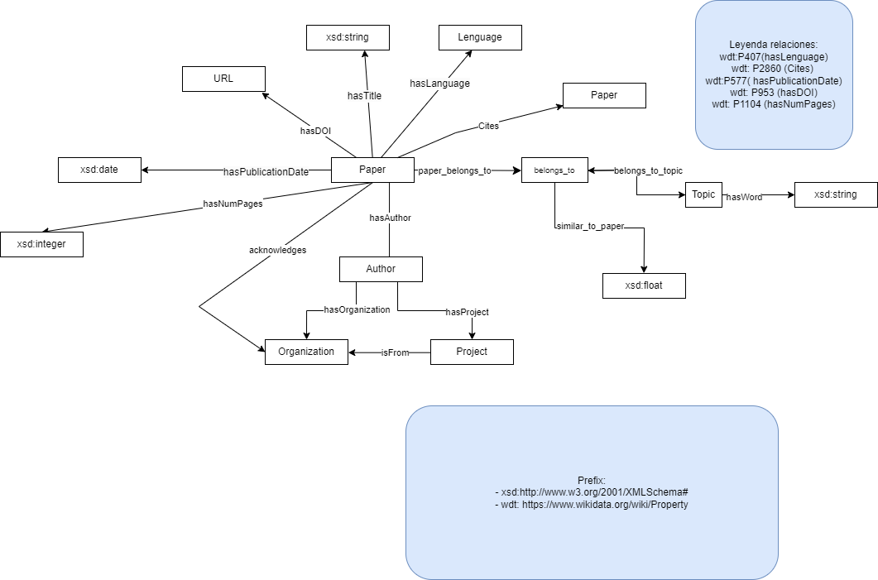
Ontology

Slide 6


How we have enriched our information?
SELECT DISTINCT ?doi ?cites ?num_pag ?publication_date ?language ?pages
WHERE {
?paper rdfs:label"Attention Is All You Need"@en.
OPTIONAL { ?paper wdt:P953 ?doi. }
OPTIONAL { ?paper wdt:P2860 ?cites. }
OPTIONAL { ?paper wdt:P1104 ?num_pag. }
OPTIONAL { ?paper wdt:P304 ?pages. }
OPTIONAL { ?paper wdt:P577 ?publication_date.}
OPTIONAL { ?paper wdt:P407 ?language. }
}
"https://api.openalex.org/works?search={title}"

Slide 7
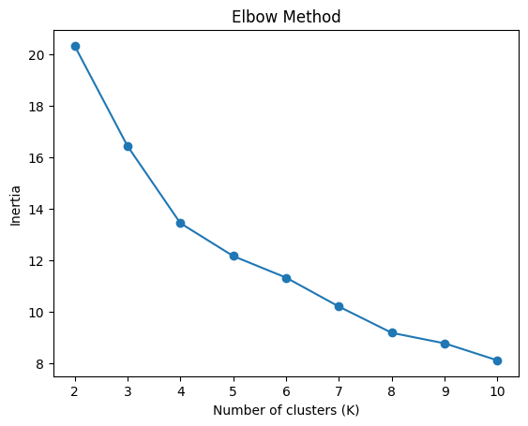
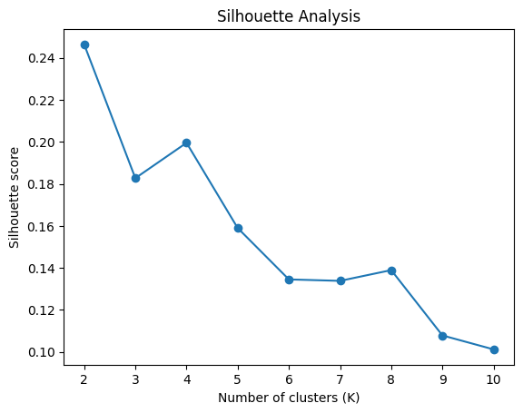
Validation

Slide 8

Best Practices
ReadME
Making Research Data accessible and reusable
Making Research Software accessible and reusable
Apache
License 2.0

Slide 9
DEMO
Time

Slide 10
Questions?

