Slide 1
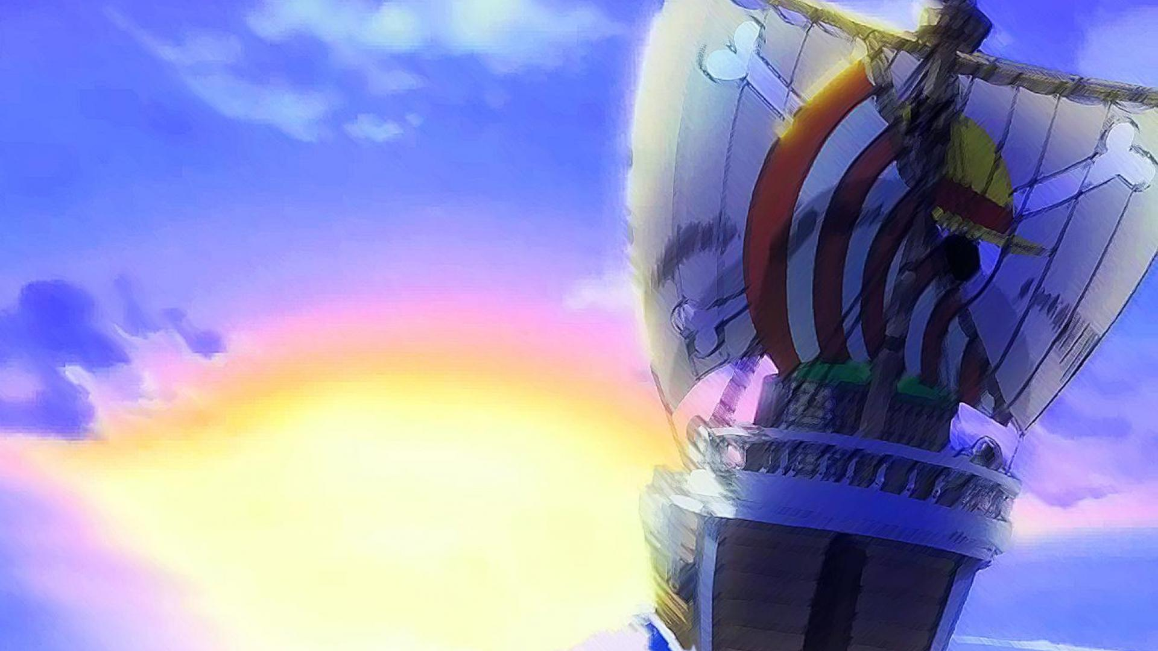
Introducing
One Piece
Epitome of Pirate Era
By Zaki Muzahid & Elman Pathan

Slide 2

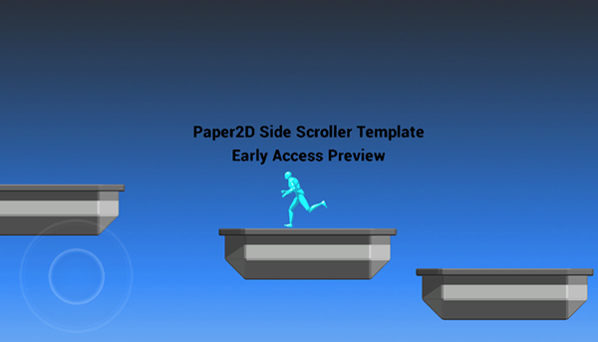
Introduction
2D Single Player
Side Scrolling genre
Adventure Fighting

Slide 3
Project Summary
Written in C Language
Libraries used :
- BGI (Borland Graphics Interface)
- Windows API
Compiler : Visual Studio 2012

Slide 4
Game Description
Story based adventure
Play as the protagonist
Defeat Enemies to proceed
Reach the end to win

Slide 5
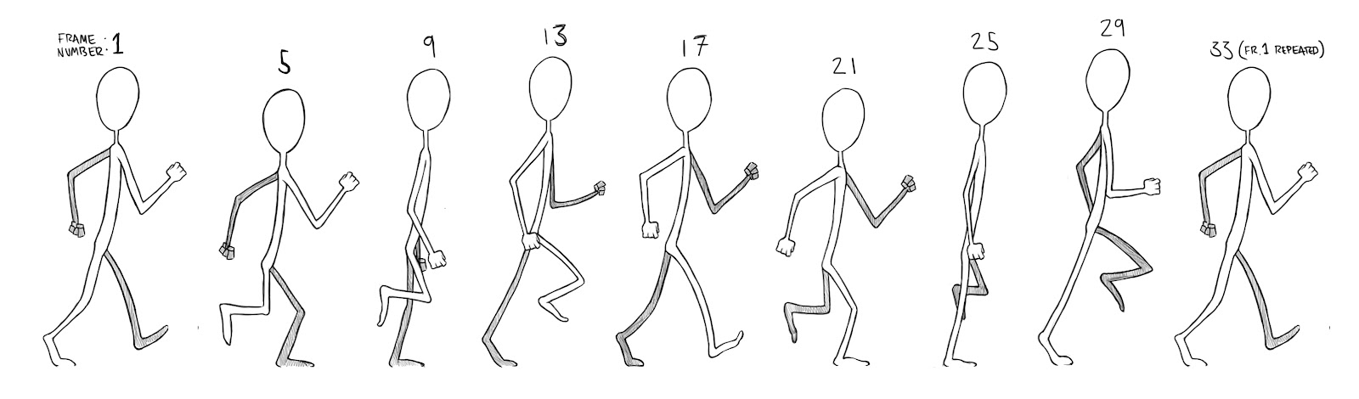
Image implementations
Sprites, (.gif)
“readimagefile()” function
Frame by Frame (Animation)

Slide 6



How to play
Keyboard Controls
Basic movements
Perform attacks on enemies
Beat all enemies to proceed

Slide 7



Artificial Intelligence
Controlled by the computer
No need of second player assist

Slide 8
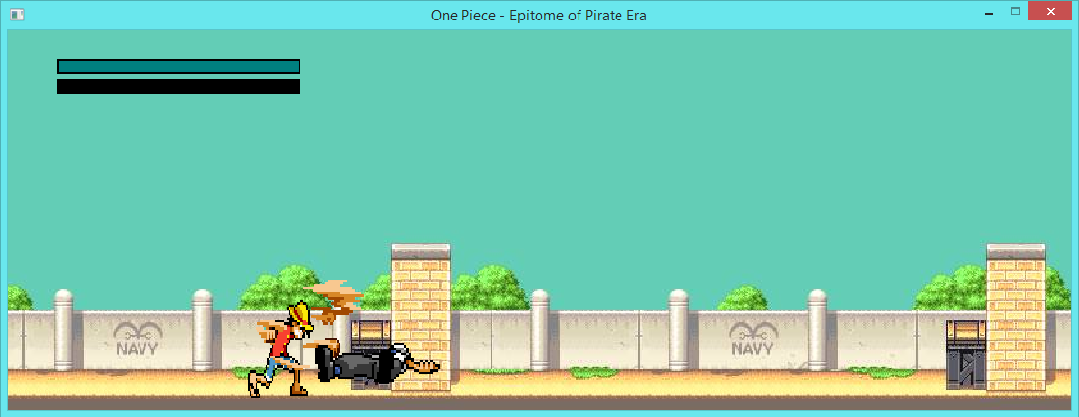
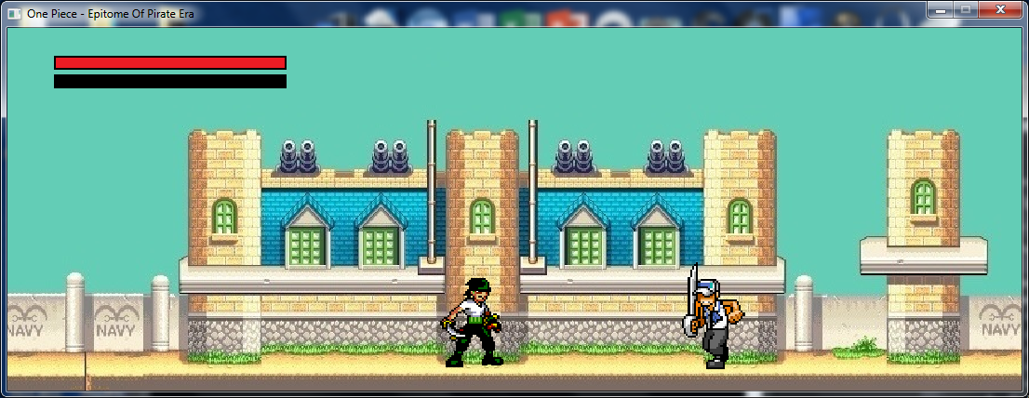
Gameplay

Slide 9
Begin
Flowchart
New Game
Loading/Control
Story
Gameplay
Level 1
No
Level Clearance
Game Over
Yes
Level 2
Yes
No
Level Clearance
End

Slide 10
Limitations
Flickering
Image Types
Artificial Intelligence (AI)
Image Types

Slide 11
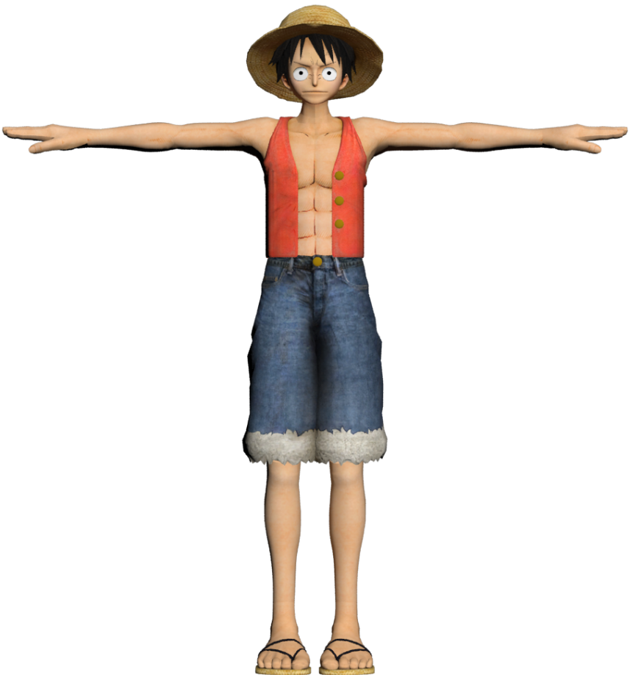
Future Scopes
More smooth
Better visuals
Less bugs
More functions
Sound effects

Slide 12
References
Programming in ANSI C By E.Balaguruswami
http://www.stackoverflow.com/
https://www.cs.colorado.edu/~main/bgi/doc/
http://www.spriters-resource.com/

Slide 13
Thank You
for your time

