Slide 1
Basic Signal and Image Processing Knowledge (1)
基礎信號與影像處理知識 (一)
丁建均 教授
國立台灣大學電信工程學研究所

Slide 2
Signal Processing and Image Processing 基礎知識
(1) 自修資料推薦
(2) Edge
(3) Corner
(4) Color and Intensity
(5) MSE and SSIM

Slide 3
(1) 自修資料推薦
(1-1) 影像處理合適的入門書籍
[1] Rafael C. Gonzalez and Richard E. Woods, Digital Image Processing, 3rd Edition, 2010
(淺顯易懂，不同科系背景的人都可以看得懂)
[2] Rafael C. Gonzalez, Richard E. Woods, Steven L. Eddins, Digital Image Processing Using MATLAB, 2010
(使用 Matlab 來處理影像的方法)

Slide 4
(1) 自修資料推薦
(1-2) 信號處理合適的入門書籍
[1] Alan V. Oppenheim, Alan S. Willsky, with Hamad Nawab, Signals and Systems, 2nd Ed., Prentice Hall, 1997
[2] Alan V. Oppenheim, Alan S. Willsky, with Hamad Nawab and Jian-Jiun Ding, Signals and Systems, 3rd ed., Prentice Hall, 2016
(信號與系統)
[3] Alan V. Oppenheim, Ronald W. Schafer, Discrete-Time Signal Processing, 3rd Edition, Prentice Hall, 2010
(數位信號處理)

Slide 5
(1) 自修資料推薦
(1-3) Matlab
Matlab 的入門書籍
洪維恩，Matlab 7 程式設計，旗標，台北市，2010.
(合適的入門書, 自學一週之內可完成)
張智星，Matlab 程式設計入門篇，第三版，碁峰，2011.
蒙以正，數位信號處理：應用 Matlab，旗標，台北市，2007.
繆紹綱譯，數位影像處理：運用-Matlab，東華，2005.
Matlab 的 commands 查詢
MathWorks
http://www.mathworks.com/
或是直接用 Google 查亦可

Slide 6
(1) 自修資料推薦
使用 Matlab Code 來讀與寫聲音檔、影像檔、Video 檔
http://disp.ee.ntu.edu.tw/class/聲音檔和%20Video%20檔的讀與寫.ppt

Slide 7
(1) 自修資料推薦
Images
Read images by Matlab
A = double(imread(‘filename’));
• For a gray-level image, A is a matrix.
0 ≤ A[m, n] ≤ 255
• For a color image, A contains 3 matrices.
0 ≤ A[m, n, c] ≤ 255
c = 1, 2, 3, which correspond to R, G, and B

Slide 8
(1) 自修資料推薦
(1-4) 其他鼓勵學習的程式語言
C++
Python
推薦入門書
B. Lubanovic, Introducing Python
中文版：
賴屹民譯, 精通Python : 運用簡單的套件進行現代運算, 碁峰資訊股份有限公司，台北市
林大貴，TensorFlow+Keras深度學習人工智慧實務應用，博碩，2017

Slide 9
(2) Edge
Simplest Method: Difference
A[m, n] – A[m, n-1] (horizontal axis)
n
11 | 10 | 10 | 10 | 12 | 11 | 10 | 9 | 10
10 | 10 | 11 | 10 | 10 | 10 | 10 | 11 | 9
10 | 10 | 9 | 150 | 150 | 150 | 10 | 10 | 10
10 | 10 | 160 | 160 | 155 | 160 | 158 | 10 | 11
10 | 10 | 158 | 160 | 161 | 161 | 160 | 150 | 10
10 | 155 | 160 | 163 | 164 | 165 | 160 | 151 | 10
10 | 148 | 160 | 160 | 162 | 160 | 155 | 10 | 12
8 | 10 | 140 | 150 | 152 | 150 | 10 | 11 | 10
9 | 12 | 10 | 10 | 10 | 10 | 9 | 10 | 10
 | -1 | 0 | 0 | 2 | -1 | -1 | -1 | 1
 | 0 | 1 | -1 | 0 | 0 | 0 | 1 | -2
 | 0 | -1 | 141 | 0 | 0 | -140 | 0 | 0
 | 0 | 150 | 0 | -5 | 5 | -2 | -148 | 1
 | 0 | 148 | 2 | 1 | 0 | -1 | -10 | -140
 | 145 | 5 | 3 | 1 | 1 | -5 | -9 | -141
 | 138 | 12 | 0 | 2 | -2 | -5 | -145 | 2
 | 2 | 130 | 10 | 2 | -2 | -140 | 1 | -1
 | 3 | -2 | 0 | 0 | 0 | -1 | 1 | 0
m

Slide 10
(2) Edge
Simplest Method: Difference
A[m, n] – A[m-1, n] (vertical axis)
11 | 10 | 10 | 10 | 12 | 11 | 10 | 9 | 10
10 | 10 | 11 | 10 | 10 | 10 | 10 | 11 | 9
10 | 10 | 9 | 150 | 150 | 150 | 10 | 10 | 10
10 | 10 | 160 | 160 | 155 | 160 | 158 | 10 | 11
10 | 10 | 158 | 160 | 161 | 161 | 160 | 150 | 10
10 | 155 | 160 | 163 | 164 | 165 | 160 | 151 | 10
10 | 148 | 160 | 160 | 162 | 160 | 155 | 10 | 12
8 | 10 | 140 | 150 | 152 | 150 | 10 | 11 | 10
9 | 12 | 10 | 10 | 10 | 10 | 9 | 10 | 10
-1 | 0 | 1 | 0 | -2 | -1 | 0 | 2 | -1
0 | 0 | -2 | 140 | 140 | 140 | 0 | -1 | 1
0 | 0 | 151 | 10 | 5 | 10 | 148 | 0 | 1
0 | 0 | -2 | 0 | 6 | 1 | 2 | 140 | -1
0 | 145 | 2 | 3 | 3 | 4 | 0 | 1 | 0
0 | -7 | 0 | -3 | -2 | -5 | -5 | -141 | 2
-2 | -138 | -20 | -10 | -10 | -10 | -145 | 1 | -2
1 | 2 | -130 | -140 | -142 | -140 | -1 | -1 | 0

Slide 11
Sobel Operator
(2) Edge
{2A[m, n+1] – 2A[m, n-1]+
A[m+1, n+1] –A[m+1, n-1]+
A[m-1, n+1] –A[m-1, n-1]}/4
A ∗
(horizontal axis)
11 | 10 | 10 | 10 | 12 | 11 | 10 | 9 | 10
10 | 10 | 11 | 10 | 10 | 10 | 10 | 11 | 9
10 | 10 | 9 | 150 | 150 | 150 | 10 | 10 | 10
10 | 10 | 160 | 160 | 155 | 160 | 158 | 10 | 11
10 | 10 | 158 | 160 | 161 | 161 | 160 | 150 | 10
10 | 155 | 160 | 163 | 164 | 165 | 160 | 151 | 10
10 | 148 | 160 | 160 | 162 | 160 | 155 | 10 | 12
8 | 10 | 140 | 150 | 152 | 150 | 10 | 11 | 10
9 | 12 | 10 | 10 | 10 | 10 | 9 | 10 | 10
 | 0 | 35 | 35.25 | 0.25 | -35.5 | -35 | -0.5
 | 37.25 | 107.5 | 69 | 0 | -69.25 | -107.25 | -37
 | 111.75 | 147.5 | 33.5 | 0.25 | -33.75 | -112.75 | -111
 | 149 | 114.5 | 1.25 | 1 | -0.75 | -46.5 | -149.25
 | 149.5 | 44.5 | 3.25 | 1.25 | -4 | -47.25 | -148.25
 | 145.5 | 43 | 5 | 0.5 | -40 | -113.25 | -109
 | 103.75 | 72.5 | 6.5 | 0 | -73 | -107 | -35.5

Slide 12
Sobel Operator
(2) Edge
{2A[m+1, n] – 2A[m-1, n]+
A[m+1, n+1] –A[m-1, n+1]+
A[m+1, n-1] –A[m-1, n-1]}/4
A ∗
(vertical axis)
11 | 10 | 10 | 10 | 12 | 11 | 10 | 9 | 10
10 | 10 | 11 | 10 | 10 | 10 | 10 | 11 | 9
10 | 10 | 9 | 150 | 150 | 150 | 10 | 10 | 10
10 | 10 | 160 | 160 | 155 | 160 | 158 | 10 | 11
10 | 10 | 158 | 160 | 161 | 161 | 160 | 150 | 10
10 | 155 | 160 | 163 | 164 | 165 | 160 | 151 | 10
10 | 148 | 160 | 160 | 162 | 160 | 155 | 10 | 12
8 | 10 | 140 | 150 | 152 | 150 | 10 | 11 | 10
9 | 12 | 10 | 10 | 10 | 10 | 9 | 10 | 10
 | -0.5 | 34.5 | 104.25 | 138.75 | 104 | 35 | 0.5
 | 37.25 | 112 | 148.5 | 147.5 | 148.25 | 111.25 | 37
 | 37.25 | 77 | 45 | 10.75 | 45.75 | 112.75 | 107.5
 | 72.5 | 37 | 3.75 | 6.5 | 5.25 | 37.5 | 70.75
 | 69.5 | 35.5 | 0.75 | 0.25 | -1.5 | -37.75 | -70.75
 | -78 | -49.5 | -14.5 | -13 | -48 | -113.75 | -107.5
 | -105.75 | -146.5 | -150.5 | -151 | -149.5 | -110.5 | -37

Slide 13
(2) Edge
Sobel Operator
{2A[m-1, n+1] – 2A[m+1, n-1]+
A[m-1, n] –A[m+1, n]+
A[m, n+1] –A[m, n-1]}/4
A ∗
(45°)
n
11 | 10 | 10 | 10 | 12 | 11 | 10 | 9 | 10
10 | 10 | 11 | 10 | 10 | 10 | 10 | 11 | 9
10 | 10 | 9 | 150 | 150 | 150 | 10 | 10 | 10
10 | 10 | 160 | 160 | 155 | 160 | 158 | 10 | 11
10 | 10 | 158 | 160 | 161 | 161 | 160 | 150 | 10
10 | 155 | 160 | 163 | 164 | 165 | 160 | 151 | 10
10 | 148 | 160 | 160 | 162 | 160 | 155 | 10 | 12
8 | 10 | 140 | 150 | 152 | 150 | 10 | 11 | 10
9 | 12 | 10 | 10 | 10 | 10 | 9 | 10 | 10
 | 0.25 | 0.25 | -33.75 | -104 | -104.75 | -70.25 | -0.5
 | 0.25 | -2.25 | -77.25 | -111.25 | -145 | -146.5 | -74.25
 | 37 | 70.25 | -7.75 | -7.75 | -77.5 | -150.5 | -146.75
 | 75.75 | 40 | -2.5 | -3.5 | -4.5 | -80.75 | -147.25
 | 77 | 7.5 | 1.5 | 0.75 | -1.75 | -7.25 | -75
 | 149.75 | 84.5 | 15.75 | 10.5 | 6 | 0.5 | -0.75
 | 142.5 | 146.5 | 116.5 | 113 | 74.5 | 1.75 | 1.5
m

Slide 14
(2) Edge
Sobel Operator
{2A[m-1, n-1] – 2A[m+1, n+1]+
A[m-1, n] –A[m+1, n]+
A[m, n-1] –A[m, n+1]}/4
A ∗
(135°)
n
11 | 10 | 10 | 10 | 12 | 11 | 10 | 9 | 10
10 | 10 | 11 | 10 | 10 | 10 | 10 | 11 | 9
10 | 10 | 9 | 150 | 150 | 150 | 10 | 10 | 10
10 | 10 | 160 | 160 | 155 | 160 | 158 | 10 | 11
10 | 10 | 158 | 160 | 161 | 161 | 160 | 150 | 10
10 | 155 | 160 | 163 | 164 | 165 | 160 | 151 | 10
10 | 148 | 160 | 160 | 162 | 160 | 155 | 10 | 12
8 | 10 | 140 | 150 | 152 | 150 | 10 | 11 | 10
9 | 12 | 10 | 10 | 10 | 10 | 9 | 10 | 10
 | 0.75 | -69.75 | -104.75 | -104.5 | -33.75 | 0.25 | 0
 | -74.75 | -147.25 | -144.75 | -111.25 | -76.5 | -2 | -0.25
 | -111.5 | -149.75 | -77.25 | -8.25 | -8.5 | 0 | 1.75
 | -148.25 | -114 | -3.5 | -5 | -3.5 | 6.75 | 76.25
 | -147 | -77.5 | -3 | -0.75 | 4.25 | 80.25 | 146.5
 | -66.25 | 4.5 | 6.75 | 9.5 | 82.5 | 152 | 145.75
 | 1 | 71.5 | 109.5 | 113 | 149.5 | 146.25 | 72.5
m

Slide 15
(2) Edge
Laplacian Operator
{8A[m, n] –A[m+1, n] –A[m-1, n]
–A[m+1, n-1]–A[m, n-1] – A[m-1, n-1]
–A[m+1, n+1]–A[m, n+1] – A[m-1, n+1]}/8
A ∗
n
11 | 10 | 10 | 10 | 12 | 11 | 10 | 9 | 10
10 | 10 | 11 | 10 | 10 | 10 | 10 | 11 | 9
10 | 10 | 9 | 150 | 150 | 150 | 10 | 10 | 10
10 | 10 | 160 | 160 | 155 | 160 | 158 | 10 | 11
10 | 10 | 158 | 160 | 161 | 161 | 160 | 150 | 10
10 | 155 | 160 | 163 | 164 | 165 | 160 | 151 | 10
10 | 148 | 160 | 160 | 162 | 160 | 155 | 10 | 12
8 | 10 | 140 | 150 | 152 | 150 | 10 | 11 | 10
9 | 12 | 10 | 10 | 10 | 10 | 9 | 10 | 10
 | -0.13 | -16.38 | -35.25 | -52.88 | -35.38 | -17.63 | 1.25
 | -18.75 | -56.13 | 66.88 | 49.38 | 67.13 | -54.88 | -18.63
 | -37.13 | 76.63 | 22.13 | -1.50 | 21.88 | 56.63 | -54.88
 | -74.13 | 35.75 | -0.13 | 0.00 | 0.63 | 20.63 | 66.25
 | 71.75 | 20.75 | 2.38 | 2.50 | 4.63 | 21.00 | 67.63
 | 66.38 | 24.25 | 3.63 | 4.00 | 20.25 | 52.88 | -54.88
 | -52.13 | 57.50 | 49.50 | 50.50 | 66.50 | -54.38 | -17.25
m

Slide 16
(2) Edge
General form of the 1-D edge detection filter
(1) h[n] = − h[−n]
(2) |h[n₁]| ≤ |h[n₂]| if |n₁| > |n₂|
General form of the 2-D edge detection filter
(1) h[m, n] = − h[−m, −n]
(2) |h[cn₁, cn₂]| ≤ | h[n₁, n₂]| if c > 1
(1) 任何能量隨著 |n| 遞減的 odd function，都可以當成 edge detection filter
(2) The edge detection filter is in fact a matched filter.

Slide 17
(2) Edge
without noise
with noise

Slide 18
(2) Edge
(long impulse response)

Slide 19
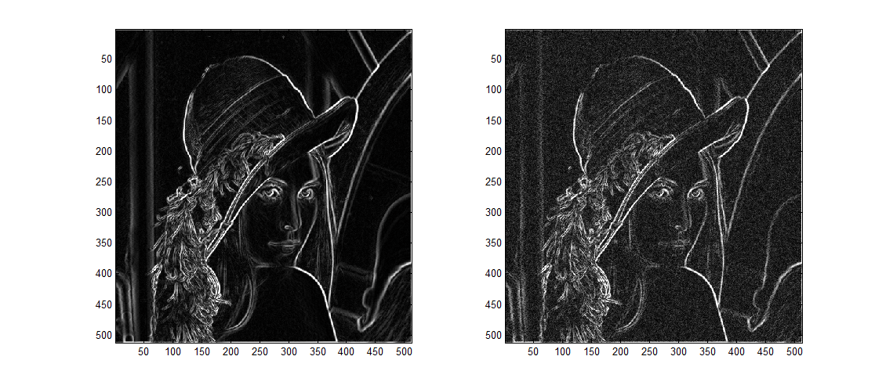
(2) Edge
Short impulse response
without noise
with noise

Slide 20
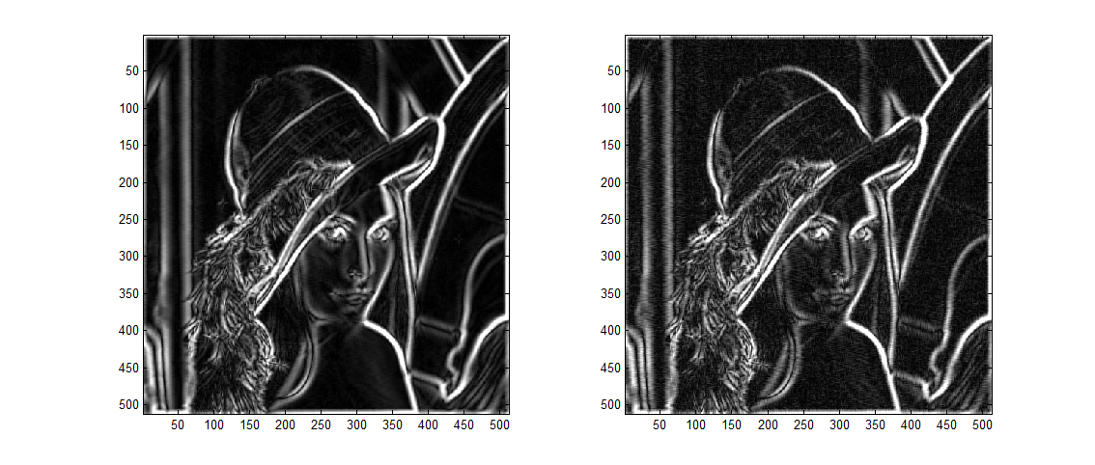
(2) Edge
Long impulse response
without noise
with noise

Slide 21
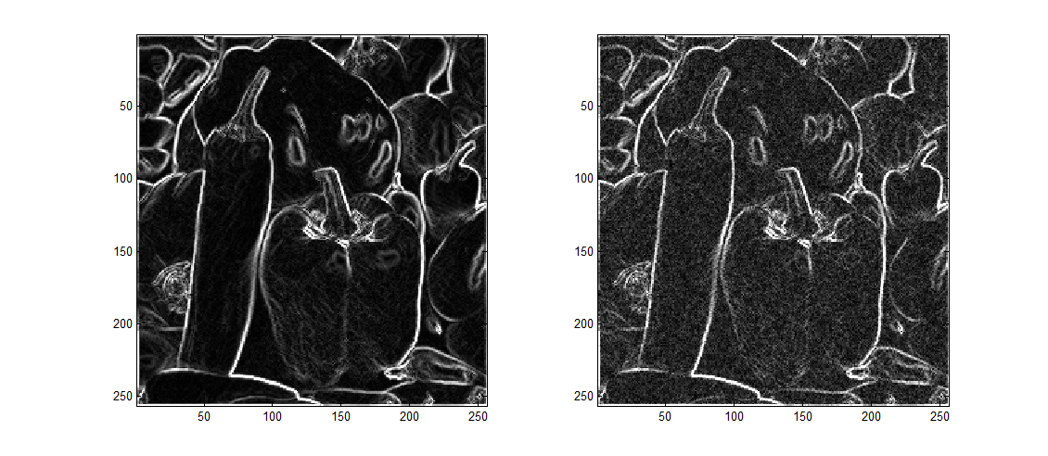
(2) Edge
Short impulse response
without noise
with noise

Slide 22
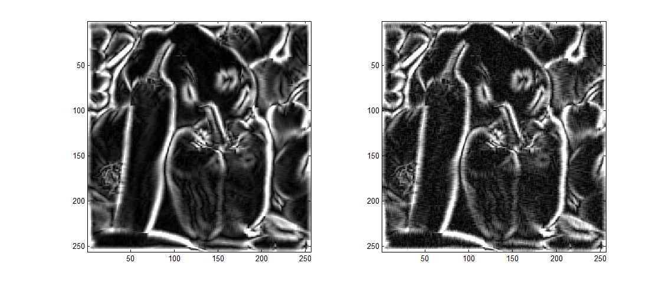
(2) Edge
Long impulse response
without noise
with noise

Slide 23
(2) Edge
Well-known Advanced Edge Detection Operator
(a) Difference of Gaussian (DoG)
(b) Canny’s Edge Detection Filter
edge(I, 'Canny');
Canny, J. (1986). A computational approach to edge detection. IEEE Transactions on Pattern Analysis and Machine Intelligence, (6), 679-698.

Slide 24



(3) Corner
The edge pixel has large variation along one direction
The corner pixel has large variation along two directions

Slide 25
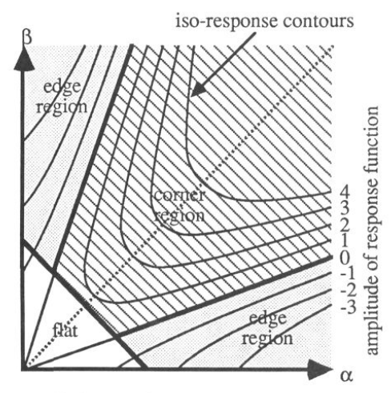
(3) Corner
α, β :
the variation along two axes
C. Harris and M. Stephens, “A combined corner and edge detection”, Proc. 4th Alvey Vision Conf., 1988, pp. 147-151.

Slide 26
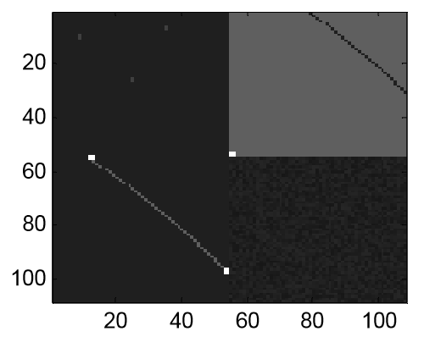
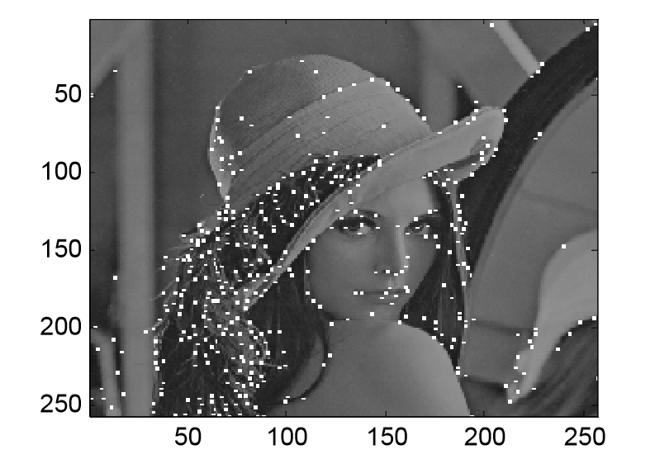
(3) Corner
PEI, Soo-Chang; DING, Jian-Jiun. Improved Harris' Algorithm for Corner and Edge Detections. In: 2007 IEEE International Conference on Image Processing. IEEE, 2007, p. III-57-III-60.
Pei, S. C., & Ding, J. J. (2005, September). New corner detection algorithm by tangent and vertical axes and case table. In IEEE International Conference on Image Processing 2005 (Vol. 1, pp. I-365). IEEE.

Slide 27
(4) Color and Intensity
三原色：R, G, B
對應人類感光細胞的三種錐狀體
波長 R > G > B
頻率 B > G > R

Slide 28
(4) Color and Intensity
亮度 Y 和 R, G, B 之間的關係
Y = 0.299R + 0.587G + 0.114B
RGB 不是唯一的座標系
RGB to YCbCr 轉換
此外，尚有 RGB to HSV (hue, saturation, intensity)
RGB to XYZ
RGB to Lab 等轉換

Slide 29
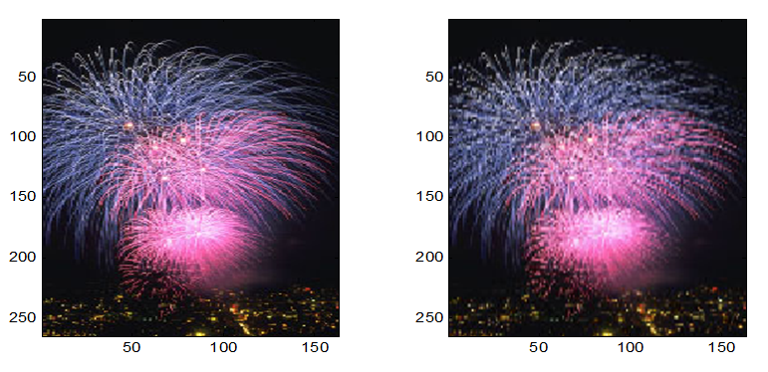
(4) Color and Intensity
原圖 直接在縱軸取一半的pixels 再還原

Slide 30
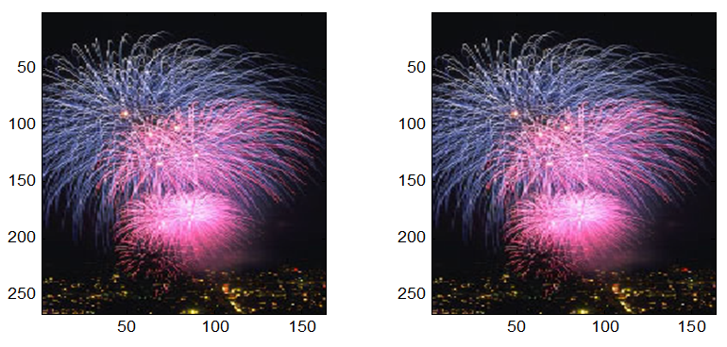
(4) Color and Intensity
Y 不變
CbCr在縱軸取一半的pixels 再還原
Y 不變
CbCr在縱軸及橫軸取一半的pixels 再還原

Slide 31
(4) Color and Intensity
Lighten and Darken
Y_{o} = f(Y)
Lighten
f(0) = 0, f(255) = 255,
f(Y₁) > f(Y₂) if Y₁ > Y₂
f(Y) > Y if 0 < Y < 255
Darken
f(0) = 0, f(255) = 255,
f(Y₁) > f(Y₂) if Y₁ > Y₂
f(Y) < Y if 0 < Y < 255

Slide 32
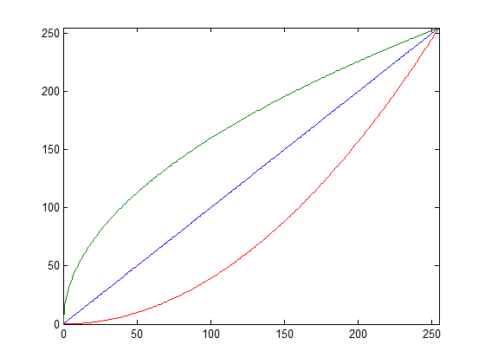
(4) Color and Intensity
Examples of the mapping function for Lighten and Darken
The cosine function, the hyperbolic tangent function, and many other functions have similar effect.
α < 1: lighten, α > 1: darken
α = 0.5
α = 2

Slide 33
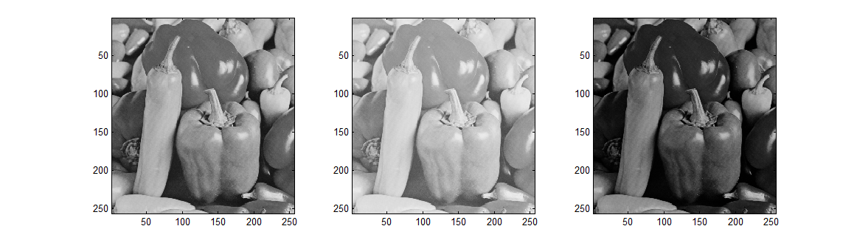
(4) Color and Intensity
Original image
lighten
darken

Slide 34
(4) Color and Intensity
Lighten and Darken for color image
Y_{o} = f(Y)
Output
Input
YCbCr
Cb unchanged
Cr unchanged
YCbCr to RGB
RGB to YCbCr
Lighten
f(0) = 0, f(255) = 255,
f(Y₁) > f(Y₂) if Y₁ > Y₂
f(Y) > Y if 0 < Y < 255
Darken
f(0) = 0, f(255) = 255,
f(Y₁) > f(Y₂) if Y₁ > Y₂
f(Y) < Y if 0 < Y < 255

Slide 35
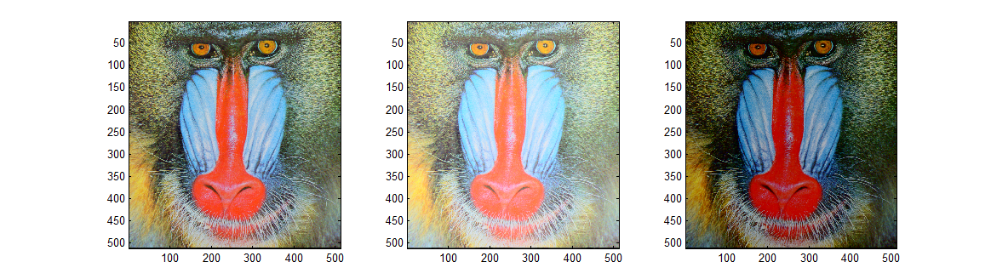
(4) Color and Intensity
Original image
lighten
darken

Slide 36
(4) Color and Intensity
視覺和 intensity
Intensity 範圍是從 0 至 255
但人眼會覺的 intensities 150 和 200 之間的差異，會比 intensities 0 和 50 之間的差異明顯
(Intensities 中間的部分的差異會較為明顯)

Slide 37
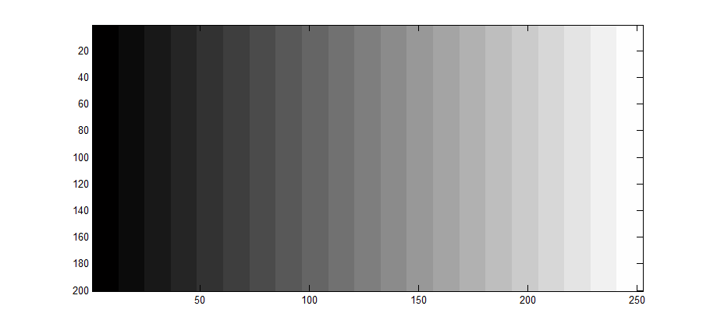
(4) Color and Intensity
Intensity 由 0 至 255, 每一個相鄰長條的 intensities 差 12.75

Slide 38
(5) MSE and SSIM
There are several ways to measure the difference / similarity between two images.
傳統量測兩個信號 (including images, videos, and vocal signals) 之間相似度的方式：
(1) maximal error
(2) mean square error (MSE)
(3) normalized mean square error (NMSE)
(4) normalized root mean square error (NRMSE)

Slide 39
(5) MSE and SSIM
(5) signal to noise ratio (SNR)，信號處理常用
(6) peak signal to noise ratio (PSNR)，影像處理常用
X_{Max}: the maximal possible value of x[m, n]
In image processing, X_{Max} = 255
for color image:
color = R, G, or B

Slide 40
(5) MSE and SSIM
然而，MSE 和 NRMSE 雖然在理論上是合理的，但卻無法反映出實際上兩個影像之間的相似度
例如：以下這三張圖
圖一
圖二
圖三
圖三 = 圖一 × 0.5 + 255.5 × 0.5
照理來說，圖一和圖三較相近
然而，圖一和圖二之間的 NRMSE 為 0.4411
圖一和圖三之間的 NRMSE 為 0.4460

Slide 41


(5) MSE and SSIM
(7) Structural Similarity (SSIM)
有鑑於 MSE 和 PSNR 無法完全反映人類視覺上所感受的誤差，在 2004 年被提出來的新的誤差測量方法
μ_{x}, μ_{y}: means of x and y
σ_{x}², σ_{y}²: variances of x and y
σ_{xy}: covariance of x and y
c₁, c₂: adjustable constants
L: the maximal possible value of x − the minimal possible value of x = 255
Z. Wang, A. C. Bovik, H. R. Sheikh, and E. P. Simoncelli, “Image quality assessment: from error visibility to structural similarity,” IEEE Trans. Image Processing, vol. 13, no. 4, pp. 600−612, Apr. 2004.

Slide 42
(5) MSE and SSIM
若使用 SSIM，且前頁的 c₁, c₂ 皆選為
圖一、圖二之間的 SSIM 為 0.1040
圖一、圖三之間的 SSIM 為 0.7720
反映出了圖一、圖三之間確實有很高的相似度

Slide 43
(5) MSE and SSIM
其他幾個用 MSE 和 NRMSE 無法看出相似度，但是可以用 SSIM 看出相似度的情形
影子 shadow
圖四
圖五
NRMSE = 0.4521 (大於圖一、圖二之間的 NRMSE)
SSIM = 0.6010

Slide 44
(5) MSE and SSIM
底片 the negative of a photo
圖六
圖七
圖七 = 255 － 圖六
NRMSE = 0.5616 (大於圖一、圖二之間的 NRMSE)
SSIM = -0.8367 (高度負相關)

Slide 45
(5) MSE and SSIM
同形，但亮度不同 (Same shape but different intensity)
圖八
圖九
NRMSE = 0.4978 (大於圖一、圖二之間的 NRMSE)
SSIM = 0.7333

Slide 46
Practice
(1) Read these PowerPoint files
(2) Determine the edges of an image for different directions according to ALL of the methods on pages 9-15.
(將結果取絕對值、乘常數之後，用 graylevel 的方式畫出) image(C*abs(E)); % E: edge detection result
colormap(gray(256))
(3) 依據 page 34 和 page 32 的方式，將影像調亮、調暗
(4) 用 pages 38, 39, 41 的式子，寫出量測兩個信號 NRMSE, PSNR, 和 SSIM 的程式
下次討論要帶隨身碟，讓我看程式碼

