Slide 1

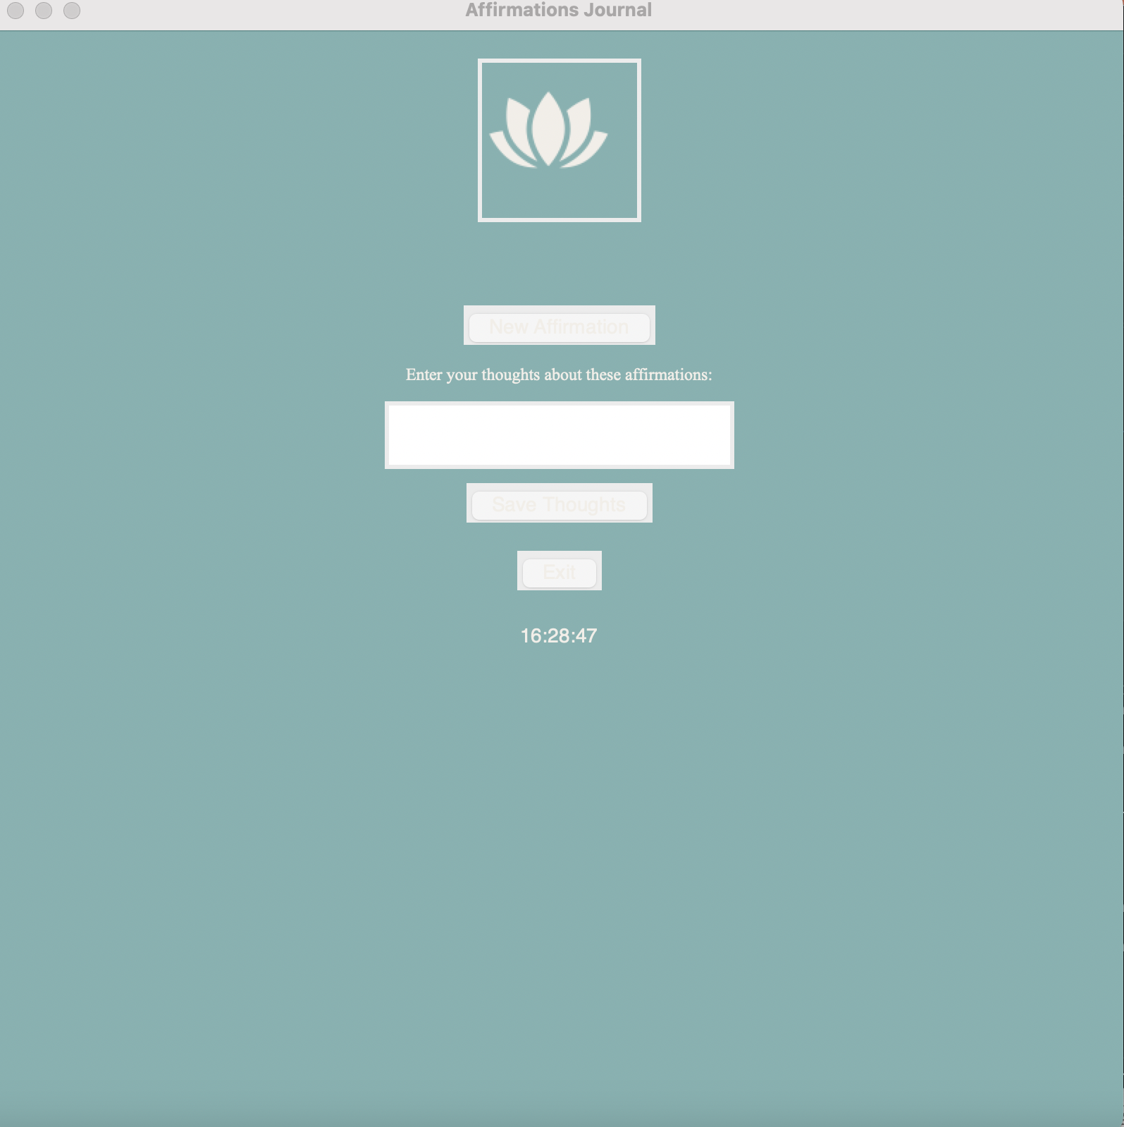
AFFIRMATIONS+: An app that integrates affirmations into your life and your phone!
Team Members: Michael Tait

