Slide 1
Clustering Project
February 16, 2023

Slide 2
Part 1
Customer Demographics Table
Goal: to interpret and segment our customers in clusters from a particular bank
Dataset 747 rows and 15 columns

Slide 3
Analytical Process

Slide 4
Involved: one-hot encoding (marital status) and binning (age) but dropped them; after, scaled the income (log) and label encoder (city names)
Loading the .csv file into a dataframe
K = 3 clusters checked with elbow method (lower inertia) and silhouette score
Data Gathering
Data Selection and Feature Engineering
EDA
PCA
Clustering
Data cleaning and preparation (e.g. Null, missing values, dtypes, outliers, changing cat-num values (genre) etc.)
DF (645 rows and 7 columns): it was scaled and performed PCA

Slide 5
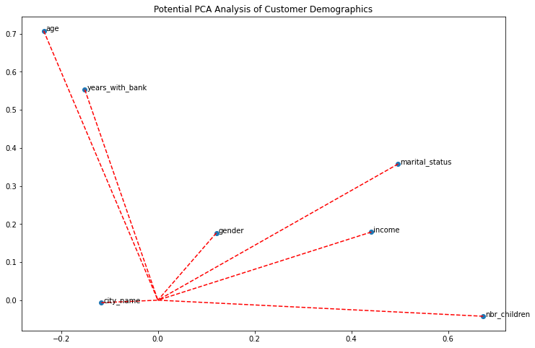

Slide 6
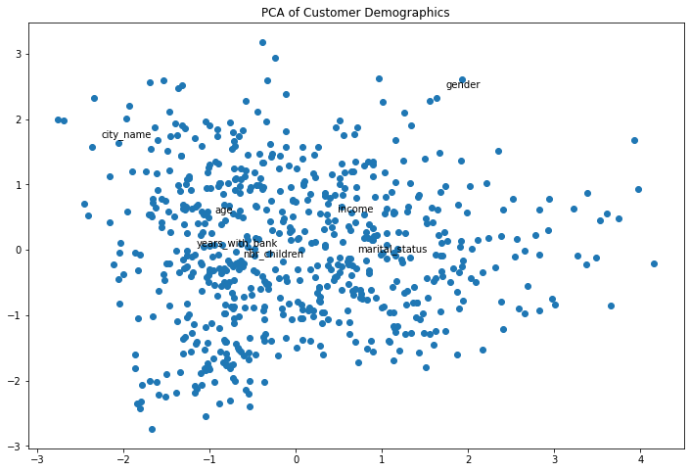

Slide 7
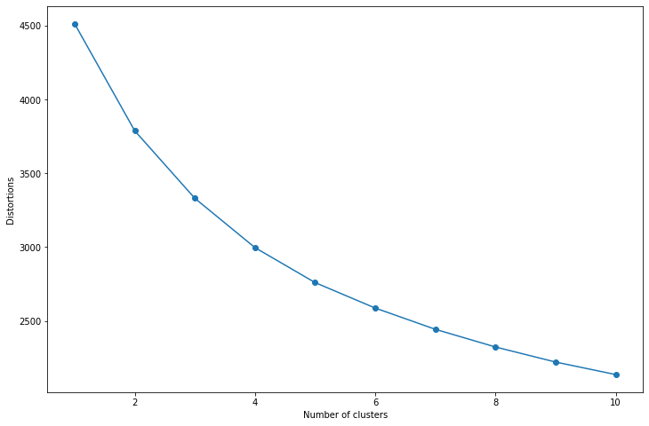
We can see by checking the elbow rule that the number of clusters pointed out where the model can be maximized could be between 3 and 6 because after that the graph doesn't decline much and there is no much variation after that.

Slide 8
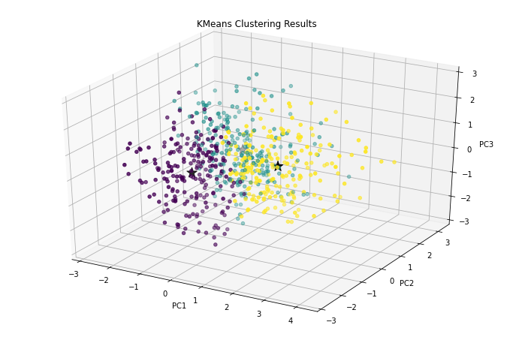
As the inertia is a measure of the sum of squared distances between each data point and its assigned cluster center, a lower inertia generally indicates better clustering, as it means the data points within each cluster are closer to their cluster center.
The inertia has a value of 1412.416690750788 so we should plot it to try visualize how the clusters are distributed.

Slide 9
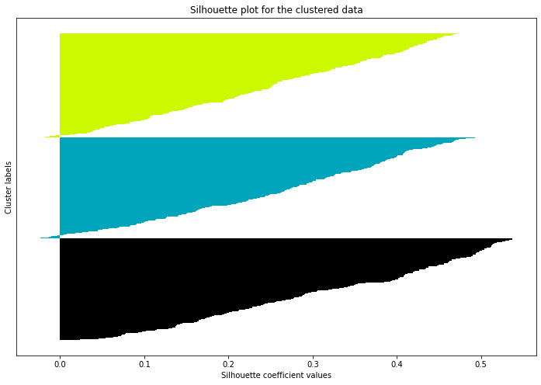
We checked the difference of the score between There wasn't much difference k = 3 and k = 4 and there wasn't almost any difference, so we stayed with k =3

Slide 10
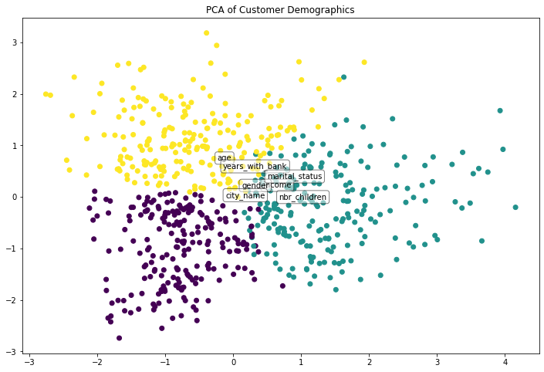
After plotting the data with different clusters sizes, it is noted that the k-means of 3 clusters provide the best min distance from their center and the best max distance of their neighborhood centers.

Slide 11
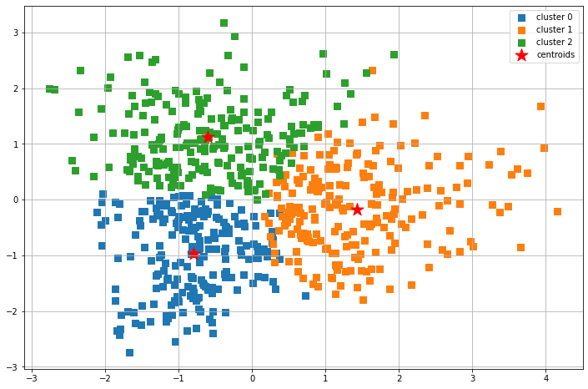

Slide 12
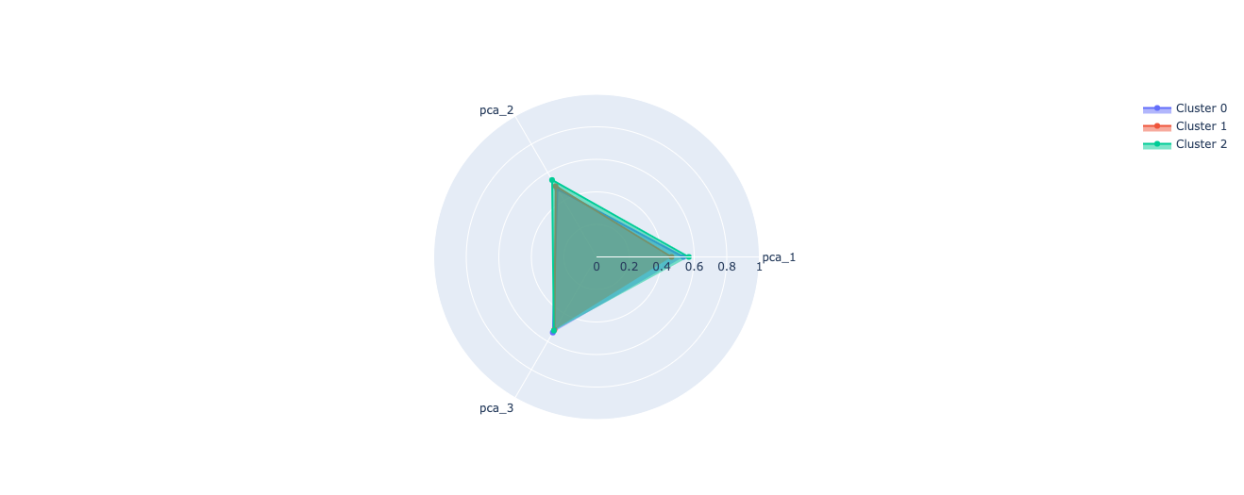

Slide 13
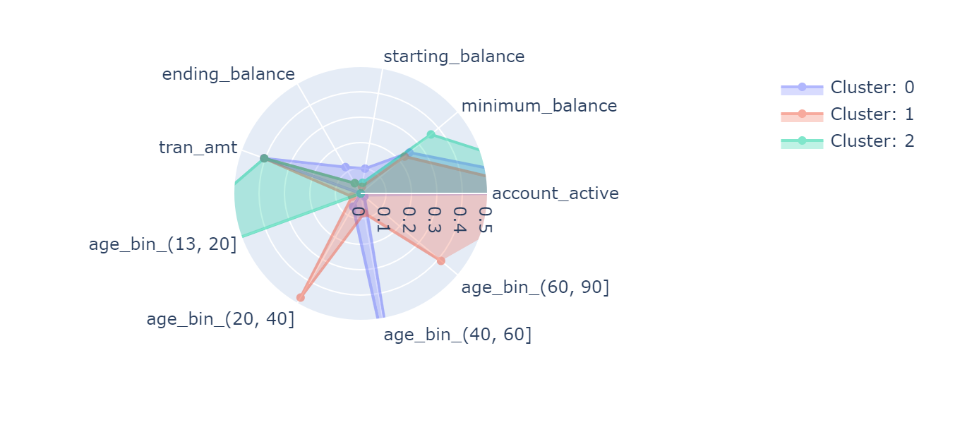
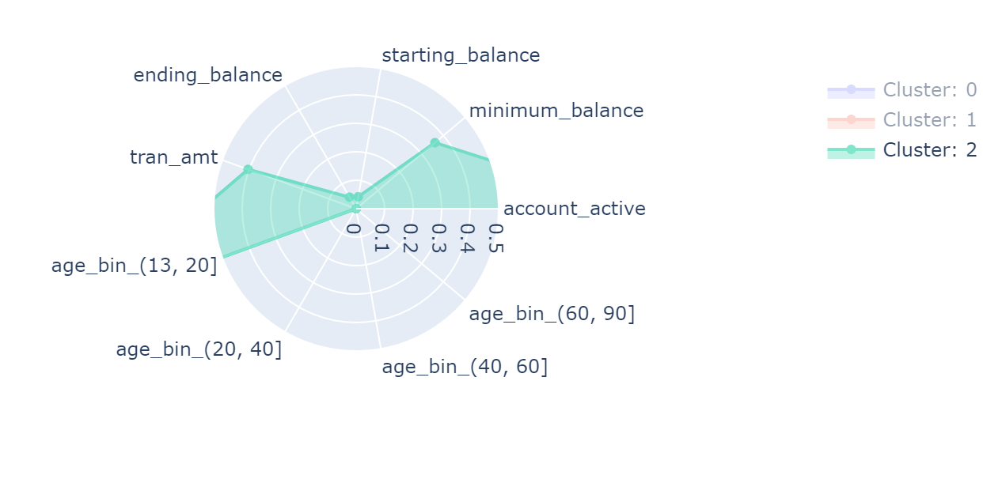
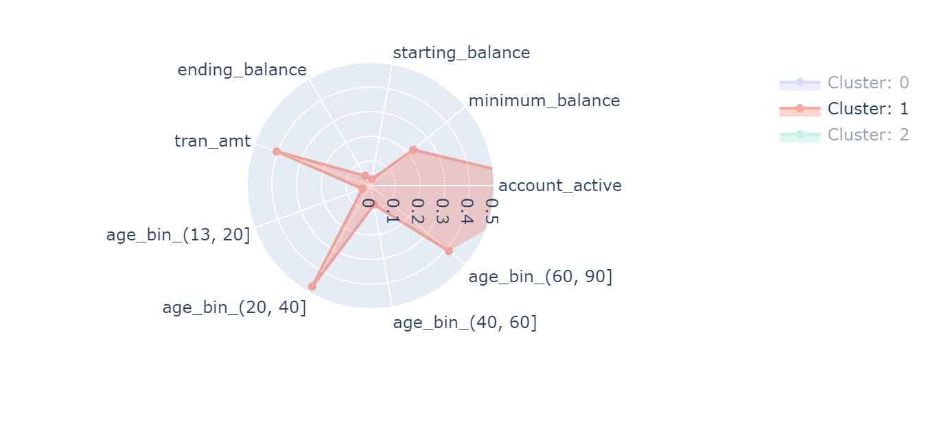
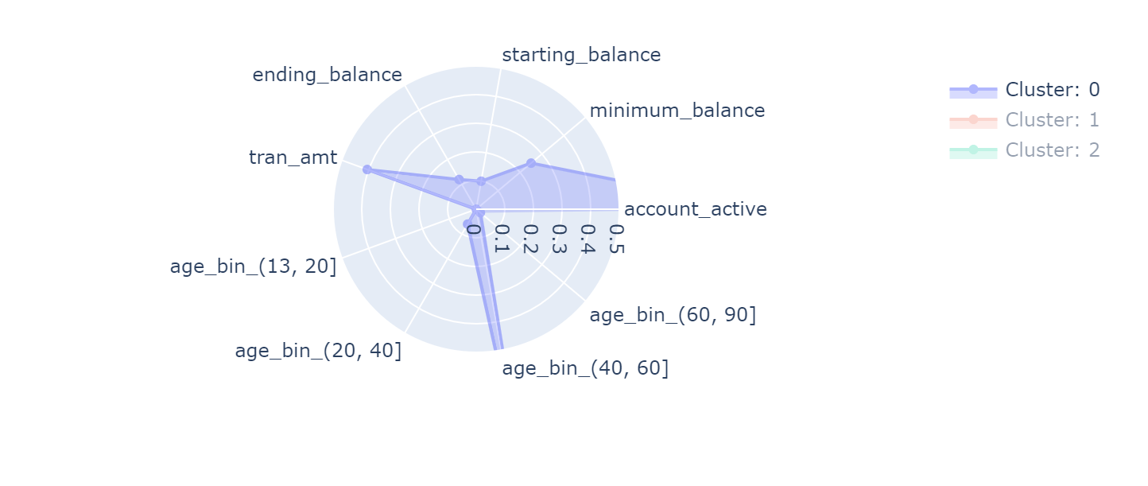
Saving Account

Slide 14
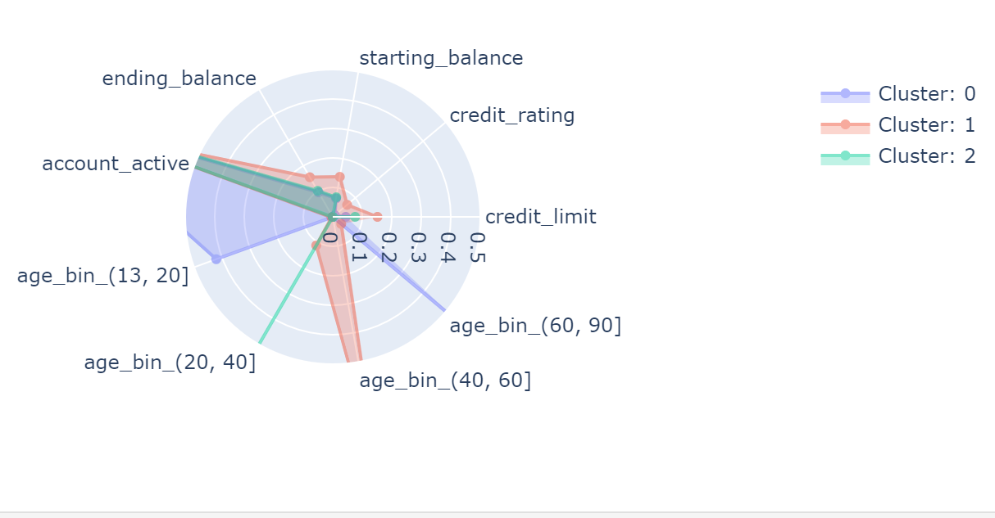
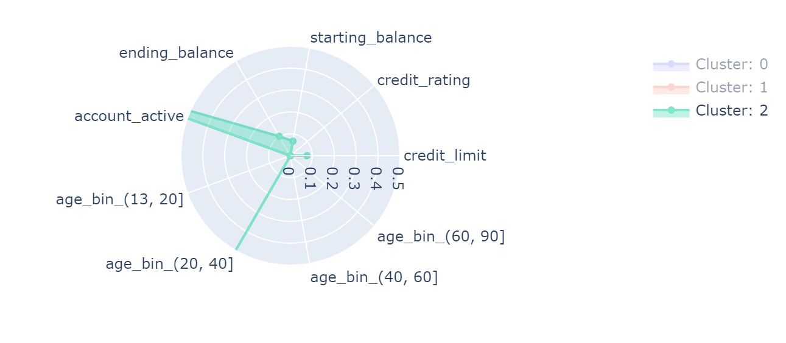
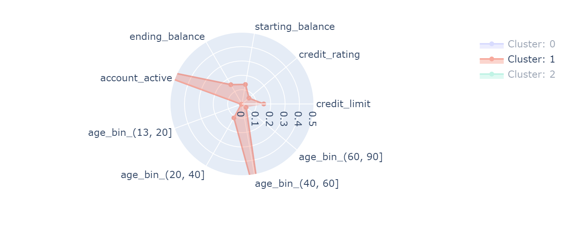
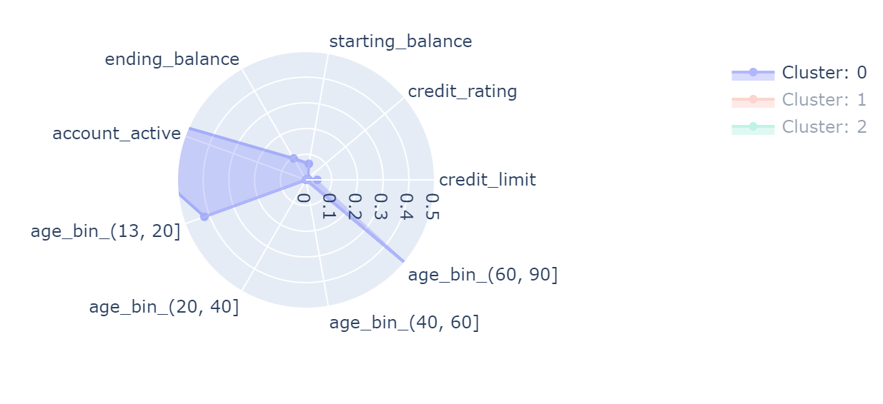
Credit Account

