Slide 1

Flight Prediction Project
Ali Faisal Raza
Colin Tran

Slide 2
Agenda
Project Flow Structure
Exploratory Data Analysis
Results
Biggest Challenge

Slide 3
Project flow structure
Retrieve weather data
Cleaning data
Perform EDA
Feature Engineering
Building Model
Model Evaluation

Slide 4
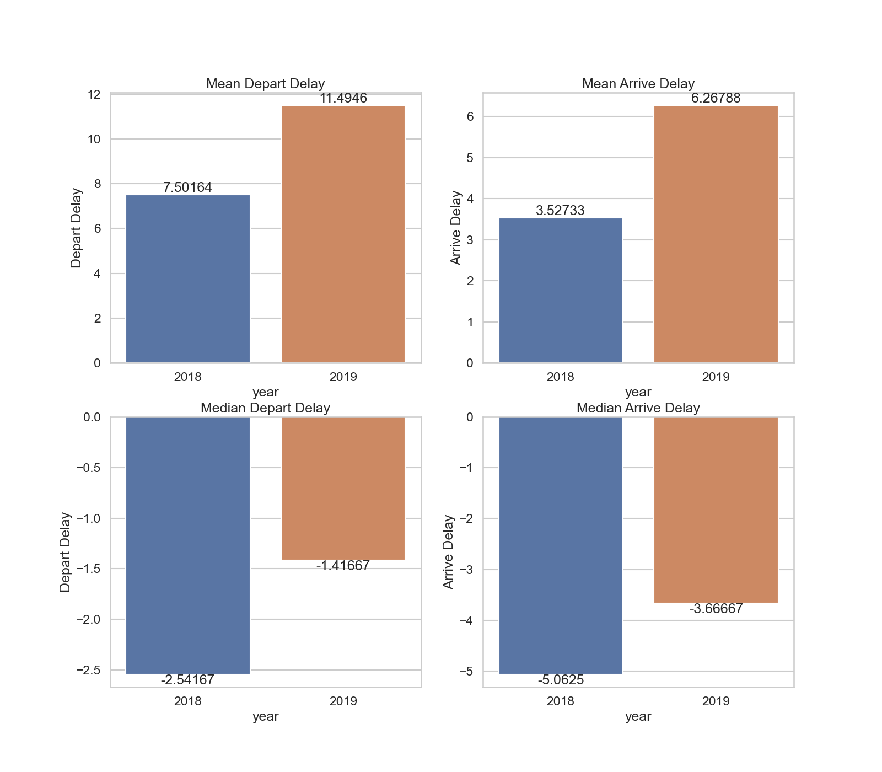
eda
In 2019, the average duration of flight delay was roughly 177% greater than it was in 2018

Slide 5
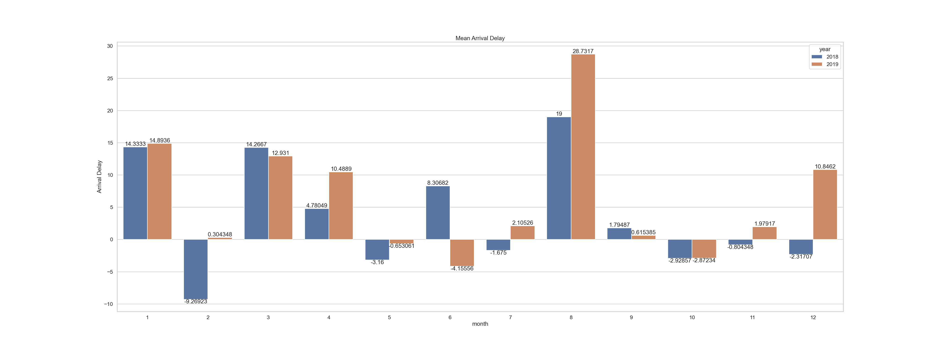
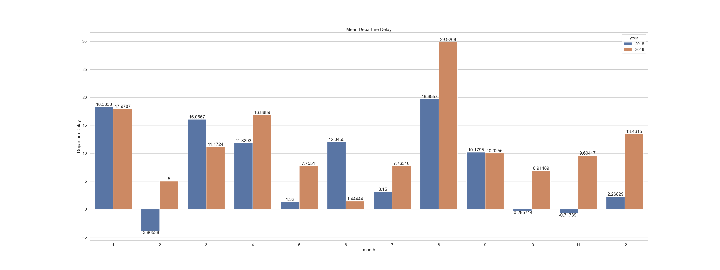
EDA
August has the highest average flight delay in both 2018 and 2019

Slide 6
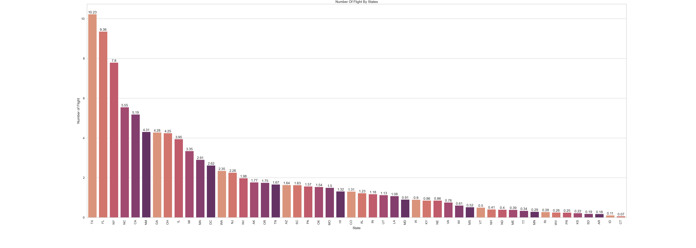
EDA
There are 7 states that cover 50% of US air traffic
Texas
Florida
New York
North Carolina
California
New Mexico
Georgia

Slide 7
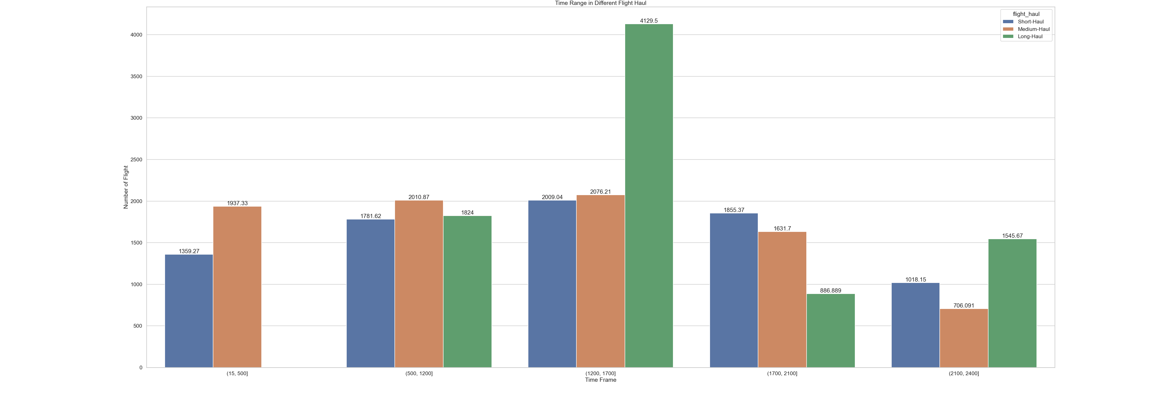
EDA
Most of the long-haul flight takes off from 12pm-17pm

Slide 8
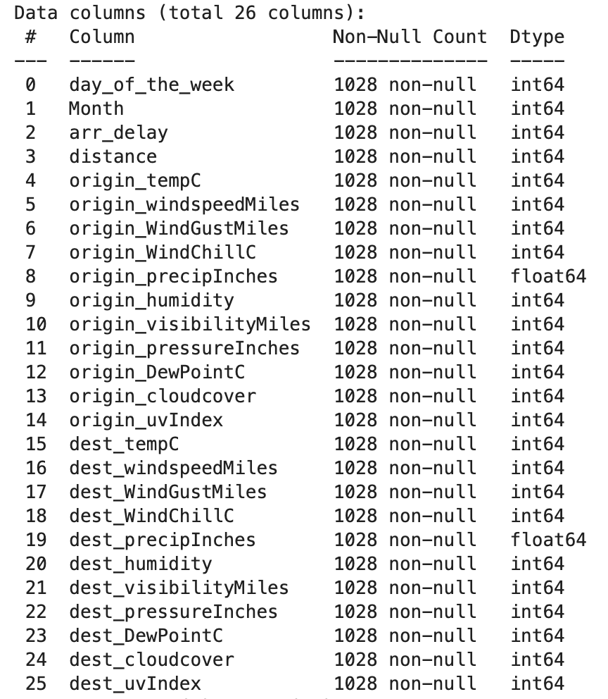
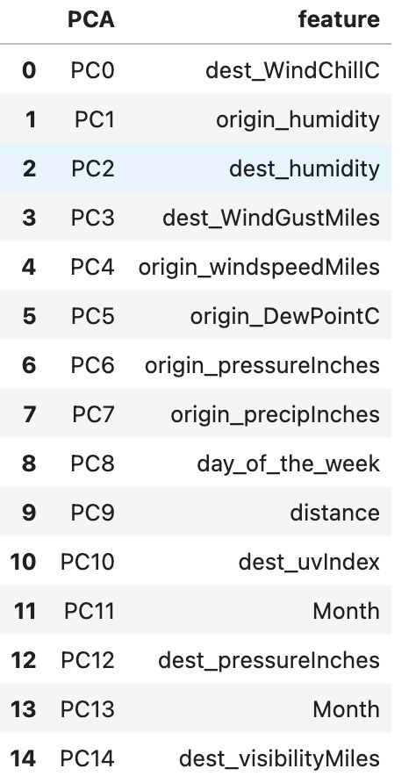
selected features significant features

Slide 9
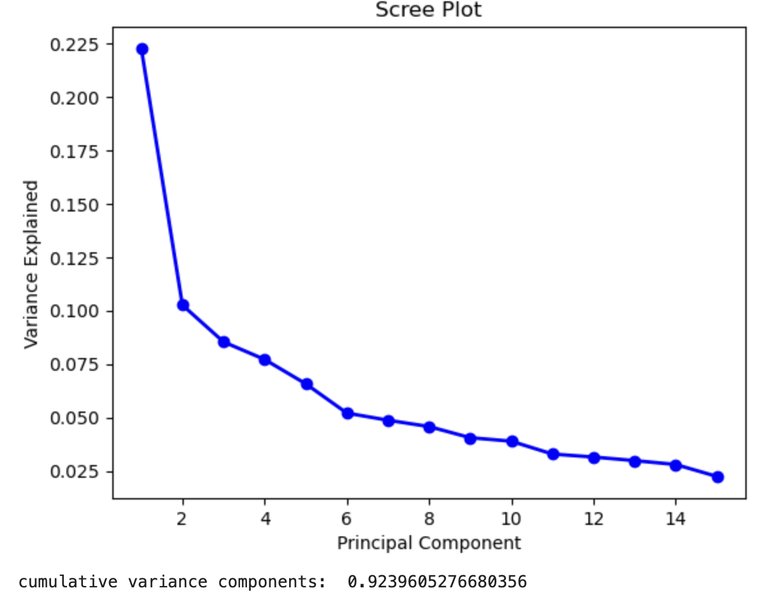

PCA Analysis
No dominant PCA vectors.

Slide 10
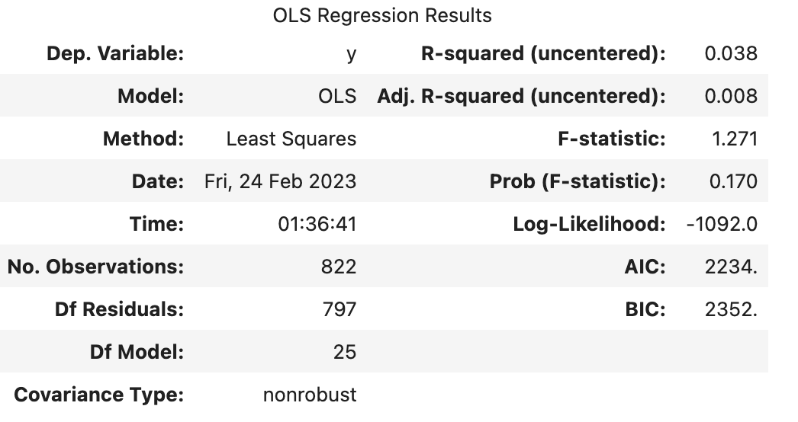

Linear regression fit

Slide 11
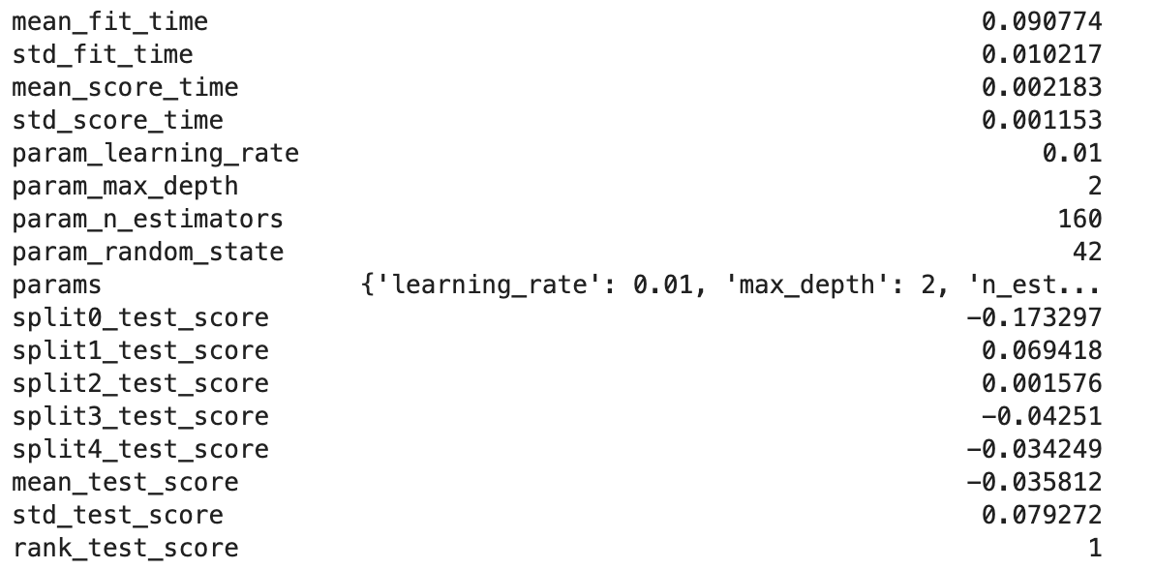
XGBOOST fit (5 kfolds with grid search tuning)

Slide 12
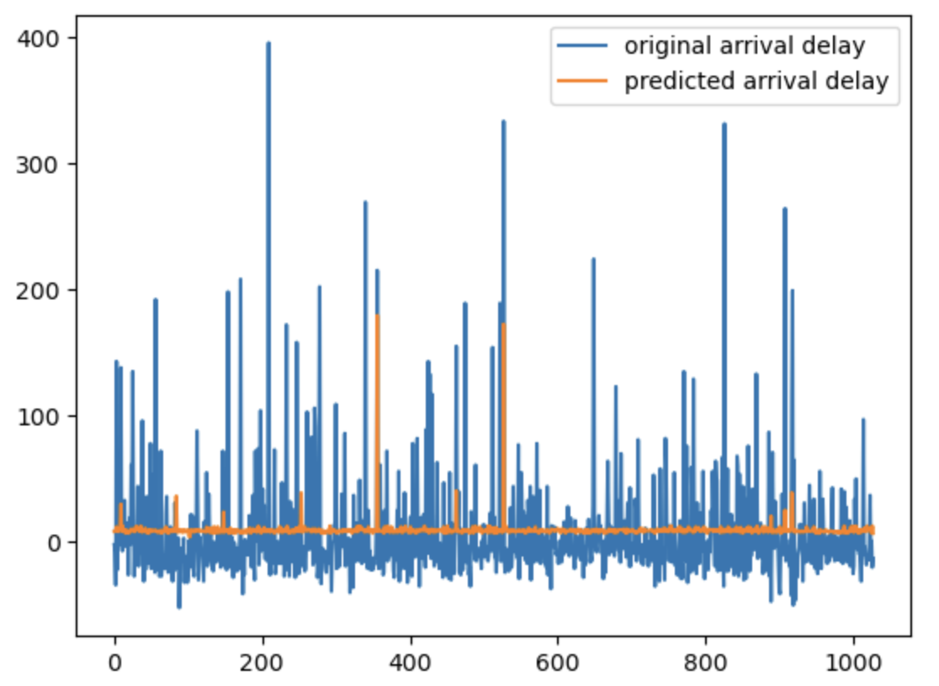
ORIGINAL DELAY vs predicted delay (training data)

Slide 13
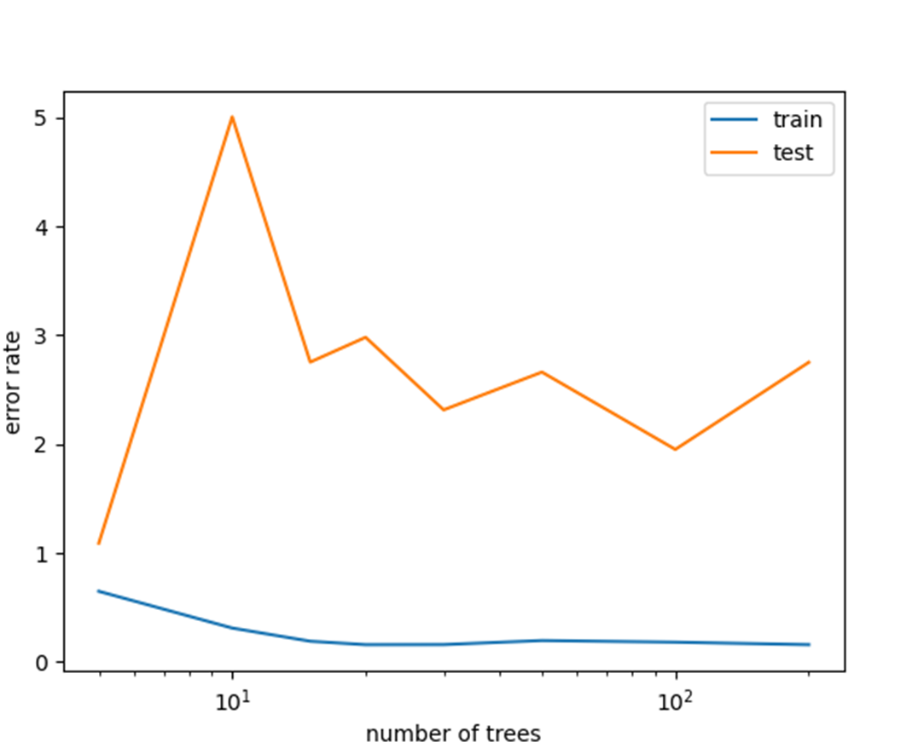
Random forest

Slide 14
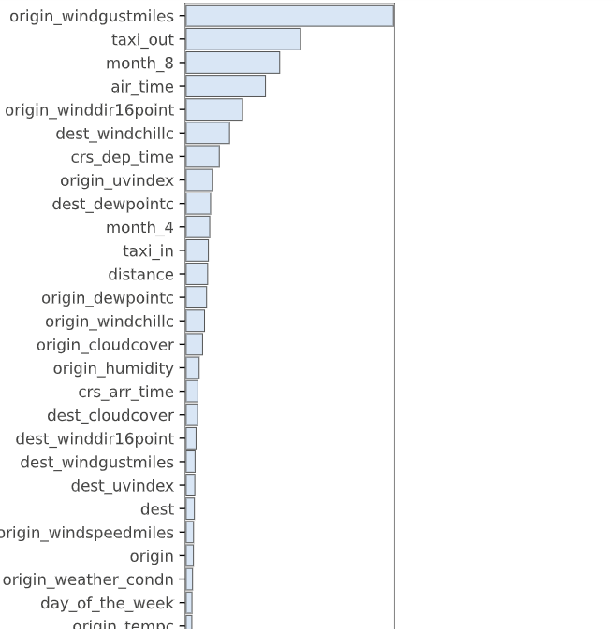
Important feature of random forest

Slide 15
challenge
The random nature of data
The restriction on weather API leading to small sample dataset

Slide 16

Thank you for your listening

