Slide 1
Lecture 11: RISC-V Processor Datapath

Slide 2
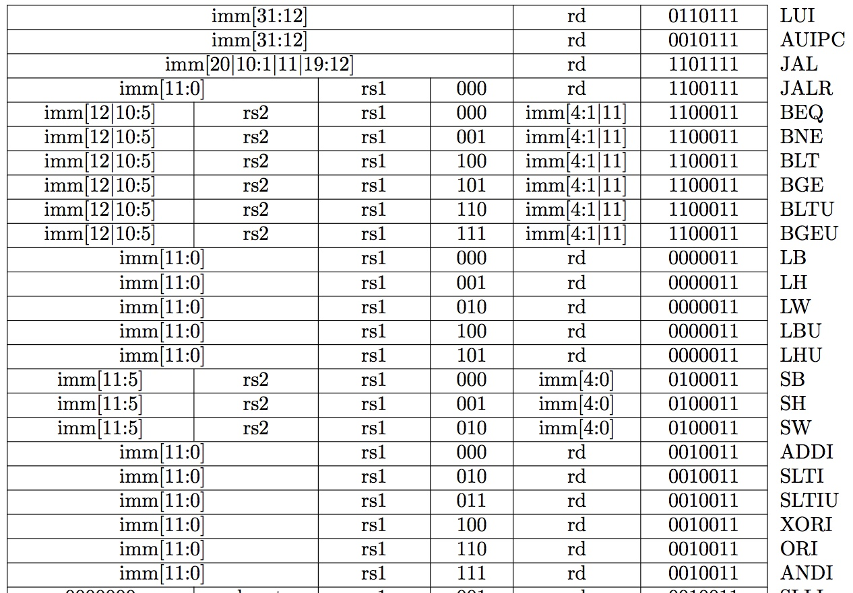
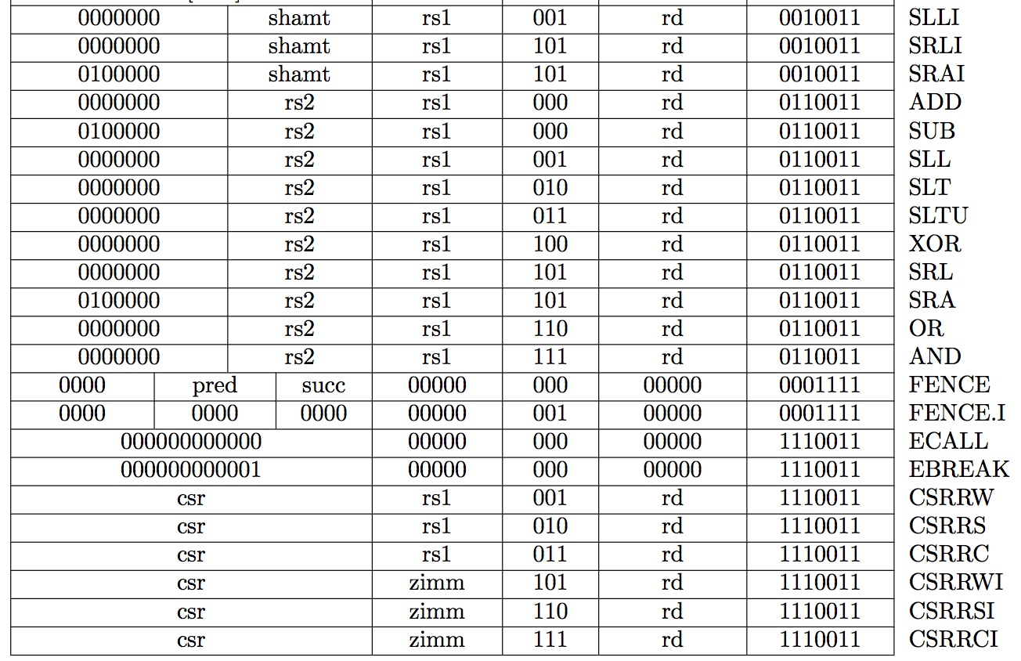
Recap: Complete RV32I ISA
Not in CS61C

Slide 3
State Required by RV32I ISA
Each instruction reads and updates this state during execution:
Registers (x0..x31)
Register file (or regfile) Reg holds 32 registers x 32 bits/register: Reg[0].. Reg[31]
First register read specified by rs1 field in instruction
Second register read specified by rs2 field in instruction
Write register (destination) specified by rd field in instruction
x0 is always 0 (writes to Reg[0]are ignored)
Program Counter (PC)
Holds address of current instruction
Memory (MEM)
Holds both instructions & data, in one 32-bit byte-addressed memory space
We’ll use separate memories for instructions (IMEM) and data (DMEM)
Later we’ll replace these with instruction and data caches
Instructions are read (fetched) from instruction memory (assume IMEM read-only)
Load/store instructions access data memory

Slide 4
One-Instruction-Per-Cycle RISC-V Machine
On every tick of the clock, the computer executes one instruction
Current state outputs drive the inputs to the combinational logic, whose outputs settles at the values of the state before the next clock edge
At the rising clock edge, all the state elements are updated with the combinational logic outputs, and execution moves to the next clock cycle
pc
Combinational Logic
clock
IMEM
Reg[]
DMEM

Slide 5
Basic Phases of Instruction Execution
rd
PC
IMEM
DMEM
rs1
Reg[]
ALU
rs2
+4
imm
mux
2. Decode/
Register
Read
1. Instruction
Fetch
5. Register
Write
3. Execute
4. Memory
Clock
time

Slide 6
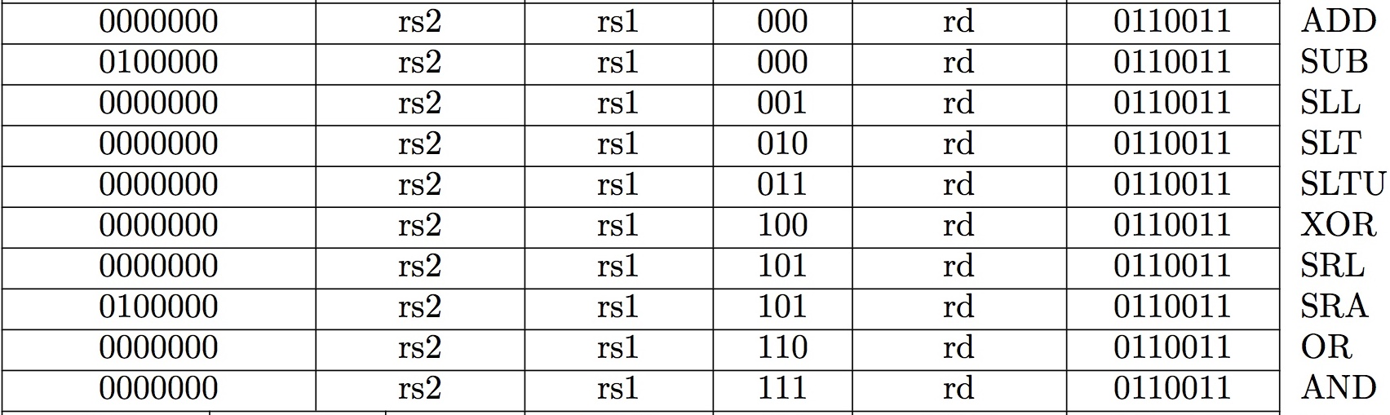
Implementing the add instruction
add rd, rs1, rs2
Instruction makes two changes to machine’s state:
Reg[rd] = Reg[rs1] + Reg[rs2]
PC = PC + 4

Slide 7
Datapath for add
+4
Reg[]
pc
Reg[rs1]
DataD
inst[11:7]
+
alu
IMEM
AddrD
pc+4
inst[19:15]
AddrA
DataA
Reg[rs2]
inst[24:20]
AddrB
DataB
Control Logic
inst[31:0]
RegWriteEnable
(RegWEn)

Slide 8
Timing Diagram for add
+4
Reg[]
pc
DataD
Reg[rs1]
pc+4
IMEM
inst[11:7]
+
alu
AddrD
inst[19:15]
AddrA
DataA
Reg[rs2]
inst[24:20]
AddrB
DataB
inst[31:0]
clock
RegWEn
time
Clock
PC
1000
1004
PC+4
1004
1008
inst[31:0]
add x1,x2,x3
add x6,x7,x9
Reg[rs1]
Reg[2]
Reg[7]
Reg[rs2]
Reg[3]
Reg[9]
alu
Reg[2]+Reg[3]
Reg[7]+Reg[9]
Reg[1]
???
Reg[2]+Reg[3]

Slide 9
Implementing the sub instruction
sub rd, rs1, rs2
Almost the same as add, except now have to subtract operands instead of adding them
inst[30] selects between add and subtract

Slide 10
Datapath for add/sub
+4
Reg[]
pc
Reg[rs1]
DataD
ALU
IMEM
inst[11:7]
AddrD
alu
pc+4
inst[19:15]
AddrA
DataA
Reg[rs2]
inst[24:20]
AddrB
DataB
Control Logic
inst[31:0]
RegWEn
(1=write, 0=no write)
ALUSel
(Add=0/Sub=1)

Slide 11
Implementing other R-Format instructions
All implemented by decoding funct3 and funct7 fields and selecting appropriate ALU function

Slide 12
Implementing the addi instruction
RISC-V Assembly Instruction:
addi x15,x1,-50
111111001110
00001
000
01111
0010011
imm=-50
rs1=1
ADD
rd=15
OP-Imm
10/1/2018

Slide 13
Datapath for add/sub
+4
Reg[]
pc
Reg[rs1]
DataD
ALU
IMEM
inst[11:7]
AddrD
alu
pc+4
inst[19:15]
AddrA
DataA
Reg[rs2]
inst[24:20]
AddrB
DataB
Control Logic
inst[31:0]
RegWEn
(1=write, 0=no write)
ALUSel
(Add=0/Sub=1)

Slide 14
Adding addi to datapath
+4
Reg[]
pc
DataD
ALU
IMEM
inst[11:7]
AddrD
Reg[rs1]
alu
pc+4
inst[19:15]
AddrA
DataA
0
Reg[rs2]
inst[24:20]
AddrB
DataB
1
inst[31:20]
Imm.
Gen
imm[31:0]
Control Logic
inst[31:0]
ImmSel=I
RegWEn=1
BSel=1
ALUSel=Add

Slide 15
I-Format immediates
inst[31:0]
------inst[31]-(sign-extension)-------
inst[30:20]
imm[31:0]
inst[31:20]
Imm.
Gen
imm[31:0]
High 12 bits of instruction (inst[31:20]) copied to low 12 bits of immediate (imm[11:0])
Immediate is sign-extended by copying value of inst[31] to fill the upper 20 bits of the immediate value (imm[31:12])
ImmSel=I

Slide 16
Adding addi to datapath
+4
Reg[]
pc
DataD
ALU
IMEM
inst[11:7]
AddrD
Reg[rs1]
alu
pc+4
inst[19:15]
AddrA
DataA
0
Reg[rs2]
inst[24:20]
AddrB
DataB
1
Also works for all other I-format arithmetic instruction (slti,sltiu,andi,ori,xori,slli,srli,srai) just by changing ALUSel
inst[31:20]
Imm.
Gen
imm[31:0]
Control Logic
inst[31:0]
ImmSel=I
RegWEn=1
BSel=1
ALUSel=Add

Slide 17

TSMC Announces 3nm CMOS Fab
Latest Apple iPhone 8, iPhone X use TSMC’s 10nm process technology.
3nm technology should allow 10x more stuff on the same sized chip (10/3)²
The new manufacturing plant will occupy nearly 200 acres and cost around $15B, open in around 5 years (~2022).
Currently, fabs use 193nm light to expose masks
For 3nm, some layers will use Extreme Ultra-Violet (13.5nm)

Slide 18
Break!

Slide 19
Implementing Load Word instruction
RISC-V Assembly Instruction:
lw x14, 8(x2)
000000001000
00010
010
01110
0000011
imm=+8
rs1=2
LW
rd=14
LOAD
10/1/2018

Slide 20
Adding addi to datapath
+4
Reg[]
pc
DataD
ALU
IMEM
inst[11:7]
AddrD
Reg[rs1]
alu
pc+4
inst[19:15]
AddrA
DataA
0
Reg[rs2]
inst[24:20]
AddrB
DataB
1
inst[31:20]
Imm.
Gen
imm[31:0]
Control Logic
inst[31:0]
ImmSel=I
RegWEn=1
BSel=1
ALUSel=Add

Slide 21
Adding lw to datapath
alu
+4
Reg[]
pc
wb
DataD
Reg[rs1]
ALU
1
DMEM
IMEM
inst[11:7]
AddrD
Addr
Reg[rs2]
DataR
wb
pc+4
inst[19:15]
AddrA
DataA
0
0
mem
inst[24:20]
AddrB
DataB
1
inst[31:20]
Imm.
Gen
imm[31:0]
inst[31:0]
ImmSel
RegWEn
BSel
ALUSel
MemRW
WBSel

Slide 22
Adding lw to datapath
alu
+4
Reg[]
pc
wb
DataD
Reg[rs1]
ALU
1
DMEM
IMEM
inst[11:7]
AddrD
Addr
Reg[rs2]
DataR
wb
pc+4
inst[19:15]
AddrA
DataA
0
0
mem
inst[24:20]
AddrB
DataB
1
inst[31:20]
Imm.
Gen
imm[31:0]
inst[31:0]
ImmSel=I
RegWEn=1
Bsel=1
ALUSel=Add
MemRW=Read
WBSel=0

Slide 23
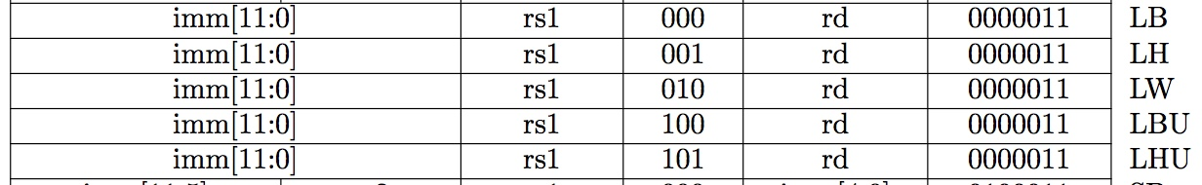
All RV32 Load Instructions
funct3 field encodes size and signedness of load data
Supporting the narrower loads requires additional circuits to extract the correct byte/halfword from the value loaded from memory, and sign- or zero-extend the result to 32 bits before writing back to register file.

Slide 24
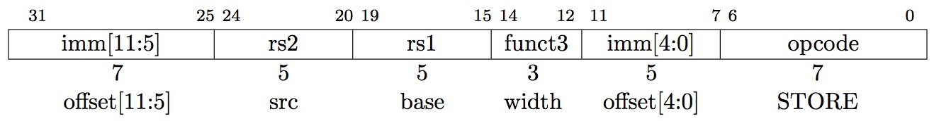
Implementing Store Word instruction
RISC-V Assembly Instruction:
sw x14, 8(x2)
0000000
01110
00010
010
01000
0100011
offset[11:5]
=0
rs2=14
rs1=2
SW
offset[4:0]
=8
STORE
0000000
01000
combined 12-bit offset = 8
10/1/2018

Slide 25
Adding lw to datapath
alu
+4
Reg[]
pc
wb
DataD
Reg[rs1]
ALU
1
DMEM
IMEM
inst[11:7]
AddrD
Addr
Reg[rs2]
DataR
wb
pc+4
inst[19:15]
AddrA
DataA
0
0
mem
inst[24:20]
AddrB
DataB
1
inst[31:20]
Imm.
Gen
imm[31:0]
inst[31:0]
ImmSel
RegWEn
BSel
ALUSel
MemRW
WBSel

Slide 26
Adding sw to datapath
+4
Reg[]
alu
pc
wb
DataD
Reg[rs1]
ALU
DMEM
IMEM
inst[11:7]
AddrD
Addr
1
pc+4
Reg[rs2]
DataR
wb
inst[19:15]
AddrA
DataA
0
0
DataW
mem
inst[24:20]
AddrB
DataB
1
inst[31:7]
Imm.
Gen
imm[31:0]
inst[31:0]
ImmSel
RegWEn
Bsel
ALUSel
MemRW
WBSel=

Slide 27
Adding sw to datapath
+4
Reg[]
alu
pc
wb
DataD
Reg[rs1]
ALU
DMEM
IMEM
inst[11:7]
AddrD
Addr
1
pc+4
Reg[rs2]
DataR
wb
inst[19:15]
AddrA
DataA
0
0
DataW
mem
inst[24:20]
AddrB
DataB
1
inst[31:7]
Imm.
Gen
imm[31:0]
inst[31:0]
ImmSel=S
RegWEn=0
Bsel=1
ALUSel=Add
MemRW=Write
WBSel=*
*= “Don’t Care”

Slide 28
I-Format immediates
inst[31:0]
------inst[31]-(sign-extension)-------
inst[30:20]
imm[31:0]
inst[31:20]
Imm.
Gen
imm[31:0]
High 12 bits of instruction (inst[31:20]) copied to low 12 bits of immediate (imm[11:0])
Immediate is sign-extended by copying value of inst[31] to fill the upper 20 bits of the immediate value (imm[31:12])
ImmSel=I

Slide 29
I & S Immediate Generator
inst[31:0]
31
25
24
20
19
15
14
12
11
7
6
0
imm[11:0]
rs1
funct3
rd
I-opcode
imm[11:5]
rs2
rs1
funct3
imm[4:0]
S-opcode
5
5
1
6
I
S
inst[31](sign-extension)
inst[30:25]
inst[24:20]
I
inst[31](sign-extension)
inst[30:25]
inst[11:7]
S
31
11
10
5
4
0
Just need a 5-bit mux to select between two positions where low five bits of immediate can reside in instruction
Other bits in immediate are wired to fixed positions in instruction
imm[31:0]

Slide 30
Implementing Branches
B-format is mostly same as S-Format, with two register sources (rs1/rs2) and a 12-bit immediate
But now immediate represents values -4096 to +4094 in 2-byte increments
The 12 immediate bits encode even 13-bit signed byte offsets (lowest bit of offset is always zero, so no need to store it)

Slide 31
Adding sw to datapath
+4
Reg[]
alu
pc
wb
DataD
Reg[rs1]
ALU
DMEM
IMEM
inst[11:7]
AddrD
Addr
1
pc+4
Reg[rs2]
DataR
wb
inst[19:15]
AddrA
DataA
0
0
DataW
mem
inst[24:20]
AddrB
DataB
1
inst[31:7]
Imm.
Gen
imm[31:0]
inst[31:0]
ImmSel
RegWEn
Bsel
ALUSel
MemRW
WBSel=

Slide 32
Adding branches to datapath
+4
Reg[]
pc
alu
pc
wb
1
1
DataD
Reg[rs1]
ALU
alu
0
DMEM
0
IMEM
inst[11:7]
AddrD
Addr
1
pc+4
Branch Comp.
Reg[rs2]
DataR
wb
inst[19:15]
AddrA
DataA
0
0
DataW
mem
inst[24:20]
AddrB
DataB
1
inst[31:7]
Imm.
Gen
imm[31:0]
PCSel
inst[31:0]
ImmSel
RegWEn
BrUn
BrEq
BrLT
BSel
ASel
ALUSel
MemRW
WBSel

Slide 33
Adding branches to datapath
+4
Reg[]
pc
alu
alu
pc
wb
1
1
DataD
Reg[rs1]
ALU
0
DMEM
0
IMEM
inst[11:7]
AddrD
Addr
1
Branch Comp.
Reg[rs2]
DataR
wb
pc+4
inst[19:15]
AddrA
DataA
0
0
DataW
mem
inst[24:20]
AddrB
DataB
1
inst[31:7]
Imm.
Gen
imm[31:0]
PCSel=taken/not-taken
inst[31:0]
ImmSel=B
RegWEn=0
BrUn
BrEq
BrLT
Bsel=1
ASel=1
MemRW=Read
WBSel=*
ALUSel=Add

Slide 34
Branch Comparator
BrEq = 1, if A=B
BrLT = 1, if A < B
BrUn =1 selects unsigned comparison for BrLT, 0=signed
BGE branch: A >= B, if !(A<B)
A
Branch Comp.
B
BrUn
BrEq
BrLT

Slide 35
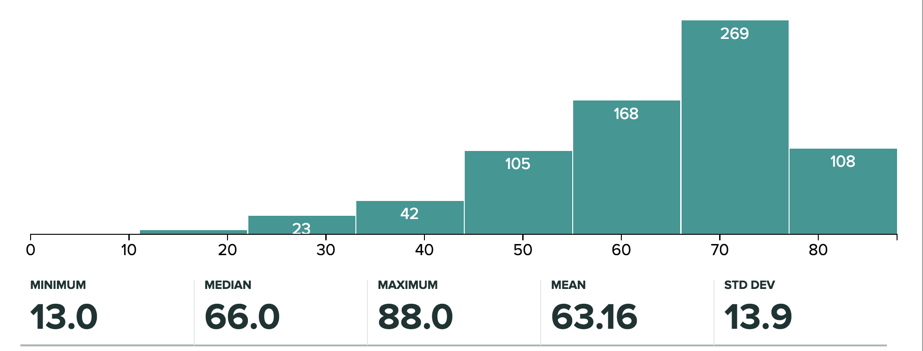
Administrivia (1/2)
Midterm 1 has been graded!
Regrade Requests will open tonight
Due next Tuesday (in one week)
Piazza will explain the instructions

Slide 36
Administrivia (2/2)
Project 1 has been released
Part 1 is due next Monday
Project Party in Cory 293 on Wednesday 7-9pm (possibly later if needed)
Homework 2 is due this Friday at 11:59pm
Will help to do this before the project!
No Guerrilla Session this week—will start up again next Tuesday

Slide 37
Break!

Slide 38
Multiply Branch Immediates by Shift?
12-bit immediate encodes PC-relative offset of -4096 to +4094 bytes in multiples of 2 bytes
Standard approach: treat immediate as in range -2048..+2047, then shift left by 1 bit to multiply by 2 for branches
s
imm[10:5]
rs2
rs1
funct3
imm[4:0]
B-opcode
sign-extension
s
imm[10:5]
imm[4:0]
S-Immediate
sign-extension
s
imm[10:5]
imm[4:0]
0
B-Immediate (shift left by 1)
Each instruction immediate bit can appear in one of two places in output immediate value – so need one 2-way mux per bit

Slide 39
RISC-V Branch Immediates
12-bit immediate encodes PC-relative offset of -4096 to +4094 bytes in multiples of 2 bytes
RISC-V approach: keep 11 immediate bits in fixed position in output value, and rotate LSB of S-format to be bit 12 of B-format
sign=imm[11]
imm[10:5]
imm[4:0]
S-Immediate
sign=imm[12]
imm[10:5]
imm[4:1]
0
B-Immediate (shift left by 1)
imm[11]
Only one bit changes position between S and B, so only need a single-bit 2-way mux

Slide 40
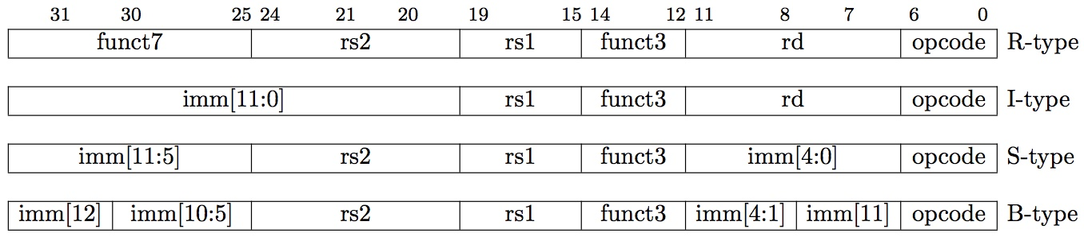
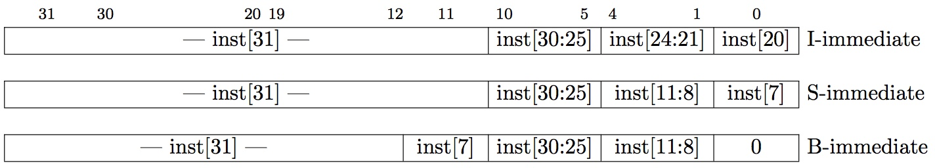
RISC-V Immediate Encoding
Instruction Encodings, inst[31:0]
32-bit immediates produced, imm[31:0]
Only bit 7 of instruction changes role in immediate between S and B
Upper bits sign-extended from inst[31] always

Slide 41
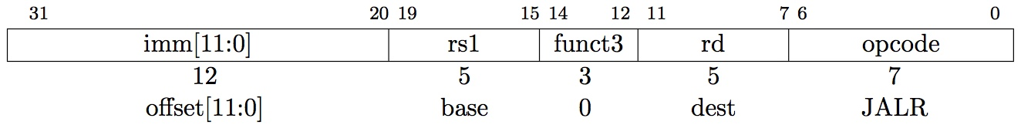
Implementing JALR Instruction (I-Format)
JALR rd, rs, immediate
Writes PC+4 to Reg[rd] (return address)
Sets PC = Reg[rs1] + immediate
Uses same immediates as arithmetic and loads
no multiplication by 2 bytes

Slide 42
Adding branches to datapath
+4
Reg[]
pc
alu
pc
wb
1
1
DataD
Reg[rs1]
ALU
alu
0
DMEM
0
IMEM
inst[11:7]
AddrD
Addr
1
pc+4
Branch Comp.
Reg[rs2]
DataR
wb
inst[19:15]
AddrA
DataA
0
0
DataW
mem
inst[24:20]
AddrB
DataB
1
inst[31:7]
Imm.
Gen
imm[31:0]
PCSel
inst[31:0]
ImmSel
RegWEn
BrUn
BrEq
BrLT
BSel
ASel
ALUSel
MemRW
WBSel

Slide 43
Adding jalr to datapath
+4
Reg[]
pc
pc+4
pc
wb
1
alu
1
DataD
Reg[rs1]
ALU
2
alu
0
DMEM
0
IMEM
inst[11:7]
AddrD
Addr
1
pc+4
Branch Comp.
Reg[rs2]
DataR
wb
inst[19:15]
AddrA
DataA
0
0
DataW
mem
inst[24:20]
AddrB
DataB
1
inst[31:7]
Imm.
Gen
imm[31:0]
PCSel
inst[31:0]
ImmSel
RegWEn
BrUn
BrEq
BrLT
BSel
ASel
ALUSel
MemRW
WBSel

Slide 44
Adding jalr to datapath
+4
Reg[]
pc
alu
pc+4
alu
pc
wb
1
1
DataD
Reg[rs1]
ALU
2
0
DMEM
0
IMEM
inst[11:7]
AddrD
Addr
1
pc+4
Branch Comp.
Reg[rs2]
DataR
wb
inst[19:15]
AddrA
DataA
0
0
DataW
mem
inst[24:20]
AddrB
DataB
1
inst[31:7]
Imm.
Gen
imm[31:0]
PCSel
inst[31:0]
ImmSel=B
RegWEn=1
Bsel=1
Asel=0
MemRW=Read
WBSel=2
ALUSel=Add
BrUn=*
BrEq=*
BrLT=*

Slide 45
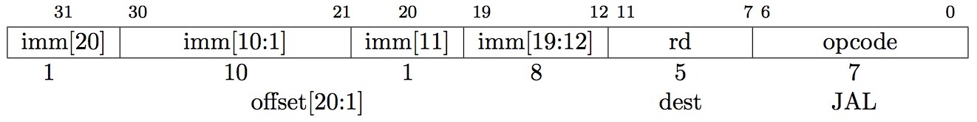
Implementing jal Instruction
JAL saves PC+4 in Reg[rd] (the return address)
Set PC = PC + offset (PC-relative jump)
Target somewhere within ±2¹⁹ locations, 2 bytes apart
±2¹⁸ 32-bit instructions
Immediate encoding optimized similarly to branch instruction to reduce hardware cost

Slide 46
Adding jal to datapath
+4
Reg[]
pc
pc+4
pc
wb
1
alu
1
DataD
Reg[rs1]
ALU
2
alu
0
DMEM
0
IMEM
inst[11:7]
AddrD
Addr
1
pc+4
Branch Comp.
Reg[rs2]
DataR
wb
inst[19:15]
AddrA
DataA
0
0
DataW
mem
inst[24:20]
AddrB
DataB
1
inst[31:7]
Imm.
Gen
imm[31:0]
PCSel
inst[31:0]
ImmSel
RegWEn
BrUn
BrEq
BrLT
BSel
ASel
ALUSel
MemRW
WBSel

Slide 47
Adding jal to datapath
+4
Reg[]
pc
alu
pc+4
alu
pc
wb
1
1
DataD
Reg[rs1]
ALU
2
0
DMEM
0
IMEM
inst[11:7]
AddrD
Addr
1
pc+4
Branch Comp.
Reg[rs2]
DataR
wb
inst[19:15]
AddrA
DataA
0
0
DataW
mem
inst[24:20]
AddrB
DataB
1
inst[31:7]
Imm.
Gen
imm[31:0]
PCSel
inst[31:0]
ImmSel=J
RegWEn=1
Bsel=1
Asel=1
MemRW=Read
WBSel=2
ALUSel=Add
BrUn=*
BrEq=*
BrLT=*

Slide 48
Single-Cycle RISC-V RV32I Datapath
+4
Reg[]
pc
pc+4
pc
wb
1
alu
1
DataD
Reg[rs1]
ALU
2
alu
0
DMEM
0
IMEM
inst[11:7]
AddrD
Addr
1
pc+4
Branch Comp.
Reg[rs2]
DataR
wb
inst[19:15]
AddrA
DataA
0
0
DataW
mem
inst[24:20]
AddrB
DataB
1
inst[31:7]
Imm.
Gen
imm[31:0]
PCSel
inst[31:0]
ImmSel
RegWEn
BrUn
BrEq
BrLT
BSel
ASel
ALUSel
MemRW
WBSel

Slide 49
And in Conclusion, …
Universal datapath
Capable of executing all RISC-V instructions in one cycle each
Not all units (hardware) used by all instructions
5 Phases of execution
IF, ID, EX, MEM, WB
Not all instructions are active in all phases
Controller specifies how to execute instructions
what new instructions can be added with just most control?

