Slide 1
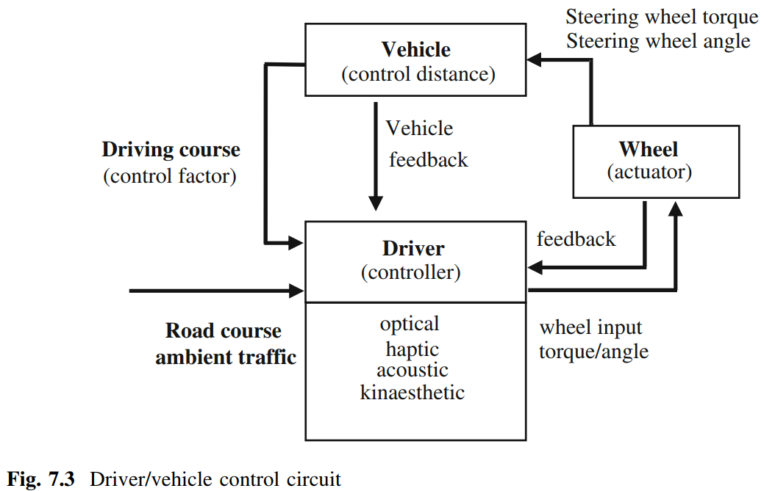
Notes:
Steering handbook

Slide 2
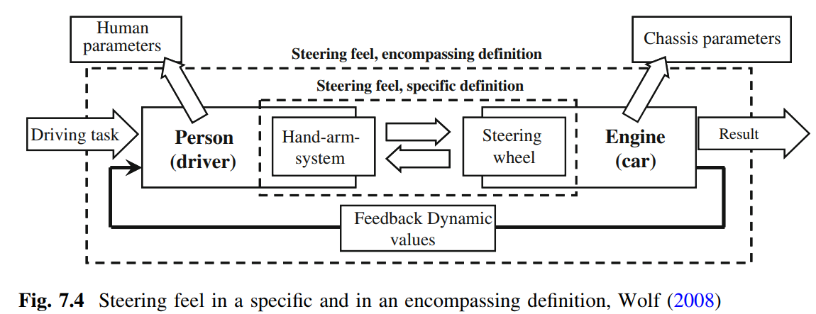
Notes:
Steering handbook

Slide 3
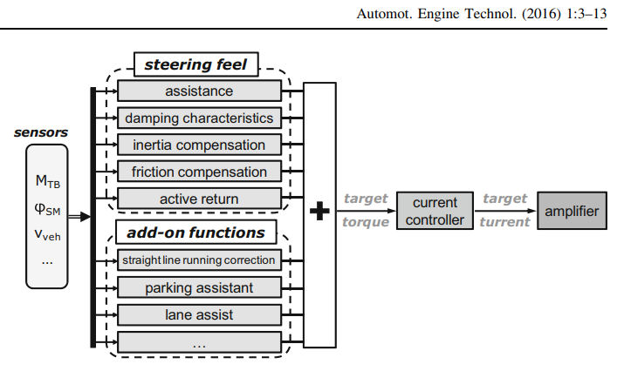

Slide 4
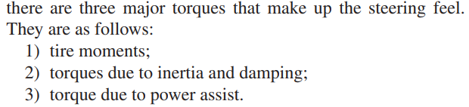
Notes:
Sci-Hub | Designing Steering Feel for Steer-by-Wire Vehicles Using Objective Measures. IEEE/ASME Transactions on Mechatronics, 20(1), 373–383 | 10.1109/tmech.2014.2324593

