Slide 1
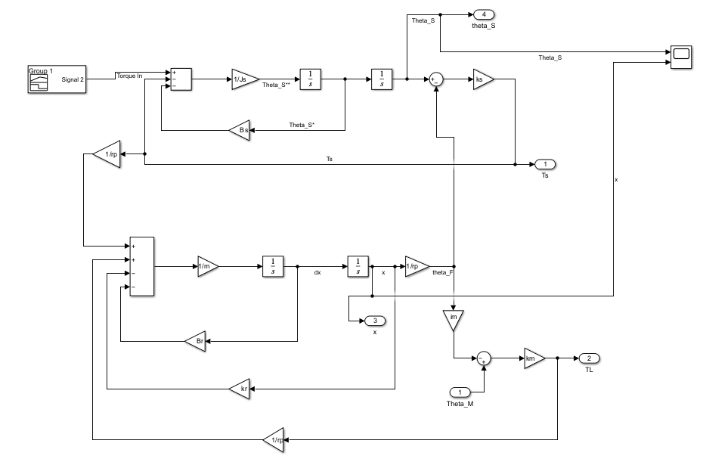

Slide 2
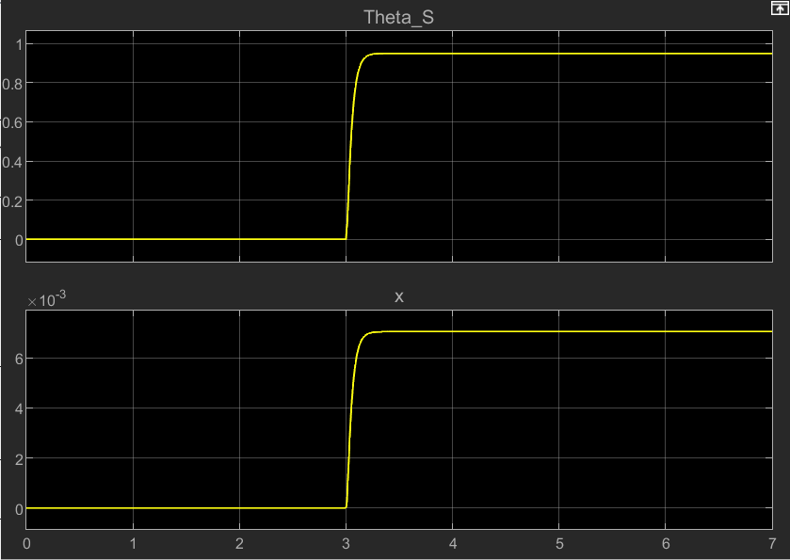

Slide 3
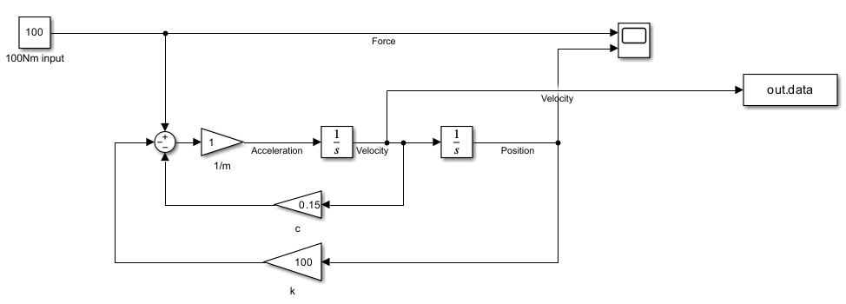

Slide 4
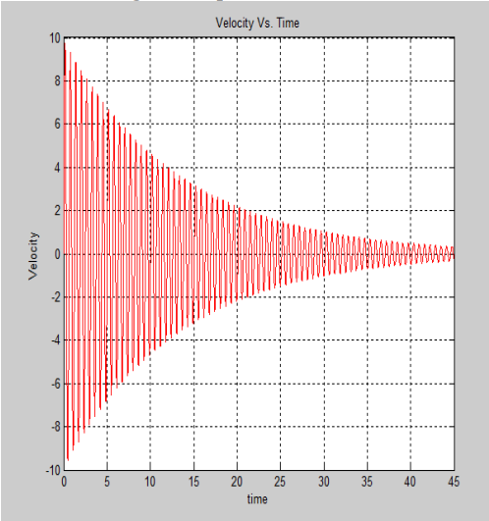
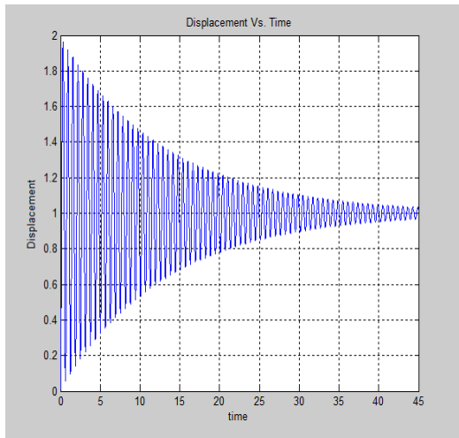

Slide 6
The position and velocity of the spring-damper system are generated by solving the developed transfer function using MATLAB. The displacement graph is shown in Fig 4 while the velocity graph is shown in Fig 5.
For the given parameters of the system, the position vs. time response in MATLAB gives the maximum value equal to 1.961 m. Similarly, the maximum velocity is found to be 9.761 m/s.
Simulink model uses the solver ode45 for solving the differential equation for the spring-mass-damper system.

Slide 7
