Slide 1
Building an application with React & Node Js

Slide 2
Overview
Technical
Client: React ver 11.2.6
Server: Node Js 6.9.0
RDBMS: MariaDb/mysql 2.18.1
Framework: Express Framework
IDE: Visual Studio Code 1.56.2

Slide 3
React
A JavaScript library for building user interfaces

Slide 4
Overview
What is React?
Features Of React
Components, state & props
React Prerequisites for building an application

Slide 5

What is React?
React is JavaScript library for building fast and interactive user interfaces.
It is an open-source and can be used as a base in the development of single- page or mobile applications.
React was created by Jordan Walke, who was a software engineer at Facebook
Complex React applications usually require the use of additional libraries for state management, routing, and interaction with an API.

Slide 6
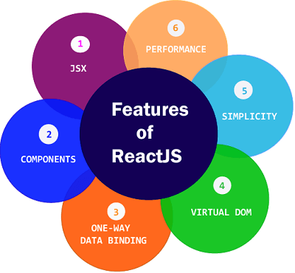

Slide 7
Features Of React
JSX (JavaScript XML): Its an XML or HTML like syntax used by ReactJS(recommended)
UI Components: Reusable and interactive components.
One-way data binding: React Js use the concept of unidirectional data flow which improve the overall performance.
Virtual DOM: React Js use the concept of virtual DOM which helps in the performance.
Simplicity: ReactJS is a component-based approach which makes the code reusable as your need. This makes it simple to use and learn.
Performance: ReactJS is known to be a great performance because React use the concept of virtual DOM

Slide 8
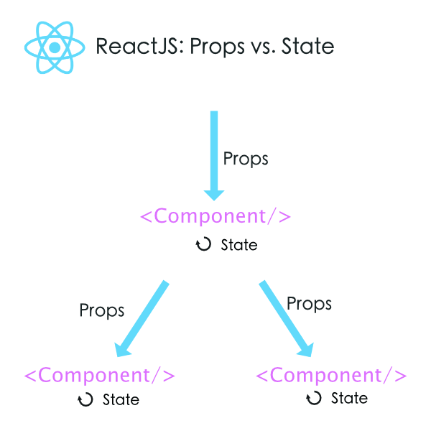
Components, state & props
props are variables passed to it by its parent component.
State on the other hand is still variables, but directly initialized and managed by the component.

Slide 9
React Prerequisites
Route
Axios
Define structure for component
Render
Callback

Slide 10
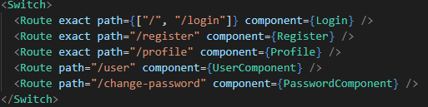
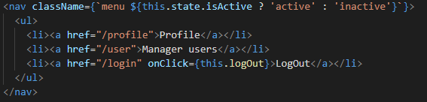
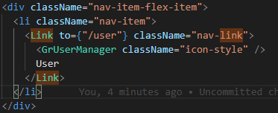
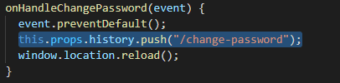
Route

Slide 11
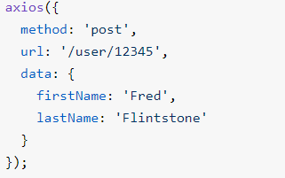
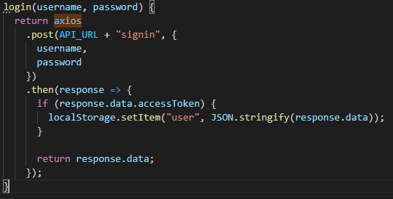
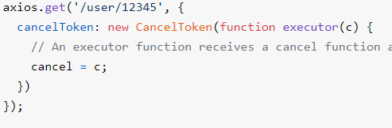
Axios
Promise based HTTP client for the browser and node.js
axios(config)
axios(url[, config])
Request method aliases

Slide 12
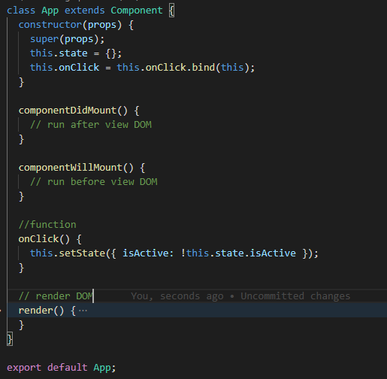
Define structure for component

Slide 13
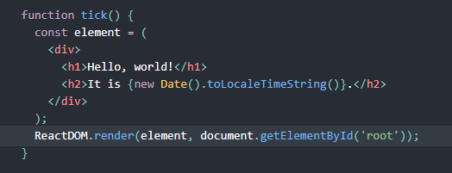
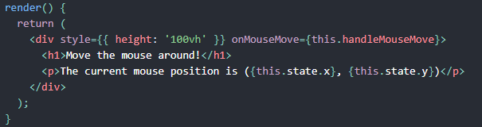
Render
Is function for create UI elements by Virtual DOM
Render function will reload UI whenever have any change

Slide 14
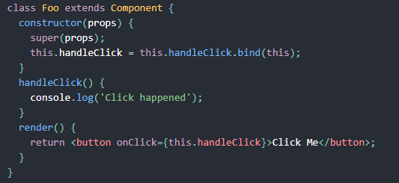
Callback
Using Function.prototype.bind in render creates a new function each time the component renders, which may have performance implications

Slide 15
Node Js
The server-side JavaScript

Slide 16
Overview
What is Node Js?
Server-side JavaScript
Non-blocking I/O
Some good modules
Node Js framework
Combined with react
Express Js and demo app

Slide 17
What is Node Js?
Node.js is an open source server environment
Node.js is free
Node.js runs on various platforms (Windows, Linux, Unix, Mac OS X, etc.)
Node.js uses JavaScript on the server
Why Node.js?
Sends the task to the computer's file system.
Ready to handle the next request.
When the file system has opened and read the file, the server returns the content to the client.

Slide 18
Server-side JavaScript
Node.js is a server-side JavaScript run-time environment. It's open-source, including Google's V8 engine, libuv for cross-platform compatibility, and a core library.
Django (Python) and Express (Node.js/JavaScript) are web frameworks to create basic applications as Server-side JavaScript

Slide 19
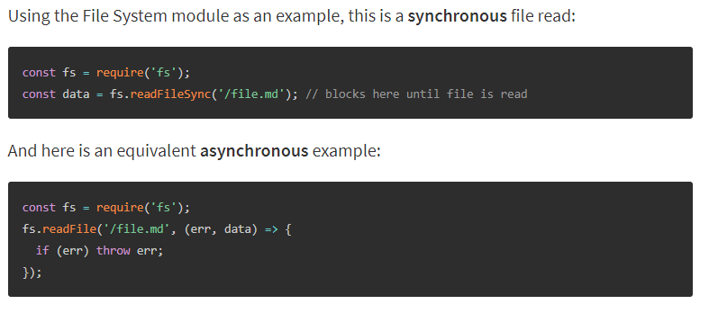
Non-blocking I/O
All of the I/O methods in the Node.js standard library provide asynchronous versions, which are non-blocking, and accept callback functions

Slide 20
Some good modules
Express
Async
Moment
Lodash

Slide 21
Node Js framework
Express
Meteor
Nest
LoopBack

Slide 22
Why Developers Prefer Node.JS & React.JS
High server load: Using Nodejs with React makes sense when your web application needs handling of multiple requests and maintaining server load balance.
Real-time data
JSON APIs
Single Page Applications (SPA): single page, asynchronous , callback function
MERN stack: use react for client in node js application and connect to mongodb

Slide 23
Express framework
Fast, unopinionated, minimalist web framework for Node.js

Slide 24
Introduction
Express is a minimal and flexible Node.js web application framework that provides a robust set of features for web and mobile applications.
Feature
Allows to set up middlewares to respond to HTTP Requests.
Defines a routing table which is used to perform different actions based on HTTP Method and URL.
Allows to dynamically render HTML Pages based on passing arguments to templates.
Question?
What is Require statements in ExpressJs?
Middleware
What is Routing in ExpressJs?
App.listen()/ Starting the server

Slide 25
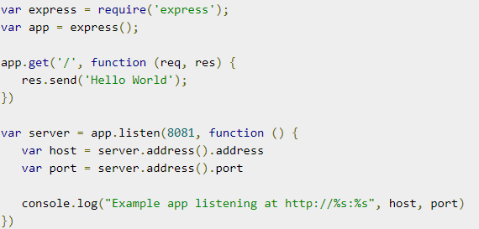
Install and build an application
# restart server whenever change code
npm install --save-dev nodemon
# create server
npm install express --save
# add configuration for connect to database
npm install dotenv --save
# add RDBMS for app
npm install mysql --save

Slide 26
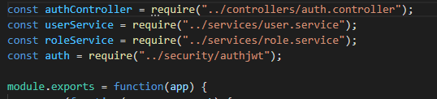
Require statements in ExpressJs
Syntax: var example = require('./example.js')
Step:
Resolving: To find the absolute path of the file.
Loading: To determine the type of the file content.
Wrapping: To give the file its private scope. This is what makes both the require and module objects local to every file we require.
Evaluating: This is what the VM eventually does with the loaded code.
Caching: So that when we require this file again, we don’t go over all the steps another time.

Slide 27
Middleware
Middleware functions are functions that have access to the request object (req), the response object (res), and the next middleware function in the application’s request-response cycle
Middleware functions can perform the following tasks:
Execute any code.
Make changes to the request and the response objects.
End the request-response cycle.
Call the next middleware function in the stack.

Slide 28
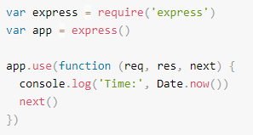
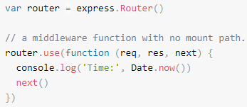
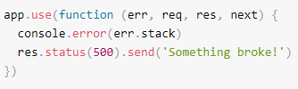
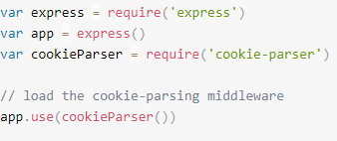
Type
Application-level middleware
Router-level middleware
Error-handling middleware
Built-in middleware
Third-party middleware

Slide 29
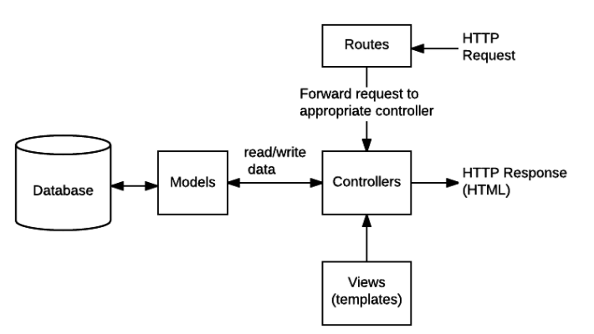
Route

Slide 30

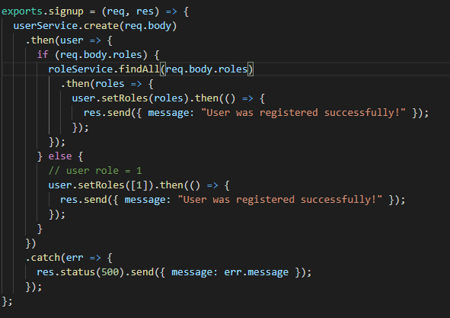
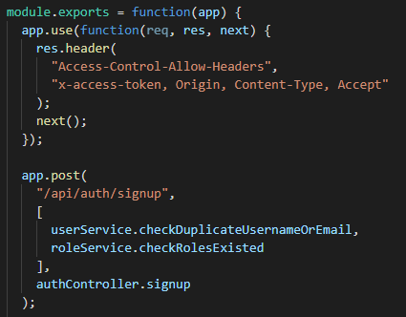

Slide 31
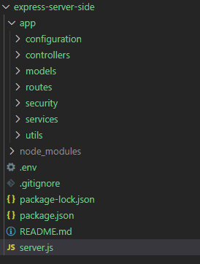
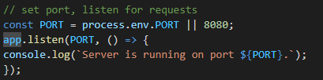
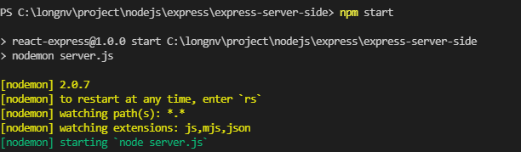
Run app and structure for application

Slide 32
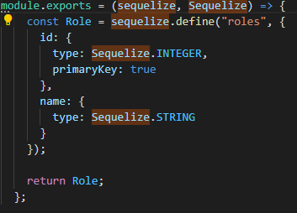
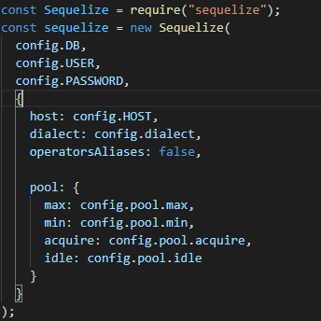
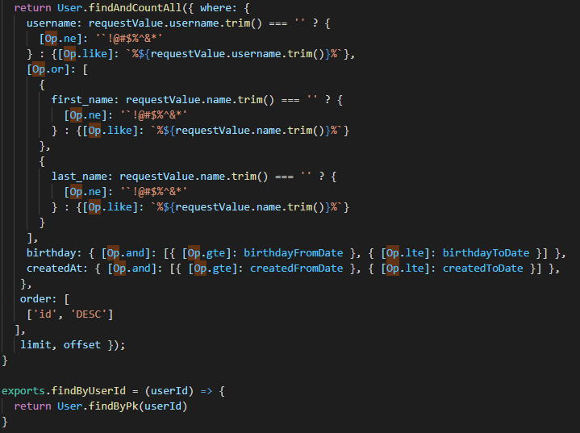
Sequelize ORM
Define: Is ORM mapping between models entity and table in database
Install: npm i sequelize
Link doc: https://sequelize.org/master/

Slide 33
Thanks for watching
Do you have questions for me?

