Slide 1

BRAZILIAN E-COMMERCE REPORTS 2020
Nguyễn Việt Long

Slide 2

Table of Contents
1
DATA EXPLORATION
2
BUSINESS ACUMEN
3
SUGGESTION

Slide 3






DATA OVERVIEW
Time Window: 2020
Dataset Info:
Customers Info
Items
Payment Info
Order Info
Location
Seller Info
Requirements:
Data Exploration and Preprocess (if necessary)
Analyze and show at least 3 key metrics to evaluate the company

Slide 4

DATA EXPLORATION

Slide 5
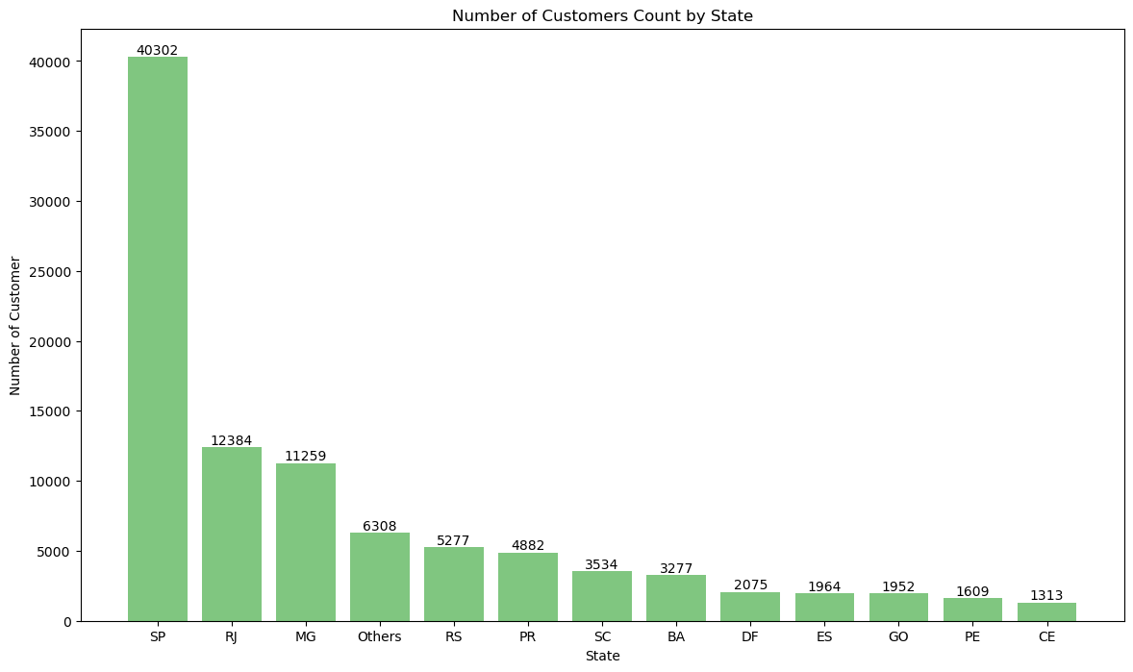
DATA EXPLORATION - CUSTOMER
Number of customer_id : 99441
Number of customer_unique_id: 96096
Most of the customers are located in SP (Sao Paolo) and RJ (Rio de Janeiro)

Slide 6
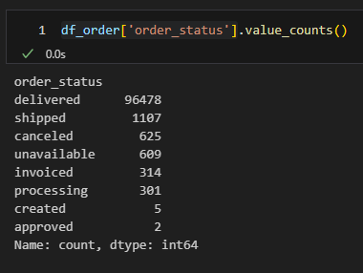
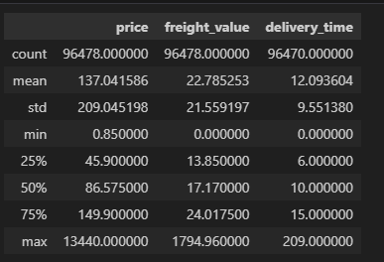
DATA EXPLORATION – ORDER DETAILS
Most of the order are delivered. However there are unfinished order in the dataset
The average freight is ~22.78 and the delivery time ~ 12 days per order

Slide 7
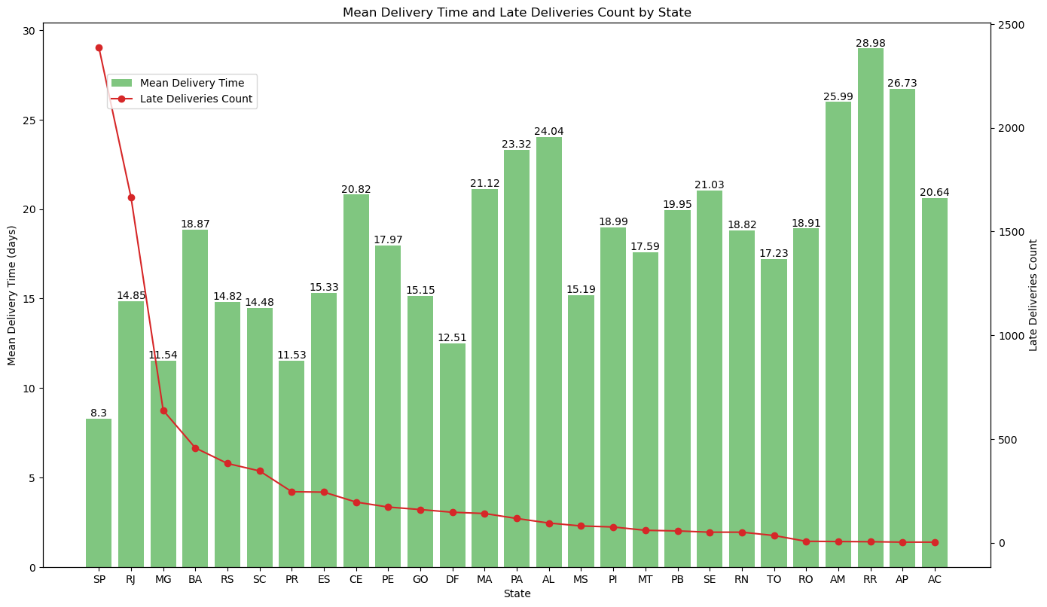
DATA EXPLORATION – ORDER DETAILS

Slide 8
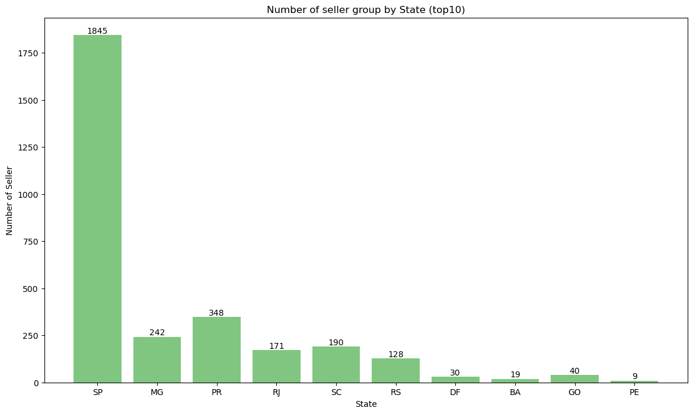
DATA EXPLORATION – SELLER DETAILS

Slide 9
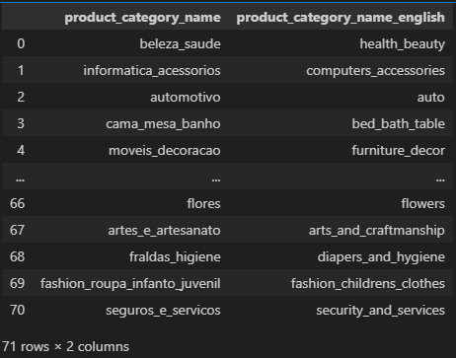
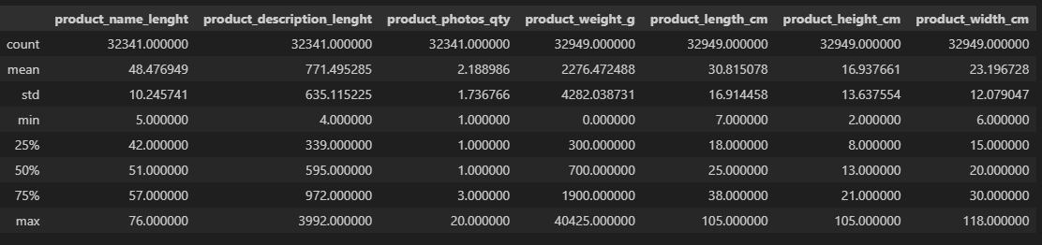
DATA EXPLORATION – ITEM DETAILS
There are over 70 product categories in the dataset and each of them has their own info such as length, weigth, height, width

Slide 10
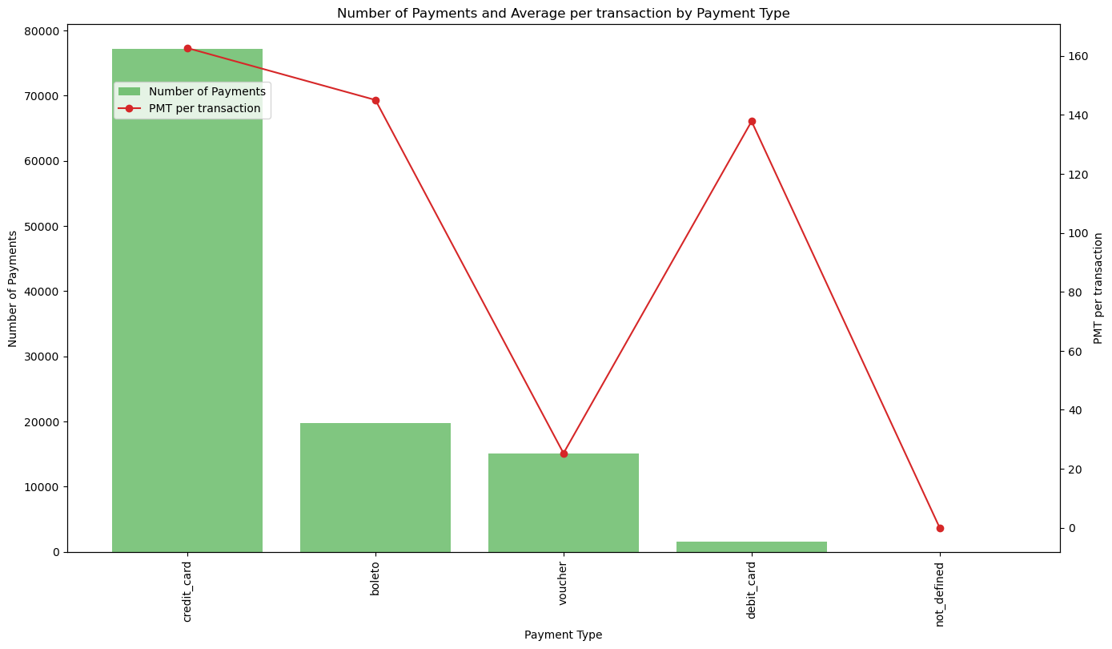
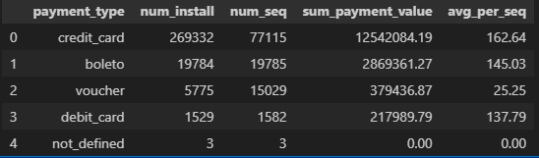
DATA EXPLORATION – ITEM DETAILS
There are 5 main payment methods. Credit Card is prefer by most of the customers in this website

Slide 11

BUSINESS ACUMEN

Slide 12
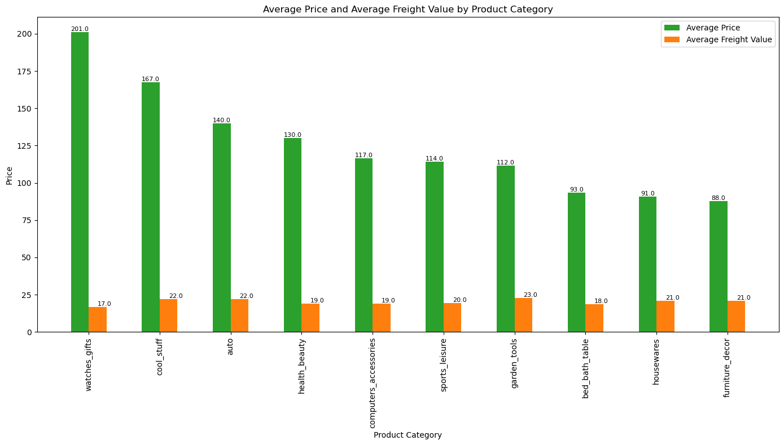
BUSINESS ACUMEN – AVERAGE VALUE PER ORDER
Average Order Value (AOV) in this dataset is ~136.68 => Other Product Categories such as sports, gardening, computer accessories can have room to improve

Slide 13
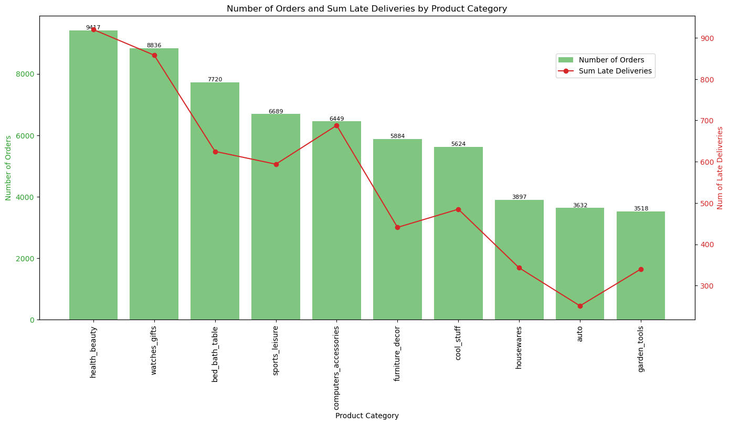
BUSINESS ACUMEN – Late Delivery Rate
Focus on Reducing Late Deliveries: Bed Bath Table, Health and Beauty, and Furnitures
Maintain Efficient Delivery: Categories like Auto and Cool Stuff

Slide 14
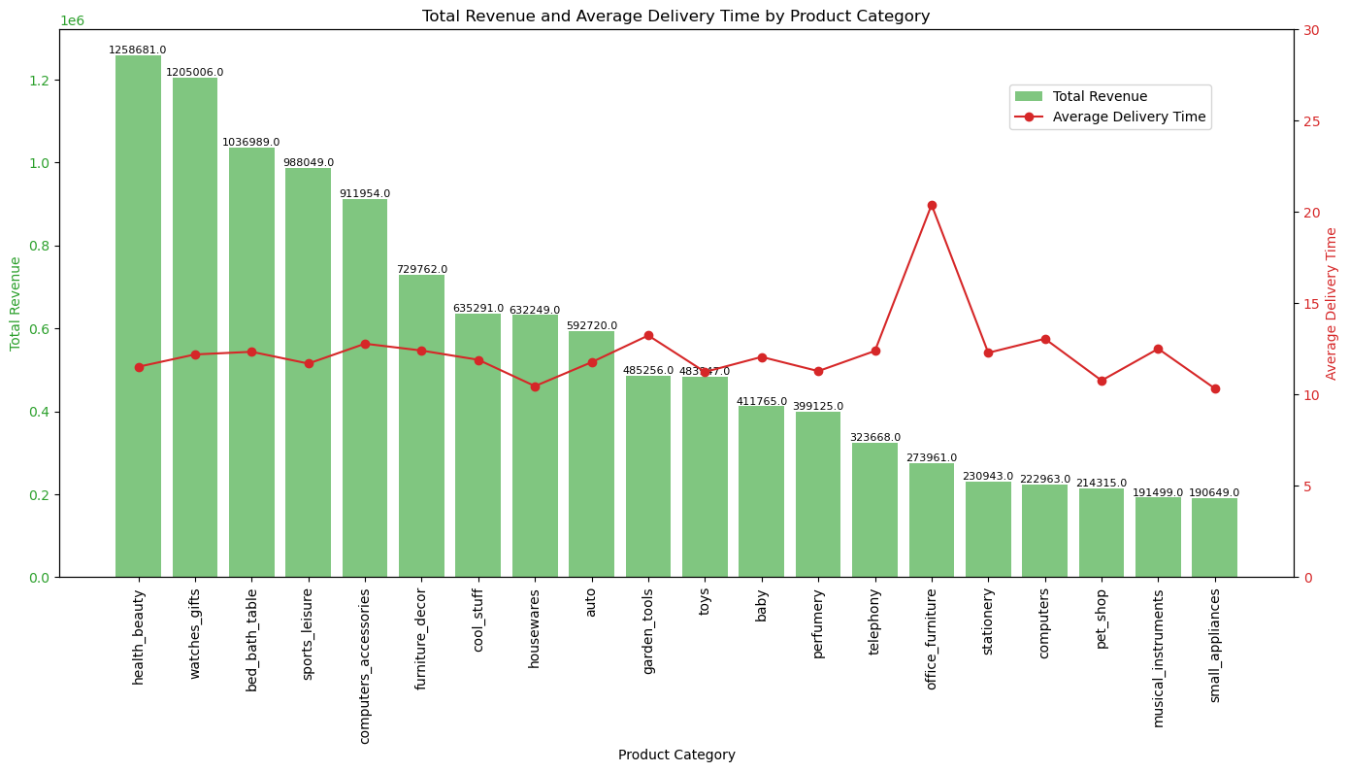
BUSINESS ACUMEN – Delivery Time
Focus on Reducing Late Deliveries: Telephone and Office Furnitures
Maintain Consistent Delivery Time: between 8-10 days is recommend

Slide 15
SUGGESTIONS

Slide 16


SUGGESTIONS
Offer cashloan in payment methods => Credit Card requires a lot of relevant documents
Show seller stocks => Managing Demand and Inventory + Planning and Forecasting

