Slide 1

PRACTICAL DEEP LEARNING FINAL PROJECT
SUMMARIZATION MODEL

Slide 2

TABLE OF CONTENTS
1
Project Objective
2
Pretrained + Dataset
3
LoRA
4
Model Result
5
Pros and Cons

Slide 3
PROJECT OBJECTIVE
Articles
Fine-tuning
Merged Model
Summary Task
Pretrained
LoRA
Dataset
Result

Slide 4
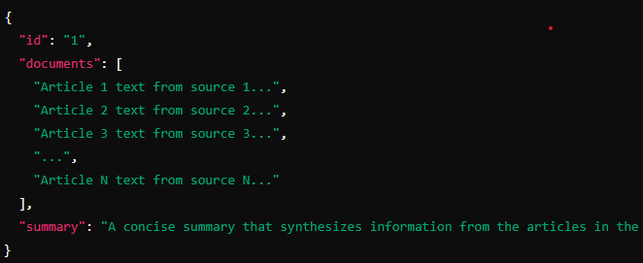
PRETRAINED + DATASET
Dataset
Multi-News, consists of news articles and human-written summaries of these articles from the site newser.com.
- Train: 44972
- Validation: 5622
- Test: 5622
Pretrained
BART is a transformer encoder-encoder (seq2seq) model with a bidirectional (BERT-like) encoder and an autoregressive (GPT-like) decoder. BART is pre-trained by:
corrupting text with an arbitrary noising function
learning a model to reconstruct the original text.
Using GeLU instead of ReLU
BART model pre-trained on English language, and fine-tuned on CNN Daily Mail.

Slide 5
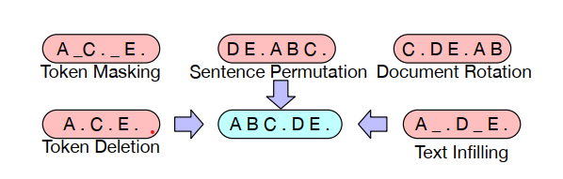
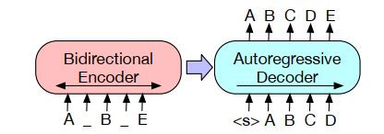
PRETRAINED + DATASET
A document has been corrupted by replacing spans of text with mask symbols
The corrupted document (left) is encoded with a bidirectional model, and then the likelihood of the original document (right) is calculated with an autoregressive decoder.
Some tasks for pretrained – BART: Token Classification, Sequence Generation, Sequence Classification, Summarization, Translation,…

Slide 6
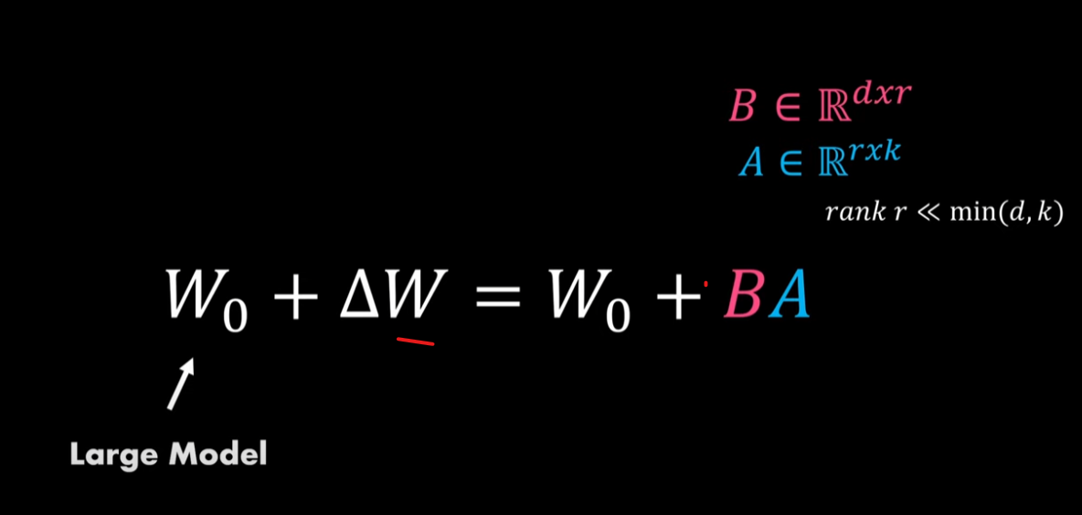
LORA – LOW-RANK ADAPTION

Slide 7
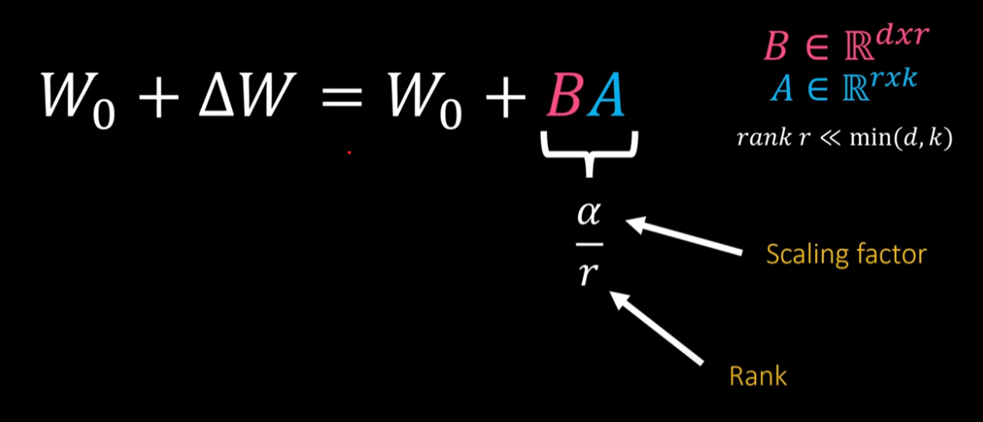
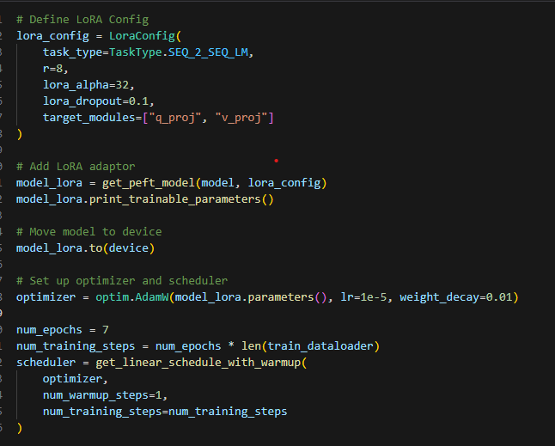
LORA – LOW-RANK ADAPTION

Slide 8
MODEL EVALUATION
Metric | Model 1 | Model 2
ROUGE-1
Precision | 0.5260 | 0.5581
Recall | 0.2546 | 0.2749
F1-score | 0.3356 | 0.3607
ROUGE-2
Precision | 0.1677 | 0.2032
Recall | 0.0811 | 0.1012
F1-score | 0.1070 | 0.1325
ROUGE-L
Precision | 0.2761 | 0.3075
Recall | 0.1339 | 0.1525
F1-score | 0.1762 | 0.1995
ROUGE-Lsum
Precision | 0.2760 | 0.3073
Recall | 0.1338 | 0.1525
F1-score | 0.1762 | 0.1996
Rouge-1 measures the precision of unigram (single-word) overlap between the generated text and a reference (human-generated) text.
Rouge-2 measures the precision of bigram overlap between the generated text and a reference (human-generated) text.
Rouge L matches the LCS (longest common subsequence) in reference and human-generated text.
Model still struggles with wall of texts

Slide 9
APPENDIX
Hu, E. J., Shen, Y., Wallis, P., Allen-Zhu, Z., Li, Y., Wang, S., ... & Chen, W. (2021). Lora: Low-rank adaptation of large language models. arXiv preprint arXiv:2106.09685.
https://arxiv.org/pdf/2106.09685
Lewis, M., Liu, Y., Goyal, N., Ghazvininejad, M., Mohamed, A., Levy, O., ... & Zettlemoyer, L. (2019). Bart: Denoising sequence-to-sequence pre-training for natural language generation, translation, and comprehension. arXiv preprint arXiv:1910.13461.
https://arxiv.org/abs/1910.13461
https://pytorch.org/docs/stable/generated/torch.nn.GELU.html
https://github.com/fshnkarimi/Fine-tuning-an-LLM-using-LoRA/
https://github.com/microsoft/LoRA
https://huggingface.co/datasets/alexfabbri/multi_news
https://www.youtube.com/watch?v=BGWpNQHIcs4&t=244s
https://medium.com/@MUmarAmanat/llm-evaluation-with-rouge-0ebf6cf2aed4

Slide 10
