Slide 1






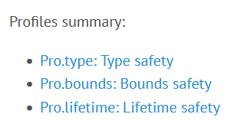
GSL: Guidelines Support Library
/docs
The Guidelines Support Library (GSL) contains functions and types that are suggested for use by the C++ Core Guidelines maintained by the Standard C++ Foundation. This repo contains Microsoft's implementation of GSL. […] The implementation generally assumes a platform that implements C++14 support.
gsl-lite is a single-file header-only implementation of the C++ Core Guidelines Support Library originally based on Microsoft GSL and adapted for C++98, C++03. It also works when compiled as C++11, C++14, C++17, C++20.

Slide 2
/docs

Slide 3
The Guidelines Support Library (GSL) contains functions and types that are suggested for use by the C++ Core Guidelines maintained by the Standard C++ Foundation. This repo contains Microsoft's implementation of GSL. […] The implementation generally assumes a platform that implements C++14 support.
gsl-lite is a single-file header-only implementation of the C++ Core Guidelines Support Library originally based on Microsoft GSL and adapted for C++98, C++03. It also works when compiled as C++11, C++14, C++17, C++20.

Slide 4
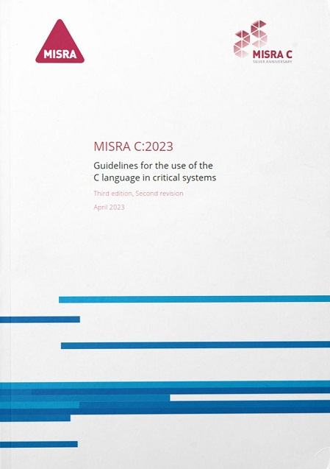
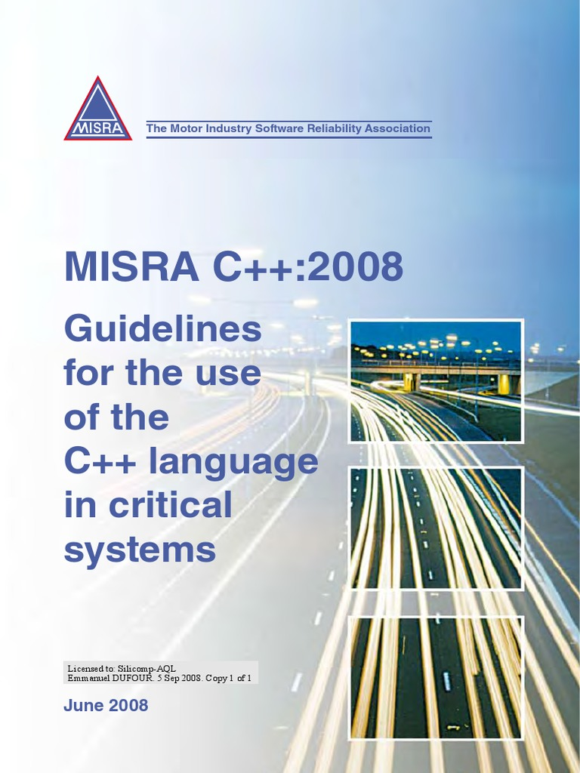
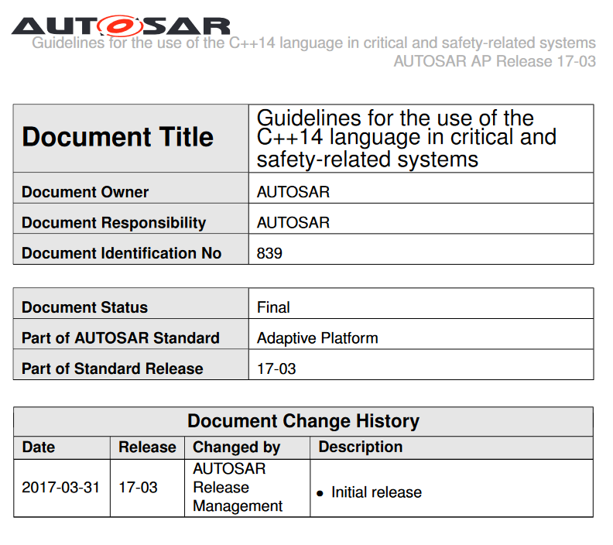
C++03
C++11/14
C++17
*
* AUTOSAR Press Release 1/29/2019 - MISRA will merge the AUTOSAR guidelines with its own established best practice to develop a single ‘go to’ language subset for safety-related C++ development. The MISRA led guidelines will incorporate the latest version of C++ language - C++17 - and, when available, its successor C++20.

Slide 5




