Slide 1
TL;DR
Use clang-tidy to enforce safety profiles from C++ Core Guideines
Leverage the Guidelines Support Library to replace unsafe features prohibited by the safety profiles

Slide 2
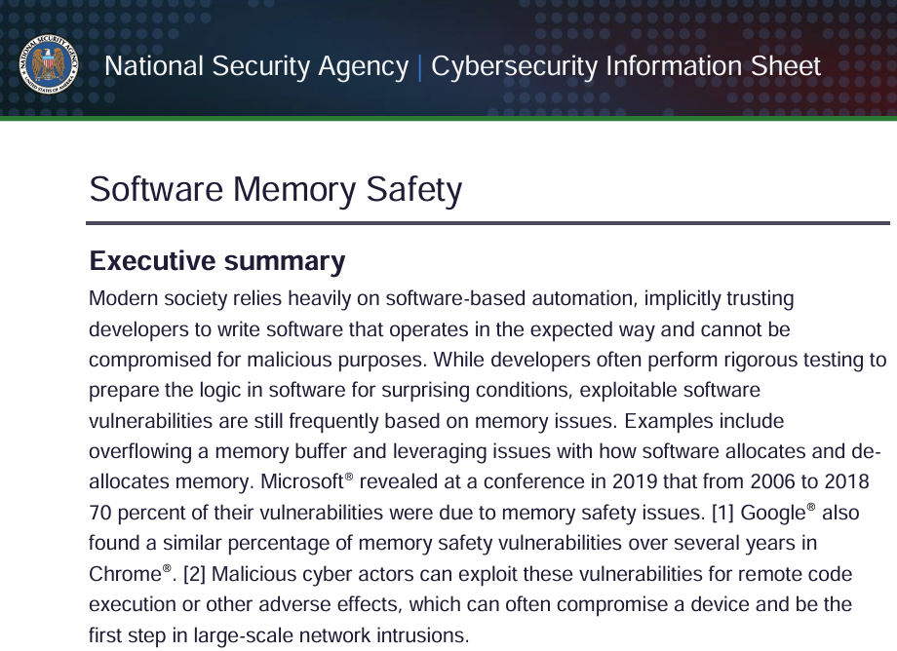
"NSA advises organizations to [...] shift from [...] C/C++ [...] to a memory safe language when possible"

Slide 3

"C and C++ [...] can lead to memory unsafe code and are still among the most widely used languages today."

Slide 4

"memory unsafe programming languages, such as C and C++",

Slide 5
Type Safety, Casting
// IEEE 754 representation of NaN
uint32_t NaN = 0x7F800001;
float f = *reinterpret_cast<float*>(&bad_value);
// May raise an exception
std::cout << f << std::endl;

Slide 6
Type Safety, Uninitialized Data
float f1;
float f2;
// Uninitialized stack data can have arbitrary values
// and result in a floating point exception
float f3 = f1 / f2;

Slide 7
Type Safety, Union
// We do this a lot with bits on HW systems
union Data
{
uint32_t i;
float f;
}
Data data;
data.i = 0x7F800001;
// NaN
std::cout << f;

Slide 8
Bounds Safety, Raw Array
// Raw arrays/pointers
char buffer[SIZE];
for(int i = 0; i=SIZE; i++){
read(buffer[i]); // WRONG: i = SIZE is out of bounds
}

Slide 9
Lifetime Safety, Use After Free
// lack of ownership/lifetime checking
int32_t* anInt = new int32_t(42);
delete anInt;
int32_t badRead = *anInt;

Slide 10


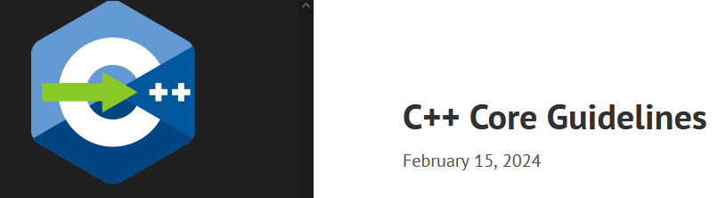
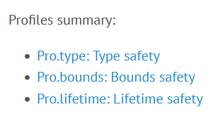

GSL: Guidelines Support Library
The Guidelines Support Library (GSL) contains functions and types that are suggested for use by the C++ Core Guidelines maintained by the Standard C++ Foundation. This repo contains Microsoft's implementation of GSL. […] The implementation generally assumes a platform that implements C++14 support.
gsl-lite is a single-file header-only implementation of the C++ Core Guidelines Support Library originally based on Microsoft GSL and adapted for C++98, C++03. It also works when compiled as C++11, C++14, C++17, C++20.

Slide 11
Superset of a Subset
GSL
Standard C++
Do not use

Slide 12
Core Guidelines Profiles
A set of deterministic and portably enforceable rules ensures
specific safety guarantees.
“Deterministic” means they need only local analysis and could be compiler-implemented.
“Portably enforceable” means they function like language
rules, providing consistent enforcement across tools.
Conforming code is considered safe for targeted properties,
though errors may still arise from other code, libraries,
or external factors.

Slide 13
Type Safety Profile
[…​] type-safety is defined to be the property that a variable is not used in a way/ that doesn’t obey the rules for the type of its definition. Memory accessed as a type T should not be valid memory that actually contains an object of an unrelated type U. Note that the safety is intended to be complete when combined also with Bounds safety and Lifetime safety.

Slide 14
Type Safety Profile Summary
Type.1: Avoid casts:
Don’t use reinterpret_cast;
A strict version of Avoid casts and prefer named casts.
Don’t use static_cast for arithmetic types;
A strict version of Avoid casts and prefer named casts.
Don’t cast between pointer types where the source type and
the target type are the same; A strict version of Avoid casts.
Don’t cast between pointer types when the conversion could be
implicit; A strict version of Avoid casts.

Slide 15
Type Safety Profile Summary
Type.2: Don’t use static_cast to downcast:
Use dynamic_cast instead.
Type.3: Don’t use const_cast to cast away const (i.e., at all):
Don’t cast away const.
Type.4: Don’t use C-style (T)expression or functional T(expression)
casts: Prefer construction or named casts or T{expression}.

Slide 16
Type Safety Profile Summary
Type.5: Don’t use a variable before it has been initialized:
always initialize.
Type.6: Always initialize a data member: always initialize,
possibly using default constructors or default member initializers.
Type.7: Avoid naked union: Use variant instead.
Type.8: Avoid varargs: Don’t use va_arg arguments.

Slide 17
Bounds Safety Profile
We define bounds-safety to be the property that a program does not use an object to access memory outside of the range that was allocated for it. Bounds safety is intended to be complete only when combined with Type safety and Lifetime safety, which cover other unsafe operations that allow bounds violations.

Slide 18
Bounds Safety Profile Summary
Bounds.1: Don’t use pointer arithmetic.
Use span instead: Pass pointers to single objects (only) and
Keep pointer arithmetic simple.
Bounds.2: Only index into arrays using constant expressions:
Pass pointers to single objects (only) and Keep pointer
arithmetic simple.
Bounds.3: No array-to-pointer decay: Pass pointers to single
objects (only) and Keep pointer arithmetic simple.
Bounds.4: Don’t use standard-library functions and types that
are not bounds-checked: Use the standard library in a type-safe
manner.

Slide 19
Lifetime Safety
Accessing through a pointer that doesn’t point to anything is a major source of errors, and very hard to avoid in many traditional C or C++ styles of programming. For example, a pointer might be uninitialized, the nullptr, point beyond the range of an array, or to a deleted object.

Slide 20
Lifetime Safety Profile Summary
Lifetime.1: Don’t dereference a possibly invalid pointer: detect or avoid.

Slide 21
The Guidelines Support Library (GSL) contains functions and types that are suggested for use by the C++ Core Guidelines maintained by the Standard C++ Foundation. This repo contains Microsoft's implementation of GSL. […] The implementation generally assumes a platform that implements C++14 support.
gsl-lite is a single-file header-only implementation of the C++ Core Guidelines Support Library originally based on Microsoft GSL and adapted for C++98, C++03. It also works when compiled as C++11, C++14, C++17, C++20.

Slide 22
GSL Key Facilities
variant<>
span<>
owner<>
unique_ptr<>
shared_ptr<>
not_null and nullptr

Slide 23
Variants over Unions
// Variants
std::variant<int, float> v;
v = 12.0f;
int i = std::get<int>(v); // Throw std::bad_variant_access
const int* p_int = std::get_if<int>(&v); // Avoid throw by checking for nullptr
const float* pf = std::get_if<float>(&v); // Valid pointer//

Slide 24
Span Over Raw Arrays
void pass_span(gsl::span<int> s)
{
for(int i : s) { /* Range based for loop */ }
}
{
int array[] = {1, 2, 3, 4, 5};
gsl::span<int, 5> s(array);
pass_span(s); // No array decay!
s[6]; // Out of bounds error (customizable assert!)
}

Slide 25
Owner<>
// Zero overhead indicator that this pointer owns the object
void g(owner<int*> p, int* q, owner<int*> p2)
{
// p = q; // bad: q is not an owner
// delete q; // bad: q is not an owner
q = p; // OK: q points to the object owned by p
delete p; // needed: we are about to overwrite p
p = p2; // OK: we just deleted p
p2 = nullptr; // so that there are not two owners of *p2
// *q = 7; // bad: assignment through now dangling pointer
delete p; // needed: we are about to leave g()
}

Slide 26
Shared_ptr<>
{// Reference = 1
std::shared_ptr<CoolThing> ptrToThing(new CoolThing());
{ // Reference count = 2
std::shared_ptr<CoolThing> 2ndPtrToThing = ptrToThing;
// Temporarily increases reference count
passByValueFunction(2ndPtrToThing); // Reference count drops back to 2 after function call
}
// 2ndPtrToThing is destroyed, reference count = 1
}
// ptrToThing is destroyed, reference count = 0,
// CoolThing is deleted

Slide 27
Unique_ptr<>
{
std::unique_ptr<MyObj> uniquePtr = std::make_unique<MyObj>();
uniquePtr->doSomething();
// Transfer ownership
std::unique_ptr<MyObj> newOwnerPtr = std::move(uniquePtr);
// Now, uniquePtr is null, and newOwnerPtr owns the object.
}
// The MyObj is automatically destroyed when newOwnerPtr
// goes out of scope.

Slide 28
TL;DR
Drop | Adopt
C-Style Casts | Named Casts and brace-initialization
union {} | variant<>
raw_arrays[] | span<>
raw_pointers* | owner<> unique_ptr<> shared_ptr<>

Slide 29
Static Analysis
clang-tidy test.cpp -checks=-*,cppcoreguidelines-*

Slide 30
Core Guidelines Rule | Checker
Type.1 Avoid Casts: Don’t use reinterpret_cast | cppcoreguidelines-pro-type-reinterpret-cast
Type.1 Avoid Casts: Don’t use static_cast
Type.1 Avoid Casts: Don’t cast between pointer types that can be the same
Type.1 Avoid Casts Don’t cast between pointer types that can be implict
Type.2 Don’t use static to downcast, use dynamic_cast instaed | cppcoreguidelines-pro-type-static-cast-downcast
Type.3 Don’t use const_cast to cast away const | cppcoreguidelines-pro-type-const-cast
Type.4: Don’t use C -Style casts | cppcoreguidelines-pro-type-cstyle-cast
Type.5: Don’t use a variable before it has been initialized | cppcoreguidelines-init-variables
Type.6: Always initialize a data member | cppcoreguidelines-pro-type-member-init
Type.7: Avoid naked union: Use variant instead. | cppcoreguidelines-pro-type-union-access
Type.8: Avoid varargs: Don’t use va_arg arguments. | cppcoreguidelines-pro-type-vararg
Bounds.1: Don’t use pointer arithmetic. | cppcoreguidelines-pro-bounds-pointer-arithmetic
Bounds.2: Only index into arrays using constant expressions: | cppcoreguidelines-pro-bounds-constant-array-index
Bounds.3: No array-to-pointer decay: | cppcoreguidelines-pro-bounds-array-to-pointer-decay
Bounds.4: Don’t use standard-library functions and types that are not bounds-checked
Lifetime.1: Don’t dereference a possibly invalid pointer: detect or avoid. | cppcoreguidelines-owning-memory

Slide 31
Referecnes
github.com/isocpp/CppCoreGuidelines/docs
A brief introduction to C++'s model for type and resource safety
Lifetime Safety: Preventing Common dangling
Others
C++ Safety In Context, Herb Sutter
Many conference talks…

Slide 32
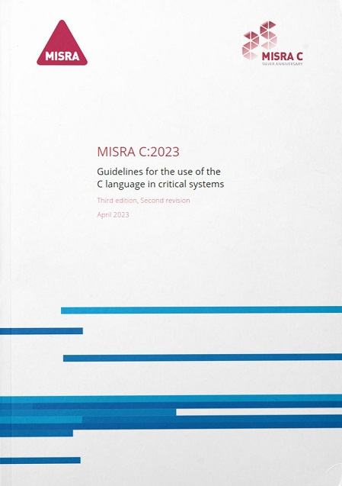
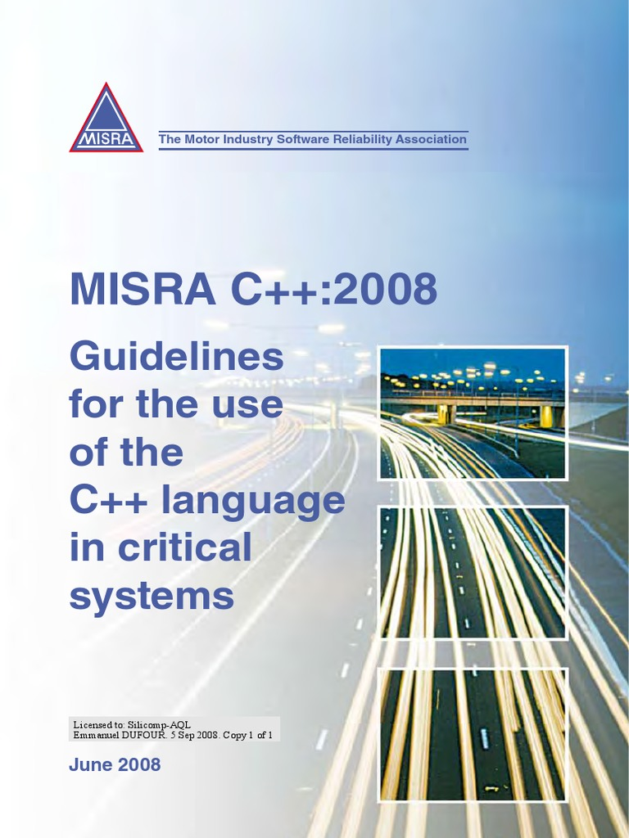
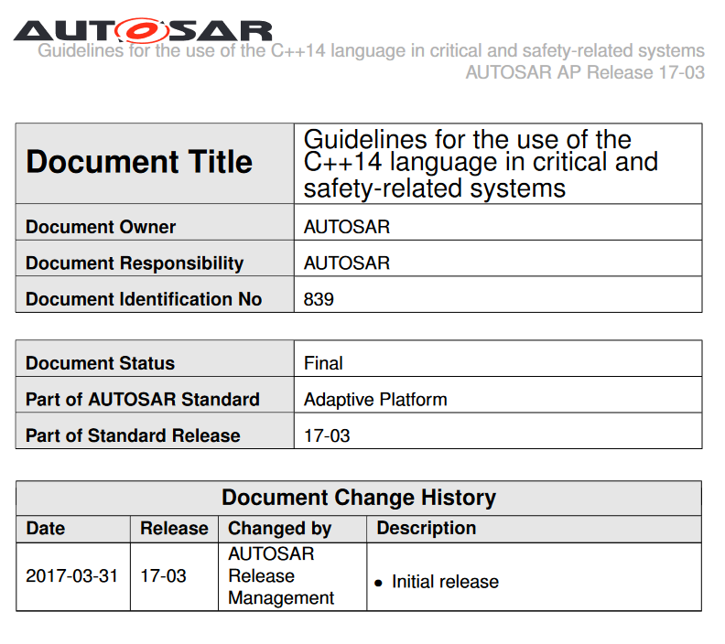
C++03
C++11/14
C++17
*
* AUTOSAR Press Release 1/29/2019 - MISRA will merge the AUTOSAR guidelines with its own established best practice to develop a single ‘go to’ language subset for safety-related C++ development. The MISRA led guidelines will incorporate the latest version of C++ language - C++17 - and, when available, its successor C++20.

Slide 34

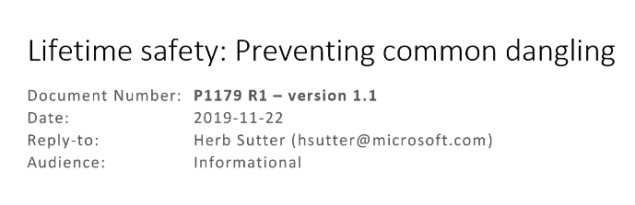
GSL: Guidelines Support Library
/docs
The Guidelines Support Library (GSL) contains functions and types that are suggested for use by the C++ Core Guidelines maintained by the Standard C++ Foundation. This repo contains Microsoft's implementation of GSL. […] The implementation generally assumes a platform that implements C++14 support.
gsl-lite is a single-file header-only implementation of the C++ Core Guidelines Support Library originally based on Microsoft GSL and adapted for C++98, C++03. It also works when compiled as C++11, C++14, C++17, C++20.

Slide 35
/docs

