Slide 1
Safer C++
Safety Profiles And Their Adoption
Matthew Wadsworth

Slide 2
ISO/IEC 23643:2020 Defintions
Software security (or “cybersecurity” or similar)
Making software able to protect its assets from a malicious attacker
Examples: securing power grids, hospitals, banks, personal data, secrets, …
Software safety (or “life safety” or similar)
Making software free from unacceptable risk of causing unintended harm to humans, property, or the environment
Examples: hospital equipment, autonomous vehicles/weapons
Programming language safety
A language’s (including its standard libraries’) static and dynamic guarantees, including but not limited to type and memory safety, which helps make our software both more secure and more safe

Slide 3
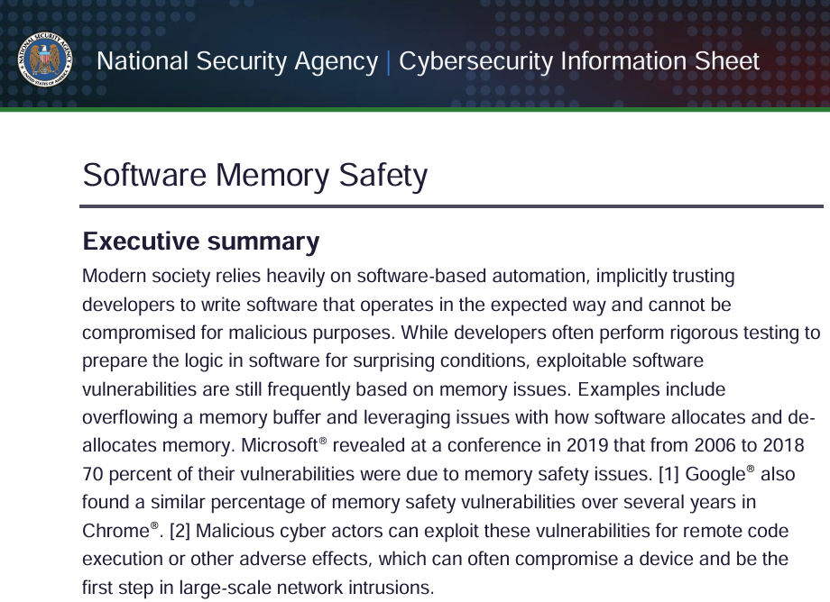
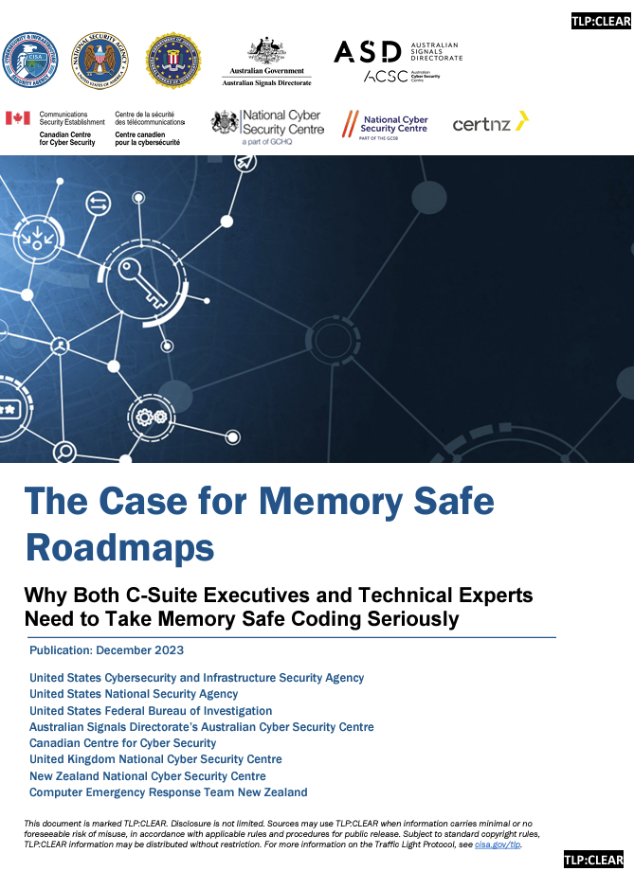
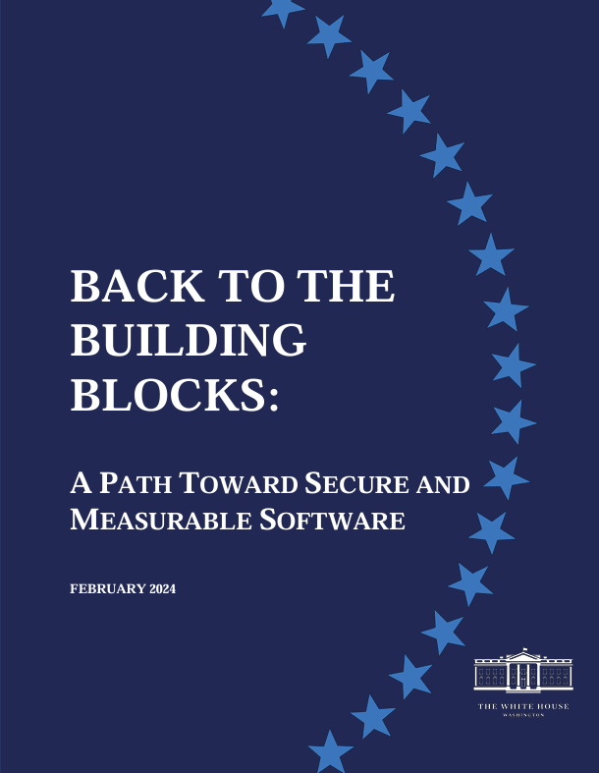
Memory Safety Is Hot
Notes:
Memory Safety is hot

Slide 4
"NSA advises organizations to [...] shift from [...] C/C++ [...] to a memory safe language when possible"
Notes:
C++ has a bad reputation

Slide 5
"C and C++ [...] can lead to memory unsafe code and are still among the most widely used languages today."
Notes:
C++ has a bad reputation

Slide 6

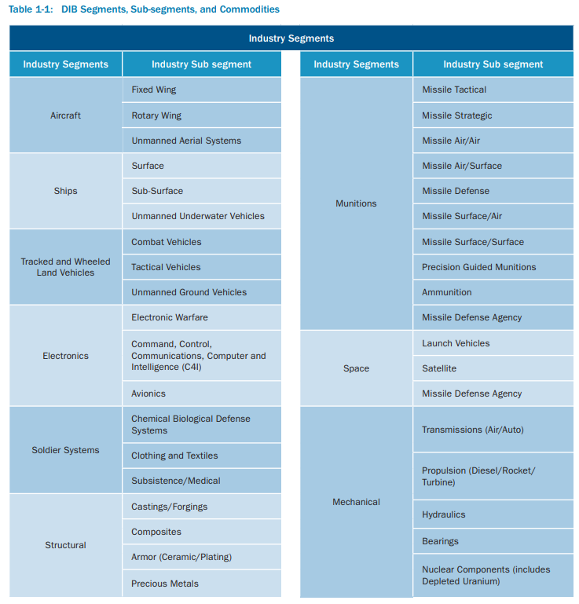
“[...] development of new product lines for use in service of critical infrastructure or NCFs in a
memory-unsafe language (e.g., C or C++) where there are readily available alternative memory-safe languages that could be used is dangerous and significantly elevates risk to national security, national economic security, and national public health and safety.”
https://www.cisa.gov/sites/default/files/publications/nipp-ssp-defense-industrial-base-2010-508.pdf

Slide 7
"memory unsafe programming languages, such as C and C++"
“Rust [...] has not yet been proven in space systems [...] Therefore, to reduce memory safety vulnerabilities in space or other embedded systems [...] a complementary approach to implement memory safety through hardware can be explored.”
Notes:
C++ has a bad reputation

Slide 8
C++ May Survive
Gov’t memos admit there are fewer options for constrained and embedded systems
It’s time and dollars expensive to switch
C++ may yet prevail in the long run
See SafeCpp and other proposals

Slide 9
TL;DR
Review the Safety Profiles from the C++ Core Guidelines
Use clang-tidy to enforce C++ Core Guidelines Rules and subset the language
clang-tidy main.cpp -checks=cppcoreguidelines-*
Leverage the Guidelines Support Library to augment the language subset

Slide 10
Why is C++ Unsafe?
Type Safety
Bounds Safety
Lifetime Safety
Notes:
We can break down the reasons why it’s unsafe as follows..

Slide 11
Type Safety, Casting
// IEEE 754 representation of NaN
uint32_t nan_value = 0x7F800001;
float f = reinterpret_cast<float>(nan_value);
// May raise an exception
std::cout << f << std::endl;
Notes:
Examples...

Slide 12
Type Safety, Uninitialized Data
// Uninitialized data can have arbitrary values
int* p_data;
// Forget to initialize…
std::cout << “Data: ” << *p_data << std::endl;

Slide 13
Type Safety, Union
// We do this a lot with bits on HW systems
union Data {
uint32_t i;
float f;
}
Data data;
data.i = 0x7F800001;
// This is reserved value for float, NaN
std::cout << f;

Slide 14
Bounds Safety, Raw Array
// Raw arrays/pointers
char buffer[SIZE];
for(int i = 0; i=SIZE; i++){
read(buffer[i]); // WRONG: i = SIZE is out of bounds
}

Slide 15
Lifetime Safety, Use After Free
// lack of ownership/lifetime checking
int32_t* anInt = new int32_t(42);
delete anInt;
int32_t badRead = *anInt;

Slide 16


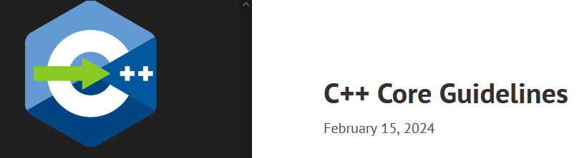
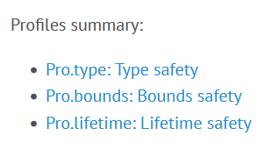

GSL: Guidelines Support Library
The Guidelines Support Library (GSL) contains functions and types that are suggested for use by the C++ Core Guidelines maintained by the Standard C++ Foundation. This repo contains Microsoft's implementation of GSL. […] The implementation generally assumes a platform that implements C++14 support.
gsl-lite is a single-file header-only implementation of the C++ Core Guidelines Support Library originally based on Microsoft GSL and adapted for C++98, C++03. It also works when compiled as C++11, C++14, C++17, C++20.

Slide 17
Superset of a Subset
GSL
Standard C++
Do not use

Slide 18
Safety Profiles
A set of deterministic and portably enforceable rules designed to achieve specific guarantees.
“Deterministic” means they need only local analysis and could be compiler-implemented.
“Portably enforceable” means they function like language
rules, providing consistent enforcement across tools.
Conforming code is considered safe for targeted properties,
though errors may still arise from other code, libraries,
or external factors.
Notes:
This text is minimally paraphrased from the CGL

Slide 19
Type Safety Profile
[…​] type-safety is defined to be the property that a variable is not used in a way that doesn’t obey the rules for the type of its definition. Memory accessed as a type T should not be valid memory that actually contains an object of an unrelated type U. Note that the safety is intended to be complete when combined also with Bounds safety and Lifetime safety.

Slide 20
Type Safety Profile Summary
Type.1: Avoid casts:
Don’t use reinterpret_cast; A strict version of Avoid casts and prefer named casts.
Don’t use static_cast for arithmetic types; A strict version of Avoid casts and prefer named casts.
Don’t cast between pointer types where the source type and the target type are the same; A strict version of Avoid casts.
Don’t cast between pointer types when the conversion could be implicit; A strict version of Avoid casts.

Slide 21
Type Safety Profile Summary
Type.2: Don’t use static_cast to downcast: Use dynamic_cast instead.
Type.3: Don’t use const_cast to cast away const (i.e., at all): Don’t cast away const.
Type.4: Don’t use C-style (T)expression or functional T(expression) casts: Prefer construction or named casts or T{expression}.

Slide 22
Type Safety Profile Summary
Type.5: Don’t use a variable before it has been initialized: always initialize.
Type.6: Always initialize a data member: always initialize, possibly using default constructors or default member initializers.
Type.7: Avoid naked union: Use variant instead.
Type.8: Avoid varargs: Don’t use va_arg arguments.

Slide 23
Bounds Safety Profile
We define bounds-safety to be the property that a program does not use an object to access memory outside of the range that was allocated for it. Bounds safety is intended to be complete only when combined with Type safety and Lifetime safety, which cover other unsafe operations that allow bounds violations.

Slide 24
Bounds Safety Profile Summary
Bounds.1: Don’t use pointer arithmetic. Use span instead: Pass pointers to single objects (only) and keep pointer arithmetic simple.
Bounds.2: Only index into arrays using constant expressions: Pass pointers to single objects (only) and Keep pointer arithmetic simple.
Bounds.3: No array-to-pointer decay: Pass pointers to single objects (only) and Keep pointer arithmetic simple.
Bounds.4: Don’t use standard-library functions and types that are not bounds-checked: Use the standard library in a type-safe manner.

Slide 25
Lifetime Safety
Accessing through a pointer that doesn’t point to anything is a major source of errors, and very hard to avoid in many traditional C or C++ styles of programming. For example, a pointer might be uninitialized, the nullptr, point beyond the range of an array, or to a deleted object.

Slide 26
Lifetime Safety Profile Summary
Lifetime.1: Don’t dereference a possibly invalid pointer: detect or avoid.

Slide 27
The Guidelines Support Library (GSL) contains functions and types that are suggested for use by the C++ Core Guidelines maintained by the Standard C++ Foundation. This repo contains Microsoft's implementation of GSL. […] The implementation generally assumes a platform that implements C++14 support.
gsl-lite is a single-file header-only implementation of the C++ Core Guidelines Support Library originally based on Microsoft GSL and adapted for C++98, C++03. It also works when compiled as C++11, C++14, C++17, C++20.

Slide 28
GSL Key Facilities
span<>
variant<>
owner<>
unique_ptr<>
shared_ptr<>
not_null and nullptr

Slide 29
Replace Raw Arrays With span<>
void pass_span(gsl::span<int> s)
{
for(int i : s) { /* Range based for loop */ }
}
{
int array[] = {1, 2, 3, 4, 5};
gsl::span<int, 5> s(array);
pass_span(s); // No array decay!
s[6]; // Out of bounds error (customizable assert!)
}

Slide 30
Replace unions With variants<>
// Variants
std::variant<int, float> v;
v = 12.0f;
// Throws std::bad_variant_access
int i = std::get<int>(v);
// Avoid throw by checking for nullptr
const int* p_int = std::get_if<int>(&v);
// Valid pointer
const float* pf = std::get_if<float>(&v);

Slide 31
owner<>
// Zero overhead indicator that this pointer owns the object
void g(owner<int*> p, int* q, owner<int*> p2)
{
// p = q; // bad: q is not an owner
// delete q; // bad: q is not an owner
q = p; // OK: q points to the object owned by p
delete p; // needed: we are about to overwrite p
p = p2; // OK: we just deleted p
p2 = nullptr; // so that there are not two owners of *p2
// *q = 7; // bad: assignment through now dangling pointer
delete p; // needed: we are about to leave g()
}

Slide 32
Ownership Rules
A pointer returned by new is an owner and must be deleted (unless stored in static storage to ensure that it lives “forever.”).
Only a pointer known to be an owner can be deleted. Thus, a pointer passed into a scope as an owner<T*> must be deleted in that scope or passed along to another scope as an owner.
A pointer that is passed into a scope as a plain T* may not be deleted.
A pointer passed to another scope as an owner and not passed back as an owner is said to be invalidated and cannot be used again in its original scope (since it will have been deleted).

Slide 33
shared_ptr<>
{// Reference = 1
std::shared_ptr<CoolThing> ptrToThing(new CoolThing());
{ // Reference count = 2
std::shared_ptr<CoolThing> 2ndPtrToThing = ptrToThing;
// Temporarily increases reference count
passByValueFunction(2ndPtrToThing); // Reference count drops back to 2 after function call
}
// 2ndPtrToThing is destroyed, reference count = 1
}
// ptrToThing is destroyed, reference count = 0,
// CoolThing is deleted

Slide 34
unique_ptr<>
{
std::unique_ptr<MyObj> uniquePtr = std::make_unique<MyObj>();
uniquePtr->doSomething();
// Transfer ownership
std::unique_ptr<MyObj> newOwnerPtr = std::move(uniquePtr);
// Now, uniquePtr is null, and newOwnerPtr owns the object.
}
// The MyObj is automatically destroyed when newOwnerPtr
// goes out of scope.

Slide 35
Feature Replacement TL;DR
Drop | Adopt
C-Style Casts | Named Casts and brace-initialization
union {} | variant<>
raw_arrays[] | span<>
raw_pointers* | owner<> unique_ptr<> shared_ptr<>

Slide 36
Static Analysis
clang-tidy test.cpp -checks=-*,cppcoreguidelines-*

Slide 37
Core Guidelines Rule | Checker
Type.1 Avoid Casts: Don’t use reinterpret_cast | cppcoreguidelines-pro-type-reinterpret-cast
Type.1 Avoid Casts: Don’t use static_cast for arithmetic types
Type.1 Avoid Casts: Don’t cast between pointer types that can be the same
Type.1 Avoid Casts Don’t cast between pointer types that can be implict
Type.2 Don’t use static to downcast, use dynamic_cast instead | cppcoreguidelines-pro-type-static-cast-downcast
Type.3 Don’t use const_cast to cast away const | cppcoreguidelines-pro-type-const-cast
Type.4: Don’t use C -Style casts | cppcoreguidelines-pro-type-cstyle-cast
Type.5: Don’t use a variable before it has been initialized | cppcoreguidelines-init-variables
Type.6: Always initialize a data member | cppcoreguidelines-pro-type-member-init
Type.7: Avoid naked union: Use variant instead. | cppcoreguidelines-pro-type-union-access
Type.8: Avoid varargs: Don’t use va_arg arguments. | cppcoreguidelines-pro-type-vararg
Bounds.1: Don’t use pointer arithmetic. | cppcoreguidelines-pro-bounds-pointer-arithmetic
Bounds.2: Only index into arrays using constant expressions: | cppcoreguidelines-pro-bounds-constant-array-index
Bounds.3: No array-to-pointer decay: | cppcoreguidelines-pro-bounds-array-to-pointer-decay
Bounds.4: Don’t use standard-library functions and types that are not bounds-checked
Lifetime.1: Don’t dereference a possibly invalid pointer: detect or avoid. | cppcoreguidelines-owning-memory

Slide 38
Gaps
Concurrency
Iterator invalidation
Aliasing

Slide 39
Safety Profiles In Context
Safety profiles represent the low-hanging fruit available today
The safety guarantees are incomplete...
New proposals with stronger guarantees are released frequently
There is a push and pull to improve safety and avoid breaking syntax and ABI changes

Slide 40
References
github.com/isocpp/CppCoreGuidelines/docs
A brief introduction to C++'s model for type and resource safety
Lifetime Safety: Preventing Common dangling
C++ Safety In Context, Herb Sutter
Core Safety Profiles: Specification, adoptability, and impact
SafeCpp Proposal

Slide 41
Backup

Slide 42
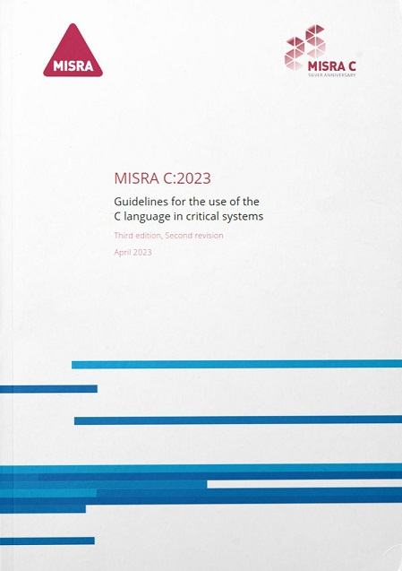
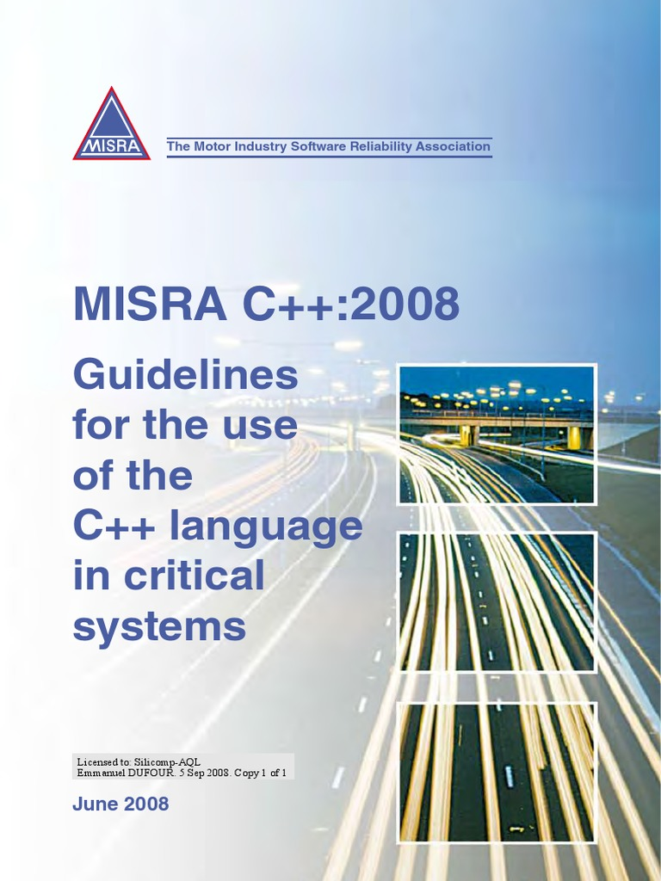
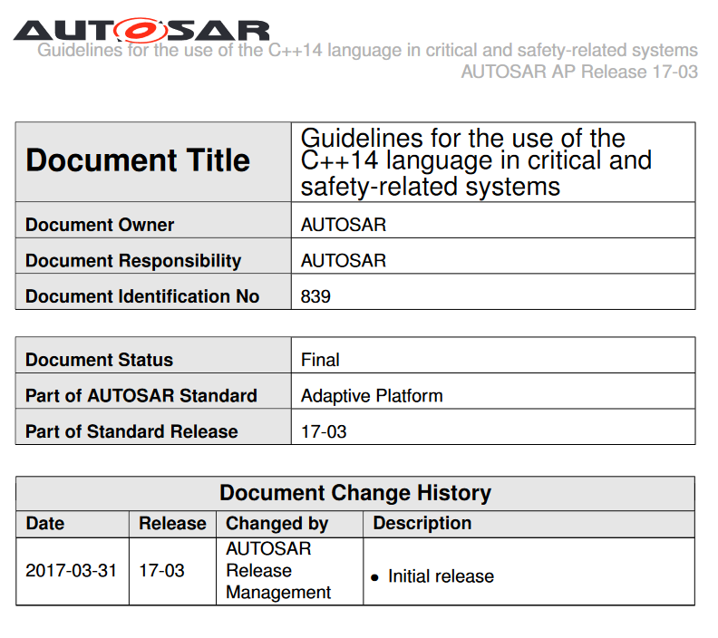
C++03
C++11/14
C++17
*
* AUTOSAR Press Release 1/29/2019 - MISRA will merge the AUTOSAR guidelines with its own established best practice to develop a single ‘go to’ language subset for safety-related C++ development. The MISRA led guidelines will incorporate the latest version of C++ language - C++17 - and, when available, its successor C++20.

Slide 44
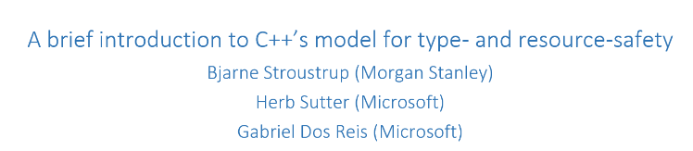
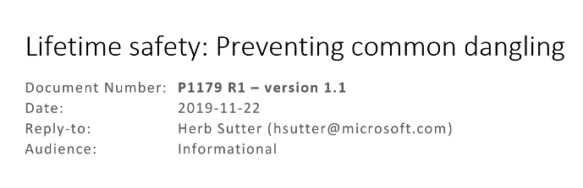
GSL: Guidelines Support Library
/docs
The Guidelines Support Library (GSL) contains functions and types that are suggested for use by the C++ Core Guidelines maintained by the Standard C++ Foundation. This repo contains Microsoft's implementation of GSL. […] The implementation generally assumes a platform that implements C++14 support.
gsl-lite is a single-file header-only implementation of the C++ Core Guidelines Support Library originally based on Microsoft GSL and adapted for C++98, C++03. It also works when compiled as C++11, C++14, C++17, C++20.

Slide 45
/docs

