Slide 1
Introduction to Python
Direct Loops: For Loops

Slide 2
Topics
For Loops

Slide 3
For Loops
In general, a loop allows a sequence of instructions to execute some task repeatedly until some condition is met.
Python’s for loop iterates over items of a sequence(e.g. a list, string or tuple) and process them with some code.
for x in sequence: block
for x in [2,3,5,7]: print(x, end=“ ”) # print all on same line
2 3 5 7
This is a list. More on lists in a later lecture.

Slide 4
For Each Loops
for x in [2,3,5,7]: print(x)
2
3
5
7
for x in "hello": print(x)
h
e
l
l
o
Iterate through each number in the list.
"for each x in" list.
Iterate through each character in the string.

Slide 5
range(stop)
A simple use of a for loop runs some code a specified number of times using the range() function.
range(stop): returns sequence of numbers from 0 (default) up to but not including stop. Increment by 1 (default).
for i in range(10):
print(i, end=" ")
0 1 2 3 4 5 6 7 8 9

Slide 6
range(start, stop)
range(start, stop): from start up to but not including stop. Increment by 1(default).
In[2]: for i in range(2, 8):
print(i, end=' ')
2 3 4 5 6 7

Slide 7
range(start, stop, step)
range(start, stop, step): from start up to but not including stop, increment by step.
for i in range(1, 10, 2):
print(i, end=' ')
1 3 5 7 9
If step is negative, a list can be traversed backwards.
for i in range(10, 2, -1):
print(i, end=' ')
10 9 8 7 6 5 4 3

Slide 8
Definite Loop
The for loop is an example of a definite loop. We can determine ahead of time the number of times the loop repeats. Later, we will talk about indefinite loop, a loop where we cannot predict the number of times a loop repeats.
for i in range(5): print("*", end="")
*****
The loop above prints five *'s. We can determine this ahead of time from the for loop statement.

Slide 9
Summing and Counting
There are two common tasks that uses for loops.
1) Summing
2) Counting

Slide 10
Summing Values
Write a segment of code that solve the problem
1 + 2 + 3 + … + 98 + 99 + 100.
We need a variable that accumulate the sum at each iteration of the loop. This variable should be initialized to 0.
sum = 0
for i in range(1, 101): sum += i

Slide 11
Writing a function to sum
Now write a function that accepts a non-negative integer input n and returns the sum of integers from 1 to n(including).
def sum(n):
sum = 0
for i in range(1, n+1): sum += i
return sum
print(sum(5)) # 1+2+3+4+5=15
a = sum(100) # a = 5050
print(a) # 5050 is printed on console

Slide 12
Conditional Summing
Write a segment of code that compute the sum of all numbers from 1 to 100 that are multiples of 3.
sum = 0
for i in range(0, 101, 3):
sum += i
Or equivalently, we can use a conditional to select the numbers to add:
sum = 0
for i in range(1, 101): if i % 3 == 0:
sum += i
Better to use if conditional for filtering.
In general, using the step size above
might not always work.

Slide 13
Conditional Summing Example
Write a segment of code that compute the sum of all numbers from 1 to 100. However:
if a number is a multiple of 3, double it before adding,
if a number is a multiple of 5, triple it before adding,
If a number is a multiple of both, quadruple it before adding.
otherwise, just add the number.

Slide 14
Conditional Summing Solution?
Is the following a correct solution?
sum = 0
for i in range(1, 101):
if i % 3 == 0:
sum += 2 * i
elif i % 5 == 0:
sum += 3 * i
elif i % 3 == 0 and i % 5 == 0:
sum += 4 * i
else:
sum += i
No! Why not?

Slide 15
Conditional Summing Solution
The following is correct.
sum = 0
for i in range(1, 101):
if i % 3 == 0 and i % 5 == 0:
sum += 4 * i
elif i % 3 == 0:
sum += 2 * i
elif i % 5 == 0 :
sum += 3 * i
else:
sum += i

Slide 16
Counting
Write a function that accepts an integer n and returns the number of factors of n.
def count_factors(n):
count = 0
for i in range(1, n+1):
if n % i == 0: # i is a factor of n
count += 1
return count
print(count_factors(10)) # 4 (factors of 10 = {1,2,5,10})
print(count_factors(7)) # 2 (factors of 7 = {1,7})

Slide 17
For Loop in Movies and TV-Shows
Movies:
Groundhog Day(1993); Bill Murray.
Looper(2010); Bruce Willis and Joseph Gordon-Levitt, Emily Blunt.
Edge of Tomorrow(2014); Tom Cruise, Emily Blunt.
Happy Death Day(2017).
TV-Show:
Russian Doll(Netflix, Emmy-Nominated)

Slide 18
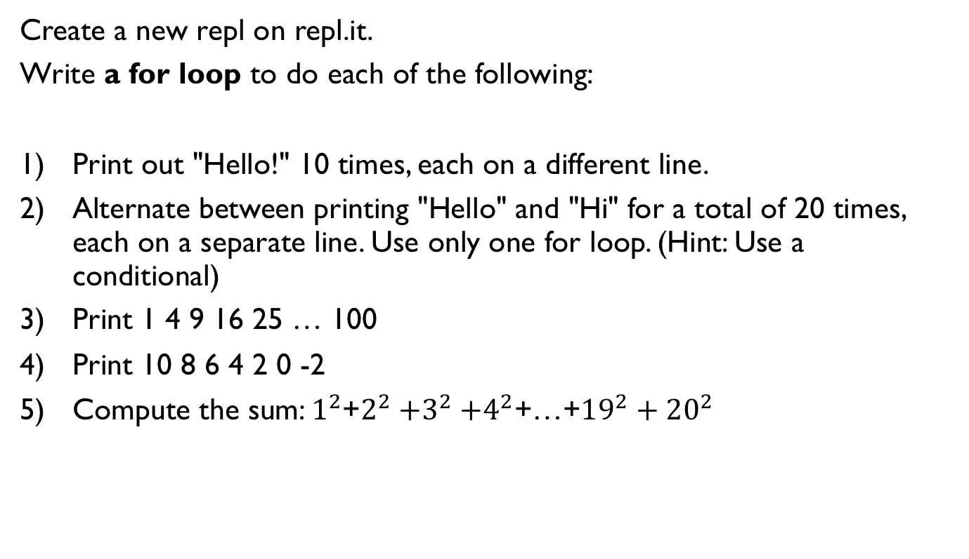
Lab 1
Create a new repl on repl.it.
Write a for loop to do each of the following:
Print out "Hello!" 10 times, each on a different line.
Alternate between printing "Hello" and "Hi" for a total of 20 times, each on a separate line. Use only one for loop. (Hint: Use a conditional)
Print 1 4 9 16 25 … 100
Print 10 8 6 4 2 0 -2
Compute the sum: $1^{2}$+$2^{2}{+3}^{2}+4^{2}$+…+${19}^{2}+{20}^{2}$

Slide 19
Lab 2: Counting Primes
Create a new repl.
1) Rewrite the function count_factors as explained in a previous slide.
2) A number n is prime if its only factors are 1 and n. Write the function is_prime which accepts an integer n and returns whether it is prime. Note that 1 is not prime. You must call the function count_factors in your implementation of is_prime.
is_prime(13) returns True
is_prime(1245) returns False
3) Write the function num_primes which accepts an integer n and and returns the number of primes up to and including n. You must call the function is_prime in your implementation.
num_prime(11) returns 5 since 2, 3, 5, 7, 11 are the 5 prime numbers less than or equal to 11.
Call the three above functions with different inputs and make sure that your functions work as expected.

Slide 20
References
Vanderplas, Jake, A Whirlwind Tour of Python, O’reilly Media.

