Slide 1
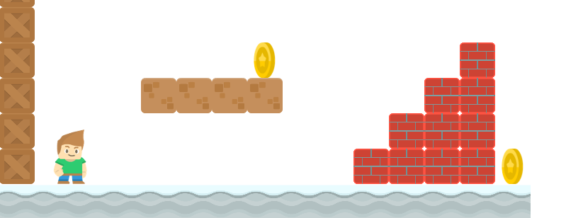
How to Write a Platformer Game in Java
Animated Sprites
Long Nguyen
Boston Latin School

