Slide 1
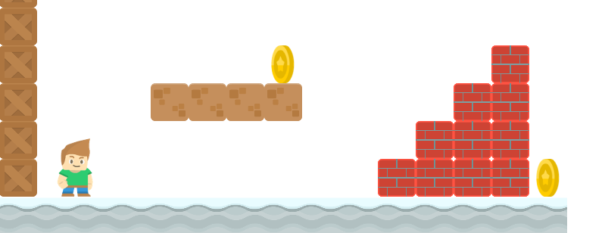
How to Write a Platformer Game in Java
Creating Enemies
Long Nguyen
Boston Latin School

