Slide 1
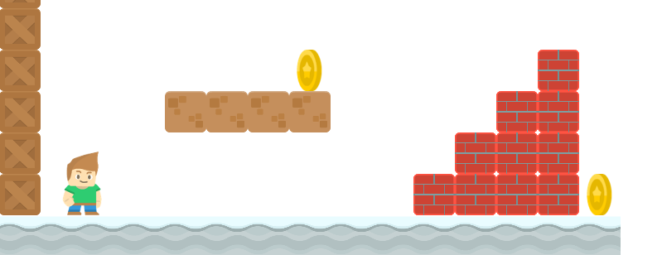
How to Write a Platformer Game in Java
Animating the Player
Long Nguyen
Boston Latin School

