Slide 1
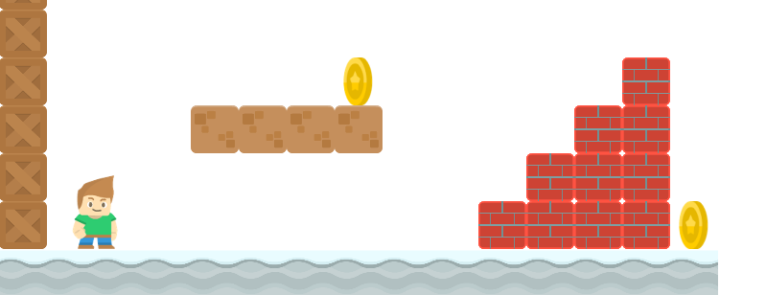
How to Write a Platformer Game in Java
Scrolling
Long Nguyen
Boston Latin School

Slide 2



Scrolling
visible part of game map
not visible
Origin (0,0)
Y
X

Slide 3
Scrolling
view_x and view_y is top left corner
of our window which we like to translate
around to see other parts of the bigger game
map.
(view_x, view_y)
Origin (0,0)
Y
X

Slide 4
Scrolling
view_x and view_y is top left corner
of our window which we like to translate
around to see other parts of the bigger game
map.
(view_x, view_y)
Origin (0,0)
Y
X

Slide 5
Scrolling
Use the method translate(new_origin_x, new_origin_y)
(view_x, view_y)
Origin (0,0)
Y
visible window doesn't move!
Everything is drawn relative to the origin (0,0)
X

Slide 6
Example
Suppose we want our visible window (view_x, view_y) to move to (15, 5).
Then we need origin to be at the relative position (-15, -5).
translate(-15, -5);
(15, 5)
Origin (0,0)
Y
Our visible screen doesn't move so we now see a new part of the map!
X

Slide 7
Boundary and Margins
If player leaves boundary:
compute new view_x, view_y to maintain margin
translate(-view_x, -view_y)
(view_x, view_y)
right boundary
Origin (0,0)
Y
bottom boundary
bottom margin
right margin
X

Slide 8
Boundary and Margins
If player leaves boundary:
compute new view_x, view_y to maintain margin
translate(-view_x, -view_y)
(view_x, view_y)
right boundary
Origin (0,0)
Y
bottom boundary
bottom margin
right margin
X

Slide 9
Boundary and Margins
If player leaves boundary:
compute new view_x, view_y to maintain margin
translate(-view_x, -view_y)
(view_x, view_y)
right boundary
Origin (0,0)
Y
bottom boundary
bottom margin
right margin
X

Slide 10
Boundary and Margins
If player leaves boundary:
compute new view_x, view_y to maintain margin
translate(-view_x, -view_y)
(view_x, view_y)
right boundary
Origin (0,0)
Y
bottom boundary
bottom margin
right margin
X

Slide 11
Boundary and Margins
If player leaves boundary:
compute new view_x, view_y to maintain margin
translate(-view_x, -view_y)
(view_x, view_y)
right boundary
Origin (0,0)
Y
bottom boundary
bottom margin
right margin
X

Slide 12
Boundary and Margins
right boundary = view_x + width – right margin
bottom boundary = view_y + height – bottom margin
(view_x, view_y)
right boundary
Origin (0,0)
Y
bottom boundary
bottom margin
right margin
X

Slide 13
Text On Screen
Text on the screen such as number of lives or score need to be relative to view_x and view_y. Otherwise, it won't scroll with the player!
(view_x, view_y)
Origin (0,0)
Lives : 3
Y
X

