Slide 1
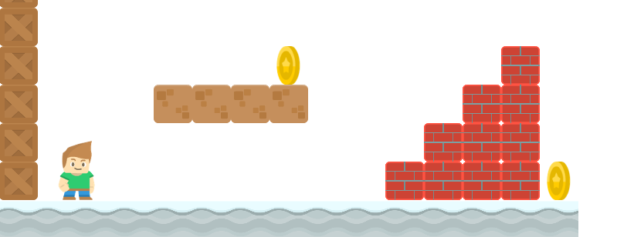
How to Write a Platformer Game in Java
Finishing Up The Game
Long Nguyen
Boston Latin School

Slide 2
Other Features
Game Over Screen
Restart Game Feature
Fall Off Cliffs and Enemy Collision
Clean Up and Refactor Some Code
Website: https://longbaonguyen.github.io/courses/platformer/platformer.html
Template for coding the key components of this game.

Slide 3
Other Resources
Website: https://longbaonguyen.github.io/
1) AP Computer Science A
2) AP Computer Science Principles
Udemy Courses:
1) Coding Games in Python.(Tank Attacks, Brick Breaker, Platformer, Tetris)
2) Image Recognition with Neural Networks From Scratch
3) Introduction to the Discrete Fourier Transform

