Slide 1
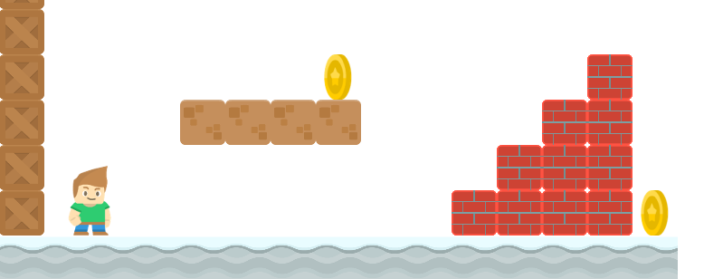
How to Write a Platformer Game in Java
Preview

Slide 2
Introduction
Long Nguyen
Faculty at Boston Latin School, Lecturer at Umass Boston
AP Computer Science A
AP Computer Science Principles

Slide 3
How to Write a Platformer Game in Java
Preview
Long Nguyen
Boston Latin School

Slide 4
Curriculum
In the course of writing the game, we’ll cover important topics:
1) conditional
2) loops
3) object-oriented programming
4) arrays, arraylists, 2D arrays
5) inheritance, polymorphism

Slide 5
Game Preview
Let's see a quick preview of the game.

