Slide 1
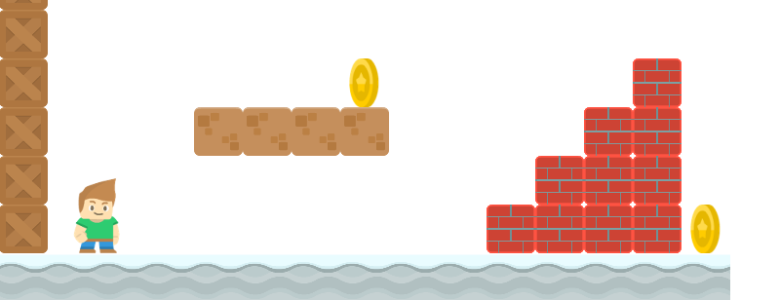
How to Write a Platformer Game in Java
Preview
Long Nguyen
Boston Latin School

Slide 2
Introduction
Long Nguyen
Faculty at Boston Latin School, Lecturer at Umass Boston
AP Computer Science A
AP Computer Science Principles

Slide 3
Curriculum
We will write a platformer(or side-scrolling) game like Super Mario, all from scratch!
In the course of writing the game, we’ll cover important topics:
1) conditional
2) loops
3) methods
4) object-oriented programming
5) arrays, arraylists, 2D arrays
6) inheritance, polymorphism

Slide 4
Labs
I will walkthrough most of the code in the videos but I created labs that:
help students apply what they learn
are accessible for both new as well as experienced programmers.

Slide 5
Game Preview
Let's see a quick preview of the game.

