Slide 1
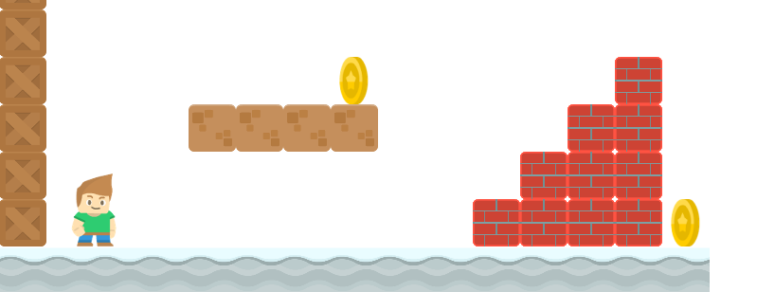
How to Write a Platformer Game in Java
Introduction to Processing
Long Nguyen
Boston Latin School
`

Slide 2
Processing
Processing is a software sketchbook that allows visual artists to create animation and art easily with very simple Java code.
Download Processing for free at www.processing.org.

Slide 3
Structure of a Sketch
A sketch or program in processing only needs two methods: setup() and draw().
setup() is similar to a constructor, it initializes variables.
draw() is similar to the main method, but it loops infinitely 60 times a second to create the animation.
void setup(){
…
}
void draw(){
…
}

Slide 4
setup()
//declare global variables on top
//setup() is called automatically to initialize variables, runs ONCE.
void setup(){
…
}
void draw(){
…
}

Slide 5
draw()
void setup(){
…
}
// draw() is called automatically 60 times a second
// each iteration is a frame where objects and images can be drawn and updated
// cycling through the frames create animation
void draw(){
…
}

Slide 6
Example
int x, y; //declare global variables
//initialize them in setup().
void setup(){
x = 5;
y = 10;
}
// modify and update them in draw().
void draw(){
x += 1; //x increases by 1, 60 times per second.
println(x);
}

