Slide 1
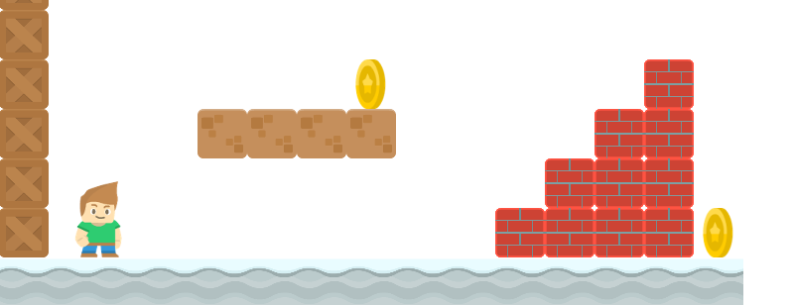
How to Write a Platformer Game in Java
Creating the Sprite Class
Long Nguyen
Boston Latin School

