Slide 1
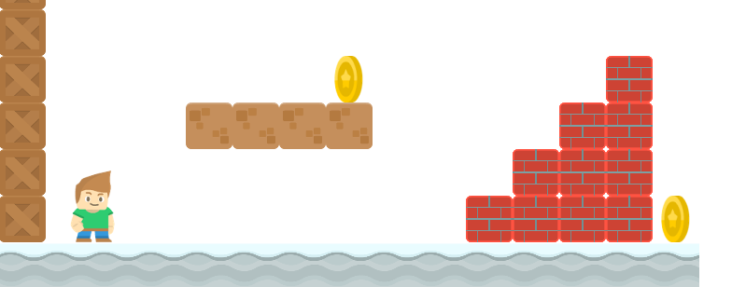
How to Write a Platformer Game in Java
Keyboard Inputs, Controlling the Sprite
Long Nguyen
Boston Latin School

