Slide 1
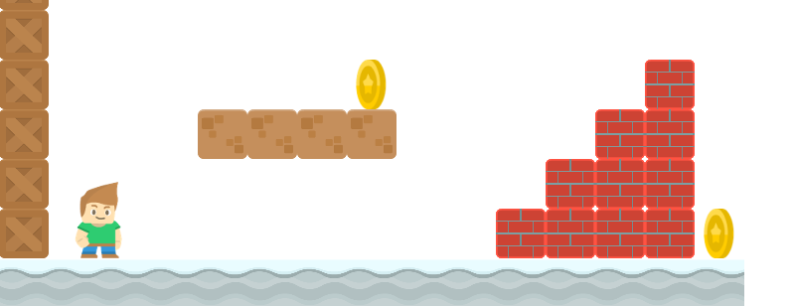
How to Write a Platformer Game in Java
Create Platforms Using a CSV File
Long Nguyen
Boston Latin School

Slide 2
CSV Files
Comma separated values(CSV) files are just text files whose values are separated by commas.
On Mac, use TextEdit.
On Windows, use NotePad.
Make sure that the format is plain text.
All images for this game can be found on https://www.kenney.nl/
Images are originally 128 x 128. We'll scale down to 50 pixels x 50 pixels.

Slide 3


Converting CSV to Grid Map
width = 200 pixels
height = 150 pixels
SPRITE_SIZE = 50
Origin (0,0)
X
(25, 25)
(75, 25)
(125, 25)
(175, 25)
csv file
0,0,0,0
0,0,1,0
1,0,0,2
Y
(25, 75)
(25, 125)
center_x = SPRITE_SIZE/2 + col * SPRITE_SIZE
center_y = SPRITE_SIZE/2 + row * SPRITE_SIZE

