Slide 1
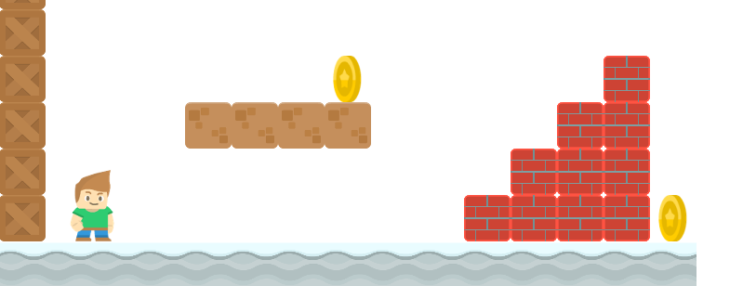
How to Write a Platformer Game in Java
Collision Detection
Long Nguyen
Boston Latin School

Slide 2


Collision Detection
Collision!

Slide 3
Collision Detection
No Collision!

Slide 4
Collision Detection
We will need accessor methods to retrieve left, right, top and bottom boundary of a
Sprite so that we can detect collision.
The Sprite Class
Pimage image float w float h float center_x float center_y float change_x float change_y
void display() void update()
top
left
right
bottom

Slide 5
Collision Detection
We will need accessor methods to retrieve left, right, top and bottom boundary of a
Sprite so that we can detect collision.
The Sprite Class
Pimage image float w float h float center_x float center_y float change_x float change_y
void display() void update() float getLeft() float getRight() float getBottom() float getTop()
top
left
right
bottom

Slide 6
imageMode
(center_x, center_y)
Make sure that in setup(), we set the position of an image to be its center.
void setup(){
size(800, 600);
imageMode(CENTER);
}

Slide 7
getLeft
w
left
(center_x, center_y)
In the Sprite class,
public float getLeft(){
return center_x – w/2;
}
Similarly for getRight(),
getTop() and getBottom()

Slide 8
Collision Detection
We will also need mutator methods setLeft, setRight, setTop and setBottom.
The Sprite Class
Pimage image float w float h float center_x float center_y float change_x float change_y
… void setLeft(float newLeft) void setRight(float newRight) void setTop(float newTop) void setBottom(float newBottom)
top
left
right
bottom

Slide 9
Fix Collisions
We need, for example, setBottom and getTop to fix this collision.
Sprite player;
Sprite crate;

Slide 10
Fix Collisions
We need, for example, setBottom and getTop to fix this collision.
Sprite player;
Sprite crate;
Code to fix collision:
player.setBottom(crate.getTop());

Slide 11
setLeft
w
newLeft
(center_x, center_y)
In the Sprite class,
public void setLeft(float newLeft){
center_x = newLeft + w/2;
}
Similarly for setRight,
setTop and setBottom

Slide 12
Collision Detection
/* returns whether two sprites collide */
public boolean checkCollision(Sprite s1, Sprite s2){
…
}

Slide 13
checkCollision
There are a couple of ways of doing it. The easiest for most people to understand is to check all the cases where the sprites are NOT colliding.
There are four such cases.
Case 1: s1's right < s2's left
Sprite s1
Sprite s2

Slide 14
checkCollision
There are a couple of ways of doing it. The easiest for most people to understand is to check all the cases where the sprites are NOT colliding.
There are four such cases.
Case 2: s1's left > s2's right
Sprite s1
Sprite s2

Slide 15
checkCollision
There are a couple of ways of doing it. The easiest for most people to understand is to check all the cases where the sprites are NOT colliding.
There are four such cases.
Case 3: s1's bottom < s2's top
Sprite s1
Sprite s2

Slide 16
checkCollision
There are a couple of ways of doing it. The easiest for most people to understand is to check all the cases where the sprites are NOT colliding.
There are four such cases.
Case 4: s1's top > s2's bottom
Sprite s2
Sprite s1

Slide 17
checkCollision and checkCollisionList
/* returns whether two sprites collide */
public boolean checkCollision(Sprite s1, Sprite s2){
…
}

Slide 18


checkCollision and checkCollisionList
/* Given a Sprite and an ArrayList of Sprites,
return an ArrayList of Sprites which collide with the given
Sprite.
*/
public ArrayList<Sprite> checkCollisionList(Sprite sprite,
ArrayList<Sprite> list){
…
}

Slide 19
checkCollision and checkCollisionList
/* Given a Sprite and an ArrayList of Sprites,
return an ArrayList of Sprites which collide with the given
Sprite.
*/
public ArrayList<Sprite> checkCollisionList(Sprite sprite,
ArrayList<Sprite> list){
…
}

