Slide 1
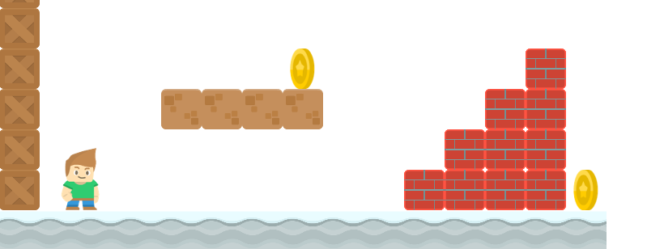
How to Write a Platformer Game in Java
Resolving Platform Collisions Part 2
Long Nguyen
Boston Latin School

Slide 2



Resolving Platform Collisions
change_y += gravity
center_y += change_y
center_x += change_x
change_y
change_x
gravity

Slide 3
Resolving Platform Collisions
change_y += gravity
center_y += change_y
center_x += change_x
change_y += gravity
# move in vertical direction
center_y += change_y
# resolve collisions
…
# move in horizontal direction
center_x += change_x
# resolve collisions
…

