Slide 1
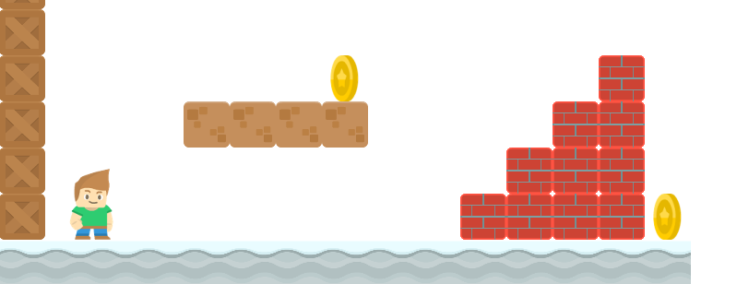
How to Write a Platformer Game in Java
Add Jumping
Long Nguyen
Boston Latin School

Slide 2



Player Jumps
Jumping Rule: Player can only jump when he is on a platform.
No multi-jumping

Slide 3
Player Jumps
Jumping Rule: Player can only jump when he is on a platform.
No multi-jumping
CAN jump!

Slide 4

Player Jumps
Jumping Rule: Player can only jump when he is on a platform.
No multi-jumping
CANNOT jump!

Slide 5
is_on_platform(sprite, platforms)
This method returns whether the sprite is on one of the platforms.
Algorithm:
move sprite down say 5 pixels

Slide 6
is_on_platform(sprite, platforms)
This method returns whether the sprite is on one of the platforms.
Algorithm:
move sprite down say 5 pixels
compute collision list with platforms
restore position by moving up 5 pixels

Slide 7
is_on_platform(sprite, platforms)
This method returns whether the sprite is on one of the platforms.
Algorithm:
move sprite down say 5 pixels
compute collision list with platforms
restore position by moving up 5 pixels

Slide 8
is_on_platform(sprite, platforms)
This method returns whether the sprite is on one of the platforms.
Algorithm:
move sprite down say 5 pixels
compute collision list with platforms
restore position by moving up 5 pixels
if collision list not empty
return true
otherwise return false

Slide 9
Jumps
if key pressed is A and sprite is on platform:
sprite.change_y = -JUMP_SPEED

Slide 10
Jumps
if key pressed is A and sprite is on platform:
sprite.change_y = -JUMP_SPEED

