Slide 1

Impact of Computing

Slide 2

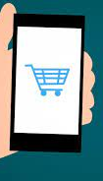
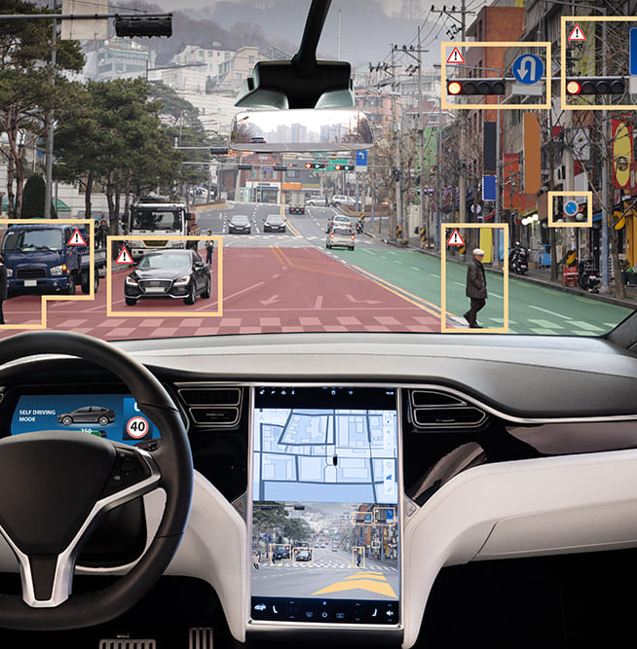
Computing Innovations
A computing innovation includes a program as an integral part of its function.
A program is a collection of program statements that performs a specific task when run by a computer. A program is often referred to as software. It can be written in different programming languages like Python or Java.
A computing innovation can be physical (e.g., self-driving car), nonphysical computing software (e.g., picture editing software), or a nonphysical computing concept (e.g., e-commerce).
The purpose of computing innovations is to solve problems or to pursue interests through creative expression. An understanding of the purpose of a computing innovation provides developers with an improved ability to develop that computing innovation.
Notes:
Crash Course: Cybersecurity

Slide 3
Effects of Computing Innovations
Not every effect of a computing innovation is anticipated in advance. Some effects are harmful.
For example, inventors of television, computers, mobile devices, and social media did not intend to unleash a slew of negative consequences for children.
shortened attention spans
lack of connection to nature
bullying and hate groups
using computing innovations as tools for deploying fake news
A single effect can be viewed as both beneficial and harmful by different people, or even by the same person. For example, video game makers will disagree about the "lack of connection to nature" argument above.
Notes:
Crash Course: Cybersecurity

Slide 4
Effects of Computing Innovations
Many effects of innovations are beneficial.
Advances in computing have generated and increased creativity in other fields, such as medicine, engineering, communications, and the arts.
Computing innovations can be used in ways that their creators had not originally intended:
The World Wide Web was originally intended only for rapid and easy exchange of information within the scientific community.
Targeted advertising is used to help businesses, but it can be misused at both individual and aggregate levels, compromising, for example, personal privacy.
Notes:
Crash Course: Cybersecurity

Slide 5
Effects of Computing Innovations
Computing innovations can be used in ways that their creators had not originally intended(continued):
Machine learning and data mining have enabled innovation in medicine, business, and science, but information discovered in this way has also been used to discriminate against groups of individuals.
For example, historical data on employment may show women getting promoted less than men. If a machine learning system trained on such data concludes that women are worse hires, it will perpetuate discrimination.
Rapid sharing of a program or running a program with a large number of users can result in significant impacts beyond the intended purpose or control of the programmer.
Notes:
Crash Course: Cybersecurity

Slide 6
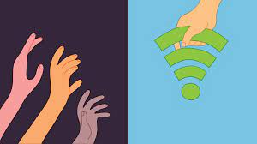
Digital Divide
Internet access varies between socioeconomic, geographic, and demographic characteristics, as well as between countries.
The digital divide is the gap that exists between individuals who have access to modern information and communication technology and those who lack access. This difference in access to computing devices and technology is based on socioeconomic, geographic, or demographic characteristics.
The digital divide:
can affect both groups and individuals
raises issues of equity, access, and influence, both globally and locally.
is affected by the actions of individuals, organizations, and governments.
Notes:
https://www.smartgrid.gov/the_smart_grid/smart_grid.html

Slide 7
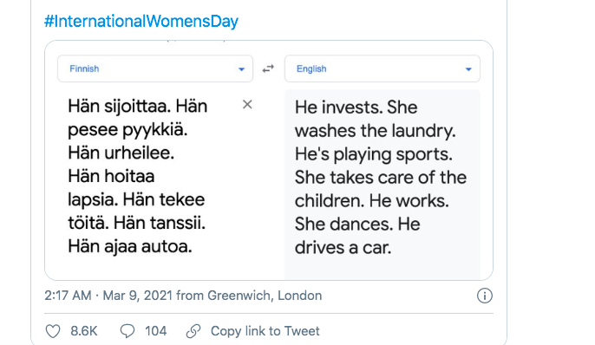
Computing Bias
Computing innovations can reflect existing human biases because of biases written into the algorithms or biases in the data used by the innovation.
For example, facial recognition systems are often trained on data sets that contain fewer images of women and minorities than men in the majority.
Alexa, for a time, struggled with understanding different accents
Google translate takes gendered-neutral languages like Filipino, Turkish, Chinese and introduces gender biases in the translations:
Programmers should take action to
reduce bias in algorithms used for
computing innovations as a way of
combating existing human biases.
Biases can be embedded at all levels
of software development.
Notes:
https://www.smartgrid.gov/the_smart_grid/smart_grid.html

Slide 8
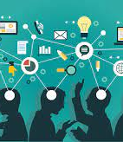
Crowdsourcing
Widespread access to information and public data facilitates the identification of problems, development of solutions, and dissemination of results.
Crowdsourcing is a sourcing model in which individuals or organizations obtain goods and services, including ideas and finances, from a large group of internet users.
Notes:
https://www.smartgrid.gov/the_smart_grid/smart_grid.html

Slide 9
Crowdsourcing
Crowdsourcing offers new models for collaboration, such as connecting businesses or social causes with funding.
it divides work between participants to achieve a cumulative result.
E.g. “idea competitions” and “innovation contests”. (Netflix Prize, Lego Ideas)
Tedious "microtasks" performed in parallel by large, paid crowds (e.g. Amazon Mechanical Turk, Bitcoin miners) are another form of crowdsourcing.
Amazon Mechanical Turk (MTurk) is a crowdsourcing marketplace that makes it easier for individuals and businesses to outsource their processes and jobs to a distributed workforce who can perform these tasks virtually.
Notes:
https://www.smartgrid.gov/the_smart_grid/smart_grid.html

Slide 10
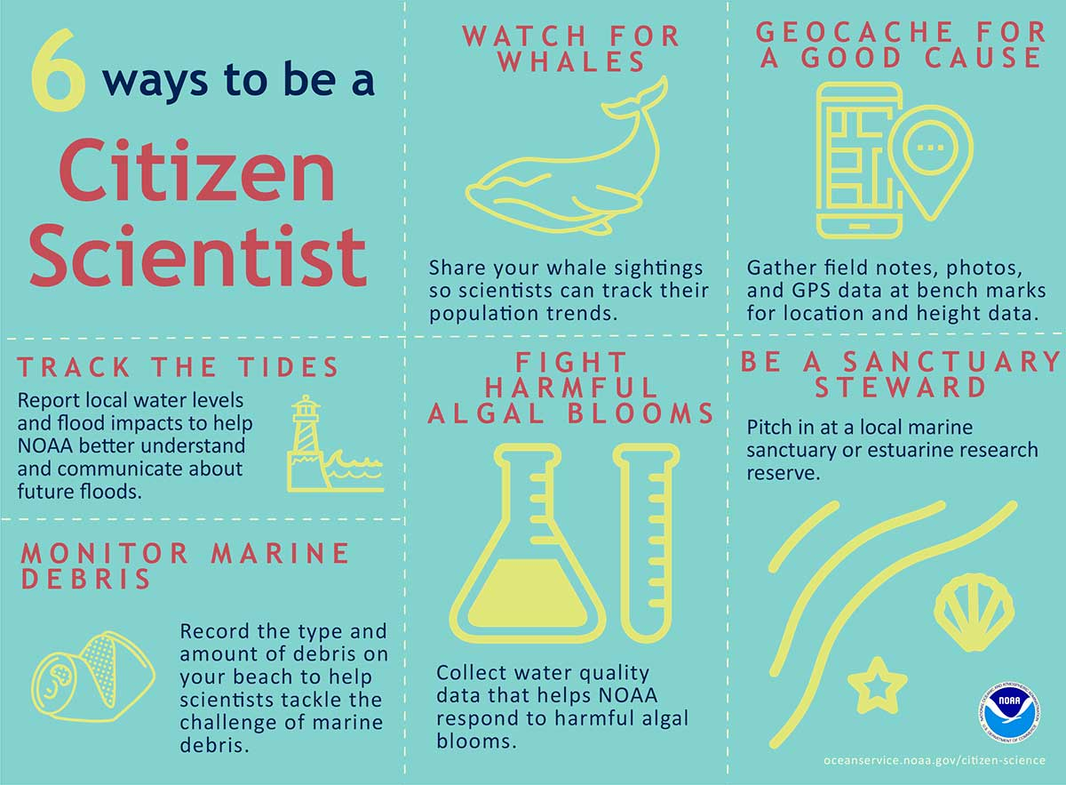
Citizen Science
Science has been impacted by using scale and “citizen science” to solve scientific problems using home computers in scientific research
Citizen science is scientific research conducted in whole or part by distributed individuals, many of whom may not be scientists, who contribute relevant data to research using their own computing devices e.g. folding@home(protein folding) and Galaxy Zoo(classify galaxies).
Some online services use the contributions of many people to benefit both individuals and society, for example, ImageNet which uses Amazon Mechanical Turk to find/hire people to classify/label images to be used for image classification algorithms.
Human capabilities are enhanced by digitally enabled collaboration.
Notes:
https://www.smartgrid.gov/the_smart_grid/smart_grid.html

Slide 11
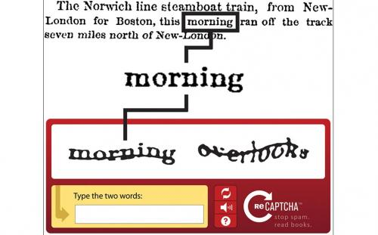
CAPTCHA VS reCAPTCHA
CAPTCHA(Completely Automated Public Turing test to tell Computers and Humans Apart) is the human validation test (usually the blurry squiglly letters that need to be deciphered) used by many sites to prevent spam.
reCAPTCHA is a reversed CAPTCHA - the same test, used not only to prevent spam but to help in the book digitizing project. In other words, the reCAPTCHA tests are not meaningless combination of words, but excerpts from books that undergo digitation, while CAPTCHA uses several human validation methods including math or general knowledge questions, visual puzzles and even chess puzzles.
reCAPTCHA has completed digitizing the archives of The New York Times and books from Google Books that are too illegible to be scanned by computers.
Notes:
https://www.smartgrid.gov/the_smart_grid/smart_grid.html

Slide 12
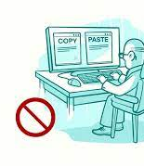
Legal and Ethical Concerns
Material created on a computer is the intellectual property of the creator or an organization.
Ease of access and distribution of digitized information raises intellectual property concerns regarding ownership, value, and use.
The use of material created by someone other than you should always be cited.
Measures should be taken to safeguard intellectual property.
The use of material created by someone else without permission and presented as one’s own is plagiarism and may have legal consequences.
Notes:
https://www.smartgrid.gov/the_smart_grid/smart_grid.html

Slide 13


Legal and Ethical Concerns
Open Access and Creative Commons have enabled broad access to digital information. Open and curated scientific databases have benefited scientific researchers.
Creative Commons—a public copyright license that enables the free distribution of an otherwise copyrighted work. This is used when the content creator wants to give others the right to share, use, and build upon the work they have created.
open source—programs that are made freely available and may be redistributed and modified(examples: Firefox browser, OpenOffice(in competition with Microsoft Office).
open access—online research output free of any and all restrictions on access and free of many restrictions on use, such as copyright or license restrictions
Open Access
Notes:
https://www.smartgrid.gov/the_smart_grid/smart_grid.html

Slide 14

Legal and Ethical Concerns
Computing can play a role in social and political issues, which in turn often raises legal and ethical concerns.
Innovations enabled by computing raise legal and ethical concerns.
the development of software that allows access to digital media downloads and streaming(downloading pirated software, movies, illegal streaming)
the existence of computing devices that collect and analyze data by continuously monitoring activities
the development of algorithms that include bias
Notes:
https://www.smartgrid.gov/the_smart_grid/smart_grid.html

Slide 15
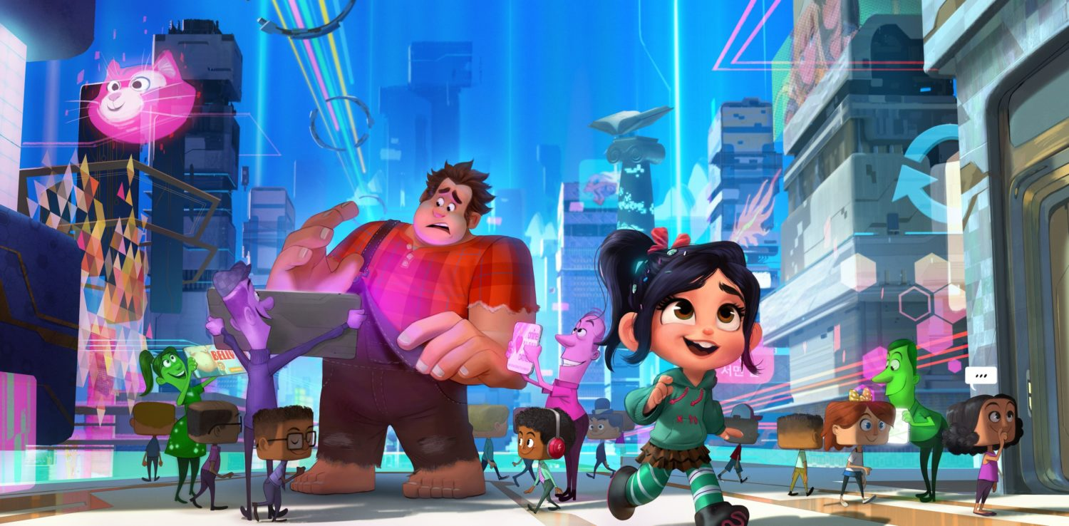
Privacy
Privacy and security concerns arise in the development and use of computational systems and artifacts.
privacy: Privacy relates to any rights you have to control your personal information and how it’s used. A bank selling your info to marketers without your consent is a breach in privacy.
security: Security, on the other hand, refers to how your personal information is protected. Cybercriminals breaking into the bank's servers and stealing your information is a breach in security.
Aggregation of information including geo-location, cookies, and browsing history raises privacy and security concerns.
cookies can track browsing habits and used for ads.
Targeted advertising is used to help individuals
but it can be misused at both individual and
aggregate levels.
Notes:
https://www.smartgrid.gov/the_smart_grid/smart_grid.html

Slide 16

Privacy
Personally identifiable information (PII) is information about an individual that identifies, links, relates, or describes them. Examples of PII include: Social Security number, age, race, phone number(s), medical information, financial information and biometric data.
PII can be used to stalk or steal the identity of a person or to aid in the planning of other criminal acts.
Information placed online can be used in ways that were not intended and that may have a harmful impact. For example, an email message may be forwarded, tweets can be retweeted, and social media posts can be viewed by potential employers.
Once information is placed online, it is difficult to delete.
Notes:
https://www.smartgrid.gov/the_smart_grid/smart_grid.html

Slide 17
Safe Computing
Search engines can record and maintain a history of searches made by users. Search engines can use search history to suggest websites or for targeted marketing.
Websites can record and maintain a history of individuals who have viewed their pages. Devices, websites, and networks can collect information about where you have been, how you got there, and how long you were at a given location.
Information posted to social media services can be used by others. Combining information posted on social media and other sources can be used to deduce private information about you.
Technology enables the collection, use, and exploitation of information about, by, and for individuals, groups, and institutions. Disparate personal data, such as geolocation, cookies, and browsing history, can be aggregated to create knowledge about an individual.
Notes:
https://www.smartgrid.gov/the_smart_grid/smart_grid.html

Slide 18

How Hackers Hack
One of the most common way hackers get into a computer system isn’t by hacking; it’s by tricking people into letting them in. social engineering: a person is tricked into revealing confidential information.
Phishing attacks: a hacker impersonate either a legitimate person or a corporation through an email that asks the user to take an action that would give the phisher an access point to critical data or information.
Phisher spoofs the logo or website of a well-known corporation or individual so their email request appears legitimate.
Contact HR department, posing as a trusted source, to get info(W2, SS#, etc..)
example: an email from Bank of America asking to reset the password by clicking on a link to a Bank of America clone site. Login credentials is compromised if account holders attempt to log on.even if less than 1% of success rate, a million phishing emails can possibly yield thousands of accounts.
Notes:
https://www.bitsighttech.com/blog/attack-vectors-types-of-security-breaches

Slide 19
How Hackers Hack
To avoid a phishing attack:
Pay attention to anything that may be slightly wrong with an email, including misspellings, strange syntax, or logos that have been slightly altered.
Never to click on a suspicious link within an email. For example, link to Bank of America to reset password.
Data sent over public networks can be intercepted, analyzed, and modified. One way that this can happen is through a rogue access point: wireless access point that gives unauthorized access to secure networks.
Through the use of a rogue access point, keylogging programs may be installed without permission. Keylogging is the use of a program to record every keystroke made by a computer user in order to gain fraudulent access to passwords and other confidential information.
Notes:
https://www.bitsighttech.com/blog/attack-vectors-types-of-security-breaches

Slide 20

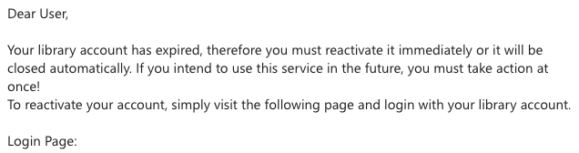

A Personal Example of Phishing
Can you spot indicators that this is a phishing email?
Notes:
https://www.bitsighttech.com/blog/attack-vectors-types-of-security-breaches

Slide 21
A Personal Example of Phishing
Can you spot indicators that this is a phishing email?
accont is a misspelling of account.
gmail instead of umb.edu
login page is some sort of proxy site.
misspelling
Notes:
https://www.bitsighttech.com/blog/attack-vectors-types-of-security-breaches

Slide 22
Security
Security boils down to two questions:
Who are you?
What should you have access to?
Access should be given to authorized people and refused to the wrong people.
To differentiate between authorized/unauthorized personnel, we use authentication, the process by which the computer understand who it’s interacting with.
Authentication measures protect devices and information from unauthorized access. Examples of authentication measures include strong passwords and multifactor authentication.
Notes:
https://www.bitsighttech.com/blog/attack-vectors-types-of-security-breaches

Slide 23
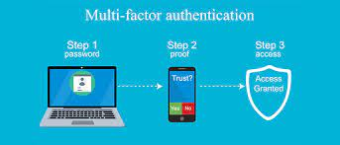
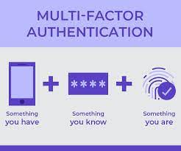
Authentication
Multifactor authentication is a method of computer access control in which a user is only granted access after successfully presenting several separate pieces of evidence to an authentication mechanism, typically in at least two of the following categories:
Knowledge(what you know): based on a secret knowledge known only to the real user and the computer. For example, username and password.
Possession(what you have): based on the possession of a secret token that only the real user has. For example, a physical key and lock.
Inherence(what you are): based on YOU! You authenticate by presenting yourself to the computer.
Biometric authenticators: e.g. fingerprint readers and iris scanners.
Notes:
https://www.bitsighttech.com/blog/attack-vectors-types-of-security-breaches

Slide 24
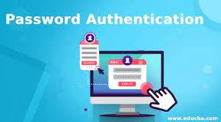
What You Know
Username/Password
Easy to implement, can be compromised if hackers can guess or find out.
Some are easy for humans to figure out: e.g. 1234 or 1111
Computers can try to brute force all password combinations. For example, a 4-digit ATM pin only as 10,000 combinations. 0000 to 9999.
Some systems will lock you out after 3 failed attempts.
But what if hackers have taken over many thousands of computers, trying a random pin like 1056 even once on thousands of computers can gain access to one or more bank accounts.
Many websites now requires upper/lower case, numbers and special symbols to explode the number of combinations.
An 8-digit pin has 100,000,000 combinations. But an 8-character password has 600 trillion combinations.
Notes:
https://www.bitsighttech.com/blog/attack-vectors-types-of-security-breaches

Slide 25

What You have
What you have: based on the possession of a secret token that only the real user has. For example, a physical key and lock.
You can open the door if you have the key.
Avoid the problem of being guessable.
Harder for remote attacker
But can be compromised if hacker is close by: keys can be copied, phones can be stolen, even locks can be picked.
Notes:
https://www.bitsighttech.com/blog/attack-vectors-types-of-security-breaches

Slide 26
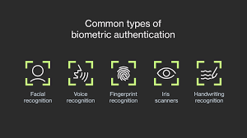
What You are
what you are: based on YOU! You authenticate by presenting yourself to the computer.
Biometric authenticators: e.g. fingerprint readers and iris scanners.
secure but can be expensive.
data over sensors varies over time.
what you know and what you have methods are deterministic
deterministic: always predicting the same output from a given input.
if you know the password or have the key, you’re granted access 100% of the time, if you don’t, you’re granted access 0% of the time.
Notes:
https://www.bitsighttech.com/blog/attack-vectors-types-of-security-breaches

Slide 27
What You are
biometric authenticators are probabilistic
probabilistic: element of chance is involved, different output may come from the same input.
if lighting is bad or you’re wearing glasses, there’s a chance that the system won’t recognize you.
Or worse, it can recognize someone who is not you! (Your twin)
biometric authenticators can’t be reset
what if your hacker compromises your fingerprint?
it’s possible to forge an iris by capturing a photo
Notes:
https://www.bitsighttech.com/blog/attack-vectors-types-of-security-breaches

Slide 28

Hackers
white hats: hackers hired to evaluate systems security, find bugs and security holes in software.
black hats: malicious hackers who intend to steal, exploit, sell private data.
Blackhat(2015); Chris Hemsworth.
(not sure if I can believe Thor is a hacker.)
why hackers hack:
for curiosity and amusement
for monetary gain(cybercriminals)
promote a political or social goal(hacktivists)
Notes:
https://www.bitsighttech.com/blog/attack-vectors-types-of-security-breaches

Slide 29
Malware
emails can be a common delivery mechanism for trojan horses, programs that masquerade as harmless attachments, like a photo, but actually contain malicious software, called malware.
malware can take on many forms.
some steal confidential data(spyware)
install keylogger, that records all your keystrokes and send them to a remote source.
others encrypt data and demand a ransom(ransomware)
virus: attach itself to a file or program and harm your computer if opened.
delete files, slow down computer
requires human interaction(running or opening the file)
Notes:
https://www.bitsighttech.com/blog/attack-vectors-types-of-security-breaches

Slide 30
References
AP CollegeBoard. AP Computer Science Course Description. (2020).
2) Uinversity of Rhode Island. AP Computer Science Principles. Global Impact. Retrieved from
http://computing-concepts.cs.uri.edu/index.php/Main_Page

