Slide 1
Introduction to Python
Direct Loops: For Loops

Slide 2
Topics
For Loops
Break vs. Continue
Nested Loops

Slide 3
For Loops
In general, a loop allows a sequence of instructions to execute repeatedly until some condition is met.
Python’s for loop iterates over items of a sequence(e.g. a list, string or tuple) and process them with some code.
for x in sequence: block
In[1]: for x in [2,3,5,7]: print(x, end=“ ”) # print all on same line
2 3 5 7
This is a list. More on lists in a later lecture.

Slide 4
For Loops
In[1]: for x in [2,3,5,7]: print(x)
2
3
5
7

Slide 5
range(stop)
A simple use of a for loop runs some code a specified number of times using the range() function.
range(stop): returns sequence of numbers from 0 (default) up to but not including stop. Increment by 1 (default).
In[1]: for i in range(10):
print(i, end=" ")
0 1 2 3 4 5 6 7 8 9

Slide 6
range(start, stop)
range(start, stop): from start up to but not including stop. Increment by 1(default).
In[2]: for i in range(2, 8):
print(i, end=' ‘)
2 3 4 5 6 7

Slide 7
range(start, stop, step)
range(start, stop, step): from start up to but not including stop, increment by step.
In[3]: for i in range(1, 10, 2):
print(i, end=' ')
1 3 5 7 9
If step is negative, a list can be traversed backwards.
In[4]: for i in range(10, 2, -1):
print(i, end=' ')
10 9 8 7 6 5 4 3

Slide 8
continue vs. break
The continue statement is used to skip the current iteration and move to the next iteration whereas the break statement is used to exit a for loop.
In [1]: for n in range(10): if n % 2 == 0:
continue
print(n, end=‘ ’)
1 3 5 7 9

Slide 9
continue vs. break
The continue statement is used to skip the current iteration and move to the next iteration whereas the break statement is used to exit a loop.
In [2]: for n in range(5): if n == 3:
break
print(n, end=‘ ’)
0 1 2

Slide 10
Definite Loop
The for loop is an example of a definite loop. We can determine ahead of time the number of times the loop repeats. Later, we will talk about indefinite loop, a loop where we cannot predict the number of times it repeats.
In [1]: for i in range(5): print("*", end="")
*****
The loop above prints five *'s. We can determine this from the for loop statement.

Slide 11
Summing Values
Write a segment of code that solve the problem
1 + 2 + 3 + … + 98 + 99 + 100.
In [1]: sum = 0
for i in range(1, 101): sum += i

Slide 12
Writing a function to sum
Now write a function that accepts a non-negative integer input n and returns the sum of integers from 1 to n(including).
In [1]: def sum(n):
sum = 0
for i in range(1, n+1): sum += i
return sum

Slide 13
Conditional Summing
Write a segment of code that compute the sum of all numbers from 1 to 100 that are multiples of 3.
In [1]: sum = 0
for i in range(0, 101, 3): sum += i
Or equivalently, we can use a conditional to select the numbers to add:
In [2]: sum = 0
for i in range(1, 101): if i % 3 == 0:
sum += i
Better to use if conditional for filtering.
In general, using the step size above
might not always work.

Slide 14
Conditional Summing Example
Write a segment of code that compute the sum of all numbers from 1 to 100. However:
if a number is a multiple of 3, double it before adding,
if a number is a multiple of 5, triple it before adding,
If a number is a multiple of both, quadruple it before adding.

Slide 15
Conditional Summing Solution?
Is the following a correct solution?
sum = 0
for i in range(1, 101):
if i % 3 == 0:
sum += 2 * i
elif i % 5 == 0:
sum += 3 * i
elif i % 3 == 0 and i % 5 == 0:
sum += 4 * i
else:
sum += i
No! Why not?

Slide 16
Conditional Summing Solution
The following is correct.
sum = 0
for i in range(1, 101):
if i % 3 == 0 and i % 5 == 0:
sum += 4 * i
elif i % 3 == 0:
sum += 2 * i
elif i % 5 == 0 :
sum += 3 * i
else:
sum += i

Slide 17
Nested Loops
A nested loop is a loop inside of another loop.
In[1]: for i in range(1, 4):
for j in range(1, 5):
print(i * j, end=‘ ’)
print()
1 2 3 4
2 4 6 8
3 6 9 12

Slide 18
Nested Loops Example 1
In[1]: for i in range(1, 6):
for j in range(1, i+1):
print(j, end=‘ ’)
print()
1
1 2
1 2 3
1 2 3 4
1 2 3 4 5

Slide 19
Nested Loops Example 2
In[2]: for i in range(1, 6):
for j in range(6, i, -1):
print(j, end=‘ ’)
print()
6 5 4 3 2
6 5 4 3
6 5 4
6 5
6

Slide 20
For Loop in Movies and TV-Shows
Movies:
Groundhog Day(1993); Bill Murray.
Looper(2010); Bruce Willis and Joseph Gordon-Levitt, Emily Blunt.
Edge of Tomorrow(2014); Tom Cruise, Emily Blunt.
Happy Death Day(2017).
TV-Show:
Russian Doll(Netflix, Emmy-Nominated)

Slide 21
Indefinite Loop
A for loop, we discussed earlier is an example of a definite loop, the number of iterations can be specified ahead of time by the programmer.
In some cases, however, the number of iterations can be unknown. For example, a user is asked to enter a set of inputs. The number of inputs the user enter is not known in advance.
The program’s input loop accepts these values until the user enters a special value or sentinel that terminates the input.
In this section, we explore the use of the while loop to describe conditional iteration: iteration that repeats as long as a condition is true.

Slide 22
While Loop
The while loop has the syntax:
while <condition>: block
The loop repeatedly executes its block of code as long as the condition is true.
At least one statement in the block of the loop must update a variable that affects the value of the condition. Otherwise, the loop will continue forever, an error known as an infinite loop.

Slide 23
While vs For Loops 1
The following two segments of code are equivalent.
# Counting down with a for loop from 10 to 1.
for count in range(10, 0, –1):
print(count, end = " ")
# Counting down with a while loop from 10 to 1.
count = 10
while count >= 1:
print(count, end = " ")
count -= 1

Slide 24
While vs For Loops 2
The following two segments of code are equivalent.
# Summation with a for loop
theSum = 0
for count in range(1, 101):
theSum += count
print(theSum)
# Summation with a while loop
theSum = 0
count = 1
while count <= 100:
theSum += count
count += 1
print(theSum)

Slide 25
While Loop
while True:
number = int(input("Enter the numeric grade: "))
if number >= 0 and number <= 100:
break
else:
print("Error: grade must be between 100 and 0")
print(number) # Just echo the valid input
Enter the numeric grade: 101
Error: grade must be between 100 and 0
Enter the numeric grade: –1
Error: grade must be between 100 and 0
Enter the numeric grade: 45
45

Slide 26
While Loop
What does the following program do?
s = 0.0
data = input("Enter a number or just enter to quit: ")
while data != "":
number = float(data)
s += number
data = input("Enter a number or just enter to quit: ")
print("The sum is", s)

Slide 27
While Loop
s = 0.0
data = input("Enter a number or just enter to quit: ")
while data != "":
number = float(data)
s += number
data = input("Enter a number or just enter to quit: ")
print("The sum is", s)
Sample Run:
Enter a number or just enter to quit: 3
Enter a number or just enter to quit: 4
Enter a number or just enter to quit: 5
Enter a number or just enter to quit:
The sum is 12.0

Slide 28
While Loop
Alternatively, the previous program can be simplified so that only one input is used. The program uses the break statement to exit the loop if the input is an empty string.
s = 0.0
while True:
data = input("Enter a number or just enter to quit: ")
if data == "":
break
number = float(data)
s += number
print("The sum is", s)

Slide 29
Random Numbers
In some situation, we like to be able to simulate randomness. For example, we might toss a coin or roll a die.
The Python's random module contains many functions to do this. The function randrange() is easy to use since it is similar to the range() function we used in for loops.
randrange(start, stop, step) generates a random integer beginning with start(including) and ending with stop(not including) with step.
for i in range(10):
num = random.randrange(1, 5)
print(num, end=" ")
Output:
3 3 3 2 1 3 2 2 3 4

Slide 30
Guessing Game
Let's write a simple guessing game.
The computer randomly generate a number in some given range. On each pass through the loop, the user enters a number to attempt to guess the number selected by the computer.
The program responds by saying “You’ve got it,” “Too large, try again,” or “Too small, try again.” When the user finally guesses the correct number, the program congratulates him and tells him the total number of guesses.

Slide 31
Guessing Game
import random
smaller = int(input("Enter the smaller number: "))
larger = int(input("Enter the larger number: "))
myNumber = random.randint(smaller, larger)
count = 0
while True:
count += 1
userNumber = int(input("Enter your guess: "))
if userNumber < myNumber:
print("Too small!") elif userNumber > myNumber:
print("Too large!")
else:
print("Congratulations! You've got it in",
count, "tries!")
break

Slide 32
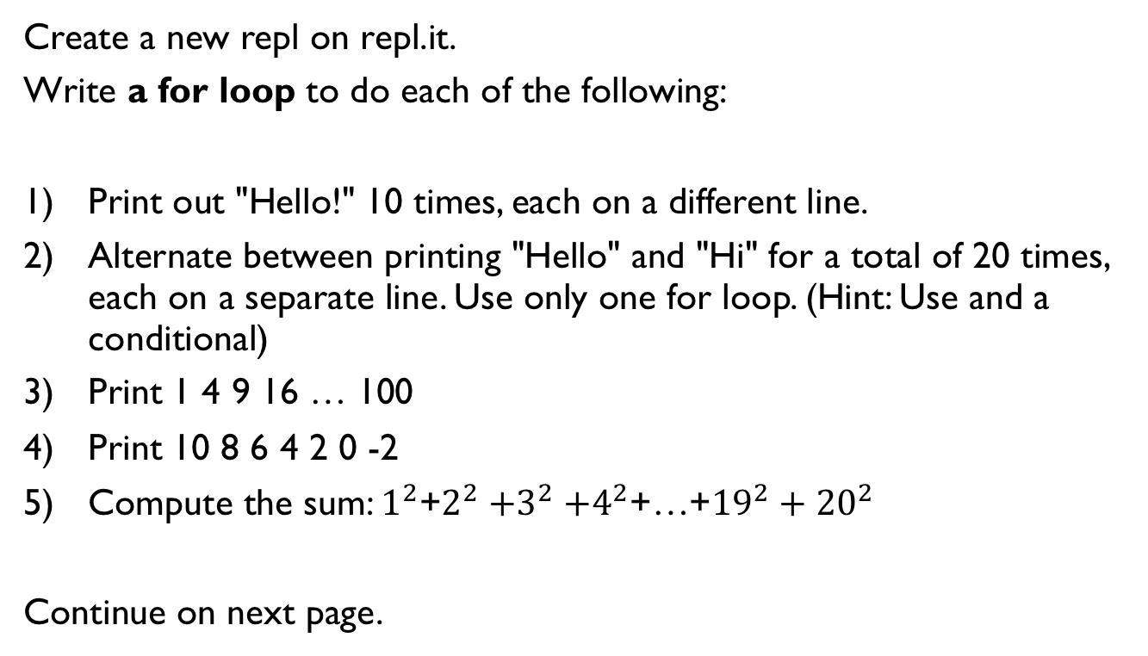
Lab 1
Create a new repl on repl.it.
Write a for loop to do each of the following:
Print out "Hello!" 10 times, each on a different line.
Alternate between printing "Hello" and "Hi" for a total of 20 times, each on a separate line. Use only one for loop. (Hint: Use and a conditional)
Print 1 4 9 16 … 100
Print 10 8 6 4 2 0 -2
Compute the sum: $1^{2}$+$2^{2}{+3}^{2}+4^{2}$+…+${19}^{2}+{20}^{2}$
Continue on next page.

Slide 33
Lab 1
Write a nested for loop to do each of the following:
Print out 10 lines, each line containing 5 "Hello" separated by spaces.
2) ******
******
******
3) Print
*
**
***
****
*****

Slide 34
References
Vanderplas, Jake, A Whirlwind Tour of Python, O’reilly Media.

