Slide 1
Unit 9: Inheritance
Introduction to Inheritance
Adapted from:
1) Building Java Programs: A Back to Basics Approach
by Stuart Reges and Marty Stepp
2) Runestone CSAwesome Curriculum
https://longbaonguyen.github.io

Slide 2
Inheritance
You may have heard of someone coming into an inheritance, which often means they were left something from a relative who died. Or, you might hear someone say that they have inherited musical ability from a parent.
In Java, all classes can inherit attributes (instance variables) and behaviors (methods) from another class.
The class being inherited from is called the parent class or superclass. The class that is inheriting is called the child class or subclass.

Slide 3
Inheritance
inheritance: A way to form new classes based on existing classes, taking on their attributes/behavior.
  a way to group related classes
  a way to share code between two or more classes
One class can extend another, absorbing its data/behavior.
  superclass: The parent class that is being extended.
  subclass: The child class that extends the superclass and inherits its behavior.
    Subclass gets a copy of every instance variable and method from superclass

Slide 4
Syntax
A class can extend another class by using the keyword extends then the name of the class it is extending.
Below, Employee extends Person.
public class Person{
private String name;
public Person(String theName){
this.name = theName;
}
…
}
public class Employee extends Person{
// not shown
}

Slide 5
Inheritance
When one class inherits from another, we can say that it is the same kind of thing as the parent class (the class it inherits from).
For example, a car is a kind of vehicle. This is sometimes called the is-a relationship, but more accurately it’s a is-a kind of relationship.
A motorcycle is a vehicle. Or a motorcycle is a kind of vehicle. All vehicles have a make, model, and year that they were created. All vehicles can go forward, backward, turn left and turn right.

Slide 6
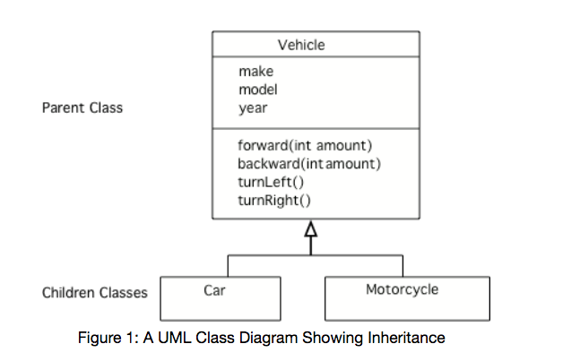
UML
A UML (Unified Modeling Language) class diagram shows classes and the relationships between the classes as seen in Figure 1.
An open triangle points to the parent class. The parent class for Car and Motorcycle is Vehicle. The Vehicle class has two child classes or subclasses: Car and Motorcycle.

Slide 7
Generalization
Inheritance allows you to reuse data and behavior from the parent class.
If you notice that several classes share the same data and/or behavior, you can pull that out into a parent class. This is called generalization.
For example, if you wrote two classes Customers and Employees and both of which have instance variables name and address, then it makes sense write the general Person class with the variables name and address and have Customers and Employees inherit from Person.
This allow us to reuse code from Person. See UML on the next page.

Slide 8
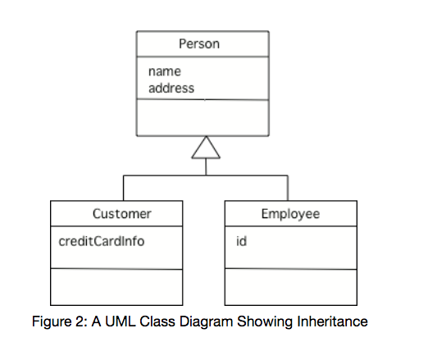
UML

Slide 9
Specialization
Conversely, inheritance is also useful for specialization which is when you want most of the behavior of a parent class, but want to do at least one thing differently and/or add more data.
The previous example below can also be seen as specialization. Suppose that you already wrote the Person class and you want a Customer class that has all of the attributes of Person but also has a credit card. Or you want an Employee class that has an additional instance variable for id.

Slide 10
super()
Subclasses inherit all the public and private instance variables in a superclass that they extend, but they cannot directly access private variables.
And constructors are not inherited.
How do you initialize inherited private variables if you don’t have direct access to them in the subclass?
In Java, the superclass constructor can be called from the first line of a subclass constructor by using the keyword super and passing appropriate parameters. This allows the parent constructors to initialize the variables.

Slide 11
Person Class
Below is the Person class. We will create an Employee class which extends this class.
class Person{
private String name;
public Person(String theName){
this.name = theName;
}
public String getName(){
return name;
}
// other methods not shown
}

Slide 12
Error!
The subclass constructor cannot directly initialize the super class' private variables.
public class Employee extends Person{
private int id;
public Employee(String name, int id){
this.name = name; // error, name is private
this.id = id;
}
public int getId(){
return id;
}
// other methods not shown
}

Slide 13
Fixed!
The superclass constructor can be called from the first line of a subclass constructor by using the keyword super and passing appropriate parameters.
super() must be called on the first line of the constructor!
public class Employee extends Person{
private int id;
public Employee(String name, int id){
super(name); // call Person's constructor
this.id = id; // to initialize name variable
}
// other methods not shown
}
Now each Employee object has an id variable in addition to the inherited name variable.

Slide 14
Main Class
public class Main{
public static void main(String[] args){
Person p = new Person("Mike");
System.out.println(p.getName()); // Mike
Employee emp = new Employee("Dani", 123);
System.out.println(emp.getName()); // Dani
System.out.println(emp.getId()); // 123
Person p1 = new Employee("Mike", 11);
// correct, every Employee is a Person.
Employee p2 = new Person("Mike");
// incorrect, not every Person is an Employee
}
}
}

Slide 15
Main Class
If a class has no constructor in Java, the compiler will add a no-argument constructor. A no-argument(or default) constructor is one that doesn’t have any parameters, for example public Person().
If a subclass has no call to a superclass constructor using super as the first line in a subclass constructor then the compiler will automatically add a super() call as the first line in a constructor.
So, be sure to provide no-argument constructors in parent classes or be sure to use an explicit call to super() as the first line in the constructors of subclasses.
See the next slide for an example of a common constructor error.

Slide 16
Constructor Error
If a subclass has no call to a superclass constructor using super as the first line in a subclass constructor then the compiler will automatically add a super() call as the first line in a constructor.
Find the error.
class Person{
// Suppose this class has only this one constructor.
public Person(String theName){…}
}
public class Employee extends Person{
private int id;
public Employee(String name, int id){
this.id = id;
}
}
implicitly call super() since subclass constructor has no super() call.
But parent class Person has no default constructor. Error!

Slide 17
Fix # 1
The simplest way to fix the previous error is to always explicitly call super with the appropriate parameters as the first line in every subclass constructor.
class Person{
// Suppose this class has only this one constructor.
public Person(String theName){…}
}
public class Employee extends Person{
private int id;
public Employee(String name, int id){
super(name);
this.id = id;
}
}
It is best to explicitly call super() with the apppropriate parameters.

Slide 18
Fix # 2
Another way to fix the previous error is to provide a default(no argument) constructor in the parent class.
class Person{
public Person(){…}
public Person(String theName){…}
}
public class Employee extends Person{
private int id;
public Employee(String name, int id){
this.id = id;
}
}
implicitly call super() since subclass constructor has no call. And since parent class does have a default construtor, no error!

Slide 19
Levels of Inheritance
Multiple levels of inheritance in a hierarchy are allowed.
public class Person{ // implementation not shown}
public class Employee extends Person{ // not shown}
public class Lawyer extends Employee{ // not shown}
Find the error. Errors in red below.
public class Main(){
public static void main(String[] args){
Person p1 = new Employee("Mike", 11);
Employee p2 = new Lawyer("John", 22);
Lawyer p3 = new Person("Katie");
Lawyer p4 = new Employee("Jim", 33);
Person p5 = new Lawyer("Michele", 44);
Employee p6 = new Person("Jack");
}
}

Slide 20
Inherited Methods
A subclass inherits all public methods from its superclass, and these methods remain public in the subclass.
But, we also usually add more methods or instance variables to the subclass.
class Person{
…
public String getName(){…}
}
Employee inherits getName() from Person.
Employee cannot access name directly but can access it indirectly through getName and setName, etc…
public class Employee extends Person{
…
public void printJobDescription(){…}
}
printJobDescription() is a new method in Employee that is not in Person.

Slide 21
Overriding methods
A subclass inherits all public methods from its superclass, and these methods remain public in the subclass. But, we also usually add more methods or instance variables to the subclass.
Sometimes, we want to modify existing inherited methods.
override: To write a new version of a method in a subclass that replaces the superclass's version.
  To override an inherited method, the method in the child class must have the same name, parameter list, and return type (or a subclass of the return type) as the parent method. Any method that is called must be defined within its own class or its superclass.
  Have we done this before? Answer:toString()

Slide 22
Example
Overriding a method of the superclass.
public class Employee extends Person{
// some constructors and methods not shown
  public String getVacationForm() {
  return "pink";
  }
}
public class Lawyer extends Employee {
  // overrides getVacationForm method in Employee class
  public String getVacationForm() {
  return "yellow";
  }
  // Lawyer has new method sue()
  public void sue(){
  System.out.println("I'll see you in court!")
  }
}

Slide 23
Superclass Reference
A superclass reference can point to a subclass object. Calling a method from this reference always calls the overriden(if there is one) method.
public class Main{
public static void main(String[] args)
{
Employee emp = new Employee("Dani", 123);
System.out.println(emp.getVacationForm()); // pink
Employee sarah = new Lawyer("Sarah", 345);
System.out.println(sarah.getVacationForm());
// yellow
}
}
Note: sarah is an Employee reference but points to a Lawyer object. Calling getVacationForm on it actually calls the Lawyer's version NOT Employee's.

Slide 24
Main Class
public class Main{
public static void main(String[] args)
{
Employee emp = new Employee("Dani", 123);
System.out.println(emp.getVacationForm()); // pink
Employee law = new Lawyer("Sarah", 345);
System.out.println(law.getVacationForm());// yellow
law.sue(); // error!
}
}
Note: law is an Employee reference but points to a Lawyer object. Calling getVacationForm on it actually call the Lawyer's version NOT Employee's.

Slide 25
Superclass Reference
A superclass reference, however, cannot call a method of a subclass that is not inherited from the superclass. Doing so will cause a compiler-error.
public class Main{
public static void main(String[] args){
Employee sarah = new Lawyer("Sarah", 345);
System.out.println(sarah.getVacationForm());
// yellow
sarah.sue(); // compiler-error
(Lawyer)(sarah).sue();
}
}
Note: Even though the sarah reference points to an actual Lawyer object. Because sarah is an Employee reference, it cannot call the sue() method which is a new method in Lawyer that is not in Employee. (More on this topic in the next lecture)

Slide 26
Another Example
public class Parent{
public void method1(){
System.out.println("Parent"); }
}
public class Child extends Parent{
public void method1(){
System.out.println("Child"; }
public void method2(){ // implementation not shown }
}
public class Main{
public static void main(String[] args){
Parent a = new Parent();
Child b = new Child();
Parent c = new Child();
a.method1(); // Parent's method1
b.method1(); // Child's method1
c.method1(); // Child's method1
c.method2(); // error!
}}

Slide 27
super() keyword
Sometimes you want the subclass to do more than what a superclass’ method is doing. You want to still execute the superclass method, but you also want to override the method to do something else.
But, since you have overridden the parent method how can you still call it? You can use super.method() to force the parent’s method to be called.
We’ve used super() before to call the superclass’ constructor. There are two uses of the keyword super:
super(); or super(arguments); calls just the super constructor if put in as the first line of a subclass constructor.
super.method(); calls a superclass’ method (not constructors).

Slide 28
super() keyword
The keyword super is very useful in allowing us to first execute the superclass method and then add on to it in the subclass.
area of circle = pi*radius^2 area of cylinder = 2*area of circle + lateral area.
public class Circle{
private double radius;
public double getArea(){
return Math.PI * radius * radius;
}
}
public Cylinder extends Circle{
double height;
…
public double getArea(){
return 2 * super.getArea() + 2 * Math.PI *
getRadius() * height;
}
}

Slide 29
Lab 1
Write the superclass Student and subclass GradStudent.
The Student class has a private string name and public integer id. It has a one constructor which accepts a string and an integer.
Student has getName(), setName (String n) and printWelcome()(prints welcoming message with their name for example "Welcome! Mike Smith!")

Slide 30
Lab 1
Write the subclass GradStudent.
The GradStudent class has a private string dissertationTopic. It has one constructor that accepts a String for name, another String for dissertation topic and one for id.
GradStudent has getTopic(), setTopic (String t),printWelcome() public methods. printWelcome() overrides the same method from the superclass Student and prints for example "Welcome to Graduate School! Mike Smith!".
Write the driver class. Create at least one Student object and one GradStudent object using the Student reference for both. Print out welcoming messages for each. What do you notice?

