Slide 1

Securing Data: Cryptography
Condensed Version

Slide 2
Cryptography
Crypto + graphy = secret + writing
encryption: the process of making text secret
decryption: the reverse process, unscrambling gibberish text to plaintext
Cipher(uses secret private key)
plaintext
ciphertext
Notes:
Crypto + graphy = secret + writing
cipher, an algorithm that converts plain text to ciphertext, which is gibberish unless you have a key that undo the cipher.
encryption: the process of making text secret
decryption: the reverse process, unscrambling gibberish text to plaintext
Julius Caesar uses a Caesar cipher; he shifts all of the letters forward by three.
A becomes D and “brutus” becomes “euxwxv”.
to decipher, you need both the algorithm and the shift number, which acts as the key. In this case, the key is 3.
The Caesar cipher uses 26 keys and is easy to break.

Slide 3

Substitution Cipher
Julius Caesar uses a Caesar cipher; he shifts all of
the letters forward by three.
Caesar cipher is an example of a larger class of ciphers
called substitution cipher.
it was the breaking of a substitution cipher that led to the
execution of Mary, Queen of Scots, in 1587, for plotting to
kill Queen Elizabeth.
Notes:
Crash Course: Cybersecurity

Slide 4
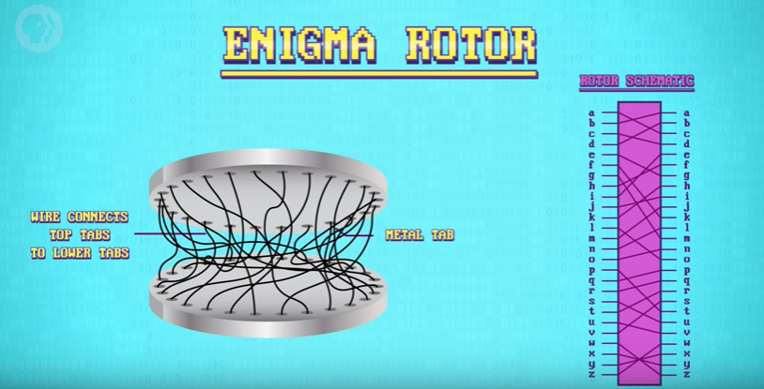
Enigma(optional)
Notes:
Crash Course: Cybersecurity

Slide 5
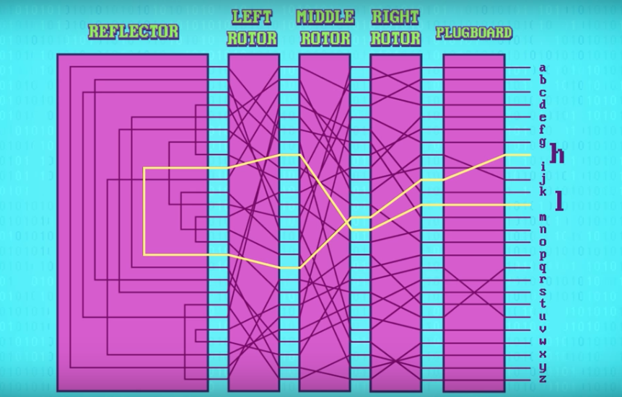
Notes:
Crash Course: To prevent it from being simple substitution cipher, after every letter, the rotor rotate by one, changing both the cipher and key.
For example “AAA” might be encoded as “BDK”
The enigma was hard to crack but Alan
Turing and his team at Bletchley Park
were able to solve it and even automate
the entire process!
watch “The Imitation Game”, Benedict Cumberbatch.)

Slide 6
Symmetric encryption: encryption technique that uses the same key for both encryption and decryption.
Notes:
Cryptographic techniques so far rely on keys known by both sender and receiver. The sender encrypt message with a key and the receiver decrypt it with the same key.
Symmetric encryption: encryption technique that uses the same key for both encryption and decryption.
For example, in the Caesar cipher, if encryption is shifting right by 3 letters, decryption is shifting left by 3 letters. Both uses the key = 3. Thus the Caesar cipher is a symmetric encryption technique.
In the old days, keys are shared physically or by voice.
Germans use codebooks with daily settings for Enigma machines.
Today, server needs to send a key over the internet.
making a purchase on Amazon, login on to Gmail, etc.
keys can be intercepted.

Slide 7
Key Exchange(optional)
key exchange: an algorithm that allows two computer to agree on a key without sending one!
A one-way function is a function that is easy to compute but hard to invert.
it’s easy to mix colors but hard to unmix, i.e., figure out the component colors used to get a mixed color.
Notes:
Solution is to use key exchange.
key exchange: an algorithm that allows two computer to agree on a key without sending one!
This is done using one-way functions.
A one-way function is a function that is easy to compute but hard to invert.
it’s easy to mix colors but hard to unmix, i.e., figure out the component colors used to get a mixed color.
We’ll use painting to illustrate how this is done conceptually.

Slide 8



Key Exchange(optional)
Alice and Bob want to establish a shared secret key for encryption/decryption.
Each starts with a secret color.
Eve is listening.
(Eve for "eavesdrops")
1. Bob’s
secret
color
1. Alice’s
secret
color
Notes:
https://www.bitsighttech.com/blog/attack-vectors-types-of-security-breaches

Slide 9


Key Exchange(optional)
Eve is listening.
Both mix the public color with their secret color.
1. Alice’s
secret
color
1. Bob’s
secret
color
2. Mix in
public
color
2. Mix in
public
color
Notes:
https://www.bitsighttech.com/blog/attack-vectors-types-of-security-breaches

Slide 10
Key Exchange(optional)
Eve is listening.
Then send it to each other publicly. Then what?
1. Bob’s
secret
color
1. Alice’s
secret
color
2. Mix in
public
color
2. Mix in
public
color
3. Send
to Bob
3. Send
to Alice
Notes:
https://www.bitsighttech.com/blog/attack-vectors-types-of-security-breaches

Slide 11

Key Exchange(optional)
Eve is listening.
Each then adds in his/her secret color to obtain a shared secret color(key). The key is then used for symmetric encryption.
1. Bob’s
secret
color
1. Alice’s
secret
color
2. Mix in
public
color
2. Mix in
public
color
3. Send
to Bob
3. Send
to Alice
4. Mix in
secret
color
4. Mix in
secret
color
Notes:
https://www.bitsighttech.com/blog/attack-vectors-types-of-security-breaches

Slide 12
Diffie-Helman(optional)
Diffie-Helman key exchange uses modular exponentiation as its one-way function.
Modular exponentiation is a one-way function because it is easy to raise a power but hard to invert.
Notes:
Diffie-Helman key exchange uses modular exponentiation as its one-way function.
Two positive integers x and y are congruent modulo n, denoted
x = y mod n, if x % n == y % n.
Note: a % b is the remainder of a divided by b.
For example, 7 = 2 mod 5 since both 2 and 7 when divided by 5 give a remainder of 2.
13 = 25 mod 2 = 1 mod 2 (Thus 13, 25 and 1 are all congruent modulo 2)
3 = 15 mod 12 = 27 mod 12(Thus 3, 15 and 27 are all congruent modulo 12)
When performing math operations, we reduce modulo n so that the result is a remainder from 0 to n- 1.
3^5 mod 31 = 243 mod 31 = 26 mod 31
For example, it is easy to compute 3^5=26 mod 31.(One line of Python code.) But it’s hard to find x such that 3^x=26 mod 31 if the base and modulo are very large integers(hundreds of digits long).
This is called the discrete logarithm problem.
The base that is used for the modulo is a large prime(hundreds of digits long).
Solve this:
298742039473927847494324^x = 7646787876034389839493034 mod 85620542843242379862561534532898765235
Diffie-Helman is an algorithm that uses this one-way function of modular exponentiation to do key exchange. The process is similar to the painting example earlier.

Slide 13
Diffie-Helman Key Exchange (optional)
Eve is listening.
B^{XY} mod M is the shared key.
Public:
Base B
Modulo M
1. Bob’s
secret
exponent
1. Alice’s
secret
exponent
Secret
Exponent
X
Secret Exponent
Y
2. Compute
2. Compute
B^X mod M
B^Y mod M
3. Send
to Bob
B^X mod M
3. Send
to Alice
B^Y mod M
4. Compute
(B^Y)^X mod M)
B^{XY} mod M
(B^X)^Y mod M)
B^{XY} mod M
4. Compute
Notes:
https://www.bitsighttech.com/blog/attack-vectors-types-of-security-breaches

Slide 14


An Example (optional)
Eve is listening.
Thus, the secret shared key is 10. For example, key = 10 can be used in the Caesar cipher by shifting/unshifting by 10
Public:
Base 3
Modulo 17
1. Bob’s
secret
exponent
1. Alice’s
secret
exponent
Secret
Exponent
15
Secret Exponent
13
2. Compute
2. Compute
3. Send
to Bob
3. Send
to Alice
4. Compute
4. Compute
Notes:
https://www.bitsighttech.com/blog/attack-vectors-types-of-security-breaches

Slide 15
Asymmetric Encryption
asymmetric encryption(public-key cryptography): encryption which uses a public and a private key. One for encryption and one for decryption.
The most famous example of asymmetric encryption is RSA named after their inventors
Rivest, Shamir and Adleman.
Notes:
https://www.bitsighttech.com/blog/attack-vectors-types-of-security-breaches

Slide 16
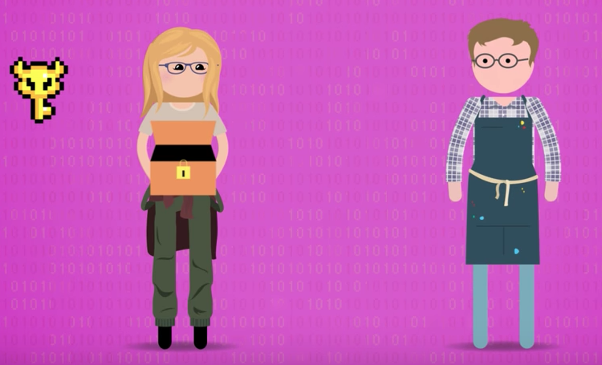
Alice has a private key and a lockbox(public key).
She wishes to receive an encrypted message from Bob.
Alice sends Bob the lockbox(public key).
Notes:
https://www.bitsighttech.com/blog/attack-vectors-types-of-security-breaches

Slide 17
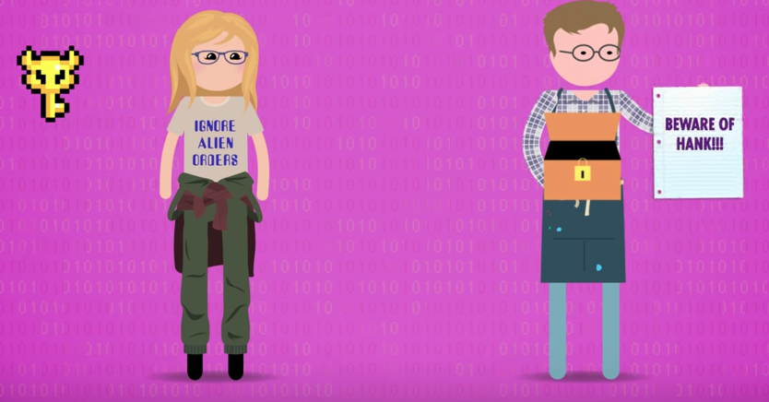
Bob put his message inside the lockbox.
Lock it(one-way function, easy to lock)
Sends it back.
Notes:
https://www.bitsighttech.com/blog/attack-vectors-types-of-security-breaches

Slide 18
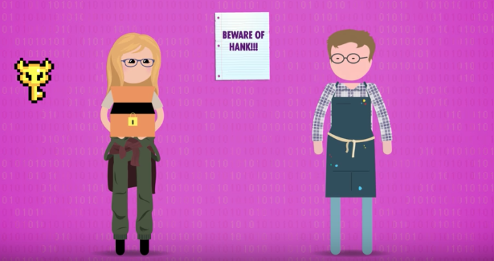
Alice can open it with her private key and receives the message. (even if the lockbox is intercepted, it cannot be opened without the private key)
If Alice is a bank, she can duplicates the lockbox(public key) and sends them to everyone she wishes to receive encrypted messages.
She only has to manage one private key.
Notes:
https://www.bitsighttech.com/blog/attack-vectors-types-of-security-breaches

Slide 19
Digital Signatures
A public digital key can encrypt something that can only be decrypted by a private digital key.
The reverse is also possible: encrypting with the private key something that can be decrypted with a public key.
Use for digital signatures
Notes:
A public digital key can encrypt something that can only be decrypted by a private digital key.
The reverse is also possible: encrypting with the private key something that can be decrypted with a public key.
Use for digital signatures
Server encrypts data with private key.
Anyone can decrypt it using the server’s public key.
This acts as an unforgeable signature that only the owner, using the private key, can encrypt.
This proves that you’re getting data from the right server/website, not an imposter.
This is how your browser knows that you are at the correct bankamerica.com and not a fake bank of America website. The brower knows Bank of America’s public key and can verify. If it’s successful, it gives you the green padlock confirmation.
Certificate authorities issue digital certificates that validate the ownership of encryption keys used in secure communications and are based on a trust model. For example, Google is a certificate authority. A website can apply for a digital certificate from Google to validate their ownership of their website(green padlock you see when you go to an https(secure http) website.
We can understand how digital signatures work by looking at hash functions.

Slide 20
Hash Functions(optional)
import hashlib
def hash(mystring):
hash_object= hashlib.sha256(mystring.encode())
return hash_object.hexdigest()
print(hash("hello"))
print(hash("Hello"))
Output:
'2cf24dba5fb0a30e26e83b2ac5b9e29e1b161e5c1fa7425e73043362938b9824'
'185f8db32271fe25f561a6fc938b2e264306ec304eda518007d1764826381969'
a small change to a message should change
the hash value extensively
Notes:
In the abstract, a cryptographic hash function is a mathematical function that takes input data of any size, performs an operation on it, and returns output data of a fixed size.
Since data(file, images, audio, video) can be encoded into a string of 0's and 1's, a hash function is simply a function f(x) which accepts a string input of any length and returns a fixed-length string output. Here's an implementation of such a hash function using the popular SHA256 algorithm(outputs 256-bit strings):

Slide 21
Digital Signature
digital signature = document(e.g. mortgage agreement) +
hash(document) +
encrypted hash value using private key
Notes:
When a signer electronically signs a document, the signature is created using the signer’s private key, which is always securely kept by the signer.
The mathematical algorithm acts like a cipher, creating data matching the signed document using the hash function and encrypting that data.
The resulting encrypted data is the digital signature. The signature is also marked with the time that the document was signed.
If the document changes after signing, the digital signature is invalidated. The image in the next slide explains this process.

Slide 22
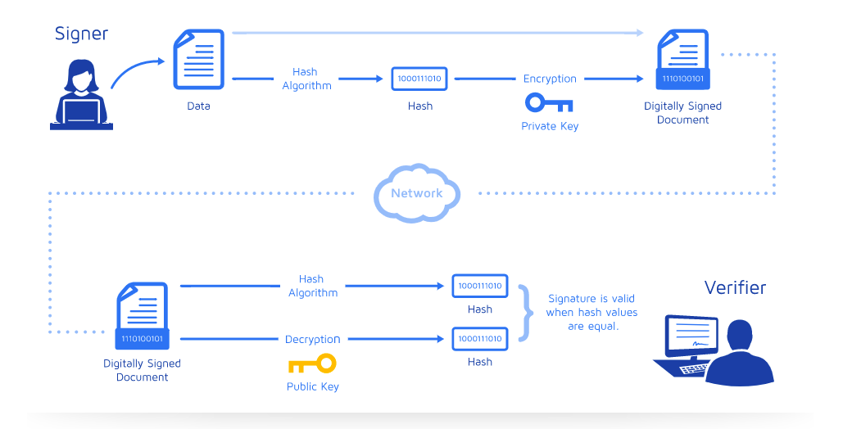
Digital Signatures
Attach the encrypted
hash value to document
Signed/date document.
Hash the signed document
to get hash value.
Encrypt the hash value
using private key.
Send the document and encrypted
hash value across the internet.
1) hash document to get hash value
2) use public key to decrypt encrypted
hash value
3) If 1) = 2), then successfully verified.
So clever!

Slide 23
How HTTPS Work
Here's how HTTPS work:
Youtube receives a digital certificate from a certificate authority(CA) which includes a public and private key. The private key lives on Youtube's server. The public key is available for anyone who wants to access Youtube.
When a user connects to youtube.com, Youtube will send over its SSL certificate which contains the public key necessary to start the secure session. How do we know that this certificate is authentic?
Youtube's certificate authority is Google. Google encrypts this certificate with its private key.
Your browser which has access to secure information from certificate authorities uses Google's known secure public key and decrypt this certificate. If the public key successfully decrypt the certificate, then your browser knows that this is the real Youtube server. The greenpad lock is the indicator for verification process.
If Youtube is down, a hacker can’t create a clone of Youtube without a valid certificate.
Notes:
https://www.bitsighttech.com/blog/attack-vectors-types-of-security-breaches

