Slide 1
Introduction to Processing
The Basics(Python Version)

Slide 2
Processing
Processing started by Ben Fry and Casey Reas while both were graduate students at MIT Media Lab in 2001.
The original language for Processing is Java. We will use the Python version. However, this Python implementation is built with Jython which still uses Python 2.x instead of the current Python 3.x. So for example, f-string(formatted-string) will not work. Otherwise, you will likely not notice the difference.
Designed for visual artists with limited programming experience who want to create art without knowing complicated Java syntax.
In its current version, hundred of libraries have been written for computer vision, data visualization, music composition, networking, 3D drawings and programming electronics.

Slide 3
Processing
Processing was created originally for the Java language. For this reason, the interface to Processing's Python version is not very "Pythonic".
I wrote some code to hide some of this interface and make it flow better with Python. In addition, I added some code to make writing games and working with images easier.(see arcade.py) Download the zip file that contains this code on our course website here.
Once you unzip the contents and open it with Processing. There should be three files:
processing_py.pyde(DO NOT MODIFY THIS FILE)
arcade.py(DO NOT MODIFY THIS FILE)
game.py(write all of your code here)
There is also a data folder where you should put all of your images for your game.

Slide 4
An Alternative to Processing
For those who are experienced at programming and can read and learn independently, you are highly encouraged to look at the Python Arcade library.
You will need to install Visual Studio Code or a similar IDE and follow the instructions for installing the Python Arcade Library from the website:
https://arcade.academy/
The Python Arcade library has some advanced features such as collision detection, physics engine for platformers, etc.. more than what we will cover with Processing.
Feel free to reach out with questions about Arcade. However, in class, we will only cover Processing.

Slide 5
game.py
All of your code should go here in game.py.
You will need to implement(provide code for) three methods/functions:
1) def __init__(self): Declare and initialize all your game/application variables.
2) def on_draw(self): Called automatically 60 times a second to draw objects. Write code to draw all objects here.
3) def on_update(self): Called automatically 60 times a second to update our objects. Write code to update all objects here(for animation).

Slide 6
Sketch
First declare and initialize all variables in __init__
class Window:
def __init__(self):
""" Initialize all variables here. """
def on_draw(self):
""" Called automatically 60 times a second to draw all objects."""
def on_update(self):
""" Called automatically 60 times a second to update all objects."""
__init__ only runs ONCE.
on_draw runs automatically 60 times a second
to draw all images
on_update runs automatically 60 times a second
to update variables

Slide 7
Example
Animation only takes five lines of code!
When declaring/initializing a global variable that is used
throughout the game, use self and the dot notation.
WIDTH and HEIGHT are width/height of the window.
class Window:
def __init__(self):
""" Initialize all variables here. """
self.x = WIDTH/2
self.y = HEIGHT/2
def on_draw(self):
""" Called automatically 60 times a second to draw all objects."""
# draw red circle at (self.x, self.y) diameter = 300 pixels
fill(255, 0, 0)
ellipse(self.x, self.y, 300, 300)
def on_update(self):
""" Called automatically 60 times a second to update all objects."""
self.x += 5
draw red circle at (self.x, self.y)
move circle 5 pixels to the right

Slide 8
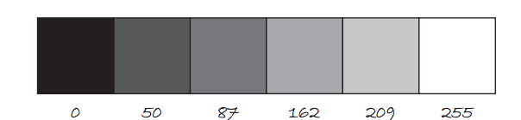
Color
Color is defined by a range of numbers.
In grayscale, 0 is black, 255 is white and any color in between is a shade of gray ranging from black to white.

Slide 9
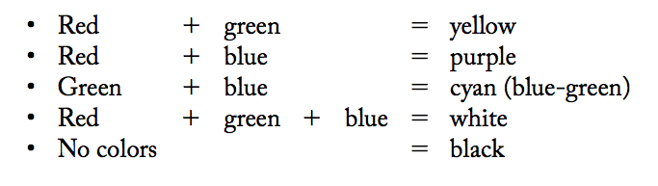
Color
RGB Color is determined by three parameters. Each parameter is in the range 0-255. The first indicates the degree of red(R), the second the degree of green(G) and the last the degree of blue(B).

Slide 10
Some Methods for Drawing Shapes
fill(r, g, b):By calling fill BEFORE a shape will set the color of the shape. Call it again before drawing another shape to change color.
line(x1, y1, x2, y2):draw line through (x1, y1) and (x2, y2).
ellipse(x, y, width, height):center of ellipse is (x, y); width and height are the lengths of the axes.
rect(x, y, width, height:center of the rectangle is (x,y)

Slide 11
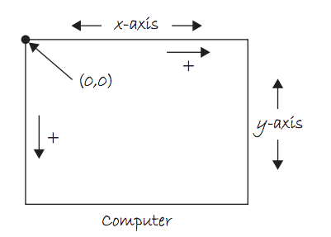
The Coordinate System

Slide 12
Class vs Objects
A class bundles together data (instance variables or attributes) and functionality (methods). Another name for class is type.
Everything in Python is a class. A list is a class. So is an integer, a string, a tuple, even functions!
The following creates two list objects.
a = [1, 2, 3]
b = [8, -5.3 "hi"]
print(type(a)) # list
Thus, in this example, list is a class(or type) and a and b are two of its objects.

Slide 13
Example
Suppose we like to write a game that contains many characters moving about on a map. Each character has a position(x and y), a speed(speedx, speedy). Consider the following code:
x1 = 0
y1 = 0
speedx1 = 5
speedy1 = 3
x2 = 10
y2 = 10
speedx2 = 2
speedy2 = 4
If we have many characters in the game, this code
makes it difficult to keep track of all the characters.
Even with 5 characters, we need to keep track of 20 variables.
This is just counting variables. What if we want each character
to have behaviors(functions) such as jumping, shooting?

Slide 14
Class
We like to write code once(called a class) and be able to reuse it for all of the objects of that class. A class bundles together data (instance variables or attributes) and behavior or functionality(functions).
x1 = 0
y1 = 0
speedx1 = 5
speedy1 = 3
x2 = 10
y2 = 10
speedx2 = 2
speedy2 = 4
player1
Two variables player1 and player2 instead
of eight variables.
player2
If our class is called Sprite, player1 and player2 are
two objects of that class.

Slide 15
Class
We like to be able to build our own classes to represent objects relevant to our game or application. Python provides the ability for programmers to design their own types or classes(custom classes).
A sprite is an image(.png or .jpg) that represent a character or object in a game.
In arcade.py, I have written a simple custom class: the Sprite class. It allows us to easily draw, scale and animate sprites. We may create several Sprite instances or objects.
This reusability feature is important especially when we need to create many objects(for example enemies) with similar data and behaviors.

Slide 16

The Sprite Class
arcade.Sprite(filename, scale=1.0)
center_x center_y angle width height change_x change_y change_angle alpha
draw() update()
The Sprite class’ constructor allows us
to create a Sprite object. It has many
parameters to help us initialize a Sprite
object for our game.
Usually, we specify only the image
filename and scaling and set the other
attributes as needed.
player = arcade.Sprite(“player.png”, 0.5)
width
height

Slide 17
The Sprite Class
arcade.Sprite(filename, scale=1.0)
center_x center_y angle width height change_x change_y change_angle alpha
draw() update()
Default center is (0,0)

Slide 18
More on the Sprite class
arcade.Sprite(filename, scale=1.0)
center_x center_y angle width height change_x change_y change_angle alpha
draw() update()
The angle attribute allows us to rotate the image of our Sprite.
This angle is measured in degrees with counterclockwise as the positive direction.

Slide 19
The Sprite Class
width and height are automatically initialized based on the image file and scale(default is 1.0)
arcade.Sprite(filename, scale=1.0)
center_x center_y angle width height change_x change_y change_angle alpha
draw() update()
width
height

Slide 20
The Sprite Class
arcade.Sprite(filename, scale=1.0)
center_x center_y angle width height change_x change_y change_angle alpha
draw() update()
For moving the sprite.
(velocity)

Slide 21
The Sprite Class
arcade.Sprite(filename, scale=1.0)
center_x center_y angle width height change_x change_y change_angle alpha
draw() update()
For rotating the sprite.

Slide 22
The Sprite Class
arcade.Sprite(filename, scale=1.0)
center_x center_y angle width height change_x change_y change_angle alpha
draw() update()
For transparency, 0 is fully transparent and 255 is fully opaque.
One use for transparency is "respawning" a sprite.

Slide 23
The Sprite Class
arcade.Sprite(filename, scale=1.0)
center_x center_y width height left right top bottom change_x change_y alpha
draw() update()
The method draw() will draw the image.

Slide 24
The Sprite Class
arcade.Sprite(filename, scale=1.0)
center_x center_y width height left right top bottom change_x change_y alpha
draw() update()
update() will automatically animate the sprite:
center_x += change_x
center_y += change_y
angle += change_angle
call update() on each object in on_update()

Slide 25
Sprite Example 1
class Window:
def __init__(self):
""" Initialize all variables here. """
self.player = arcade.Sprite(“tank.png”)
self.player.scale = 2.0
self.player.center_x = 100
self.player.center_y = 200
def on_draw(self):
""" Called automatically 60 times a second to draw all objects."""
self.player.draw()
def on_update(self):
""" Called automatically 60 times a second to update all objects."""
These four lines are equivalent to:
self.player = arcade.Sprite(“tank.png”, 2.0, 100, 200)

Slide 26
Sprite Example 2: Moving the tank
class Window:
def __init__(self):
""" Initialize all variables here. """
self.player = arcade.Sprite(“tank.png”, 2.0, 100, 200)
self.player.change_x = 5
def on_draw(self):
""" Called automatically 60 times a second to draw all objects."""
self.player.draw()
def on_update(self):
""" Called automatically 60 times a second to update all objects."""
self.player.update()

Slide 27
Adding Text
The text(str, x, y) function draws text on the screen.You can set the text size and color by using textSize(s) and fill(r, g, b) before drawing the text.
textSize(32);
fill(255, 0, 0);
text("Hello, World!", 100, 200);

Slide 28
The Console
Messages can be printed on the console(for error-checking purposes, etc..) by using the command println().
println(4);
println(4 + 3/2);
println(“Hello, world”);

Slide 29
Download Processing
Download Processing!
Your computer is probably a 64-bit computer if it’s fairly recent.
http://www.processing.org

Slide 30
List of Sprite Objects Lab
Download the zip file that contains a starter's template code for processing on our course website here.
REMEMBER TO SAVE BEFORE RE-RUNNING YOUR CODE!!!
Do the following:
Declare, initialize a sprite object using the image "tank.png". Draw it on the screen in the on_draw method.
Create a list containing 10 "coin.png" sprite objects. Randomize their positions. Display them on the screen on the on_draw method.
Display the the number of coins on the screen by using the text() function. For example, "Coins: 10".

