Slide 1

Understanding Data
Images and Their Pixels

Slide 2
File Formats
A multimedia file(audio, video, image) is simply a sequence of 0’s and 1s.
In the previous lecture, with character encoding, this sequence can be translated into text.
For example, ASCII, UTF-8. In ASCII, 65 is an A, etc.
Encoding such as ASCII, however, doesn’t specify, for example, font color.
HTML provides one way of specifying font, background color.
But a Word document(file ends in .doc and .docx) doesn’t use HTML.
.doc is called a filename extension, indicates file’s format.
The purpose of a file format is to define a standardized way of representing information.
Notes:
Crash Course: Cybersecurity

Slide 3
File Formats
A file's format simply tells your computer how the bits of a files should be interpreted.
Those 0s and 1s could represent an image, a sound, or a video, but without any kind of rules for interpreting a file's bits, they're essentially meaningless.
A file's extension usually indicates the format of the file, but isn't a definitive answer.
Microsoft word can open both important.doc to important.whatever
a PPM file for example is a text file if open with Notepad or TextEdit but is an image if open with GIMP.
Popular image file formats: BMP, JPEG, PNG, GIF.
All of these acronyms are just different ways of representing images using binary data.
Notes:
Crash Course: Cybersecurity

Slide 4
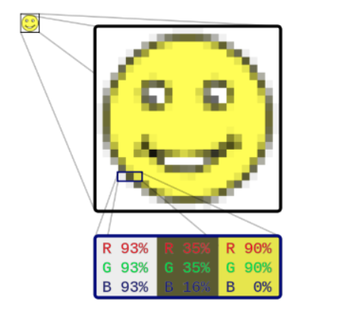
Bitmap
An image is 2D grid of squares(bitmap), where each square is filled with only one color; this is kind of structure is called a raster graphics image.
Each of these small squares, called a pixel, can be filled with exactly one color.
Computers use additive color mixing to produce
colors.
primary colors are red, green and blue(RGB)
Typically, bitmaps use 24-bit(3 bytes) for colors.
- 8 bits for each of the three primary colors.
- each color has values 0 to 255.
- 24-bit equals approximately 16.8 million colors.
Notes:
Crash Course: Cybersecurity

Slide 5
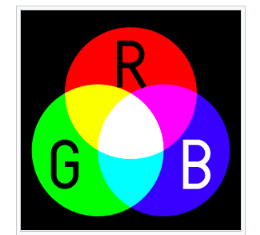
RGB Model

Slide 6
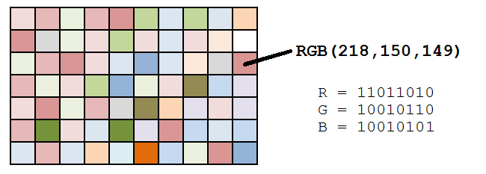
Encoding Data in Binary

Slide 7
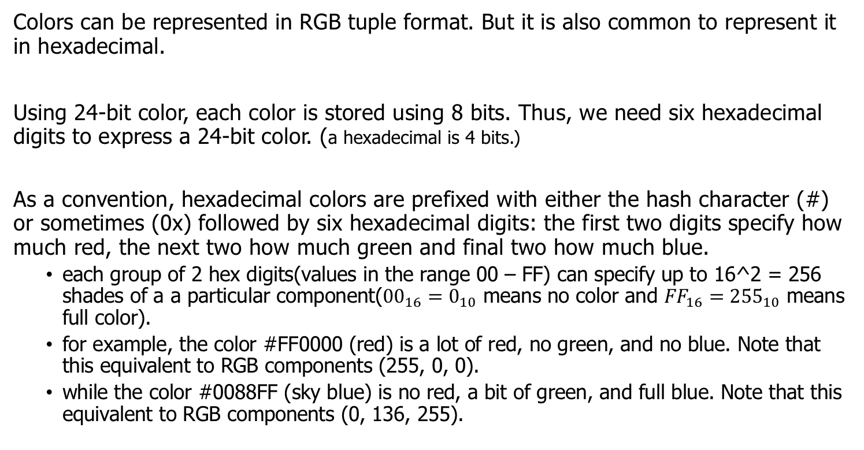
Colors
Colors can be represented in RGB tuple format. But it is also common to represent it in hexadecimal.
Using 24-bit color, each color is stored using 8 bits. Thus, we need six hexadecimal digits to express a 24-bit color. (a hexadecimal is 4 bits.)
As a convention, hexadecimal colors are prefixed with either the hash character (#) or sometimes (0x) followed by six hexadecimal digits: the first two digits specify how much red, the next two how much green and final two how much blue.
each group of 2 hex digits(values in the range 00 – FF) can specify up to 16^2 = 256 shades of a a particular component(${00}_{16}=0_{10}$ means no color and ${FF}_{16}={255}_{10}$ means full color).
for example, the color #FF0000 (red) is a lot of red, no green, and no blue. Note that this equivalent to RGB components (255, 0, 0).
while the color #0088FF (sky blue) is no red, a bit of green, and full blue. Note that this equivalent to RGB components (0, 136, 255).
Notes:
Crash Course: Cybersecurity

Slide 8
Colors in Processing
In Processing, colors can be specified in both RGB and hexadecimal formats.
# red circle with diameter 300 pixels centered at (100, 200)
fill(255, 0, 0);
ellipse(100, 200, 300, 300);
# sky blue circle with diameter 300 pixels centered at (100, 200)
fill("#0088FF");
ellipse(100, 200, 300, 300);
Notes:
Crash Course: Cybersecurity

Slide 9
Bitmap
.bmp is a bitmap file format.
The first two bytes of any bitmap file are the same: the magic number 0x42 0x4D. 0x42 is the same as the decimal number 66, while 0x4D is the same as the decimal number 77.
then some metadata(data that describes a file's data) such as width, height, size.
then the bytes that describe the pixels of the image.
Notes:
Crash Course: Cybersecurity

Slide 10
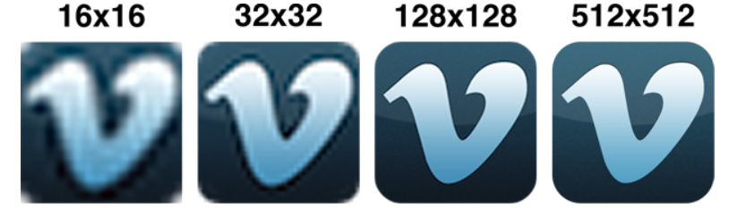
Resolution
Raster graphics image has to be made up of a grid of squares, but how big should each square be?
the resolution of an image, or the amount of information stored in the image
- same image size but smaller pixel size equals higher resolution(more detail) and therefore larger number of pixels in the image.
- for example, the left image below is 16 pixels by 16 pixels resolution but the right image is a higher resolution 512x512.
Notes:
Crash Course: Cybersecurity

Slide 11

Lossless Compression
What would the bitmap data look like for the image below?
a lot of the bytes are exactly the same!
Is there a way to encode the image with an abbreviation for “500 black pixels” rather than listing each pixel individually?
CompuServe develops GIF, or the Graphics Interchange Format, in 1987.
can be pronounced “GIF” or “JIF”
Unlike bitmaps, GIFs are compressed,
can represent exactly the same information
as some bitmaps using a smaller number of bits.
essentially, if two pixels that are horizontally
adjacent are exactly the same, then GIF
compresses the data.
This method is called lossless compression, i.e, no data is lost.
Besides images, RAR, ZIP, GZIP, LZW compress any file.
Notes:
Crash Course: Cybersecurity

Slide 12
Lossy Compression
While lossless compression preserves all of a file's data, lossy compression throws away some data in the interest of compressing the file even more.
Effective lossy compression should preserve the essential data. You use effective lossy compression every time you text someone!
Hey wat r u doin tmrw? I wntd 2 go 2 c Ben.(43 characters)
Hey, what are you doing tomorrow? I wanted to go to see Ben.(57 characters)
(compressed by about 25%.)
(you can “probs” do even better.)
GIF uses lossless compression
JPEG(Joint Photographic Experts Group), for example, uses lossy compression.
PNG(Portable Network Graphic) is another popular format.
the original creators of PNG actually picked the acronym for "PNG is Not GIF" as a reaction to some of the dubious licensing issues with the GIF format.
Notes:
Crash Course: Cybersecurity

Slide 13
Comparison
Like GIF, PNG uses lossless compression, and like JPEG, PNG uses 24 bits for color.
Another feature of the PNG format is support for alpha, or transparency. BMP and JPEG, on the other hand, don't have a channel devoted to transparency.
GIF does have the distinct advantage of supporting animation achieved by repeatedly showing a series of frames.
Notes:
Crash Course: Cybersecurity

Slide 14
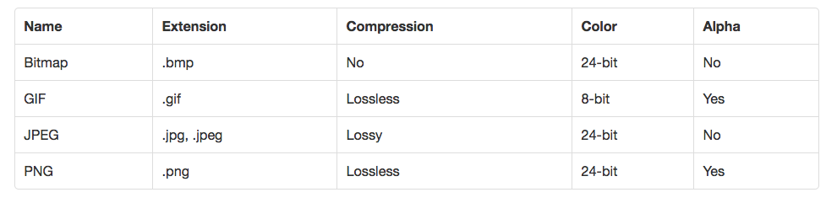
Comparison
Summary of these formats. The alpha channel is one reason .png files are popular in game images(Sprites).
Notes:
Crash Course: Cybersecurity

Slide 15
Vector Graphics
If a raster graphics image is scaled larger, the image will appear pixelated.
Vector graphics can scale without losing quality.
Unlike raster graphics, vector graphics doesn't involve turning an image into a grid and storing the values of individual pixels.
Instead, vector graphics stores images using mathematics.
For example, let's say we want to represent a circle. In raster graphics, we'd create a grid of squares and then trace out a circle by filling in squares with some color.
Using vector graphics, we'd instead say that the equation for a square looks something like x^2 + y^2 = r^2.
We can create a raster graphic simply by picking a size for the image, then using the equation to figure out which pixels should be colored.
This representation doesn't depend on any pixels. If we want to create a larger circle, we can just pick a larger value for r, and our equation will create a larger circle without any loss in quality.
Notes:
Crash Course: Cybersecurity

Slide 16
Scalable Vector Graphics
Scalable Vector Graphics(SVG) is an example of a vector graphic.
Notice the difference below between a JPEG and a SVG after some rescaling.
In the powerpoint version
of this slides, you can play
around with the SVG on
the right.
Notes:
Crash Course: Cybersecurity

Slide 17
Numpy
Python is currently one of most popular languages. It has many optimized libraries for working with data.
Numpy is a Python library that provides a high-performing multidimensional array object(matrices) and mathematical operations to work with these arrays.
import numpy as np
a = np.array([1,2,3,4])
b = np.array([[1,2,3,4], [5,6,7,8]])
print(a.shape) # (4,)
print(b.shape) # (2, 4)
print(b.dtype) # int64
np is an alias for numpy
Numpy arrays can only store data of a
single type and are super fast.
Python lists can hold objects of different types and are very slow.
Notes:
Crash Course: Cybersecurity

Slide 18
Numpy
import numpy as np
a = np.array([[1,2,3,4],
[5,6,7,8],
[9,10,11,12]])
print(a[0, 0]) # 1
print(a[1, 3] # 8
print(a[:, 1:3])
[[ 2, 3],
[ 6, 7],
[10, 11]]
Note the use of commas, if it was a 2D Python list:
print(a[0][0])
Numpy uses commas(tuples) for indexing.
# all rows, columns 1 and 2.
Similar to Python lists, slicing works with Numpy arrays!
Notes:
Crash Course: Cybersecurity

Slide 19
Matplotlib
Matplotlib is built on top of Numpy and provides plotting capabilities. It is recommended that you use the Jupyter Notebook when working with these libraries.
import matplotlib.pyplot as plt
img = plt.imread("flower.jpg")
print(img.shape)
(859, 840, 3)
RGB channel
rows
(height)
columns
(width)
Notes:
Crash Course: Cybersecurity

Slide 20
Matplotlib
In Matplotlib, the Figure object is used to contain one or more sets of Axes objects. Data is plotted within a given set of axes.
The subplots() function can be used to create a figure along with a specified layout of axes.
import matplotlib.pyplot as plt
fig, ax = plt.subplots()
By default, subplots will create a figure with a single set of axes; calling it will return the figure object and its axes object in a tuple.
Figure
object
Axes object
Notes:
Crash Course: Cybersecurity

Slide 21
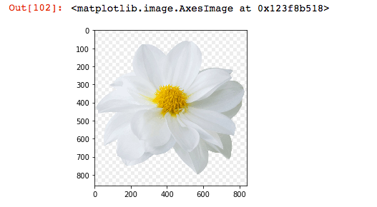
imshow()
import matplotlib.pyplot as plt
img = plt.imread("flower.jpg")
print(img.shape) # (859, 840, 3)
fig, ax = plt.subplots()
ax.imshow(img)
imshow() displays the 2D
grid of pixels as an image.
Notes:
Crash Course: Cybersecurity

Slide 22
Pixels
import matplotlib.pyplot as plt
img = plt.imread("flower.jpg")
print(img.shape) # (859, 840, 3)
fig, ax = plt.subplots()
ax.imshow(img)
# (0,0) pixel, slicing all colors
print(img[0,0,:])
array([255, 255, 255], dtype=uint8)
The (0, 0) pixel is at the top left corner of the image.
Notes:
Crash Course: Cybersecurity

Slide 23
Decomposing an Image
What would you guess the R, G and B components of the yellow pixel at the center of the flower?
Since red + green is yellow. We should expect high components in the R and G channels and a low number for the B channel.
print(img[400,400,:])
array([185, 135, 0], dtype=uint8)
Notes:
Crash Course: Cybersecurity

Slide 24
Decomposing an Image
How about a pixel on one of the white petals?
Since red + green + blue is white. We should expect high components in all R, G and B channels.
print(img[200,400,:])
array([218, 222, 225], dtype=uint8)
Notes:
Crash Course: Cybersecurity

Slide 25
Decomposing an Image
Let write code to decompose our flower image into its individual components.
import matplotlib.pyplot as plt
img = plt.imread("flower.jpg")
# same shape as img, all zeroes, 8-bit unsigned ints(0-255)
img_red = np.zeroes(img.shape, dtype="uint8")
# extract all rows, all columns, but only the Red channel
img_red[:, :, 0] = img[:, :, 0]
Similarly for the G and B channels.
Notes:
Crash Course: Cybersecurity

Slide 26
Decomposing an Image
Let's generalize this and put our code into a loop to extract all three components, create three set of axes on Matplotlib and plot all components!
import matplotlib.pyplot as plt
img = plt.imread("flower.jpg")
fig, axs = plt.subplots(nrows=1, ncols=3, figsize=(15,5))
red = np.zeros(img.shape,dtype="uint8")
red[:,:,0] = img[:,:,0]
# similarly for blue and green
axs[0].imshow(red)
axs[1].imshow(green)
axs[2].imshow(blue)
Creates 3 Axes objects using 1 row and 3 columns layout.
(width, height) of Figure object
Notes:
Crash Course: Cybersecurity

Slide 27
Decomposing an Image
We can write the previous code using a for loop instead.
import matplotlib.pyplot as plt
img = plt.imread("flower.jpg")
fig, axs = plt.subplots(nrows=1, ncols=3, figsize=(15,5))
for c in range(3):
temp_img = np.zeros(img.shape, dtype="uint8")
temp_img[:,:,c] = img[:,:,c]
axs[c].imshow(temp_img)
See the next slide for the output.
Creates 3 Axes objects using 1 row and 3 columns layout.
(width, height) of Figure object
Notes:
Crash Course: Cybersecurity

Slide 28
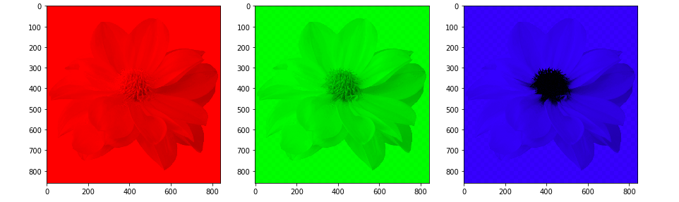
Decomposing an Image
This output is generated from the previous slide of code in Jupyter Notebook.
Pretty good for just a few lines of Python code!
Notes:
Crash Course: Cybersecurity

Slide 29
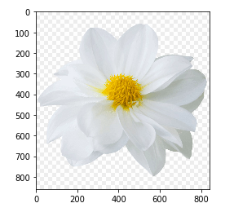
Sum of Its Parts
High red, high green component and no blue component gives yellow!
Notes:
Crash Course: Cybersecurity

Slide 30
Sum of Its Parts
High red, high green component and high blue component gives white!
Notes:
Crash Course: Cybersecurity

Slide 31
RGB to Grayscale
Many image software allows you to convert your image to a black and white version. This amounts to convert the tuple (R, G, B) to one grayscale number.
Two common algorithms found in some software uses the average method or the luminosity method. (See, for example, the free, open source, image manipulation program called GIMP).
The average method simply averages the R, G, B components:
(R + G + B) / 3
The luminosity method computes a weighted average taking into account human perception of lightness(for example, human are more sensitive to green, so green has a larger weight):
0.21* R + 0.72 * G + 0.07 * B
Notes:
Crash Course: Cybersecurity

Slide 32
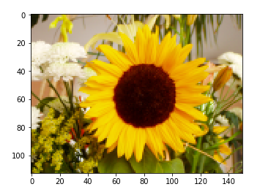
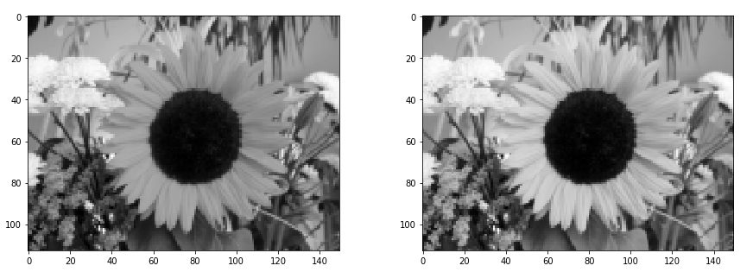
RGB to Grayscale
In your homework, you'll write
Python code to do the following
conversion to grayscale.
The left image uses the average
method, the right uses the luminosity
method.
The luminosity is the
default method in
GIMP.
Notes:
Crash Course: Cybersecurity

Slide 33
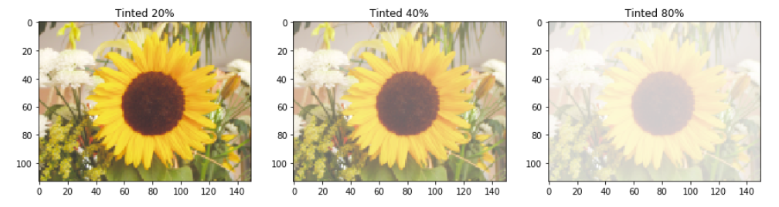
Tint
To tint an image is to mix its colors with white. This will increase the lightness of the image.
In your lab, you will write a Python function, which takes an image and a percentage value as a parameter. Setting 'percentage' to 0 will not change the image, setting it to one means that the image will be completely whitened.
For example, suppose a pixel with RGB components of [0.80, 0.60, 0.40]. Tinting it by 25% means that the pixel is now [0.85, 0.70, 0.55].
Notes:
Crash Course: Cybersecurity

Slide 34
References
1) Part of this lecture is taken from a lecture from an OpenCourseWare course below.
Computer Science E-1 at Harvard Extension School
Understanding Computers and the Internet
by Tommy MacWilliam.
2) The formulas for converting RGB to grayscale can be found in the GIMP documentation: https://docs.gimp.org/2.6/en/gimp-tool-desaturate.html

