Slide 1
Introduction to Python
Built-In Sequences: Lists and Tuples

Slide 2
Topics
Lists
Indexing and Slicing
List Methods
Tuples
a) Tuple unpacking
3) List comprehensions
4) Iterables
5) Membership and Operations

Slide 3
Containers
Python includes several built-in sequences: lists, tuples, strings.
We discussed strings in the previous lecture. String is a flat sequence which holds item of one type. Flat sequences physically store the value of each item within its own memory space.
Lists and tuples are container sequences, which can hold items of different type. They hold references to objects they contain.
Another way of grouping sequence types is by mutability. Lists are mutable sequences while strings and tuples are immutable sequences.

Slide 4
Lists
Lists are the basic ordered and mutable data collection type in Python. They can be defined with comma-separated values between square brackets.
In[1]:L = [2, 3, 5, 7]
In [2]: len(L) # len also worked with strings
Out [2]: 4
In [3]: L.append(11) # append to the end of the list
In [4]: L
Out [4]: [2, 3, 5, 7, 11]

Slide 5
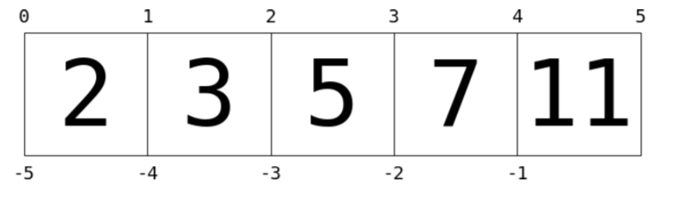
Indexing
Indexing is a means the fetching of a single value from the list. This is a 0-based indexing scheme. This is similar to strings from the previous lecture.
In[1]:L = [2, 3, 5, 7, 11] In [2]: L[0]
Out [2]: 2
In [3]: L[1]
Out [3]: 3
In [4]: L[5] # index out of bounds error.

Slide 6
Indexing
Negative index wraps around the end.
In[1]:L = [2, 3, 5, 7, 11] In [2]: L[-1]
Out [2]: 11
In [3]: L[-2]
Out [3]: 7

Slide 7
Lists can contain different types of objects
List can contain different types and even other lists.
In [1]: L = [1, 'two', 3.14, [0, 3, 5]]
In [2]: L[0]
Out [2]: 3
In [3]: L[3]
Out [2]: [0, 3, 5]

Slide 8
Slicing
Similar to strings, lists also support slicing. Slicing is accessing multiple values from the list. It uses a colon to indicate the start point (inclusive) and end point (non-inclusive) of the subarray.
In[1]: L = [1, 2, 3, 4, 5] In [2]: L[0:3]
Out [2]: [1, 2, 3]
In [9]: L[:3]
Out [9]: [1, 2, 3]
In [9]: L[-3:]
Out [9]: [3, 4, 5]
Leaving out the first index defaults to 0.
Leaving out the last index defaults to length of list.

Slide 9
Slicing
Finally, it is possible to specify a third integer that represents the step size.
In[1]:L = [2, 3, 5, 7, 11] In [2]: L[::2] # equivalent to L[0:len(L):2]
Out [2]: [2, 5, 11]

Slide 10
Slicing
A particularly useful version of this is to specify a negative step, which will reverse the list. In this case, the default starts at the end of the list and ends at the beginning.
In [1]: L = [1, 2, 3, 4, 5]
In [1]: L[::-1] # defaults end of array to beginning
Out [16]: [5, 4, 3, 2, 1]
In [1]: L[1::-1] # first two items reversed
Out [16]: [2, 1]
In [1]: L[:-3:-1] # last two items reversed
Out [16]: [5, 4]
In [1]: L[-3::-1] # everything except last two items reversed
Out [16]: [3, 2, 1]

Slide 11
Slicing
Both indexing and slicing can be used to set elements as well as access them.
In [17]: L[0] = 100
print(L)
[100, 3, 5, 7, 11]
In [17]: L[1:3] = [55, 56]
print(L)
[100, 55, 56, 7, 11]

Slide 12
Lists: Concatenation
List Concatenation
In [1]: L + [13, 17, 19]
Out [1]: [2, 3, 5, 7, 11, 13, 17, 19]

Slide 13
List Methods
The following is a short list of useful list methods.
append(value) | appends value to the end of the list
insert(index, value) | inserts value at position given by index, shifts elements to the right.
pop(index) | removes object at index from list, shifts elements left and returns removed object. Returns last element if index is omitted.
remove(value) | removes object from list by value.
index(value) | returns index of first occurrence of value if exists, otherwise throws a ValueError.
count(value) | returns the number times value appear in list.

Slide 14
List Methods
List Concatenation
In [1]: L = [3, "hi", -4, 6]
In [3]: L.append(2) # [3,"hi",-4, 6, 2]
In [4]: L.insert(1, "hello") # [3,"hello","hi",-4,6,2]
In [3]: a = L.pop(3) # [3,"hello","hi",6,2]
In [3]: print(a)
-4
In [3]: L.remove(3) # ["hello","hi",6,2]
In [3]: L.remove("hi") # ["hello",6,2]
In [3]: ind = L.index(6) # 1
In [3]: L.count("hello") # 1

Slide 15
Tuples
Tuples are in many ways similar to lists, but they are defined with parentheses rather than square brackets:
In[1]:t = (1, 2, 3)
They can also be defined without any brackets at all:
In[1]:t = 1, 2, 3
print(t)
(1, 2, 3)

Slide 16
Tuples
Like the lists, tuples have a length, and individual elements can be extracted using square-bracket indexing. Slicing is also supported.
In [1]: len(t)
Out [1]: 3
In [2]: t[0:2]
Out [2]: (1, 2)
Unlike lists, tuples are immutable: this means that once they are created, their size and contents cannot be changed:
In [1]: t[0] = 1 # error!
In [2]: t.append(10) # error!

Slide 17
Tuple Unpacking
Tuple unpacking is a assignment feature that assigns right hand side of values into left hand side. In packing, we put values into a new tuple while in unpacking we extract those values into a single variable.
This is packing values into a variable.
In [1]: student = (“Mike Smith”, 3.2)
This is unpacking values from a variable.
In [2]: name, gpa = student
In [3]: print(name, gpa)
Mike Smith 3.2

Slide 18
Tuple Unpacking
Tuple unpacking can be used to do parallel assignment.
In [1]: a = 1
b = 2
a, b = b, a # parallel assignment
print(a, b)
2 1

Slide 19
list(), tuple()
Converting between sequences can be done using the appropriate constructors: list(), tuple().
In [26]: message = “python”
list(message)
Out [26]: [‘p’, ‘y’, ‘t’, ‘h’, ‘o’, ‘n’]
In [27]: t = [1, 2, 3]
tuple(t)
Out [27]: (1, 2, 3)

Slide 20
list()
A useful operation is to use list() with range() to create new lists easily.
In [1]: lst = list(range(1,7))
In [2]: lst
Out [2]: [1, 2, 3, 4, 5, 6]
In [3]: lst2 = list(range(1,1000))

Slide 21
List Comprehensions
List comprehension(listcomp) is a concise and readable way of creating a new list from another iterable(list, tuple, string).
Suppose we want to square all numbers from a list.
In [3]: lst = [2, 3, 5, 7]
new_lst = []
for x in lst:
new_lst.append(x ** 2)
print(new_lst)
4 9 25 49
We can use list comprehension to do this much simpler and more Pythonic.

Slide 22
List Comprehensions
We can use list comprehension to do the previous problem much simpler and more Pythonic.
In[3]: lst = [2, 3, 5, 7]
new_lst = [x**2 for x in lst]
print(new_lst)
4 9 25 49
For loops are used to do many things: scan through a list, pick out items, compute sums, counts and averages, etc... Listcomp is a one trick pony: create new lists.

Slide 23
List Comprehensions
List comprehension can also contain conditions.
In[3]: lst = [x**2 for x in range(7) if x % 2 == 0]
print(lst)
0 4 16 36

Slide 24
List Comprehensions
List comprehension can also contain nested loops. A list of lists or a list of tuples can be created in this way.
In[1]: colors = ["red", "black"]
In[1]: sizes = ["S, "M", "L"]
In[1]: shirts = [(color, size) for color in colors
for size in sizes]
In[1]: shirts
Out[1]:
[('red', 'S'),('red', 'M'),('red', 'L'),('black', 'S'),
('black', 'M'),('black', 'L')]

Slide 25
List of Tuples
We can form a list of tuples(or of lists) and iterate over them by using nested loop or tuple unpacking.
In[3]: lst = [(“Mike”, 3.2), (“Sarah”, 3.6), (“Jack”, 2.8)]
for student in lst:
for data in student:
print(data)
In[3]: lst = [(“Mike”, 3.2), (“Sarah”, 3.6), (“Jack”, 2.8)]
for name, gpa in lst: # tuple unpacking
print(name, gpa)

Slide 26
Iterables
An iterable is an object from which we can loop over. Lists, strings, tuples are all iterables.
In[3]: lst = [2, 3, 5, 7]
for x in lst:
print(x, end=‘ ’)
2 3 5 7
In [26]: message = “python”
for x in message:
print(x, end=‘ ’)
p y t h o n

Slide 27
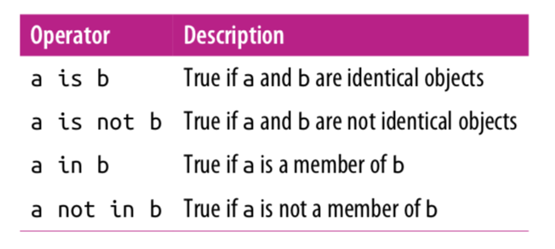
Membership and Operations

Slide 28
Identity Operations
The comparison operator == checks for object equality.
In [19]: a = [1,2,3]
b = [1,2,3]
In[20]: a == b
Out [20]: True

Slide 29
Identity Operations
The identity operators, is and is not, check for object identity.
In[21]: a is b
Out [21]: False
In[22]: a is not b
Out [22]: True
In [23]: a = [1,2,3]
b = a
a is b
Out [23]: True

Slide 30
Membership Operations
Membership operators check for membership within compound objects like lists.
In [24]: 1 in [1, 2, 3]
Out [24]: True
In[25]: 2 not in [1,2,3]
Out [25]: False
In[25]: 'a' in "python"
Out [25]: False

Slide 31
Variables Are Pointers
In [2]: x = [1, 2, 3]
y = x
In [3]: print(y)
[1, 2, 3]
In [4]: x.append(4) # append 4 to the list pointed to by x print(y) # y's list is modified as well!
[1, 2, 3, 4]
In [5]: x = 'something else’
print(y) # y is unchanged
[1, 2, 3, 4]

Slide 32
List items hold references
Items in lists and tuples hold references to objects they contain.
In [2]: x = [1, 2, [3, 4, 5]]
In [2]: y = x[2]
In [3]: y[1] = 44
In [3]: y
[3, 44, 5]
In [3]: x
[1, 2, [3, 44, 5]]
Both x[2] and y reference(points to the address) to the same list object. Modifying one will affect the other!

Slide 33
References
Vanderplas, Jake, A Whirlwind Tour of Python, O’reilly Media.
Luciano, Ramalho, Fluent Python, O'reilly Media.

