Slide 1
Introduction to Python
Built-In Sequences

Slide 2
Topics
Lists
List Comprehension
Tuples
Dictionaries
Iterables

Slide 3
Containers
Python includes several built-in sequences: lists, tuples, strings.
We discussed strings in the previous lecture. String is a flat sequence which holds item of one type. Flat sequences physically store the value of each item within its own memory space.
Lists and tuples are container sequences, which can hold items of different type. They hold references to objects they contain.
Another way of grouping sequence types is by mutability. Lists are mutable sequences while strings and tuples are immutable sequences.

Slide 4
Lists
Lists are the basic ordered and mutable data collection type in Python. They can be defined with comma-separated values between square brackets.
In[1]:L = [2, 3, 5, 7]
In [2]: len(L) # len also worked with strings
Out [2]: 4
In [3]: L.append(11) # append to the end of the list
In [4]: L
Out [4]: [2, 3, 5, 7, 11]

Slide 5
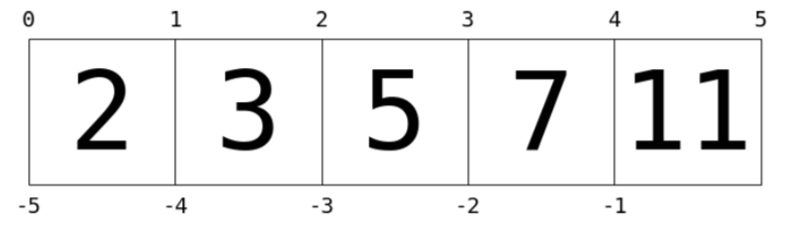
Indexing
Indexing is a means the fetching of a single value from the list. This is a 0-based indexing scheme. This is similar to strings from the previous lecture.
In[1]:L = [2, 3, 5, 7, 11] In [2]: L[0]
Out [2]: 2
In [3]: L[1]
Out [3]: 3
In [4]: L[5] # index out of bounds error.

Slide 6
Indexing
Negative index wraps around the end.
In[1]:L = [2, 3, 5, 7, 11] In [2]: L[-1]
Out [2]: 11
In [3]: L[-2]
Out [3]: 7

Slide 7
Lists can contain different types of objects
List can contain different types and even other lists.
In [1]: L = [1, 'two', 3.14, [0, 3, 5]]
In [2]: L[0]
Out [2]: 3
In [3]: L[3]
Out [2]: [0, 3, 5]

Slide 8
Slicing
Similar to strings, lists also support slicing. Slicing is accessing multiple values from the list. It uses a colon to indicate the start point (inclusive) and end point (non-inclusive) of the subarray.
In[1]:L = [1, 2, 3, 4, 5] In [2]: L[0:3]
Out [2]: [1, 2, 3]
In [9]: L[:3]
Out [9]: [1, 2, 3]
In [9]: L[-3:]
Out [9]: [3, 4, 5]
Leaving out the first index defaults to 0.
Leaving out the last index defaults to length of list.

Slide 9
Slicing
Finally, it is possible to specify a third integer that represents the step size.
In[1]:L = [2, 3, 5, 7, 11] In [2]: L[::2] # equivalent to L[0:len(L):2]
Out [2]: [2, 5, 11]
A particularly useful version of this is to specify a negative step, which will reverse the array:
In [16]: L[::-1]
Out [16]: [11, 7, 5, 3, 2]

Slide 10
Slicing
Both indexing and slicing can be used to set elements as well as access them.
In [17]: L[0] = 100
print(L)
[100, 3, 5, 7, 11]
In [17]: L[1:3] = [55, 56]
print(L)
[100, 55, 56, 7, 11]

Slide 11
Lists: Concatenation
List Concatenation
In [1]: L + [13, 17, 19]
Out [1]: [2, 3, 5, 7, 11, 13, 17, 19]

Slide 12
List Methods
The following is a short list of useful list methods.
append(value) | appends value to the end of the list
insert(index, value) | inserts value at position given by index, shifts elements to the right.
pop(index) | removes object at index from list, shifts elements left and returns removed object. Returns last element if index is omitted.
remove(value) | removes object from list by value.
index(value) | returns index of first occurrence of value if exists, otherwise throws a ValueError.
count(value) | returns the number times value appear in list.

Slide 13
List Methods
List Concatenation
In [1]: L = [3, "hi", -4, 6]
In [3]: L.append(2) # [3,"hi",-4, 6, 2]
In [4]: L.insert(1, "hello") # [3,"hello","hi",-4,6,2]
In [3]: a = L.pop(3) # [3,"hello","hi",6,2]
In [3]: print(a)
-4
In [3]: L.remove(3) # ["hello","hi",6,2]
In [3]: L.remove("hi") # ["hello",6,2]
In [3]: ind = L.index(6) # 1
In [3]: L.count("hello") # 1

Slide 14
Tuples
Tuples are in many ways similar to lists, but they are defined with parentheses rather than square brackets:
In[1]:t = (1, 2, 3)
They can also be defined without any brackets at all:
In[1]:t = 1, 2, 3
print(t)
(1, 2, 3)

Slide 15
Tuples
Like the lists, tuples have a length, and individual elements can be extracted using square-bracket indexing. Slicing is also supported.
In [1]: len(t)
Out [1]: 3
In [2]: t[0:2]
Out [2]: (1, 2)
Unlike lists, tuples are immutable: this means that once they are created, their size and contents cannot be changed:
In [1]: t[0] = 1 # error!
In [2]: t.append(10) # error!

Slide 16
Tuple Unpacking
Tuple unpacking is a assignment feature that assigns right hand side of values into left hand side. In packing, we put values into a new tuple while in unpacking we extract those values into a single variable.
This is packing values into a variable.
In [1]: student = (“Mike Smith”, 3.2)
This is unpacking values from a variable.
In [2]: name, gpa = student
In [3]: print(name, gpa)
Mike Smith 3.2

Slide 17
Tuple Unpacking
Tuple unpacking can be used to do parallel assignment.
In [1]: a = 1
b = 2
a, b = b, a # parallel assignment
print(a, b)
2 1

Slide 18
list(), tuple()
Converting between sequences can be done using the appropriate constructors: list(), tuple().
In [26]: message = “python”
list(message)
Out [26]: [‘p’, ‘y’, ‘t’, ‘h’, ‘o’, ‘n’]
In [27]: t = [1, 2, 3]
tuple(t)
Out [27]: (1, 2, 3)

Slide 19
list()
A useful operation is to use list() with range() to create new lists easily.
In [1]: lst = list(range(1,7))
In [2]: lst
Out [2]: [1, 2, 3, 4, 5, 6]
In [3]: lst = list(range(1,1000))

Slide 20
List Comprehensions
List comprehension is a concise and readable way of creating a new list from another iterable(list, tuple, string).
In [3]: lst = [2, 3, 5, 7]
new_lst = []
for x in lst:
new_lst.append(x ** 2)
print(new_lst)
4 9 25 49
In[3]: lst = [2, 3, 5, 7]
new_lst = [x**2 for x in lst]
print(new_lst)
4 9 25 49

Slide 21
List Comprehensions
List comprehension can also contain conditions.
In[3]: lst = [x**2 for x in range(7) if x % 2 == 0]
print(lst)
0 4 16 36

Slide 22
List Comprehensions
List comprehension can also contain nested loops. A list of lists can be created in this way.
In[1]: vals = [str(n) for n in range(2,11)] + list("JQKA")
suits = ['spades', 'clubs', 'diamonds', 'hearts']
cards = [(val, suit) for val in vals
for suit in suits]

Slide 23
List Comprehensions
List comprehension can also contain nested loops. A list of lists can be created in this way.
Note how easy and readable is the following code for creating a deck of cards.
In[1]: vals = [str(n) for n in range(2,11)] + list("JQKA")
suits = ['spades', 'clubs', 'diamonds', 'hearts']
cards = [(val, suit) for val in vals
for suit in suits]

Slide 24
List of Tuples
We can form a list of tuples(or of lists) and iterate over them by using nested loop or tuple unpacking.
In[3]: lst = [(“Mike”, 3.2), (“Sarah”, 3.6), (“Jack”, 2.8)]
for student in lst:
for data in student:
print(data)
In[3]: lst = [(“Mike”, 3.2), (“Sarah”, 3.6), (“Jack”, 2.8)]
for name, gpa in lst: # tuple unpacking
print(name, gpa)

Slide 25
Dictionaries
Dictionaries are extremely flexible mappings of keys to values, and form the basis of much of Python’s internal implementation. They can be created via a comma-separated list of key:value pairs within curly braces:
In [27]: numbers = {"one":1, "two":2, "three":3}
In [28]: type(numbers)
Out [28]: dict
In [28]: # Access a value via the key
numbers["two"]
Out [28]: 2

Slide 26
Dictionaries
New items can be added to the dictionary using indexing as well.
In [29]: # Set a new key/value pair
In [29] numbers['ninety'] = 90
In [29] print(numbers) {'three': 3, 'ninety': 90, 'two': 2, 'one': 1}
In [29]: numbers['one'] += 5
In [29] print(numbers) {'three': 3, 'ninety': 90, 'two': 2, 'one': 6}

Slide 27
Dictionaries
The keys and values can be extracted from a dictionary via keys() and values().
In [29]: k = list(numbers.keys())
print(k)
['three', 'ninety’, ‘two’, 'one’]
In [29]: k = list(numbers.values())
print(k)
[3, 90, 2, 1]

Slide 28
Iterables
An iterable is an object from which we can loop over. Lists, strings, tuples and dictionaries are all iterables.
In[3]: lst = [2, 3, 5, 7]
for x in lst:
print(x, end=‘ ’)
2 3 5 7
In [26]: message = “python”
for x in message:
print(x, end=‘ ’)
p y t h o n

Slide 29
Iterables
It is easy to iterate over keys of the dictionary.
In [27]: numbers = {'one':1, 'two':2, 'three':3}
for x in numbers:
print(x, end=‘ ’)
one two three
To iterate over values of the dictionary use, values().
In [27]: for x in numbers.values():
print(x, end=‘ ’)
1 2 3

Slide 30
Iterables
It is easy to iterate over both keys and values of the dictionary.
In [27]: numbers = {'one':1, 'two':2, 'three':3}
for k, v in numbers.items():
print(k, v)
one 1
two 2
three 3

Slide 31
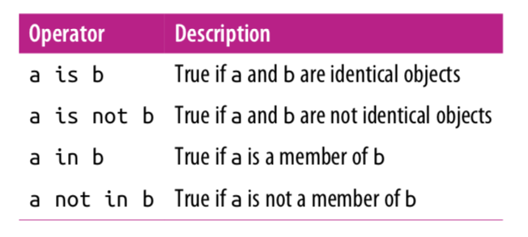
Membership and Operations

Slide 32
Identity Operations
The comparison operator == checks for object equality.
In [19]: a = [1,2,3]
b = [1,2,3]
In[20]: a == b
Out [20]: True
The identity operators, is and is not, check for object identity.
In[21]: a is b
Out [21]: False
In[22]: a is not b
Out [22]: True
In [23]: a = [1,2,3]
b = a
a is b
Out [23]: True

Slide 33
Membership Operations
Membership operators check for membership within compound objects like lists.
In [24]: 1 in [1, 2, 3]
Out [24]: True
In[25]: 2 not in [1,2,3]
Out [25]: False

Slide 34
Variables Are Pointers
In [2]: x = [1, 2, 3]
y = x
In [3]: print(y)
[1, 2, 3]
In [4]: x.append(4) # append 4 to the list pointed to by x print(y) # y's list is modified as well!
[1, 2, 3, 4]
In [5]: x = 'something else’
print(y) # y is unchanged
[1, 2, 3, 4]

Slide 35
References
Vanderplas, Jake, A Whirlwind Tour of Python, O’reilly Media.

