Slide 1
Introduction to Python
For Loops and Strings

Slide 2
Topics
For Loops

Slide 3
Iteration
Iteration is a repeating portion of an algorithm. Iteration repeats a specified number of times or until a given condition is met.
Iteration loops are frequently referred to as for loops because for is the keyword that is used to introduce them in nearly all programming languages, including Python.
Python’s for loop iterates over items of a sequence(e.g. a list of numbers or a string(sequence of characters)) and process them with some code.
for x in sequence: block

Slide 4
For Loops
Python’s for loop iterates over items of a sequence(e.g. a list of numbers or a string(sequence of characters)) and process them with some code.
for x in sequence: block
for x in [2,3,5,7]: print(x, end=“ ”) # ends each print with a space
# print all on same line
2 3 5 7
This is a list. It is an example of a sequence.
More on lists in a later lecture.

Slide 5
For Each Loops
for x in [2,3,5,7]: print(x)
2
3
5
7
for x in "hello": print(x)
h
e
l
l
o
Iterate through each number in the list.
"for each x in" list.
Iterate through each character in the string.

Slide 6
range(stop)
A simple use of a for loop runs some code a specified number of times using the range() function.
range(stop): returns sequence of numbers from 0 (default) up to but not including stop. Increment by 1 (default).
for i in range(5):
print(i, end=" ")
0 1 2 3 4
for i in range(10):
print("hi", end=" ")
hi hi hi hi hi hi hi hi hi hi
Think of range(5) as generating this
list: [0, 1, 2, 3, 4].

Slide 7
range(start, stop)
range(start, stop): from start up to but not including stop. Increment by 1(default).
for i in range(2, 8):
print(i, end=' ')
2 3 4 5 6 7

Slide 8
range(start, stop, step)
range(start, stop, step): from start up to but not including stop, increment by step.
for i in range(1, 10, 2):
print(i, end=' ')
1 3 5 7 9
If step is negative, a list can be traversed backwards.
for i in range(10, 2, -1):
print(i, end=' ')
10 9 8 7 6 5 4 3

Slide 9
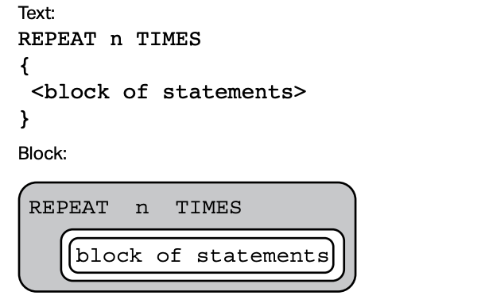
AP Exam
To perform a task n times, the AP exam use the following syntax.
Note: The above is equivalent to the following code in Python:
for i in range(n):
# block of statements
…

Slide 10
Definite Iteration
The for loop is an example of a definite iteration. We can determine ahead of time the number of times the loop repeats. Later, we will talk about indefinite iteration, a loop where we cannot predict the number of times a loop repeats.
for i in range(5): print("*", end="")
*****
The loop above prints five *'s. We can determine this ahead of time from the for loop statement.

Slide 11
Summing and Counting
There are two common tasks that uses for loops.
1) Summing
2) Counting

Slide 12
Summing Values
Write a segment of code that solve the problem
1 + 2 + 3 + … + 98 + 99 + 100.
We need a variable that accumulate the sum at each iteration of the loop. This variable should be initialized to 0.
sum = 0
for i in range(1, 101): sum += i

Slide 13
Writing a function to sum
Now write a function that accepts a non-negative integer parameter n and returns the sum of integers from 1 to n(including).
def sum(n):
sum = 0
for i in range(1, n+1): sum += i
return sum
print(sum(5)) # 1+2+3+4+5=15
a = sum(100) # a = 5050
print(a) # 5050 is printed on console

Slide 14
Conditional Summing
Write a segment of code that compute the sum of all numbers from 1 to 100 that are multiples of 3.
sum = 0
for i in range(0, 101, 3):
sum += i
Or equivalently, we can use a conditional to select the numbers to add:
sum = 0
for i in range(1, 101): if i % 3 == 0:
sum += i
Better to use if conditional for filtering.
In general, using the step size above
might not always work.

Slide 15
Conditional Summing Example
Write a segment of code that compute the sum of all numbers from 1 to 100. However:
if a number is a multiple of 3, double it before adding,
if a number is a multiple of 5, triple it before adding,
If a number is a multiple of both, quadruple it before adding.
otherwise, just add the number.

Slide 16
Conditional Summing Solution?
Is the following a correct solution?
sum = 0
for i in range(1, 101):
if i % 3 == 0:
sum += 2 * i
elif i % 5 == 0:
sum += 3 * i
elif i % 3 == 0 and i % 5 == 0:
sum += 4 * i
else:
sum += i
No! Why not?

Slide 17
Conditional Summing Solution
The following is correct.
sum = 0
for i in range(1, 101):
if i % 3 == 0 and i % 5 == 0:
sum += 4 * i
elif i % 3 == 0:
sum += 2 * i
elif i % 5 == 0 :
sum += 3 * i
else:
sum += i

Slide 18
Counting
Write a function that accepts an integer parameter n and returns the number of factors of n.
def count_factors(n):
count = 0
for i in range(1, n+1):
if n % i == 0: # i is a factor of n
count += 1
return count
print(count_factors(10)) # 4 (factors of 10 = {1,2,5,10})
print(count_factors(7)) # 2 (factors of 7 = {1,7})

Slide 19
String Indexing
Python allows you to retrieve individual members of a string by specifying the index of that member, which is the integer that uniquely identifies that member’s position in the string. The built-in len() function returns the number of characters in a string.
message = "hello"
length = len(message)
print(length) # 5
print(message[0]) # h
print(message[1]) # e
print(message[4]) # o
print(message[5]) # error! out of range!
Strings are immutable: once it is created, it cannot be changed!
message[0] = "H" # ERROR! A string is immutable!
Note: On the AP exam,
The first index of the first character of a string is 1 not 0.

Slide 20
Looping Through Each Character
Since each character of a string has index, we can use a loop to traverse a string.
message = "hello"
for i in range(len(message)):
print(message[i])
Output:
h
e
l
l
o

Slide 21
Slicing
We can also “slice” a string, specifying a start-index and stop-index, and return a subsequence of the items contained within the slice.
Slicing is a very important indexing scheme that we will see many times in other data structures(lists, tuples, strings, Numpy's arrays, Panda's data frames, etc..). Slicing can be done using the syntax:
some_string[start:stop:step]
where
start: index of beginning of the slice(included), default is 0
stop: index of the end of the slice(excluded), default is length of string
step: increment size at each step, default is 1.

Slide 22
Slicing
language = "python"
print(language[0:4]) # pyth
# 0 up to but not including index 4
print(language[:4]) # pyth, default start index at 0
print(language[4:]) # on, default end index is length of string
print(language[:]) # python, 0 to end of string
print(language[0:5:2]) # pto, step size of 2
print(language[::-1]) # negative step size traverses backwards
# nohtyp

Slide 23
Functions on Strings
Functions we discussed so far are isolated, independent entities. Sometimes functions are associated with some object and operates on the data of that object. In this context, functions are called methods.
Strings is an example of a type of objects which contains methods. These methods can be accessed through the dot notation applied to a string variable or literal.
find(value) | returns the lowest index of a substring value in a string. If substring is not found, returns -1.
upper() and lower() | returns a copy of the string capitalizing(or lower casing) all characters in the string

Slide 24
String Methods
s = "Hi, Mike!"
index = s.find("Hi")
print(index) # 0, first letter’s index is 0.
print(s.find(" ")) # 3
print(s.find("Mike")) # 4
index2 = s.find("mike") # -1, not found
b = "python"
print(b.upper()) # PYTHON
print("JAVA".lower()) # java

Slide 25
String Methods
Note that upper(), lower() do not modify the original string but rather returns a new copy of the string.
s = "HI MIKE"
s.lower() # returned value "hi mike" is lost
print(s) # HI MIKE (s is unchanged)
s = s.lower() # store the modified, returned string back in s
print(s) # hi mike

Slide 26
f-Strings
f-Strings is the new way to format strings in Python. (v 3.6)
Also called “formatted string literals,” f-strings are string literals that have an f at the beginning and curly braces containing expressions that will be replaced with their values.
name = “Mike”
gpa = 3.2
f_str = f“I am {name} with a {gpa} gpa.”
print(f_str)
print("I am " + name + " with a " + str(gpa) " gpa.”)
Output:
I am Mike with a 3.2 gpa.
I am Mike with a 3.2 gpa.

Slide 27
f-Strings
An f-string is special because it permits us to write Python code within a string; any expression within curly brackets, {}, will be executed as Python code, and the resulting value will be converted to a string and inserted into the f-string at that position.
grade1 = 1.5
grade2 = 2.5
ave = f“average is {(grade1+grade2)/2}”
print(ave) # average is 2.0
This is equivalent but it is preferable to use an f-string.
average = “average is " + str((grade1+grade2)/2)

Slide 28
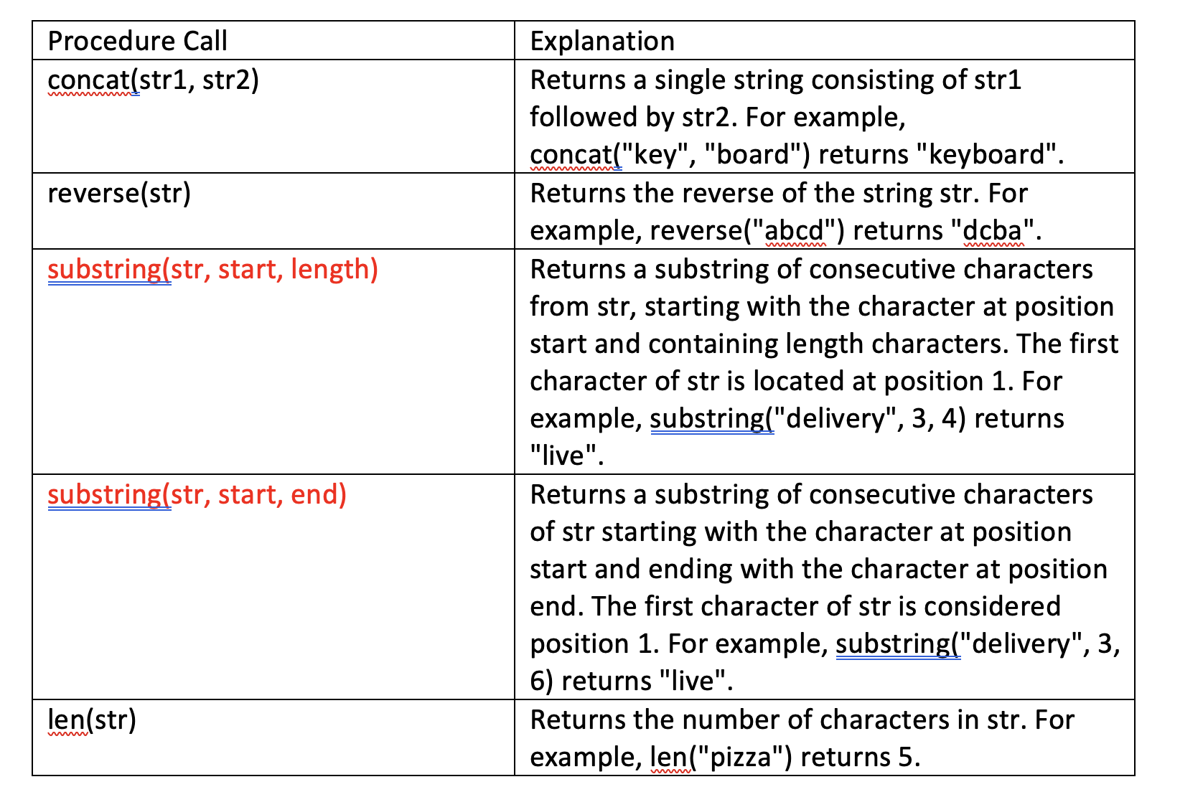
AP Exam
There will be questions on the AP exam which requires students to manipulate strings.
The exam will provide an API(application programming interface) for string
manipulation. A sample API below was given in previous exams.
The substring function may
take on different arguments
on the exam. Read
the API carefully as this
may vary year to year.

Slide 29
For Loop in Movies and TV-Shows
Movies:
Groundhog Day(1993); Bill Murray.
Looper(2010); Bruce Willis and Joseph Gordon-Levitt, Emily Blunt.
Edge of Tomorrow(2014); Tom Cruise, Emily Blunt.
Happy Death Day(2017).
TV-Show:
Russian Doll(Netflix, Emmy-Nominated)

Slide 30
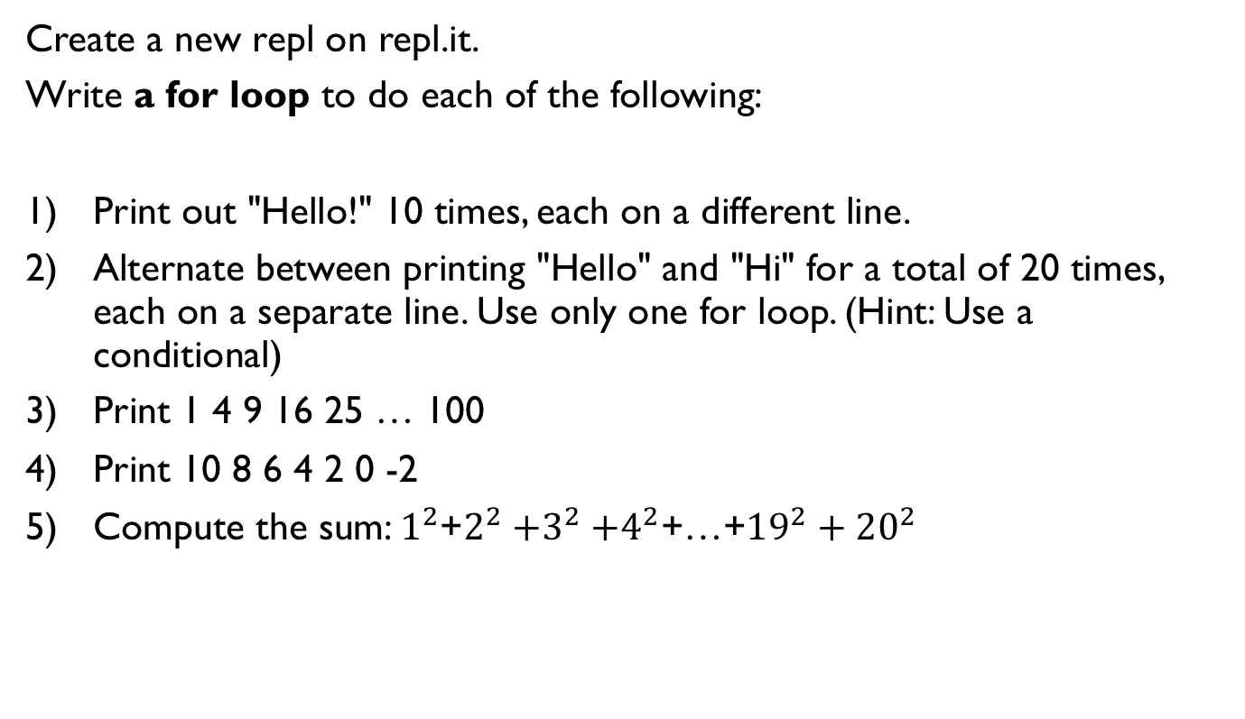
Lab 1
Create a new repl on repl.it.
Write a for loop to do each of the following:
Print out "Hello!" 10 times, each on a different line.
Alternate between printing "Hello" and "Hi" for a total of 20 times, each on a separate line. Use only one for loop. (Hint: Use a conditional)
Print 1 4 9 16 25 … 100
Print 10 8 6 4 2 0 -2
Compute the sum: $1^{2}$+$2^{2}{+3}^{2}+4^{2}$+…+${19}^{2}+{20}^{2}$

Slide 31
Lab 2: Counting Primes
Create a new repl.
1) Rewrite the function count_factors as explained in a previous slide.
2) A number n is prime if its only factors are 1 and n. Write the function is_prime which accepts an integer n and returns whether it is prime. Note that 1 is not prime. You must call the function count_factors in your implementation of is_prime.
is_prime(13) returns True
is_prime(1245) returns False
3) Write the function num_primes which accepts an integer n and and returns the number of primes up to and including n. You must call the function is_prime in your implementation.
num_prime(11) returns 5 since 2, 3, 5, 7, 11 are the 5 prime numbers less than or equal to 11.
Call the three above functions with different inputs and make sure that your functions work as expected.

Slide 32
References
Vanderplas, Jake, A Whirlwind Tour of Python, O’reilly Media.

