Slide 1
Coding Games in Python
2. Python Crash Course Part 1
Datatypes and Operations

Slide 2
Topics
Python interpreters
Jupyter Notebook
Python Scripts
Basic Built-In Types
Integers, Floats, Booleans, NoneType
Strings (indexing, slicing)
Variables
Operations
Arithmetic
Comparison
Boolean
Memberships and Identity

Slide 3
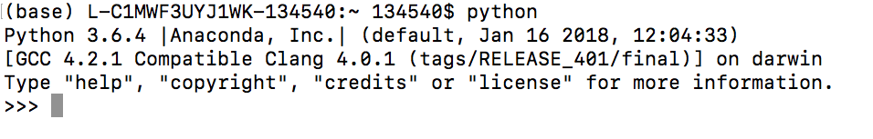
Python Interpreter
The most basic way to execute Python code is line by line within the Python interpreter.
Assuming that Python is already installed, typing python at the command prompt (Terminal on Mac OS X and Unix/Linux systems, Command Prompt in Windows):

Slide 4
Python Interpreter
With Python interpreter, we can execute Python code line by line.
>>> 1 + 1
2
>>> x = 5
>>> x * 3
15

Slide 5
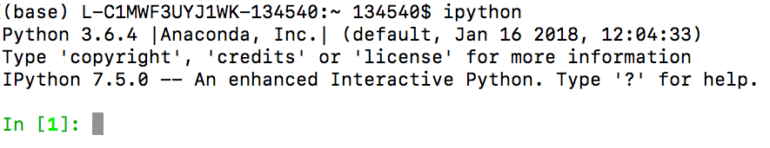
IPython Interpreter
It is recommended that you install Anaconda distribution which includes Python and many useful packages for scientific computing and data science.
Bundled with Anaconda is the IPython interpreter.

Slide 6
IPython Interpreter
The main difference between the Python interpreter and the enhanced IPython interpreter lies in the command prompt:
Python uses >>> by default, while IPython uses numbered commands.
In[1]: 1 + 1
Out[1]: 2
In[2]: x = 5
In[3]: x * 3
Out[3]: 15

Slide 7
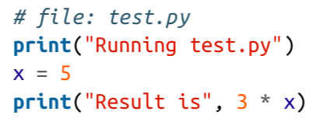
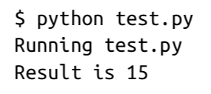
Python Scripts
Running Python snippets line by line is useful in some cases, but for more complicated programs it is more convenient to save code to file, and execute it all at once.
By convention, Python scripts are saved in files with a .py extension.
To run this file, we make sure it is in the current directory and type: python filename
at the command prompt.

Slide 8
Jupyter Notebook
A useful hybrid of the interactive terminal and the self-contained script is the Jupyter notebook.
A Jupyter notebook (.ipynb) document format allows executable code, formatted text, math formulas, graphics, and even interactive features to be combined into a single document.

Slide 9


A Syntax Example
In [1]:
# set the midpoint
midpoint = 5
# make two empty lists
lower = []
upper = []
# split the numbers into lower and upper
for i in range(10):
if (i < midpoint):
lower.append(i)
else:
upper.append(i)
print("lower:", lower)
print("upper:", upper)
a block of code is a set of statements that should be treated as a unit.
code blocks are denoted by indentation
(4 spaces)

Slide 10
Dynamic Typing
Python is dynamically typed: variable names can point to objects of any type.
Unlike Java or C, there is no need to “declare” the variable.
In [1]: x = 1 # x is an integer
x = 'hello’ # now x is a string
x = [1, 2, 3] # now x is a list

Slide 11
Variables Are Pointers
In [2]: x = [1, 2, 3]
y = x
In [3]: print(y)
[1, 2, 3]
In [4]: x.append(4) # append 4 to the list pointed to by x print(y) # y's list is modified as well!
[1, 2, 3, 4]
In [5]: x = 'something else’
print(y) # y is unchanged
[1, 2, 3, 4]

Slide 12
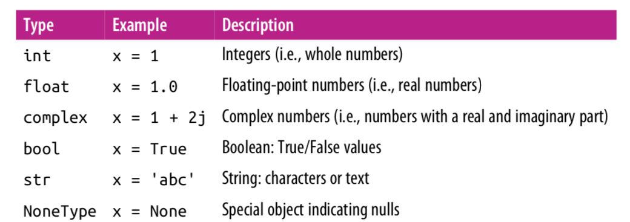
Basic Built-In Types

Slide 13
Built In Function type()
In[7]: x = 4
type(x)
Out [7]: int
In [8]: x = 'hello’
type(x)
Out [8]: str
In [9]: x = 3.14159
type(x)
Out [9]: float

Slide 14
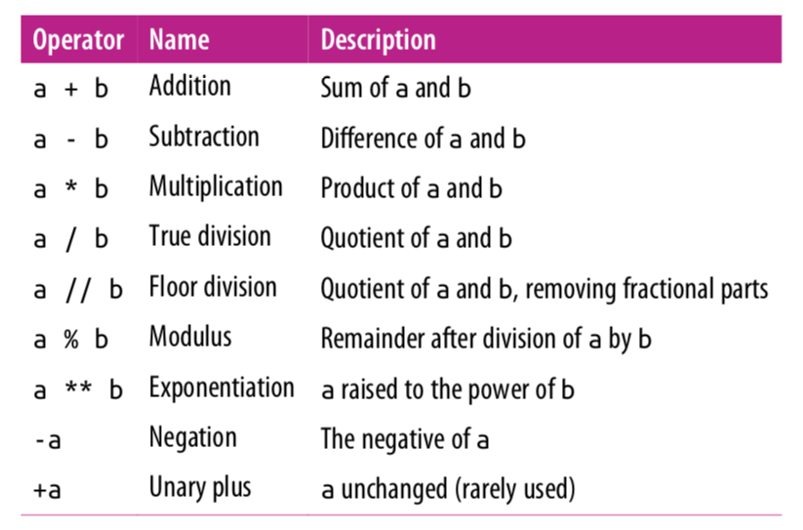
Arithmetic Operations

Slide 15
Integers
The most basic numerical type is the integer.
Any number without a decimal point is an integer.
In [1]: x = 1
type(x)
Out [1]: int
Python integers are variable-precision, so you can do computations that would overflow in other languages.
In [2]: 2 ** 200
Out [2]: 1606938044258990275541962092341162602522202993782792835301376

Slide 16
Integers
By default, division upcasts integers to floating-point type:
In [3]: 5 / 2
Out [3]: 2.5
You can use the floor-division operator //:
In [4]: 5 // 2
Out [4]: 2

Slide 17
Floating Point
The floating-point type can store fractional numbers.
They can be defined either in standard decimal notation, or in exponential notation:
In [5]: x = 0.000005
y = 5e-6
print(x == y)
True
In [6]: x = 1400000.00
y = 1.4e6
print(x == y)
True

Slide 18
Floating Point Precision
One thing to be aware of with floating-point arithmetic is that its precision is limited, which can cause equality tests to be unstable.
In [8]: 0.1 + 0.2 == 0.3
Out [8]: False
In [9]: print(f"0.1 = {0.1:.17f}")
print(f"0.2 = {0.2:.17f}")
print(f"0.3 = {0.3:.17f}")
0.1 = 0.10000000000000001
0.2 = 0.20000000000000001
0.3 = 0.29999999999999999

Slide 19
String
Strings in Python are created with single or double quotes.
In [17]: message = "what do you like?"
response = 'spam'
In [18]: len(response)
Out [18]: 4
In [19]: # Make uppercase. See also str.lower() response.upper()
Out [19]: 'SPAM’

Slide 20
String Concatenation
In [21]: # concatenation with +
message + response
Out [21]: 'what do you like?spam’
In [22]: # multiplication is multiple concatenation
5 * response
Out [22]: 'spamspamspamspamspam'

Slide 21
String Indexing
In [23]: message = "what do you like?"
In [24]: message[0]
Out [24]: 'w'
In [24]: # negative indices wraps around the end
message[-1] # last character
Out [24]: ‘?'

Slide 22
String Indexing and Slicing
In [23]: message = "what do you like?"
In [24]: # Access individual characters (zero-based indexing) message[0]
Out [24]: 'w'
In [25]: message[0:4] # up to but not including index 4
Out [25]: ‘what’
In [25]: message[0:7:2] # step size of 2
Out [25]: ‘wa o'

Slide 23
String Indexing and Slicing
In [26]: message = ”python"
In [26]: # default start index is 0
message[:4]
Out [26]: ‘pyth'
In [27]: # default end index is length of string
message[4:]
Out [27]: ‘on’
In [28]: message[:]
Out [28]: ‘python’

Slide 24
String Indexing and Slicing
In [26]: message = ”python"
In [24]: # negative indices wraps around the end
message[-1] # last character
Out [24]: ‘n'
In [25]: # all except the last character
message[:-1]
Out [25]: ‘pytho’
In [25]: # negative step size traverses backwards
message[::-1]
Out [25]: ‘nohtyp’

Slide 25
f-Strings
f-Strings is the new way to format strings in Python. (v 3.6)
In [26]: name = “Mike”
gpa = 3.2
f_str = f“I am {name} with a {gpa} gpa.”
print(f_str)
Out [26]: ‘I am Mike with a 3.2 gpa.'

Slide 26
NoneType
Python includes a special type, the NoneType, which has only a single possible value: None.
In [24]: type(None)
Out [24]: NoneType
You’ll see None used in many places, but perhaps most commonly it is used as the default return value of a function.
In [25]: return_value = print('abc’)
abc
In [26]: print(return_value) None

Slide 27
Boolean Type
The Boolean type is a simple type with two possible values: True and False.
Boolean values are case-sensitive: unlike some other languages, True and False must be capitalized!
Comparison operators return
True or False values.
In [27]: result = (4 < 5)
result
Out [27]: True
In [28]: type(result)
Out [28]: bool

Slide 28
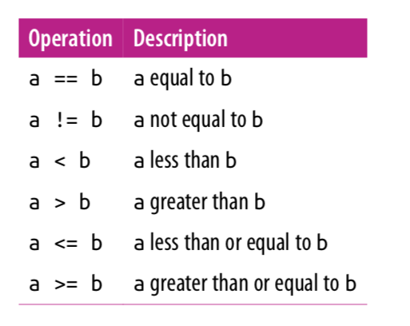
Comparison Operators

Slide 29
Boolean Operations
Python provides operators to combine the values using the standard concepts of “and”, “or”, and “not”.
Predictably, these operators are expressed using the words and, or, and not:
In[15]: x=4
(x < 6) and (x > 2)
Out [15]: True
In[16]: (x > 10) or (x % 2 == 0)
Out [16]: True
In[17]: not (x < 6) Out [17]: False

Slide 30
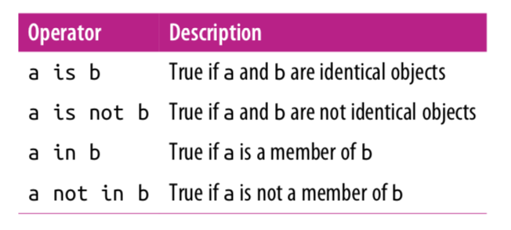
Membership and Operations

Slide 31
Identity Operations
The comparison operator == checks for object equality.
In [19]: a = [1,2,3]
b = [1,2,3]
In[20]: a == b
Out [20]: True
The identity operators, is and is not, check for object identity.
In[21]: a is b
Out [21]: False
In[22]: a is not b
Out [22]: True
In [23]: a = [1,2,3]
b = a
a is b
Out [23]: True

Slide 32
Membership Operations
Membership operators check for membership within compound objects like lists.
In [24]: 1 in [1, 2, 3]
Out [24]: True
In[25]: 2 not in [1,2,3]
Out [25]: False

Slide 33
References
Vanderplas, Jake, A Whirlwind Tour of Python, O’reilly Media.

